Slide 1
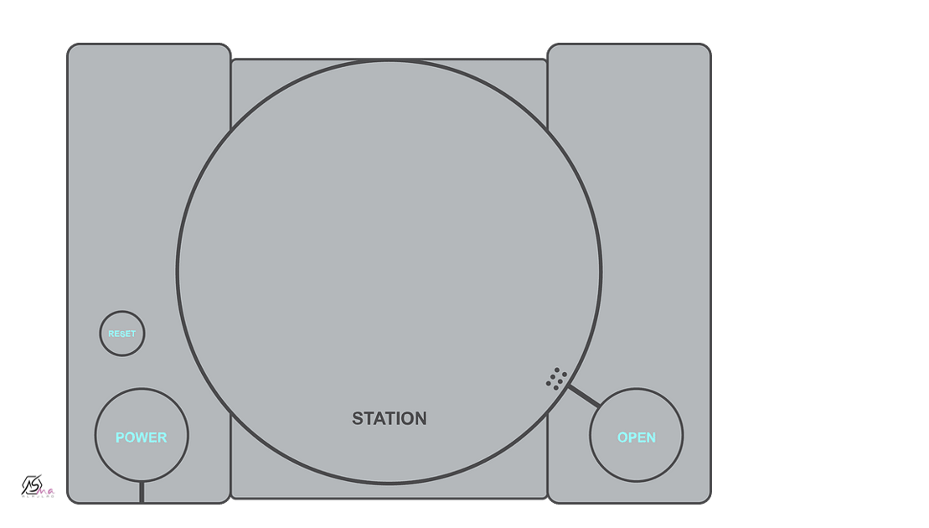

Favorite Pastimes
Reading

Slide 2
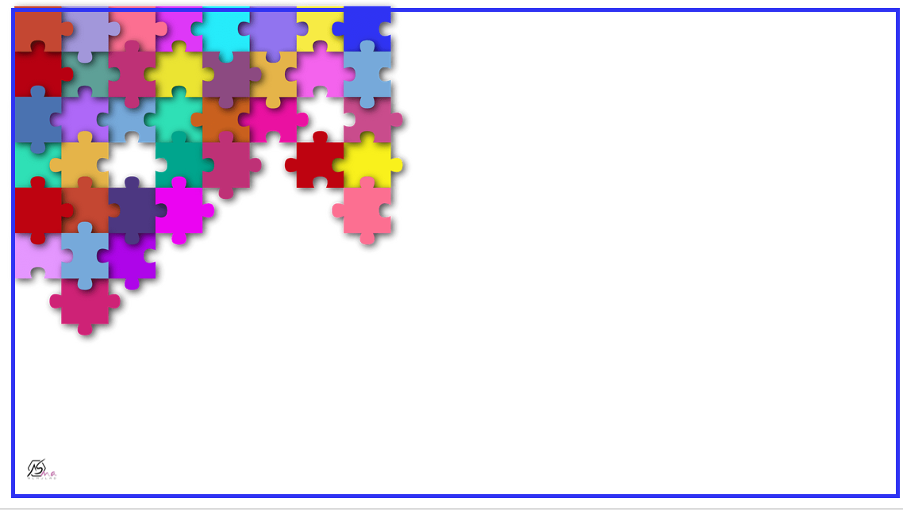
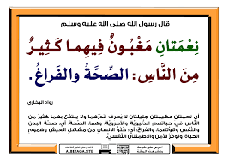

Slide 3
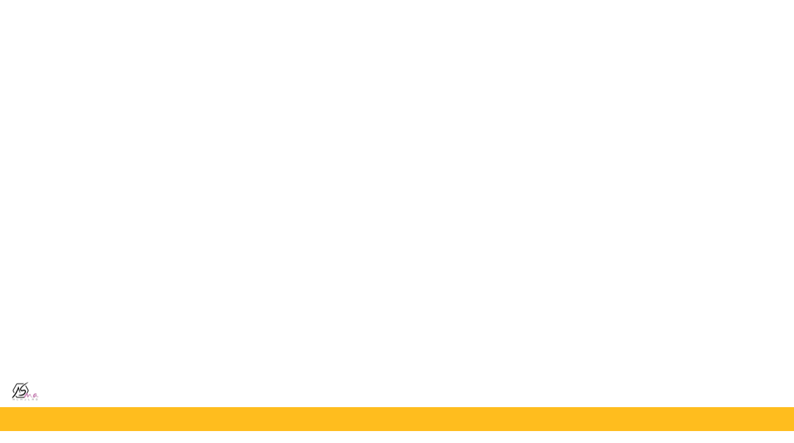

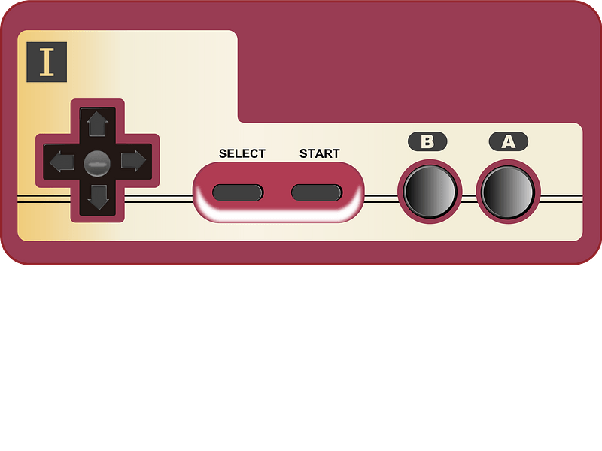

Find information in the text about aeromodelling.
Compare aeromodelling then and now.
Name the types of airplanes on the text

Slide 4
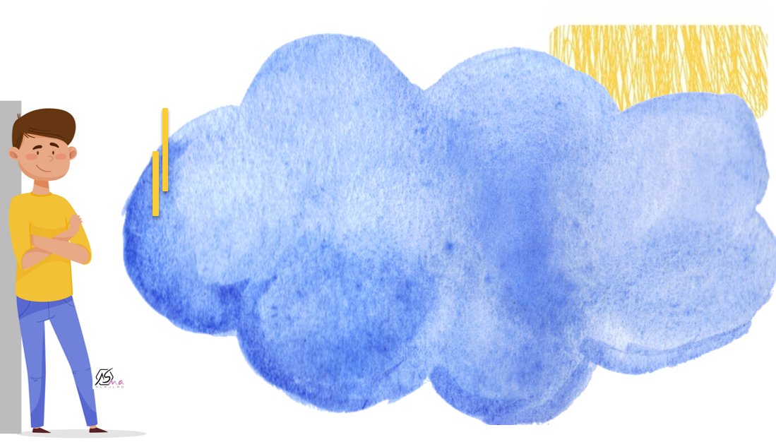


Slide 5
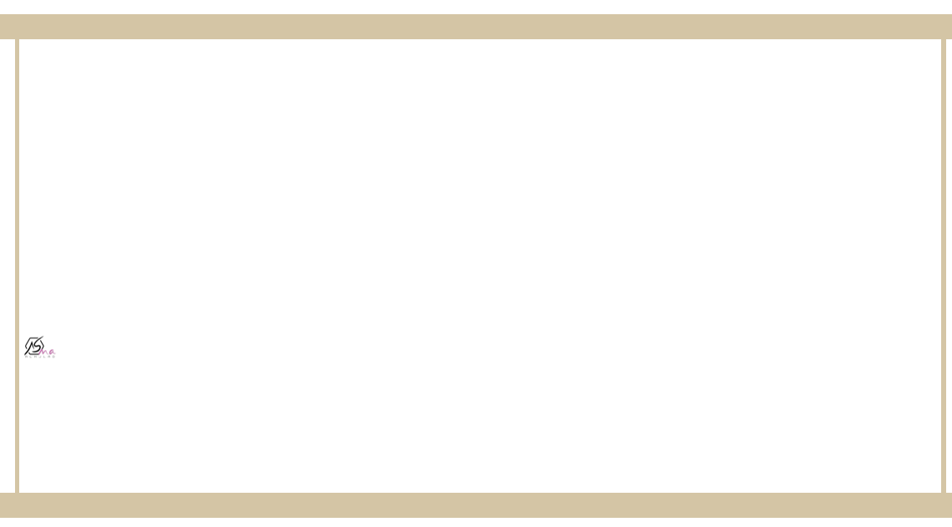


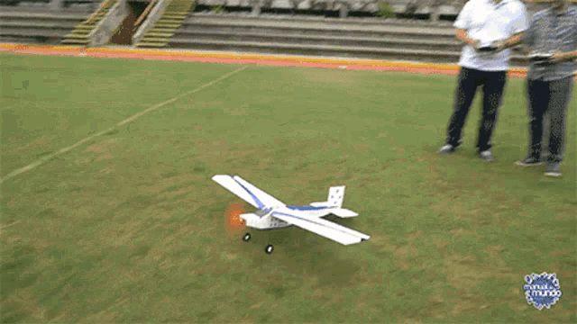
Do you or anybody you know fly aeromodels?

Slide 6

Who is the aeromodeller ?
a person who builds and flies model airplanes

Slide 7
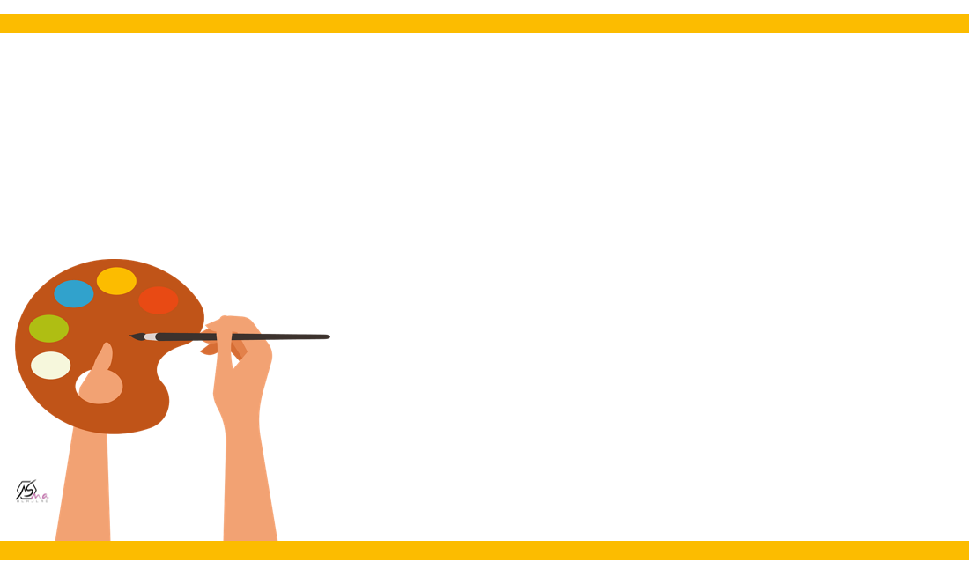
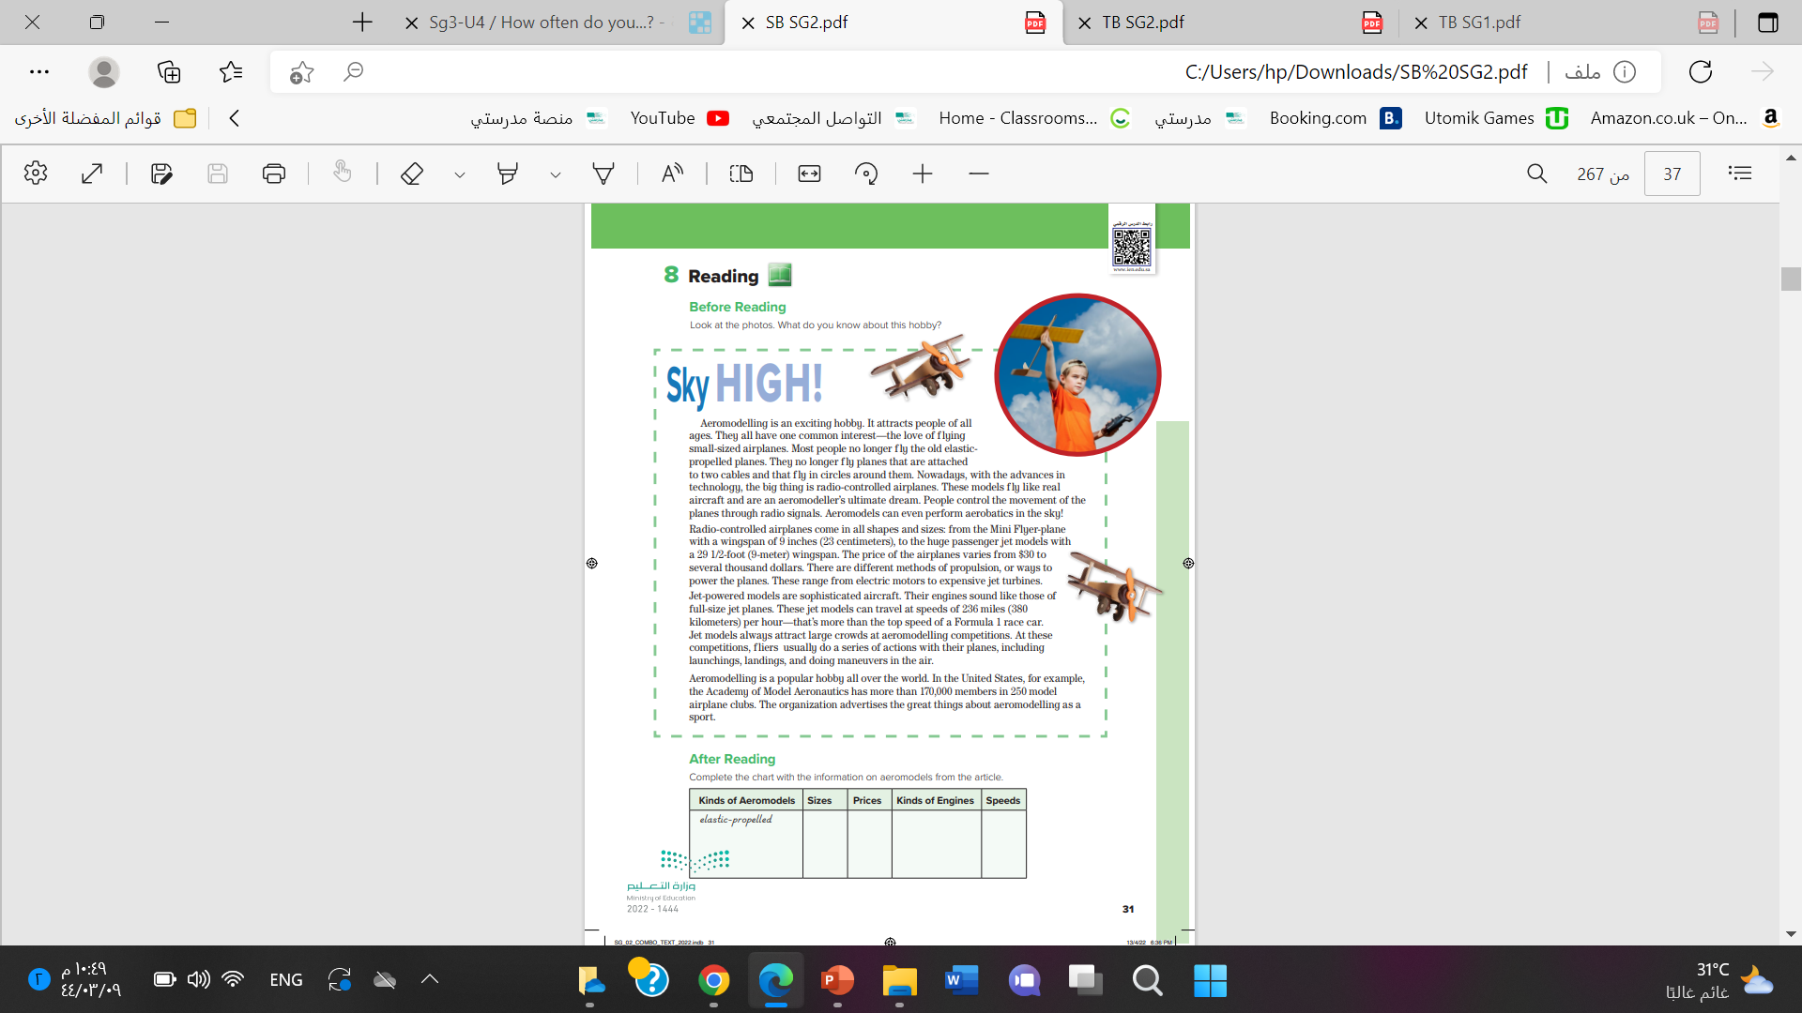

@ page 31

Slide 8
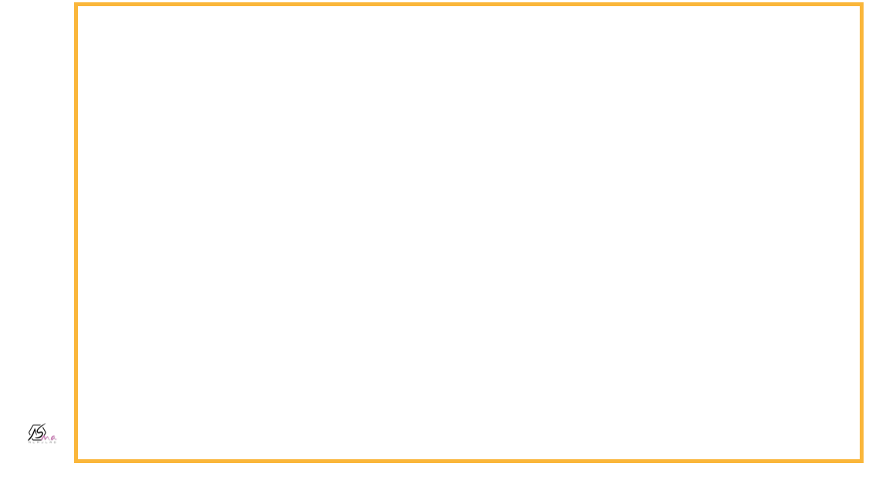

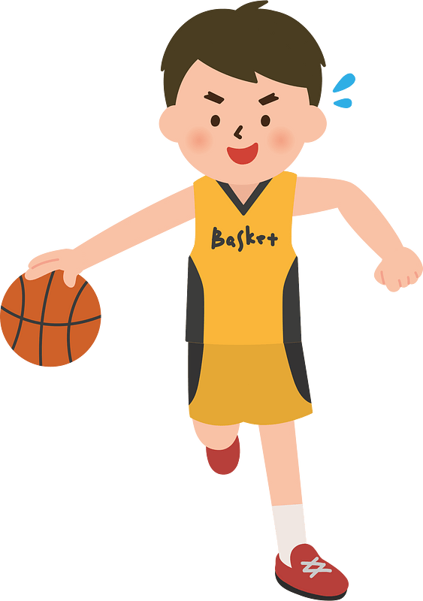
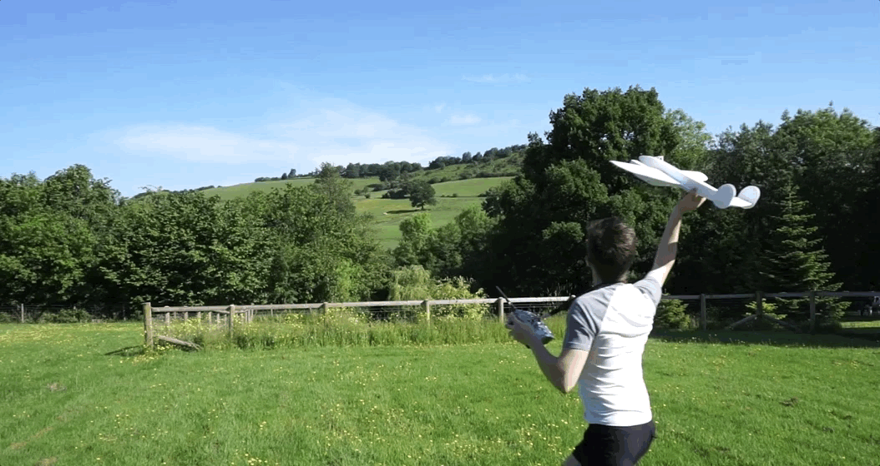
aeromodelling
Making and flying of model planes

Slide 9
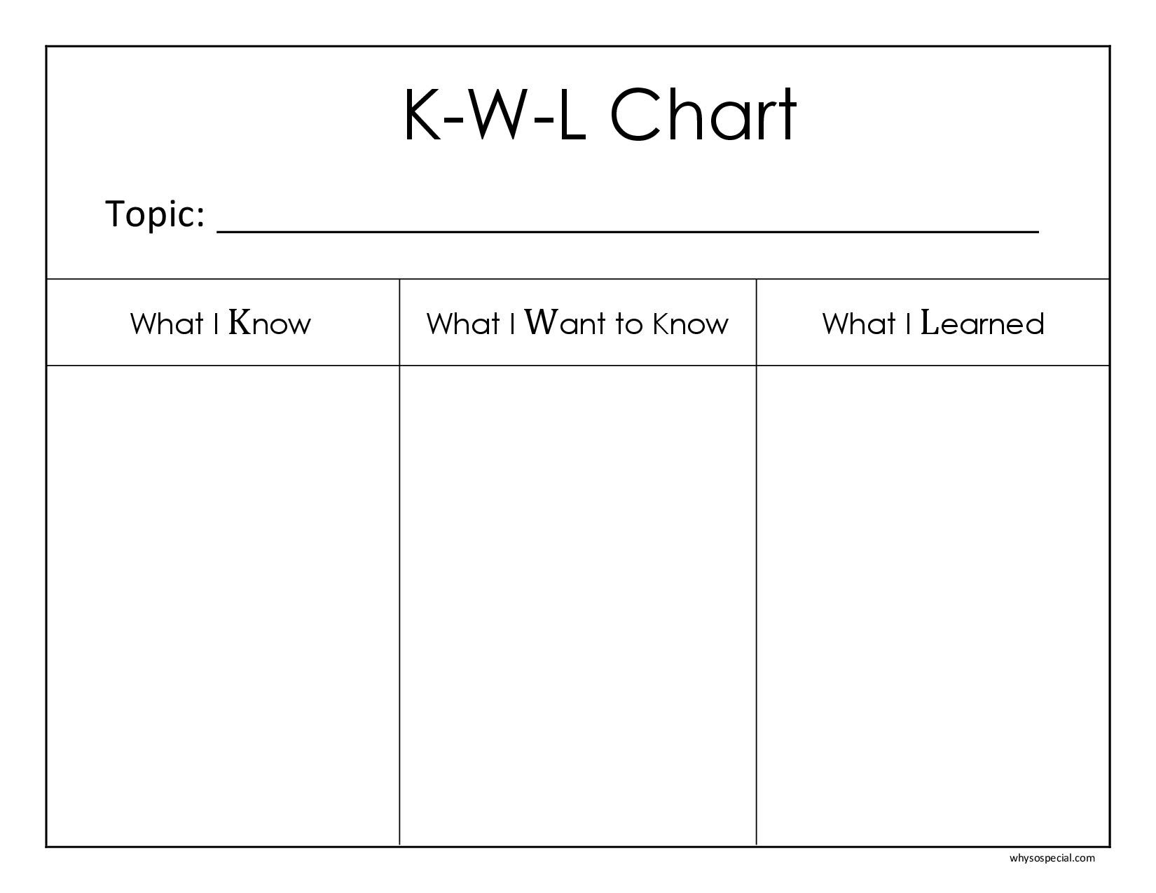
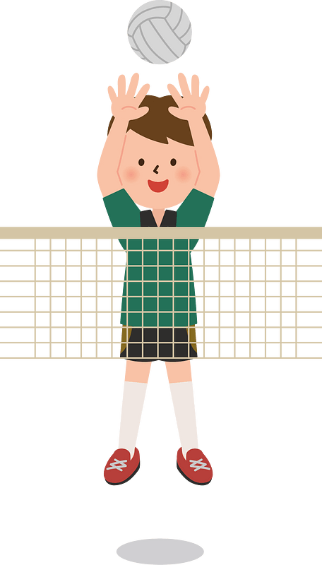
What kinds of questions do you have about aeromodelling?

Slide 10

READING STRATEGY
Scanning
to find specific information in a reading. it is better to scan the text than to read every sentence.

Slide 11
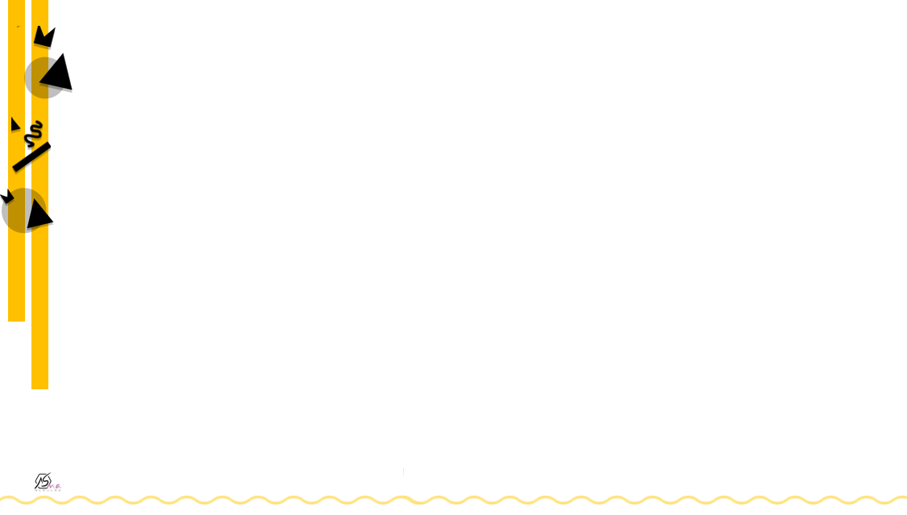
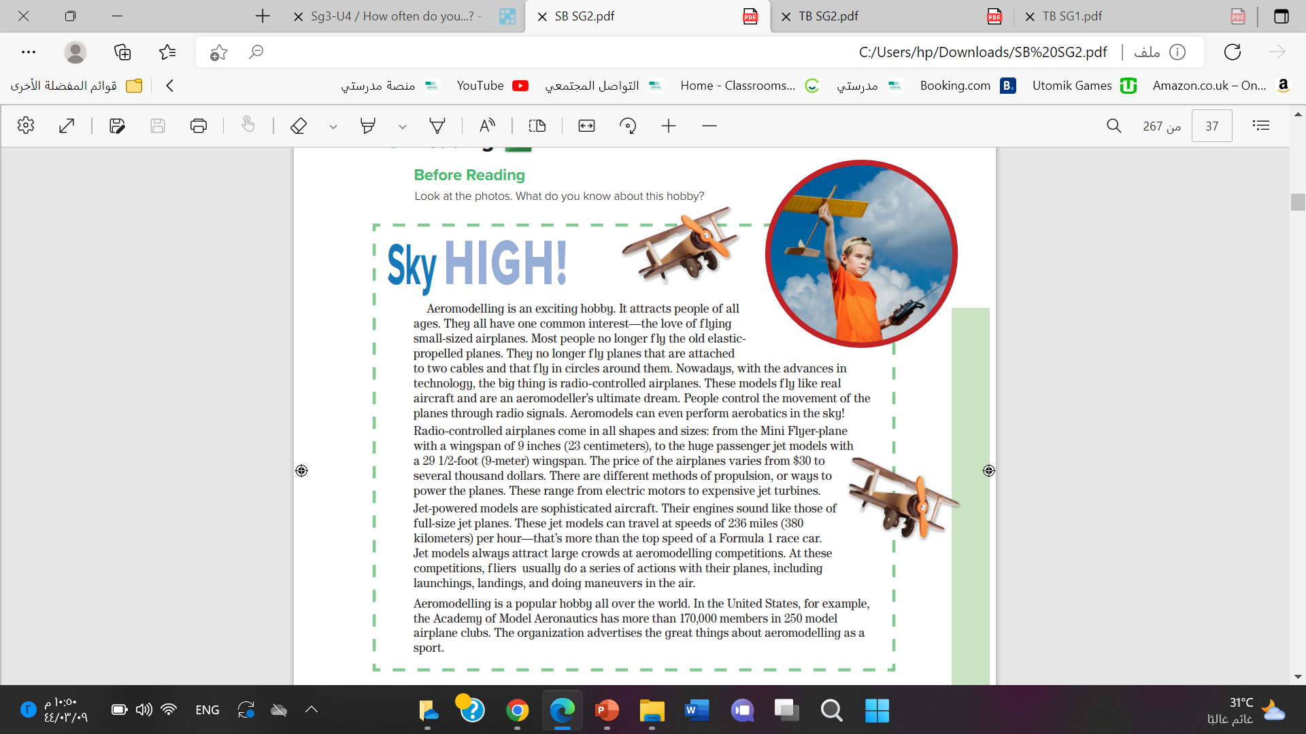



Listen

Slide 12
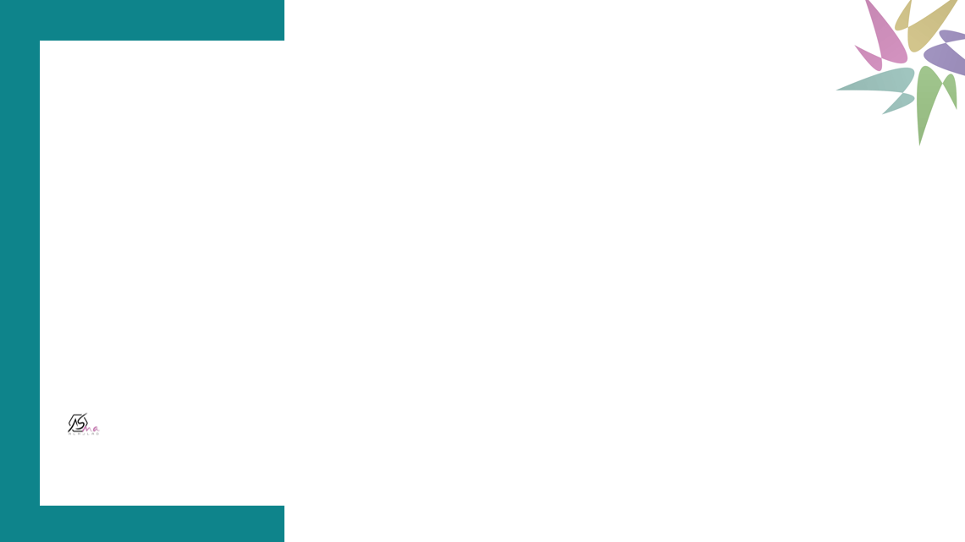


How much does the hobby cost locally?
Where can people get aeromodels?
Are there clubs or competitions anywhere in Saudi Arabi?

Slide 13
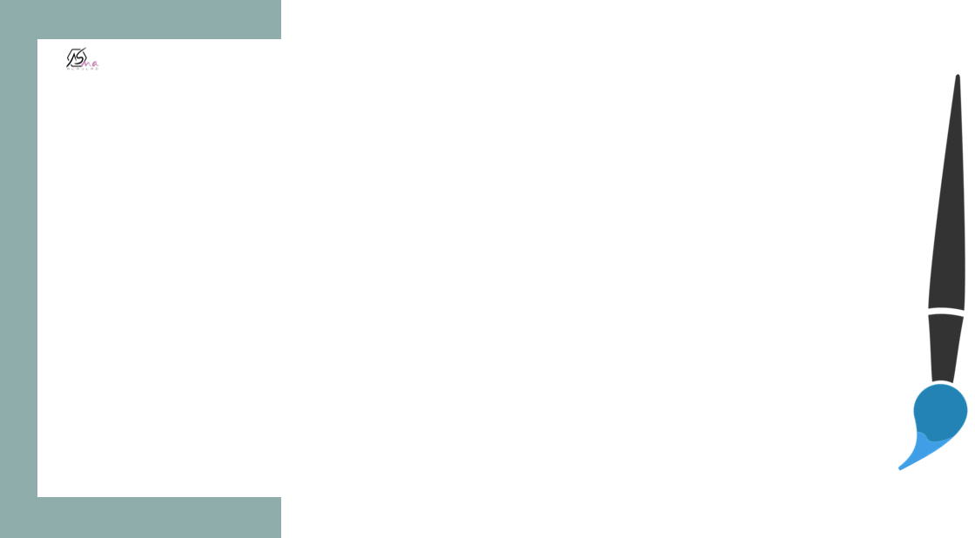
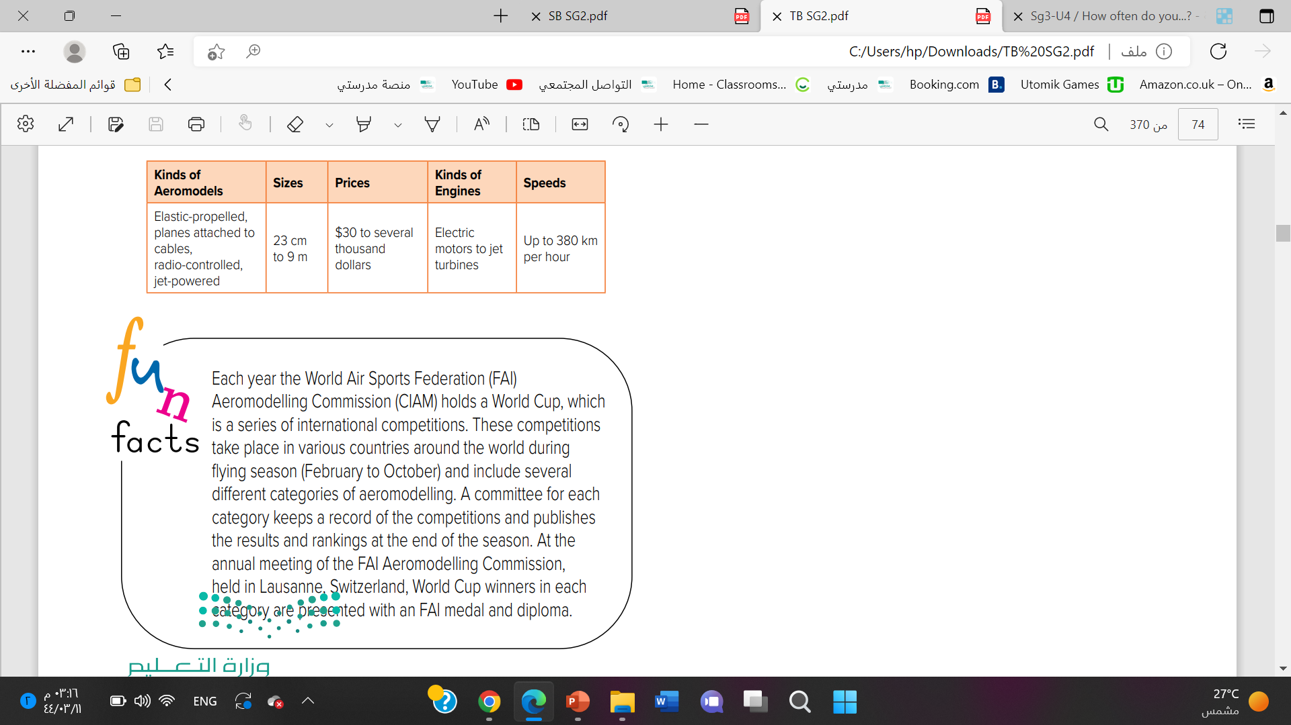


Slide 14
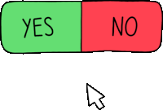


1. Radio control airplanes come in all shapes and size
2. The price of airplanes are very cheap
3. Jet –powered models are slow planes
4. Aeromodelling is a popular hobby
5. We can consider aeromodelling as a sport
6. People control the movement of the planes through radio signals

Slide 15
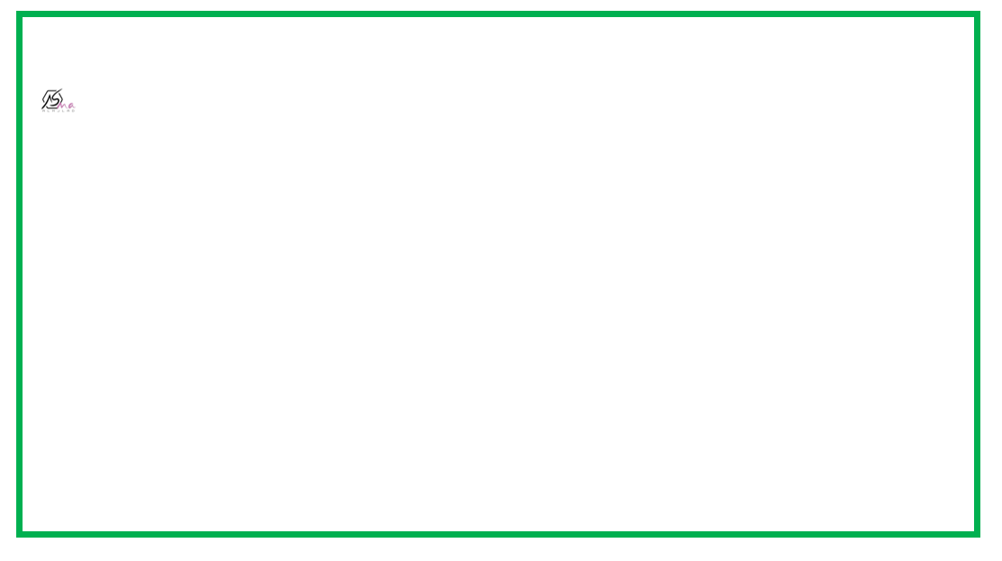

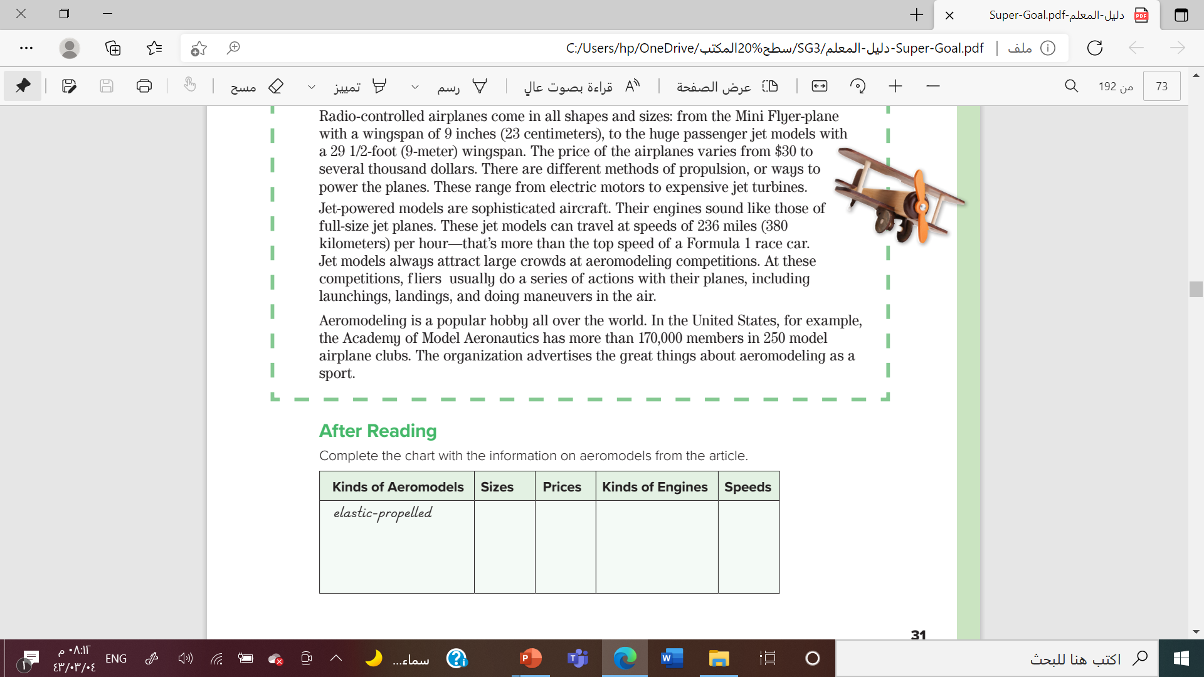


$30 to several thousand dollars
electric motors to jet turbines
up to 380 km per hour
planes attached to cables
23 cm to 9 m
radio-controlled,
jet-powered

Slide 16
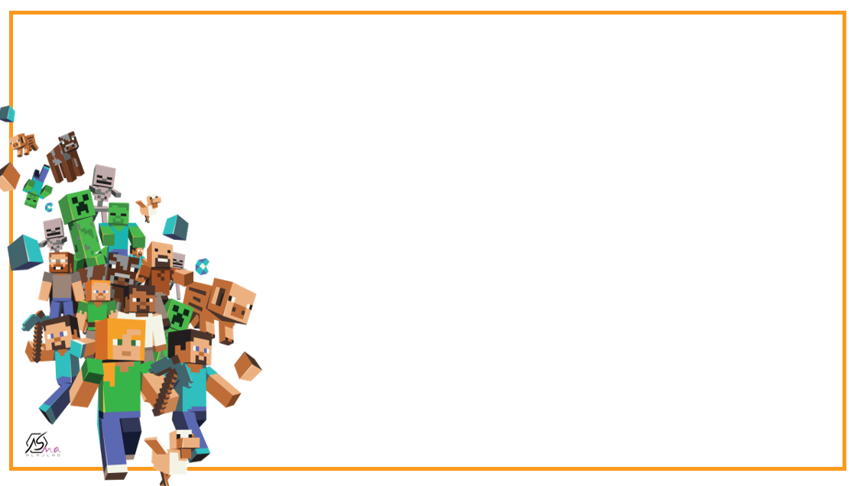




Aeromodelling is an exciting …………………
hobby
subject

Slide 17
Which of the fowlloing models are mentioned in the text.
Boing plane
Radio-controlled airplanes

Slide 18

Name the types of airplanes on the text

Slide 19
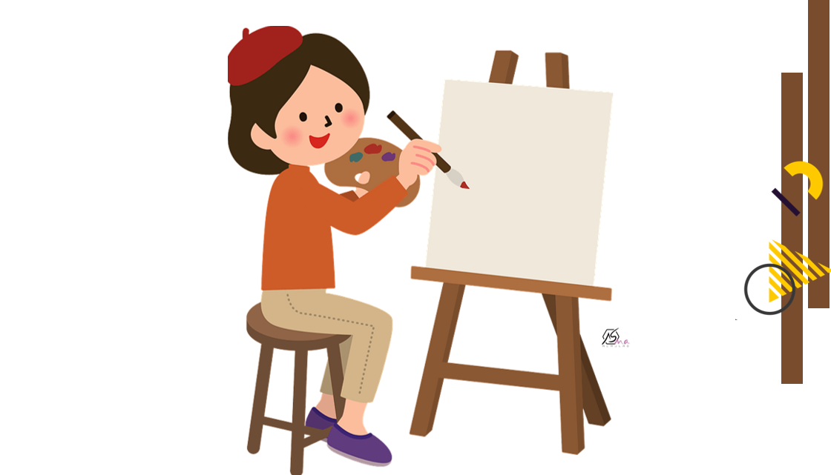


Slide 20

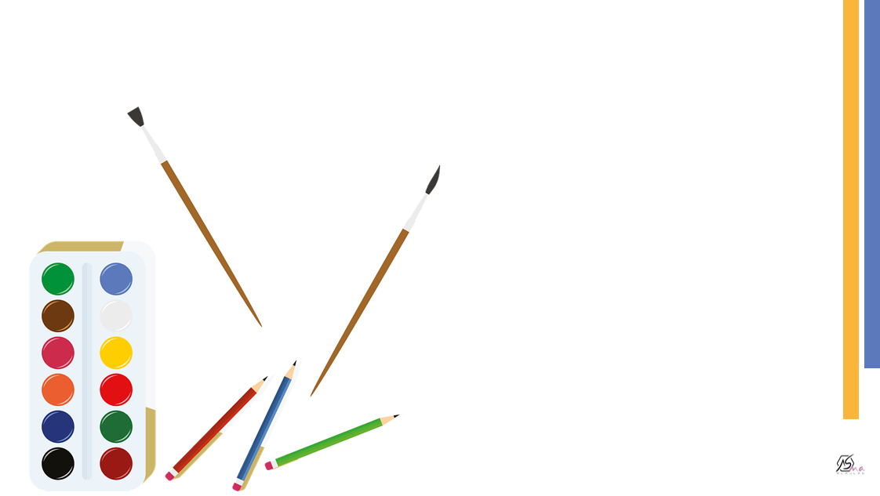
Work
book

Slide 21
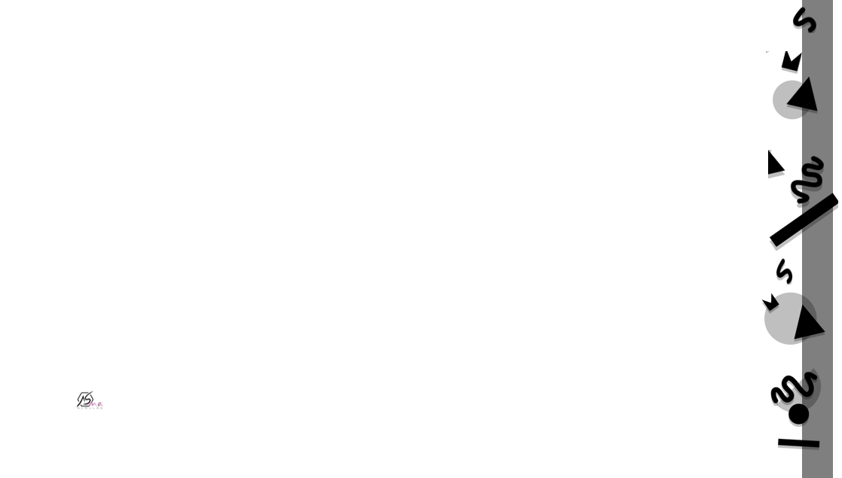
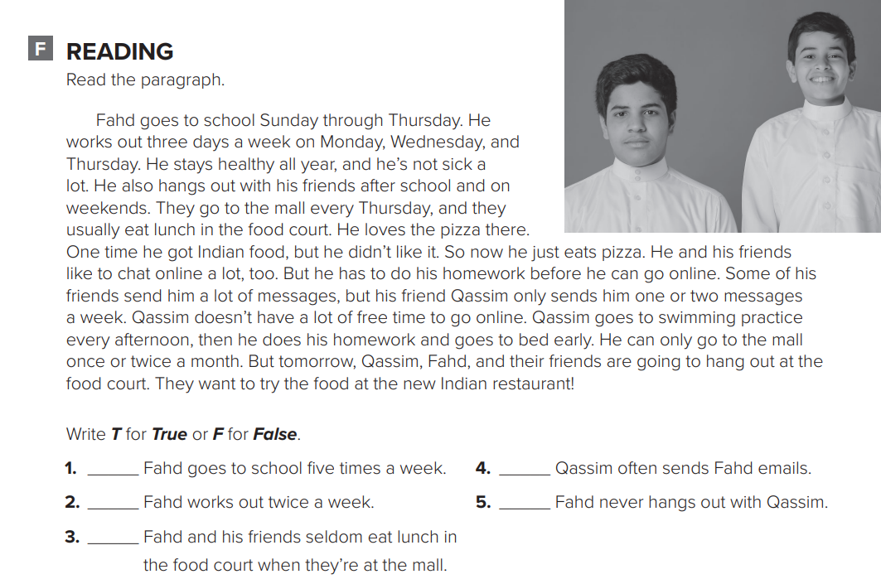
F
T
F
F
F

Slide 22
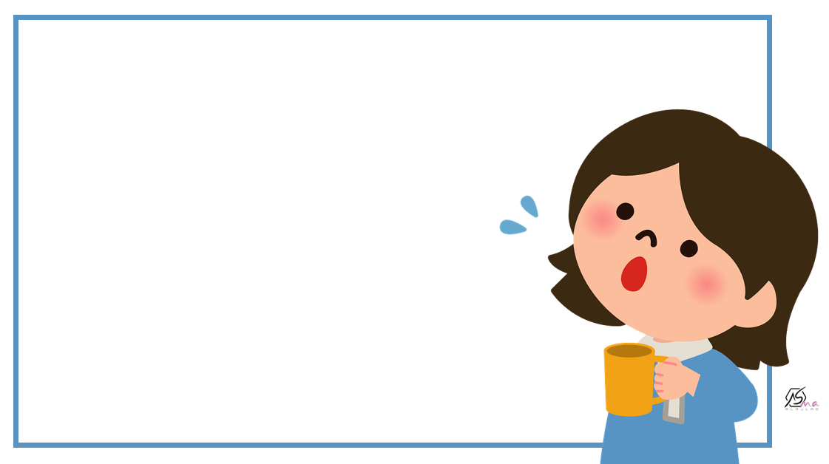



Slide 23
