Slide 1
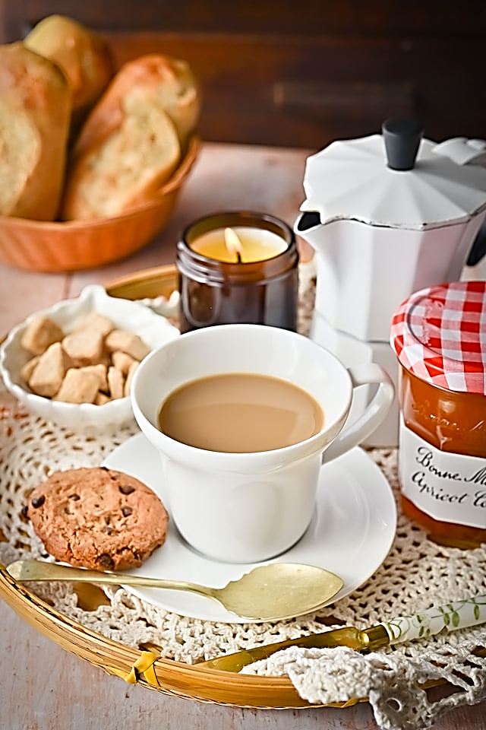
Good Morning
Everyone!

Slide 2

How are you today?

Slide 3

Objectives!
answer “writing” exercises.
learn ( and / but / because ).
study relative pronouns (who / that / which).

Slide 4
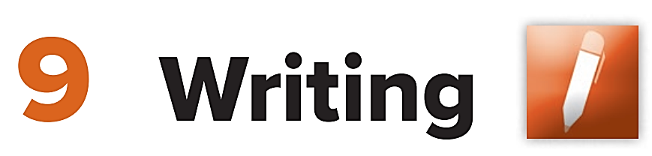

Slide 5
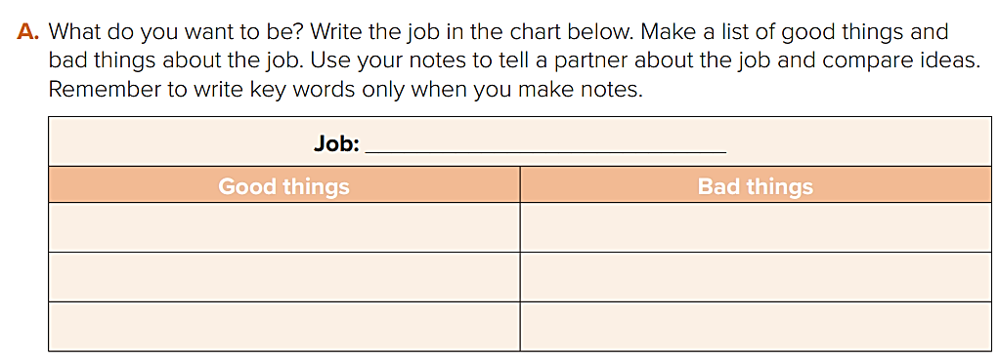
pilot
Good money (salary)
Long hours of work
Seeing the sky from above
The danger of crash
Visiting a lot of countries
stress

Slide 6
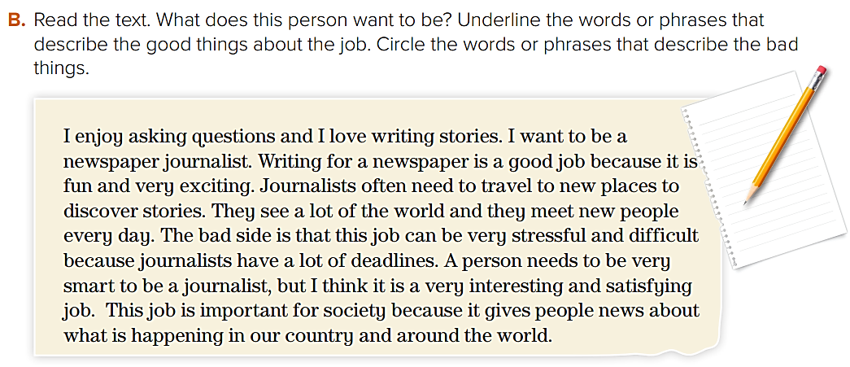
He wants to be a newspaper journalist.

Slide 7
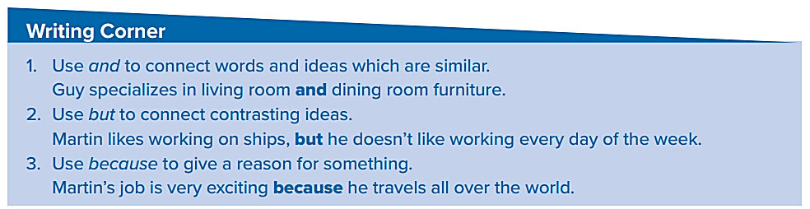
Now, we are going to study Conjunction words:
( and / but / because )

Slide 8
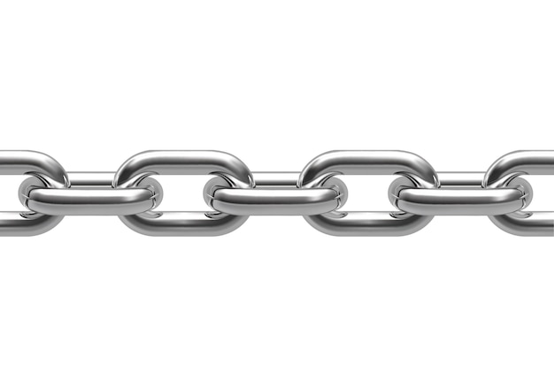
What does a Conjunction word do?
Conjunction words link two sentences together.
Sentence 1
Sentence 2
link

Slide 9
and
Sentence 1
Sentence 2
I like football.
I like basketball.
The link word is: and
The result
I like football and basketball.

Slide 10
When do we use “and”?
When the two sentences are similar to each other.
Examples
I love apples.
I love bananas.
I love apples and bananas.

Slide 11
but
Sentence 1
Sentence 2
I speak Arabic.
I don’t speak French.
The link word is: but
The result
I speak Arabic, but I don’t speak French.

Slide 12
When do we use “but”?
we use “but” to show a difference or an opposite idea.
Examples
I want to buy this car.
I don’t have money.
I want to buy this car, but I don’t have money.

Slide 13
because
Sentence 1
Sentence 2
I love my job.
It is fun.
The link word is: because
The result
I love my job because it is fun.

Slide 14
When do we use “because”?
use because to give a reason for something.
Because answers the question “Why”.
Why do you love your job?
I love my job because it is fun.

Slide 15
More Examples
Sarah is kind and friendly.
I called, but he didn’t answer.
I like apples, but I don’t like oranges.
My mother likes tea, but my father likes coffee.
He was late because he didn’t sleep last night.
The baby is crying because he wants his mother.

Slide 16

Very Good Class
Let’s take a break to play a little game, shall we?
Start!

Slide 17
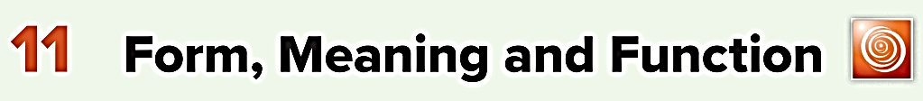
Let’s continue…

Slide 18
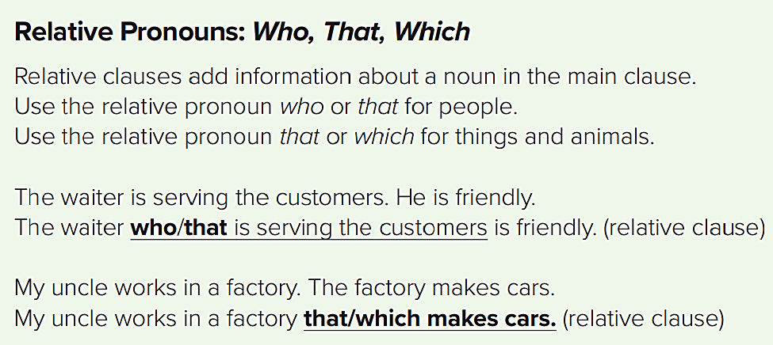

Slide 19
who
For people
Examples of people:
nurse
brother
neighbor
teacher
sister
boy
actor
friend
girl

Slide 20
The nurse who treated me was kind.
The girl who is standing there is my sister.
The people who were arrested have now been released.
The driver who caused the accident was fined 500 Riyals.

Slide 21
which
for things and animals.
Examples of things:
Examples of animals:
factory
cat
job
elephant
company
mouse
books
tiger

Slide 22
The bus which goes to the airport runs every half hour.
Ahmad works for a company which makes clothes.
We live in a world which is changing all the time.
The horse which is winning is mine.

Slide 23
that
For people, things and animals
The nurse who/ that treated me was kind.
The horse which/ that is winning is mine.
The people who/ that were arrested have now been released.

Slide 24
Exercise
Choose the correct answer:
The horse ( who – which ) is winning is mine.
Ahmad works for a company ( who – that ) makes clothes.
The girl ( who – which ) is standing there is my sister.

Slide 25
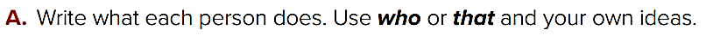
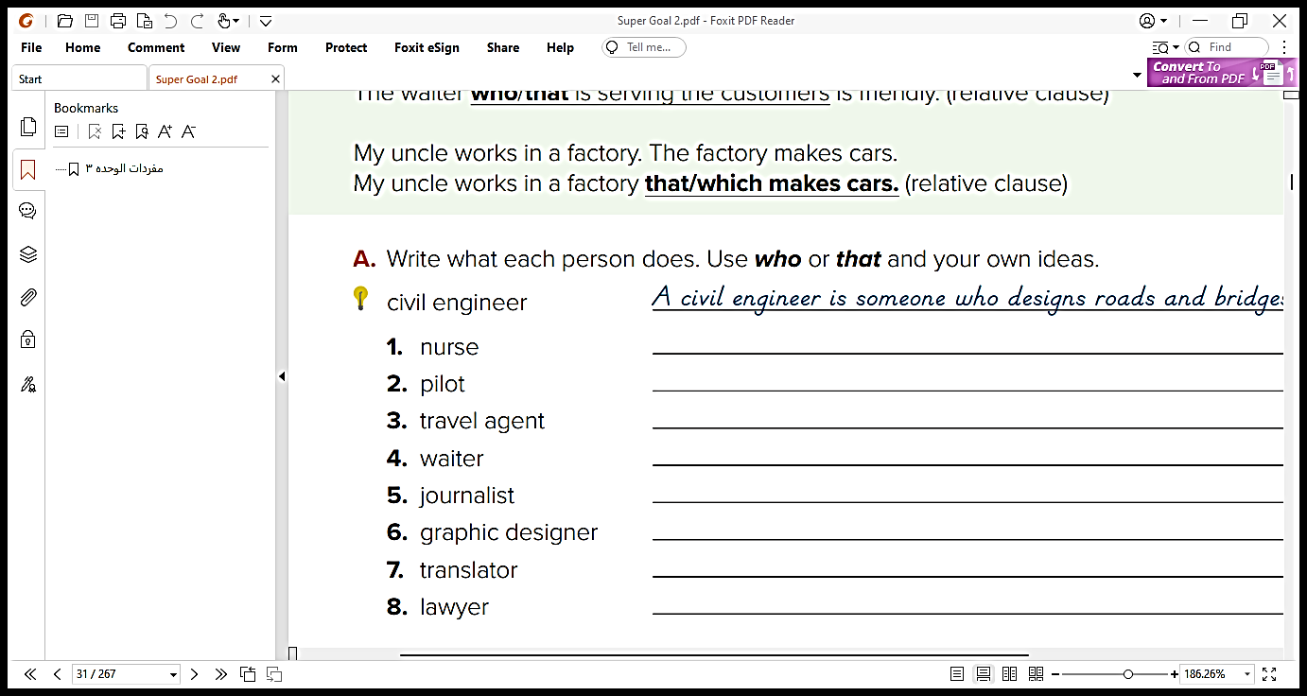
A nurse is someone who/ that takes care of sick people.
A pilot is someone who/ that flies airplanes.
A travel agent is someone who/ that arranges trips.

Slide 26
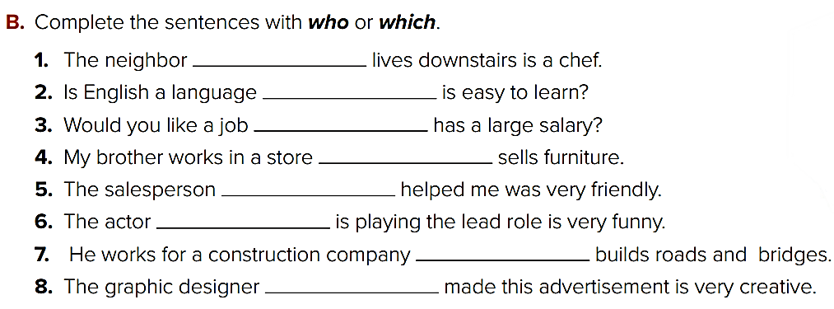
who
which
which
which
who
who
which
who

Slide 27
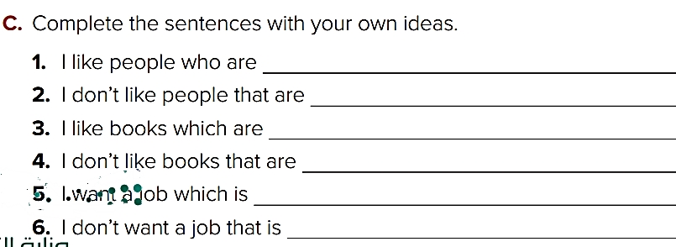
honest
greedy
strange
boring
fun
stressful

Slide 28


Slide 29

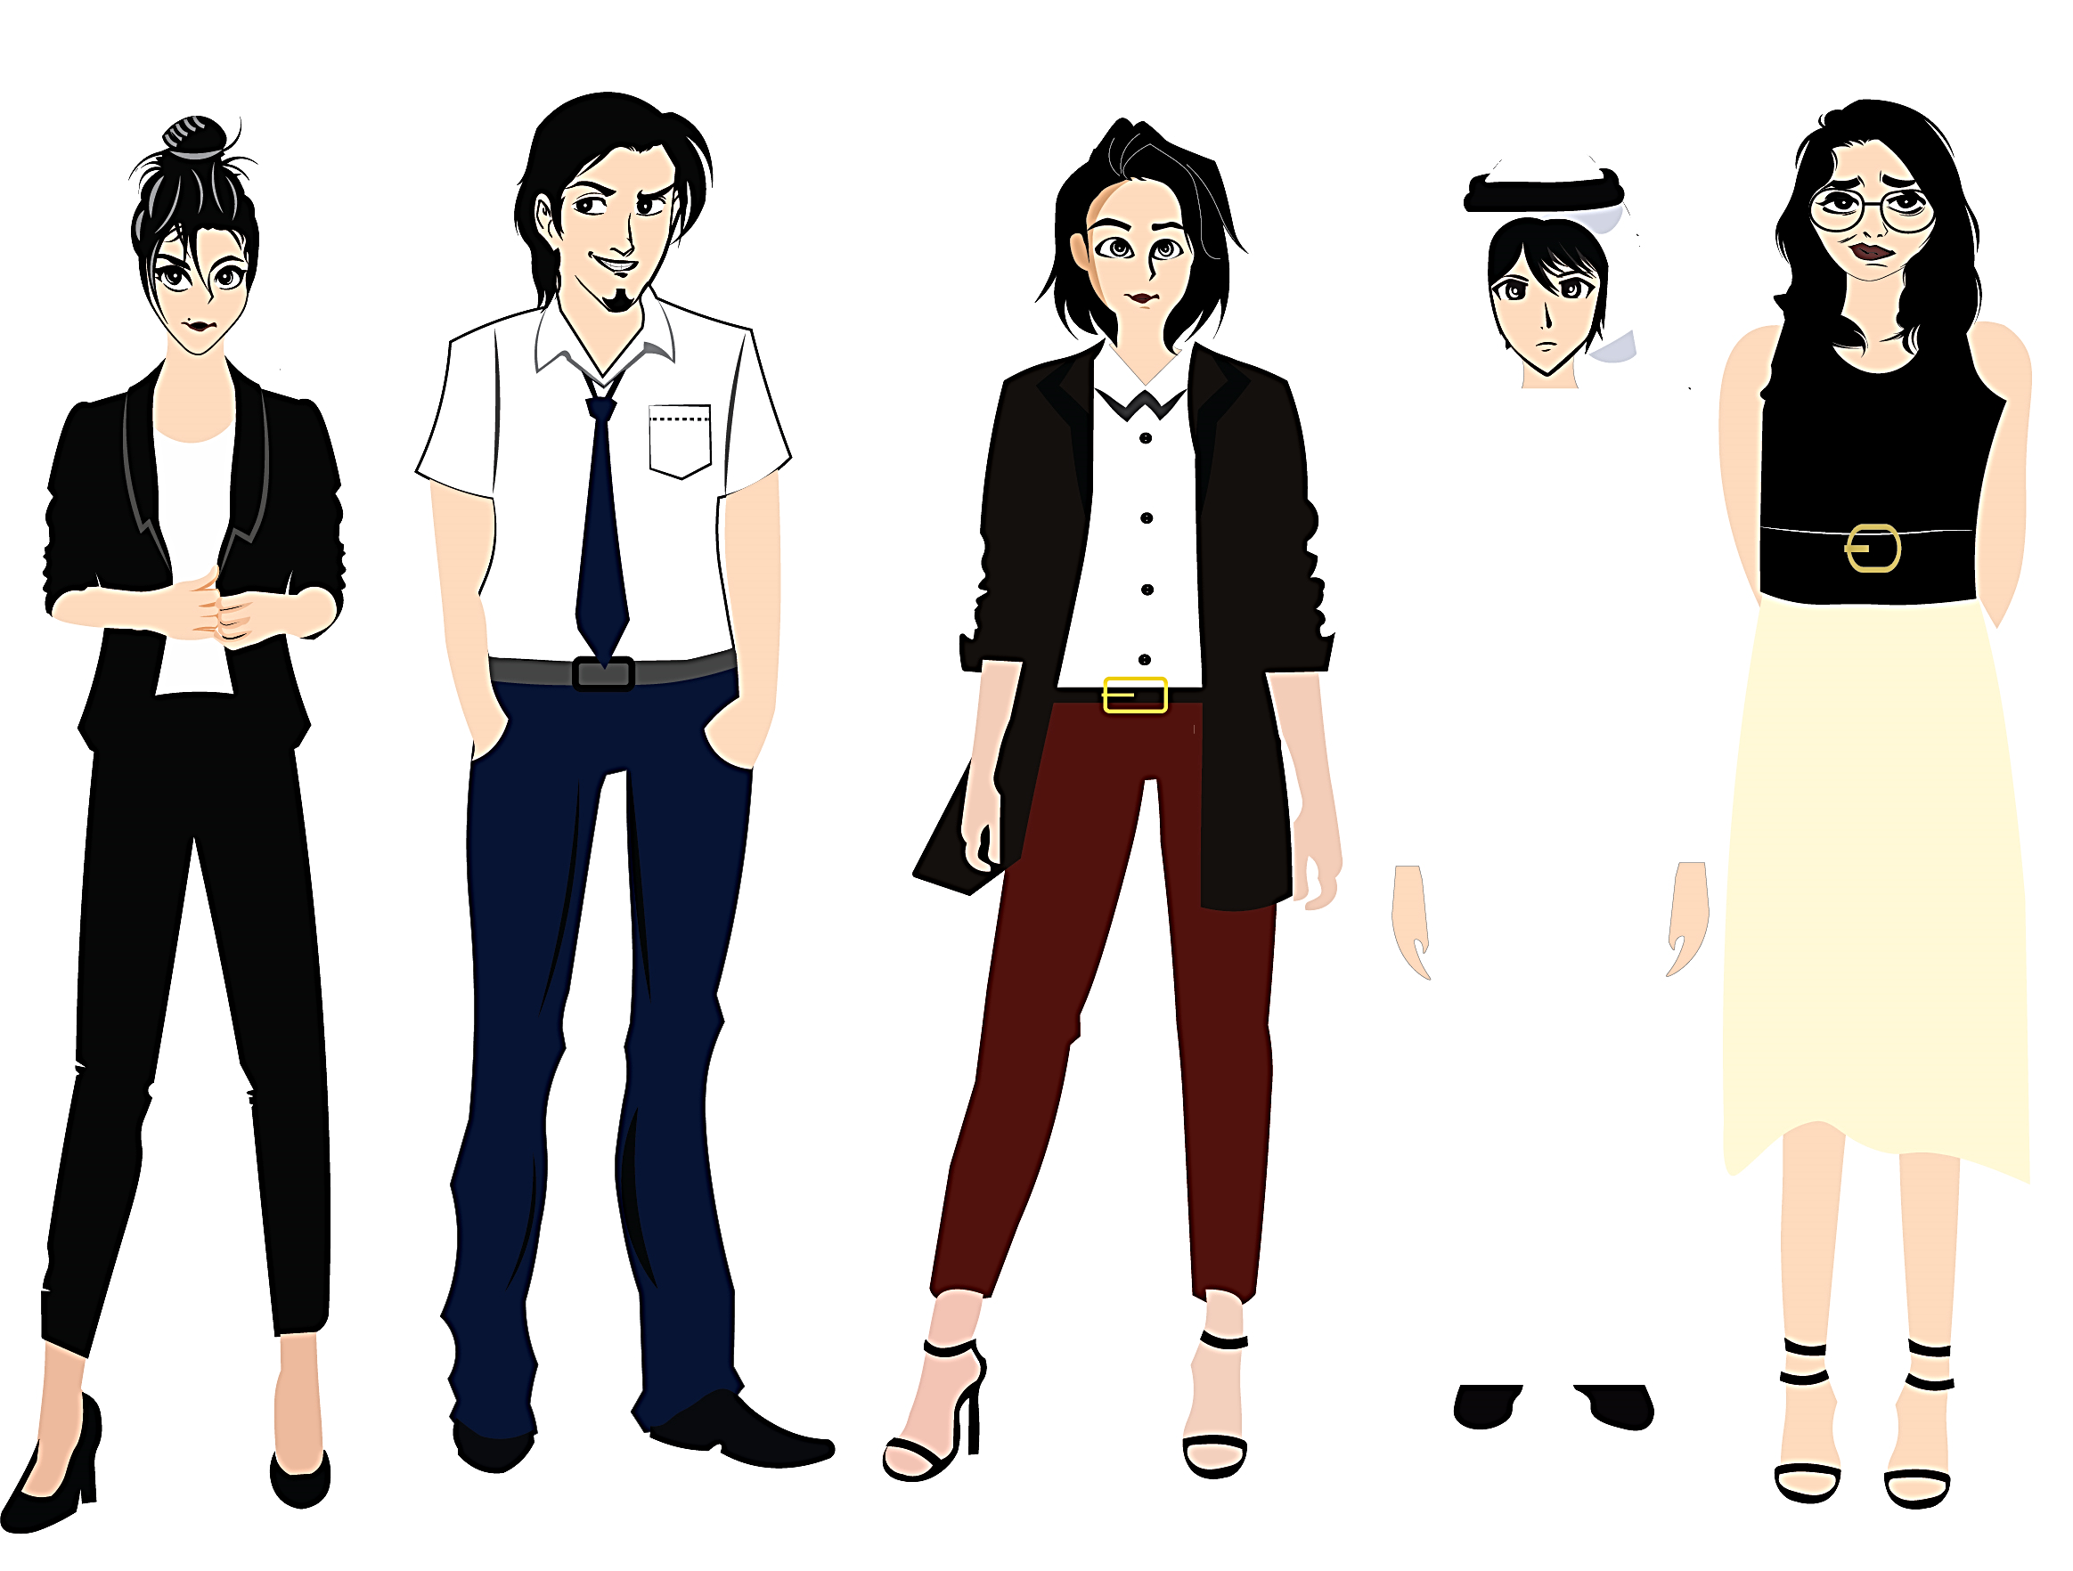


Pictures by:
www.freepik.com
تم تصميم هذا العرض من قبل: فريق عمل البوابة الإنجليزية ، وهو مجاني لكي يستفيد منه معلمي اللغة الإنجليزية.
هذه الشريحة تعتبر كـ"حفظ حقوق" نتمنى عدم حذفها حال مشاركة العرض مع معلمين آخرين.
نسمح بحذف الحقوق في حالة واحدة فقط: اذا أراد معلم الإنجليزي إضافة هذا العرض كـ انتاج معرفي خاص فيه.

