Slide 1


Slide 2

How are you feeling today?

Slide 3
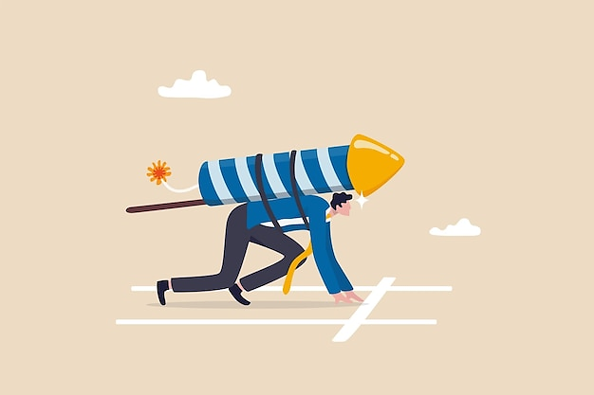
Get ready..!
We will start
Unit 3 today

Slide 4
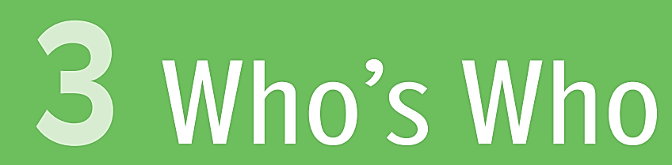
Objectives:
Listen and answer some questions.
Learn new words.

Slide 5
salesperson
nurse
travel agent
call center representative
graphic designer
engineer
These are names of jobs. Do you know what they mean?
If you don’t, that’s totally fine, we will study them together!

Slide 6
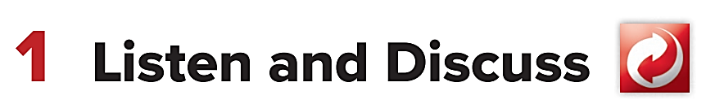

Slide 7

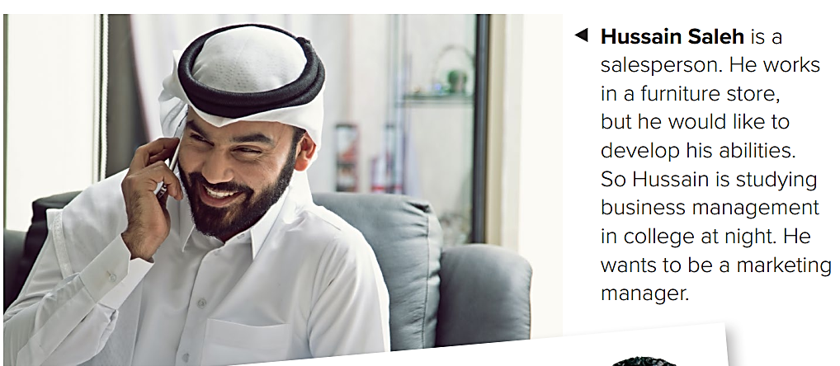

Slide 8


Slide 9
salesperson
a person whose job is selling things.
What is “Selling”?

Slide 10
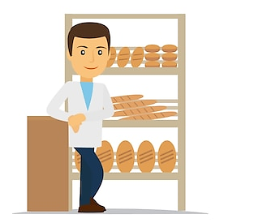
selling is giving something to someone and taking their money.
He is selling bread
He will give you (sell you) the bread if you give him money.

Slide 11

He is selling
He is buying

Slide 12

He is a Salesperson
What is he selling?
( Vegetables )

Slide 13

He is a Salesperson
What is he selling?
( furniture )

Slide 14
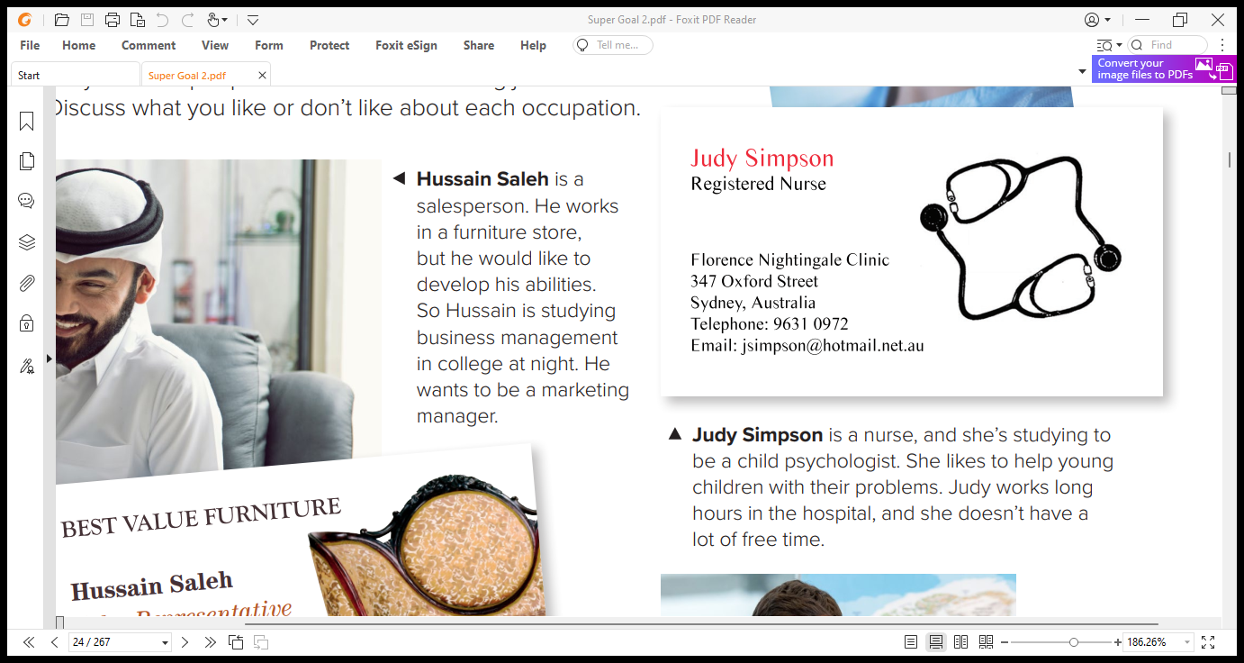


Slide 16

nurse
She is a nurse.
(a nurse: takes care of sick people)

Slide 17

She is a nurse.
a nurse helps the doctor.

Slide 18
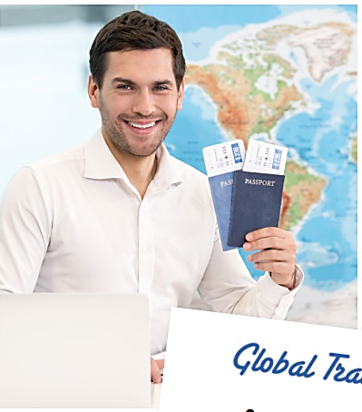
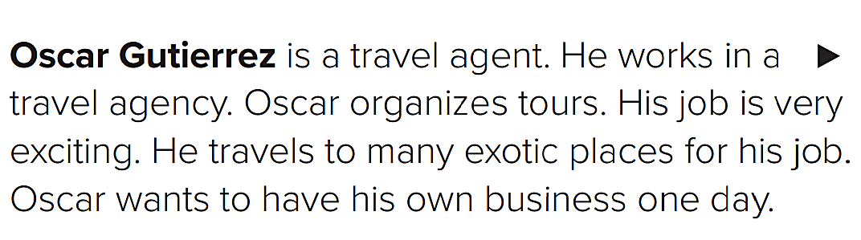

Slide 19


Slide 20
travel agent
Is a person or company that arranges tickets, hotel rooms, etc. for people going on holiday or making a journey.

Slide 21

A travel agent will prepare everything for you: hotel, tickets, etc…

Slide 22
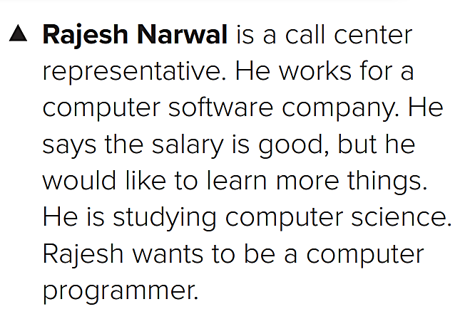
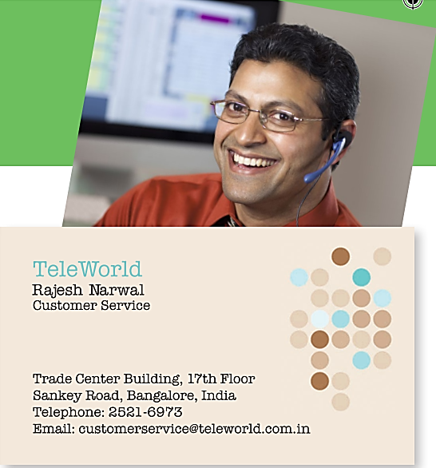

Slide 23

call center representative
also called: Customer Service
a customer service answers people’s questions on the phone.

Slide 24
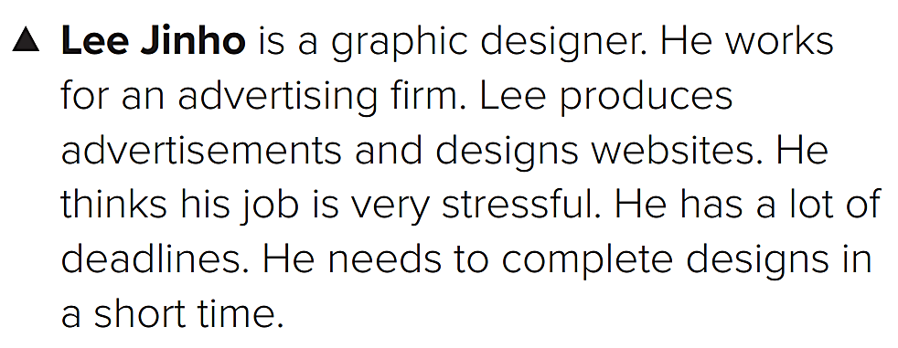

Slide 25
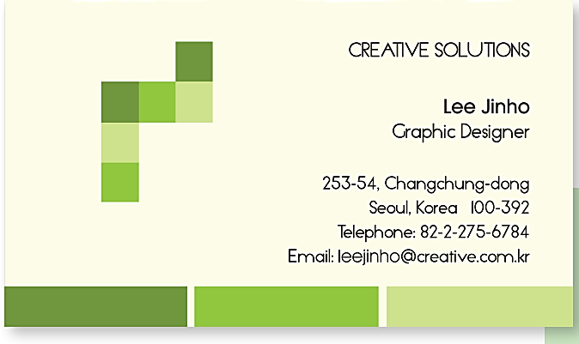

Slide 26
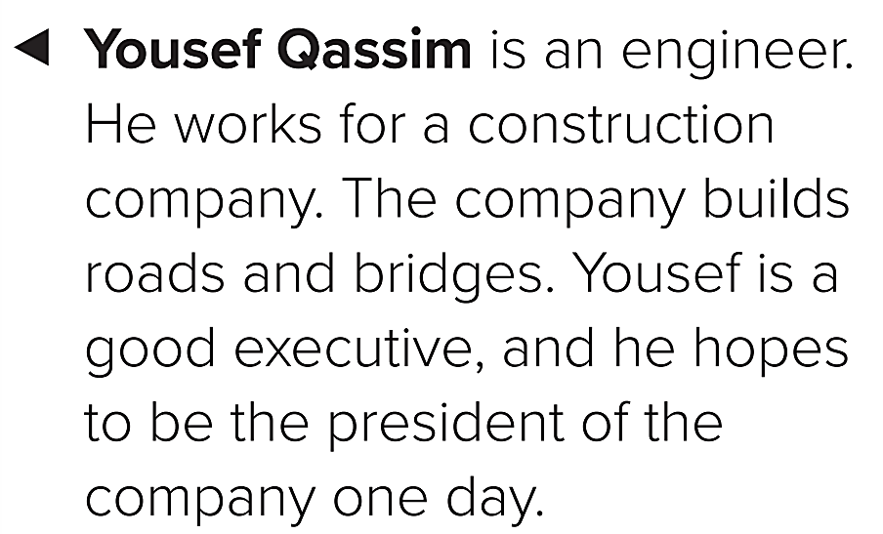

Slide 27
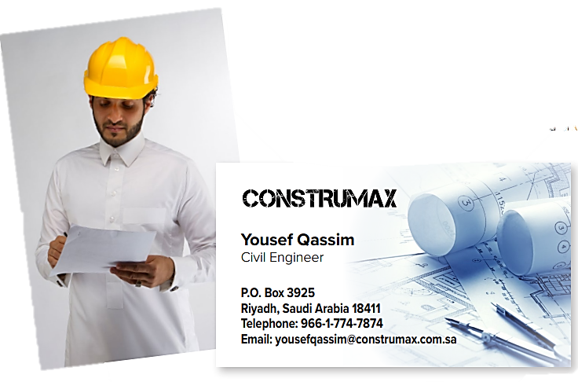

Slide 28

engineer
an engineer is a person who oversees construction projects (buildings).

Slide 29
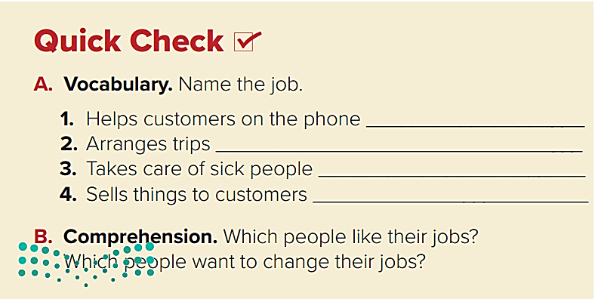
Customer Service
Travel agent
nurse
salesperson

Slide 30
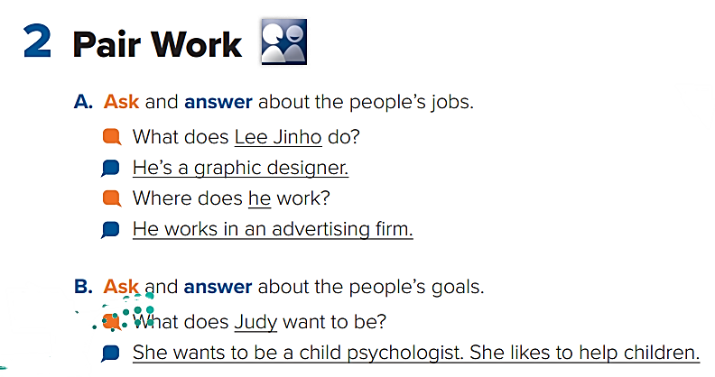

Slide 31
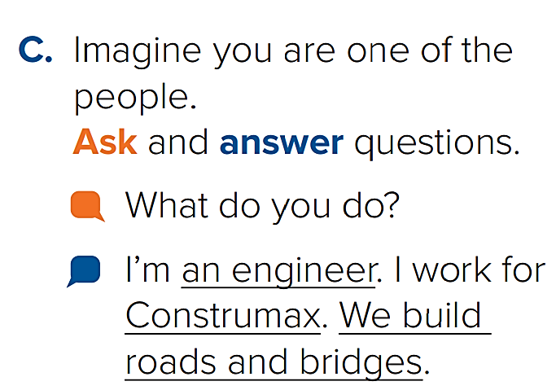

Slide 32
Linking this lesson to Religion
Today we talked about “jobs”.
Having a job is better than asking people for money!
قال صلّى الله عليه وسلّم: (لَأَنْ يَحْتَطِبَ أَحَدُكُمْ حُزْمَةً علَى ظَهْرِهِ، خَيْرٌ له مِن أَنْ يَسْأَلَ أَحَدًا فيُعْطِيَهُ أَوْ يَمْنَعَهُ).

Slide 33
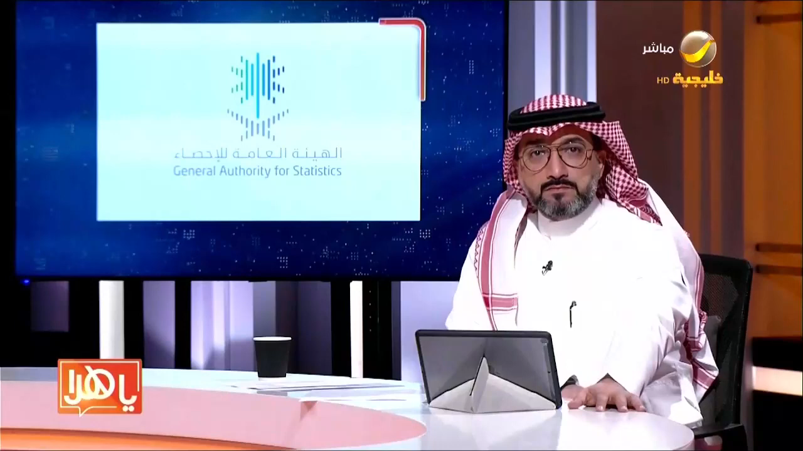
Linking this lesson to my Country
“Jobs” in Saudi Arabia are now more than ever!

Slide 34

End Of
Class

Slide 35

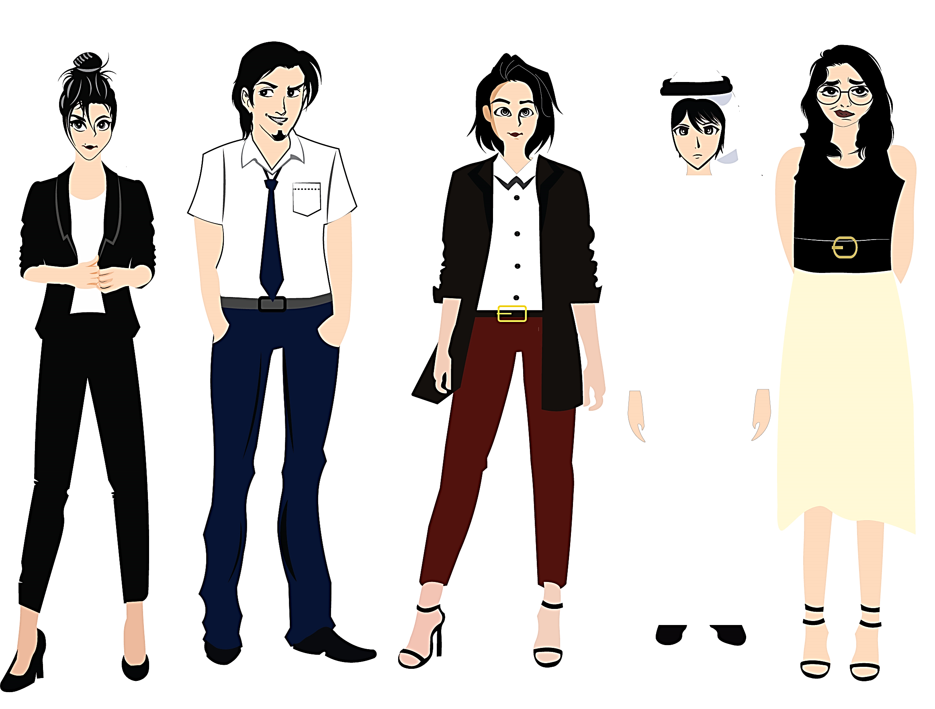


Pictures by:
www.freepik.com
تم تصميم هذا العرض من قبل: فريق عمل البوابة الإنجليزية ، وهو مجاني لكي يستفيد منه معلمي اللغة الإنجليزية.
هذه الشريحة تعتبر كـ"حفظ حقوق" نتمنى عدم حذفها حال مشاركة العرض مع معلمين آخرين.
نسمح بحذف الحقوق في حالة واحدة فقط: اذا أراد معلم الإنجليزي إضافة هذا العرض كـ انتاج معرفي خاص فيه.

