Slide 1

U 3 Grammar p 20
Tr. Nora Khalid

Slide 2

Goals:
To introduce Present simple positive and negative sentences, and some question forms. Ss will be able to make Positive ,negative sentences in simple present tense.
To introduce Verb Want + Infinitive. Ss will be able to make questions and answers using
want + Invinitive.

Slide 3

reads
He ……….. books every day.

Slide 4

works
She ……….. in a company.

Slide 5

drives
He ……….. a car for the school.

Slide 6

write
I ……….. history books .

Slide 7
What’s the difference?
drives
He ……….. a car for the school.
write
I ……….. history books .

Slide 8
He
She
It
I
We
They
You
Verb + s ( reads – writes – watches – walks )
Verb ( read – write – watch – walk )

Slide 9
He
She
It
I
We
They
You
Does not + Verb ( doesn’t read – doesn’t walk )

Slide 10


She does not work.
He does not drive.

Slide 11
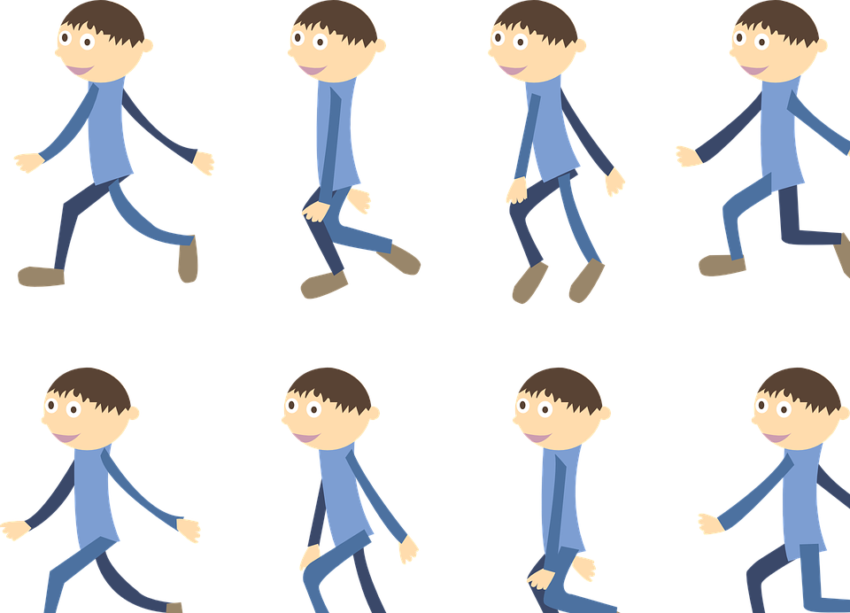
I do not write.
They do not walk.

Slide 12
What – he – work - ?
What does he work?

Slide 13
Where – they – work - ?
Where do they work?

Slide 14
Where – she – work - ?
Where does she work?

Slide 15
What – I – work - ?
What do I work?

Slide 16
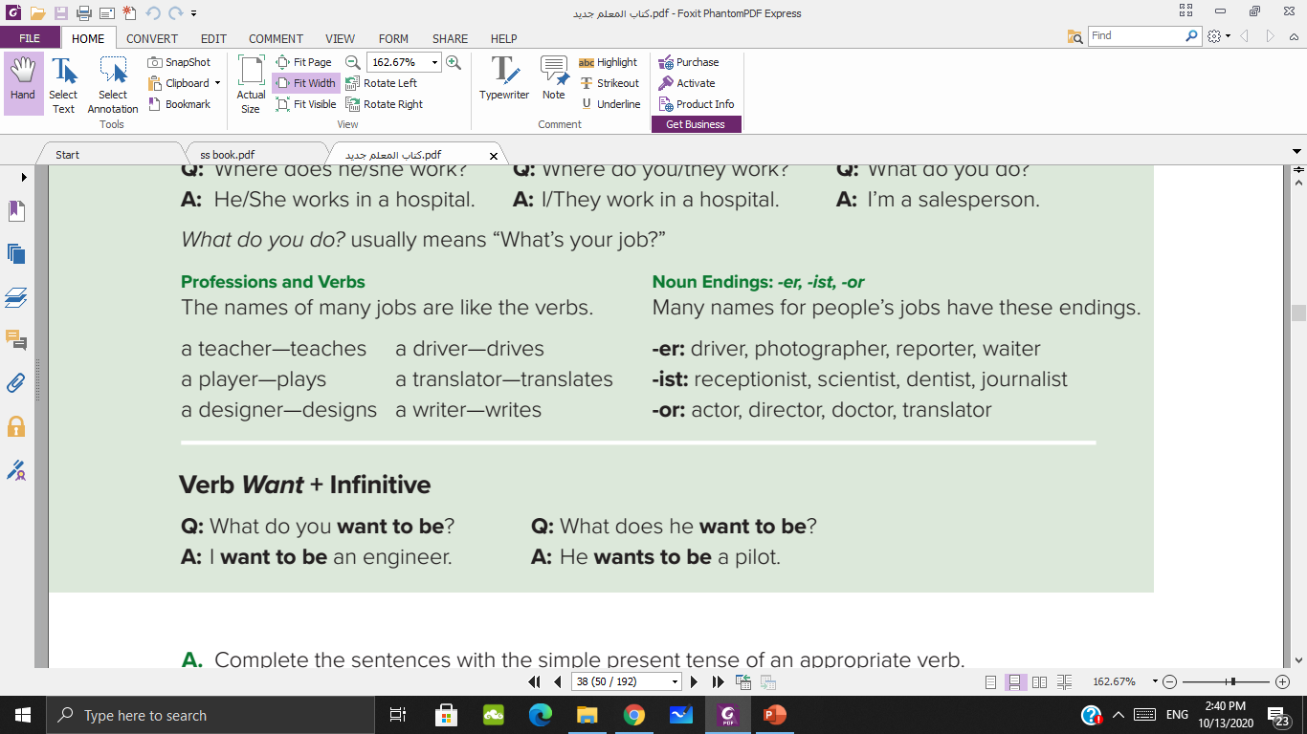

Slide 17



What do you want to be?
I want to be an engineer

Slide 18

What does he want to be?
He wants to be a pilot

Slide 19
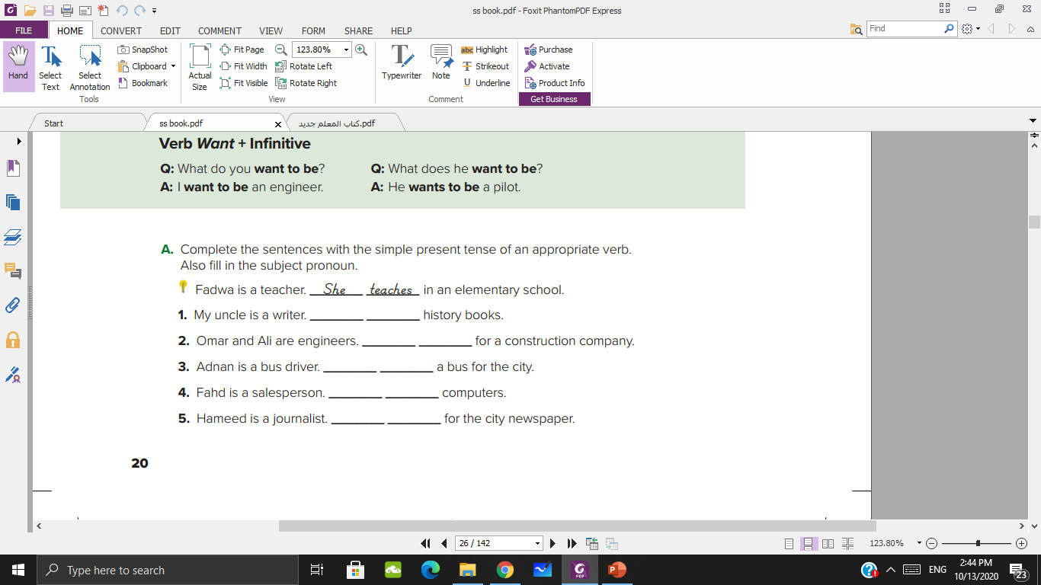
He writes
They work
He drives
He sells
He writes

Slide 20
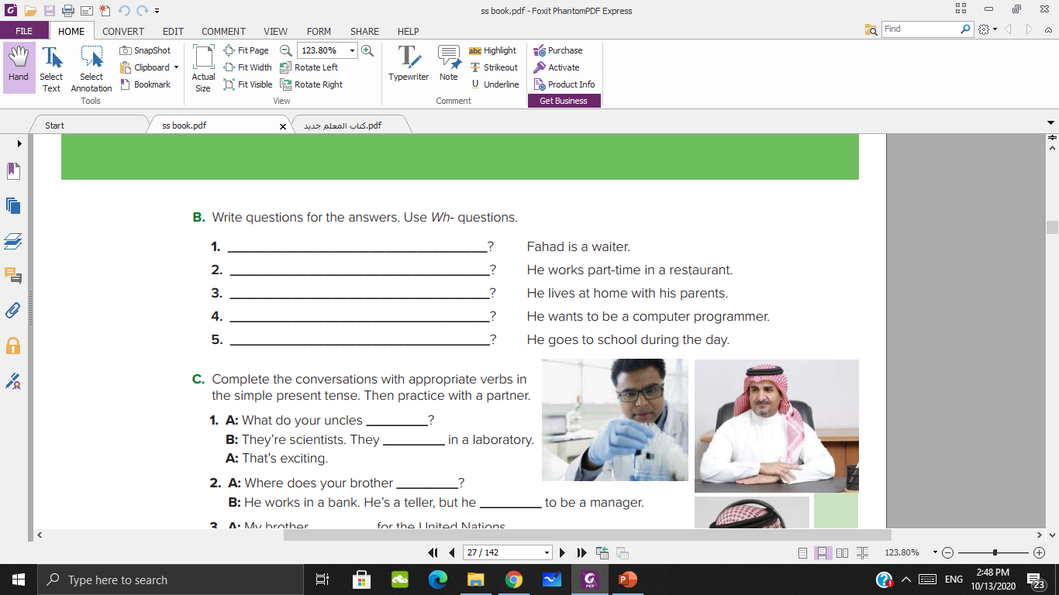
What does Fahad do
Where does he work
Where does he live
What does he want to be
What does he do during the day?

Slide 21
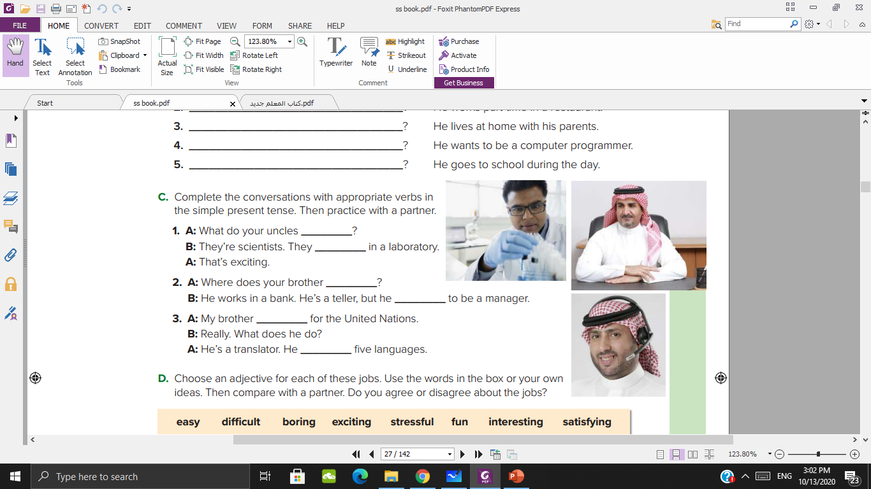
do
work
work
wants
to be
works
speaks

Slide 22
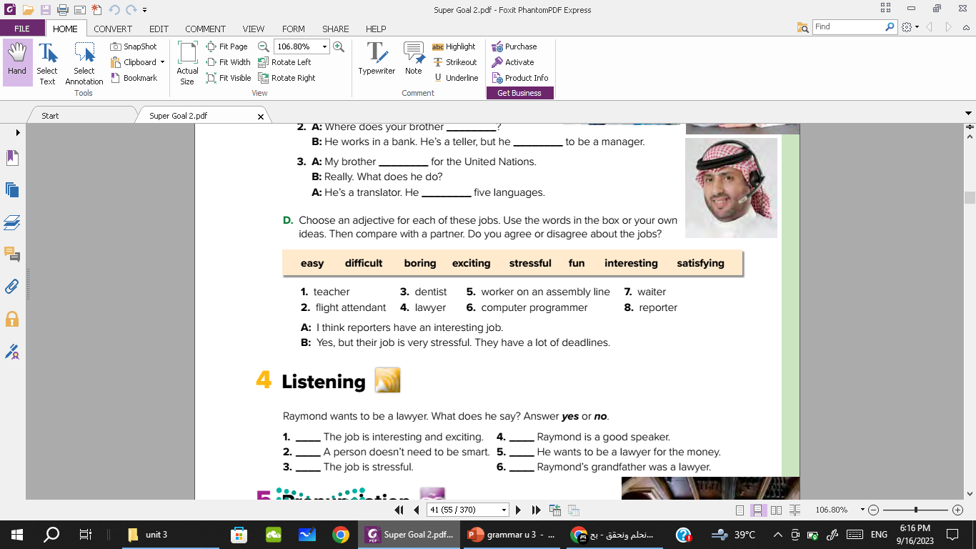

Slide 23
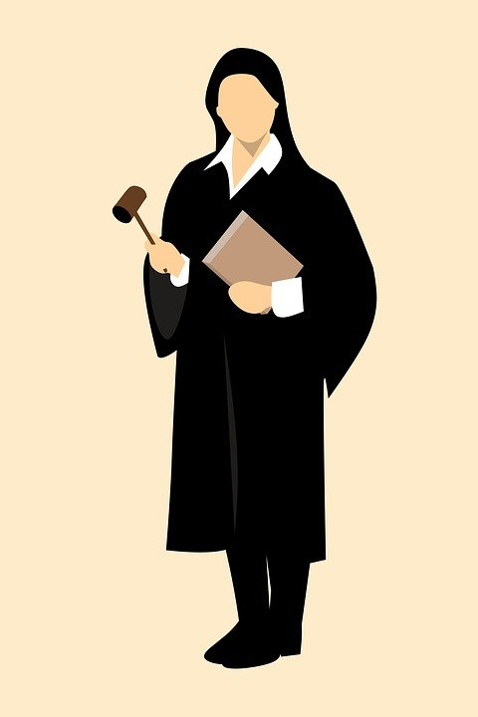
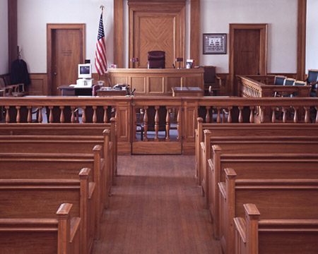

Slide 24

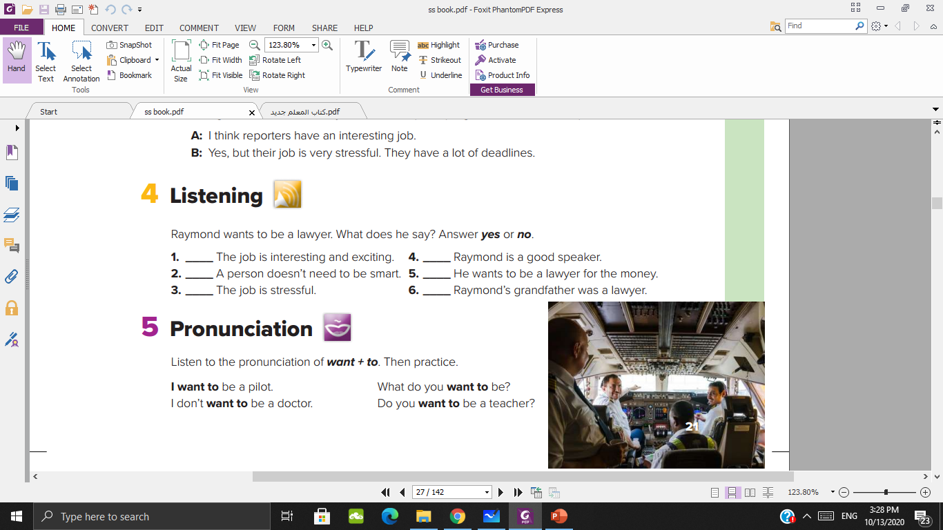
yes
yes
No
No
yes
yes

Slide 25
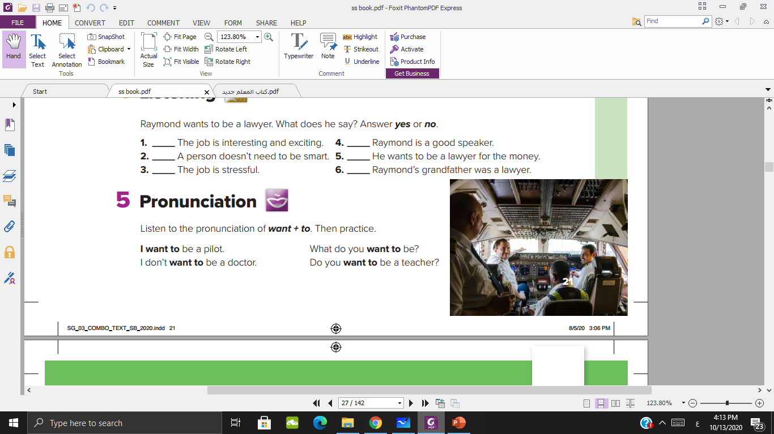

Slide 26
Homework

