Slide 1


Slide 2
What Will They Think of Next?
Grammar

Slide 3
Goals:
Express an idea using the future perfect tense
1
Illustrate the concept of the future perfect using a timeline
2
Write a future event using a time clause
3
Apply the correct tense according to the situation
4
Use the future perfect to combine the future events into one sentence
5
6
Identify the main clause and the time clause in a sentence

Slide 4
Future Perfect
Future Perfect Progressive
The Future with Dependent Time Clauses

Slide 5




Refresh Your Memory
Pass with Green Light to Future Tense
People will be taller by one to two inches
They used to live in the center of town
There will be no C, X, or Q in the English alphabet
We only drink herbal tea now
“Moving-sidewalk” stairways will connect them to the street level

Slide 6
Future Perfect

Slide 7
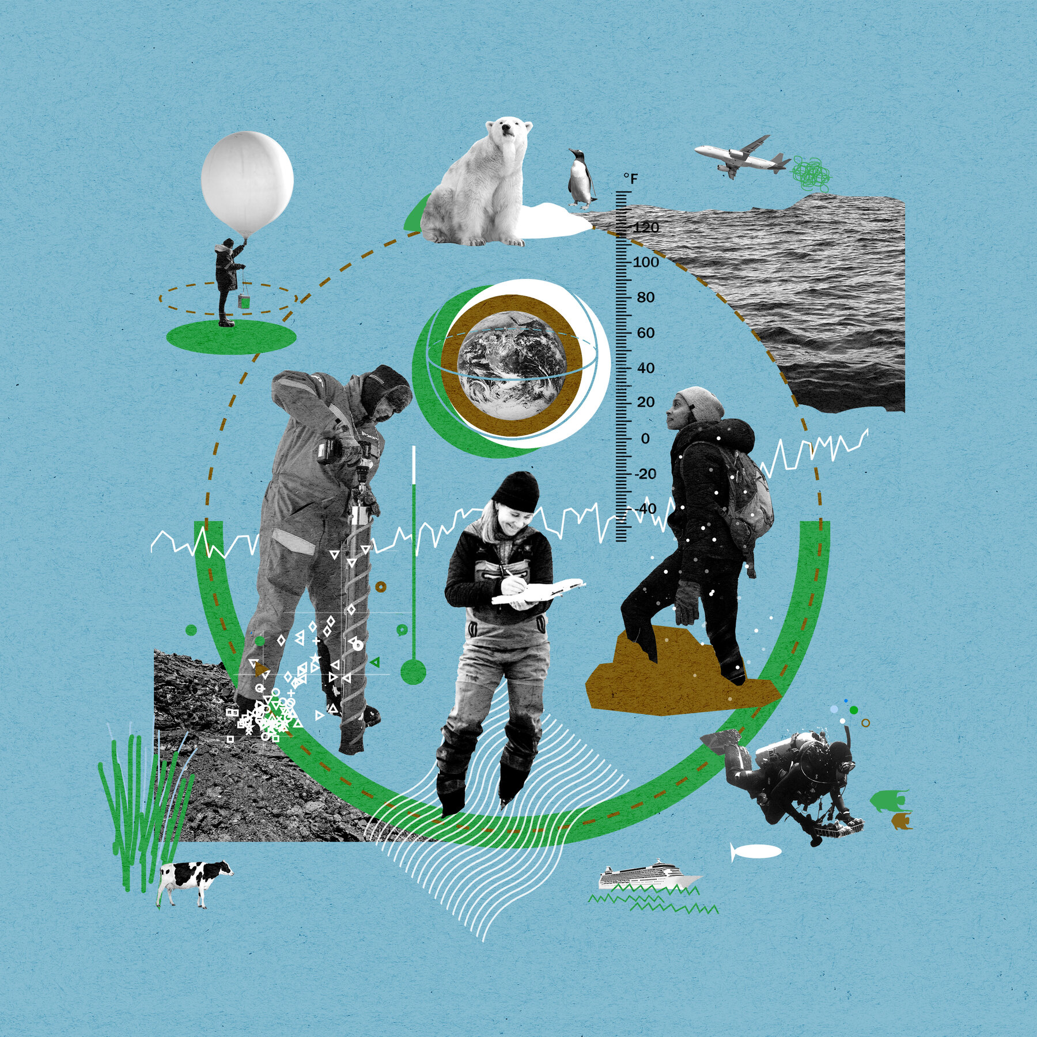
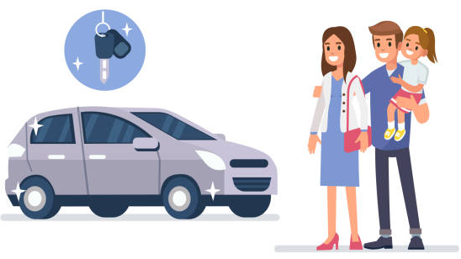
By the time my children are grown, scientists will have found a solution to global warming
The car company will have introduced their new models by November.

Slide 8
The future perfect is used to express the idea that an action will be completed in the future, before another event or before another specific time in the future.
S + will have + past participle.
now
By the time my children are grown,
scientists will have found a solution to global warming
By the time my children are grown, scientists will have found a solution to global warming
The car company will have introduced their new models by November.

Slide 9

A.Use the future perfect to combine the future events into one sentence, using by or by the time.
1st Event: I will take all my final exams. 2nd Event: The end of June will come.
By the end of June, I will have taken all my final exams.
1st Event: It will start to rain.
2nd Event: We will arrive at the picnic.
2. 1st Event: I will fall asleep.
2nd Event: This film will be over.
3. 1st Event: I will get married and have children.
2nd Event: 2024 will come.
4. 1st Event: My father will work at his company for 20 years.
2nd Event: He will retire
1-By the time we arrive at the picnic, it will have started to rain.
2. I will have fallen asleep by the time this film is over.
3. By 2024, I will have gotten married and had children.
4. By the time my father retires, he will have worked at his company for 20 years.

Slide 10
Future Perfect Progressive

Slide 11

By the year 2025, people will have been flying for 122 years.
The future perfect progressive is used to focus on the duration of an action that will be happening in the future before another time or event happens in the future.
S + will have + been + present participle.
flying
now
By the year 2025
Notes:
a Point out that in this sentence, the 1st event (flying) began in the past and continues into the future up until the second event (the year 2025).

Slide 12
By 2030, I will have been living in Sao Paulo for 15 years.
By 2030, I will have lived in Sao Paulo for 15 years.
Note: Sometimes either the future perfect or the future perfect progressive can be used to express the same idea

Slide 13
B. Use the future perfect or the future perfect progressive to complete each sentence. In some cases, both forms are possible.
Sheri started teaching biology in 2019. By 2029, she will have been teaching biology for ten years.
1-Fadi and Amina got married in 2000. By 2034,
By 2034, they will have been married for 34 years.
2. My brother became a vegetarian three weeks ago. By next week,
By next week, he will have been a vegetarian for four weeks
3. Jasim started his new job in February. By November,
By November, he will have been working there for 10 months.
4. You started studying at 4:00. By 8:00,
By 8:00, you will have been studying for four hours.

Slide 14


Future Perfect - Future Perfect Progressive
Venn
Diagram
Form
Form
Example
Example
Used
Used

Slide 15
The Future with Dependent Time Clauses

Slide 16

Time clause
My father will keep using his old-fashioned cord phone until it breaks.
When he finishes working on his invention, he’s going to let me try it out
Time clause

Slide 17
C. Put the verbs in parentheses in either the future tense (will or be going to) or the present tense.
I ’ll call you as soon as I get home.
will manufacture
1-The company _____________ (manufacture) the parts when they _____________ (receive) the order.
2. After I _____________ (make) a million dollars, I _____________ (buy) my parents a house.
3. I _____________ (travel) the world, before I _____________ (get) married and settle down.
4. He _____________ (run) to the store, before it _____________ (start) raining.
5. When you _____________ (drive) down the road, you _____________ (see) a large, red building.
6. _____________ you _____________ (argue) with me until I _____________ (change) my mind?
receive
am going to buy
make
am going to travel
get
will run
starts
drive
are going to see
Are
going to argue
change

Slide 18

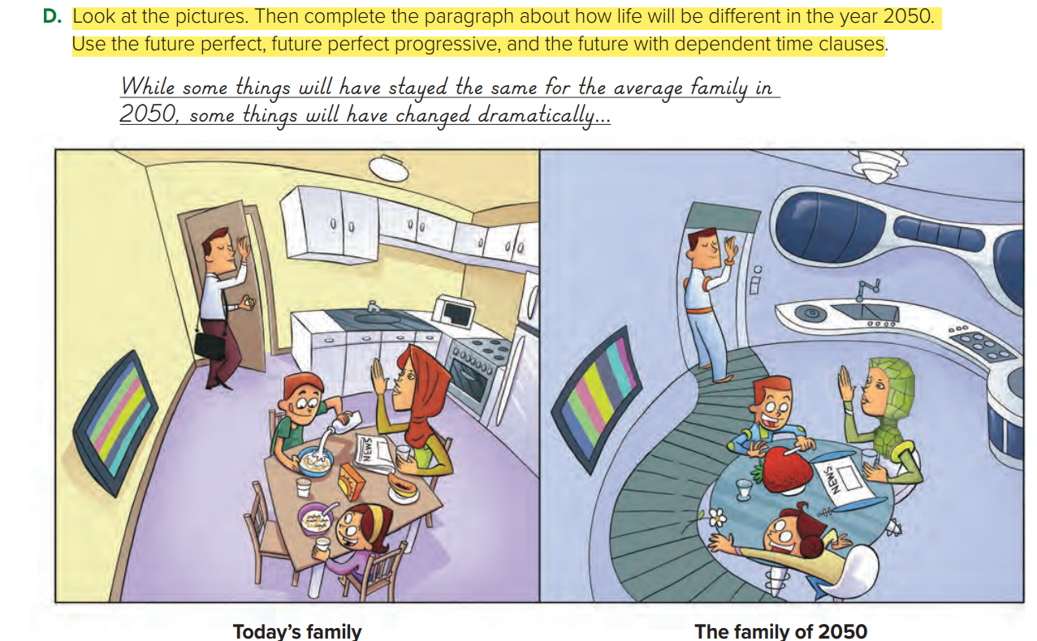

Slide 19


