Slide 1
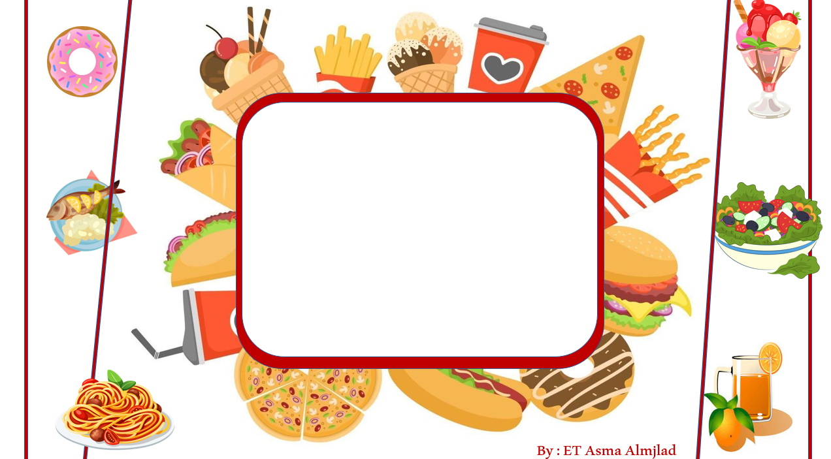
Day : Tuesday
Date: 25/3/1445

Slide 2
What do I need to buy?
Listen and discuss

Slide 3
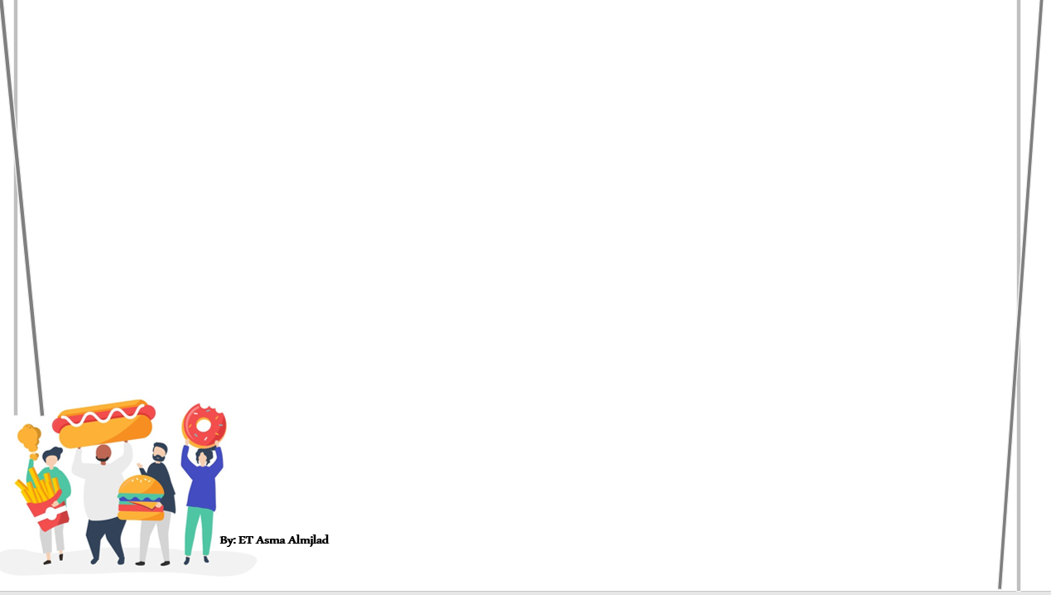
Check Homework
Match
1-Take your ticket and passport with you
A- after he does his homework.
2-He’s going to play football with his friends
B- when I go to the shopping mall.
3- I won’t spend a lot of money
C- before you leave for the airport.

Slide 4
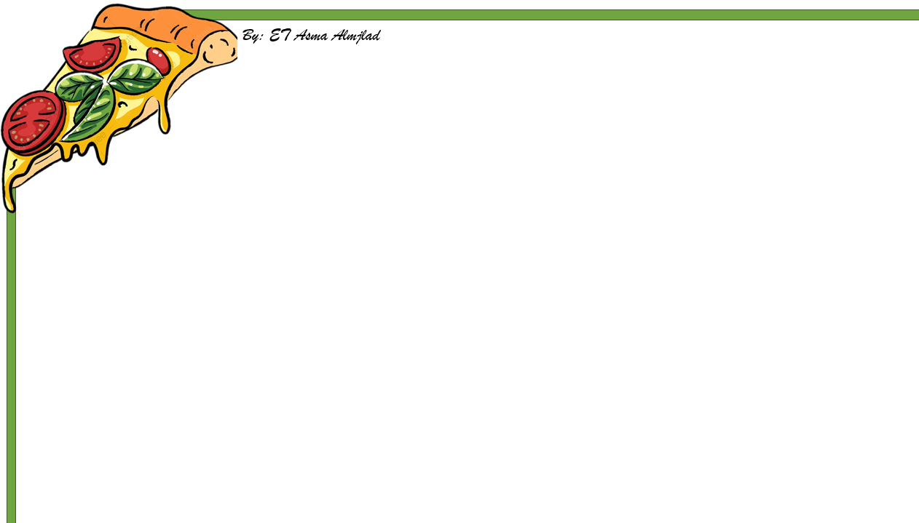
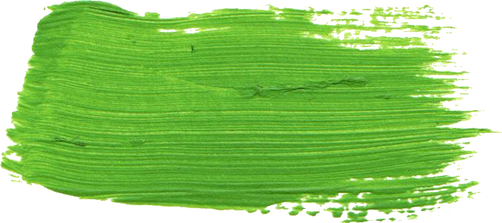
Revision
1-I ( read – reading – am reading) a book now
2-We ( are – is – am ) cooking a dinner now.
3- Richard ( makes - is marking - made ) a cake this afternoon
4-The students ( are playing - play - played ) tennis next Friday

Slide 5



Slide 6
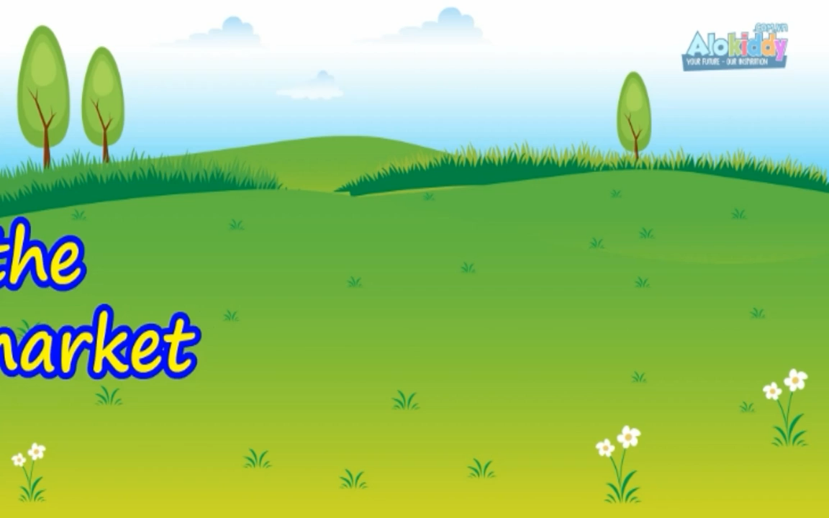

Slide 7
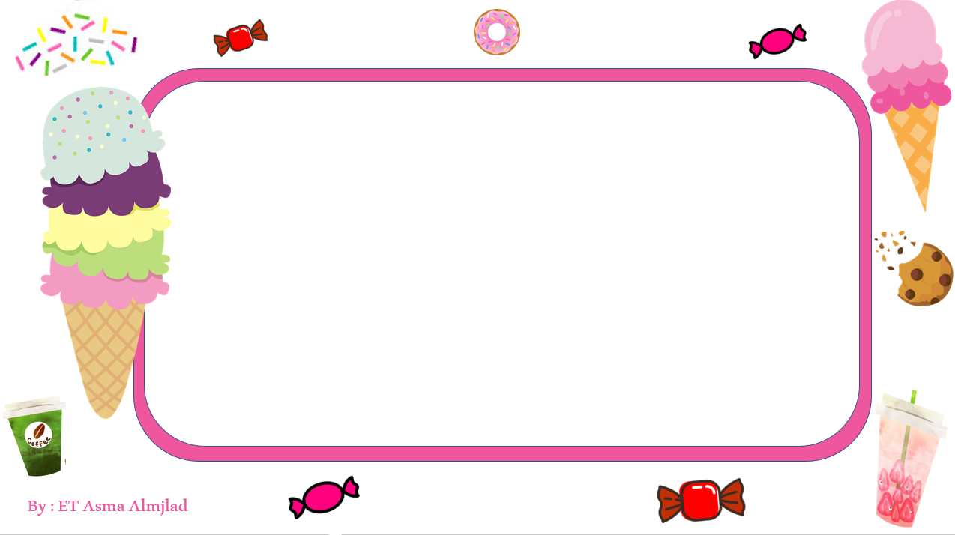
objectives
Talk about food , buying food , planning meals
Perform a conversation talking about food shopping and describing quantities

Slide 8
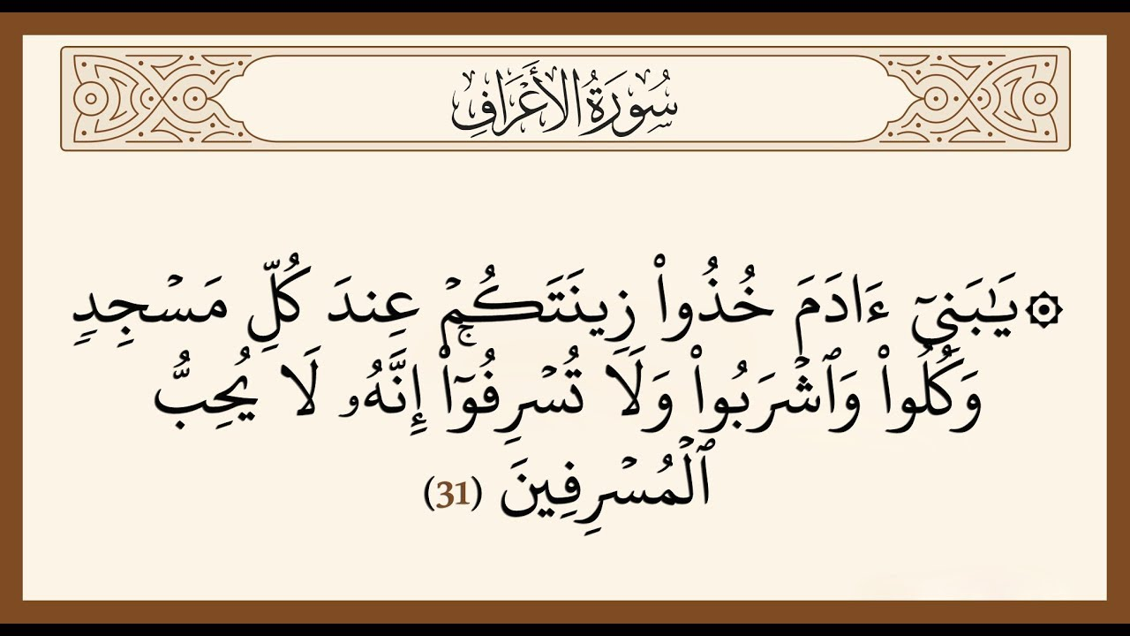

Slide 9


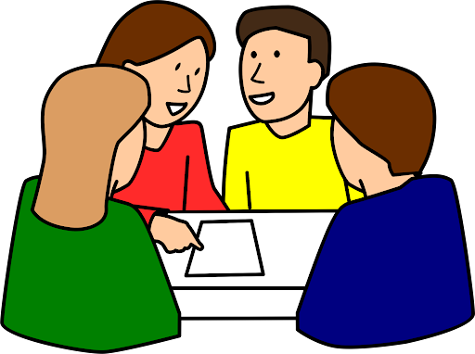
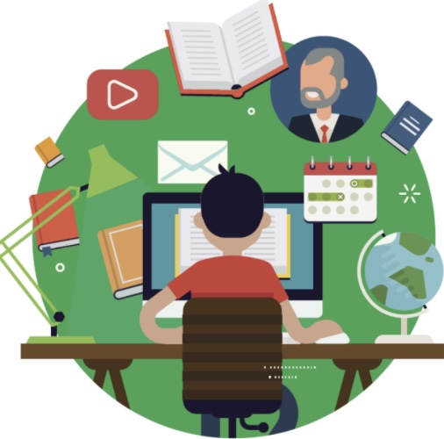



Slide 10
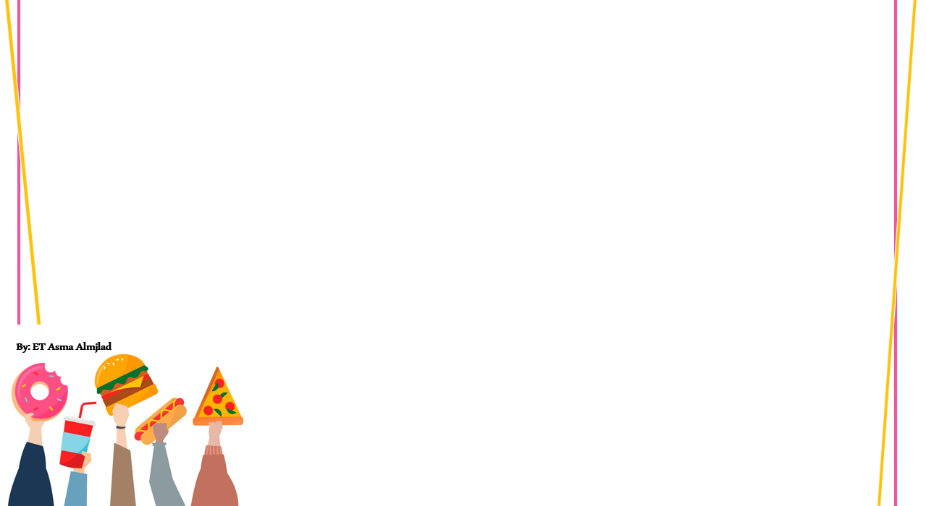

How often do you go to the supermarket ?
What do you usually buy?
Who buys the food and supplies in your family ?

Slide 11
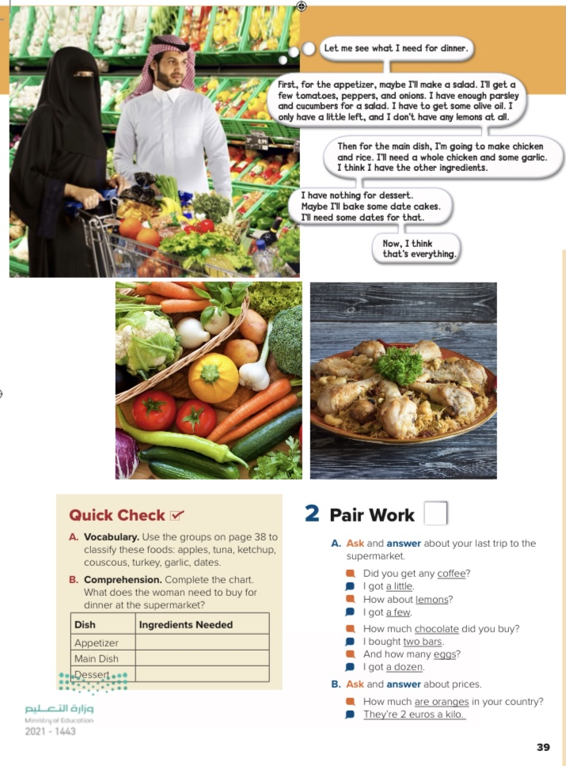
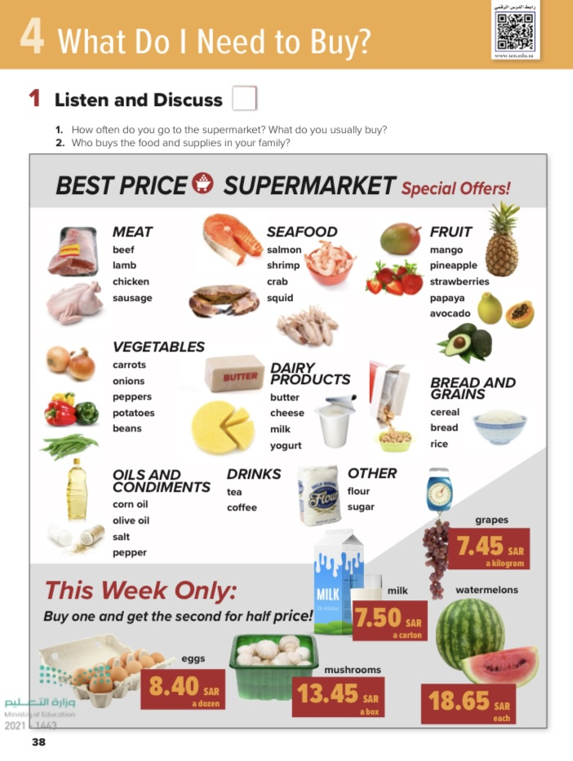
@ page 38 + 39
Pages 32-33

Slide 12
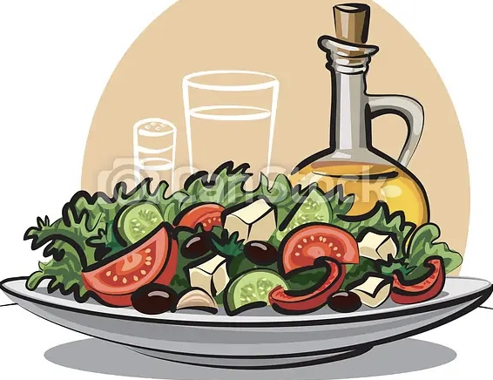
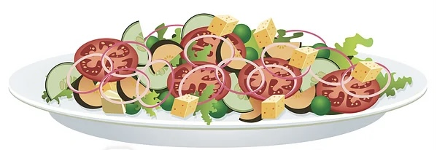
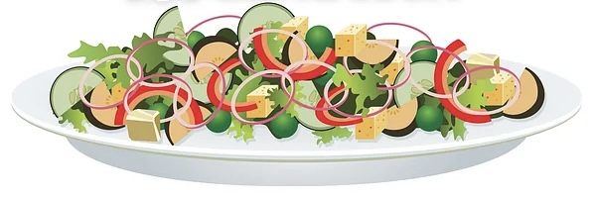
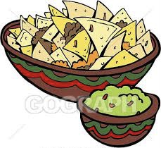
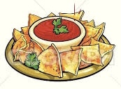
Appetizer

Slide 13
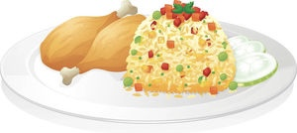
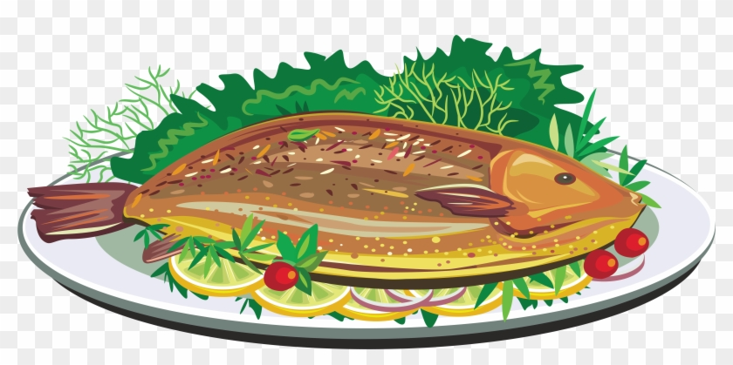
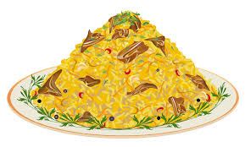
Main dish

Slide 14
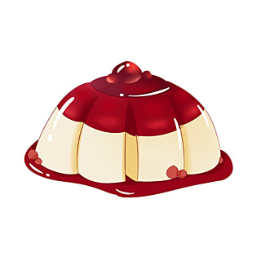


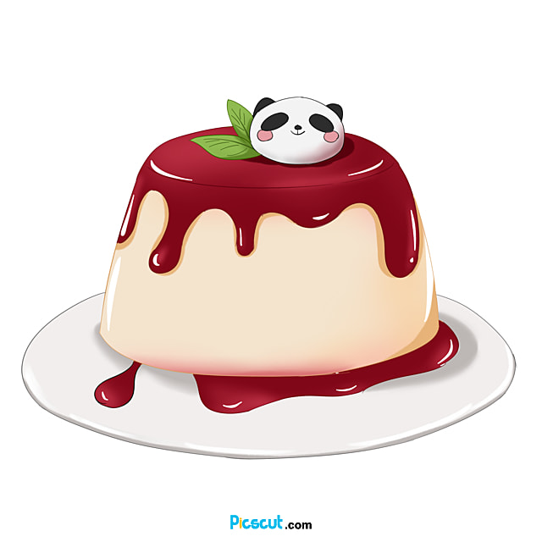

Dessert

Slide 15

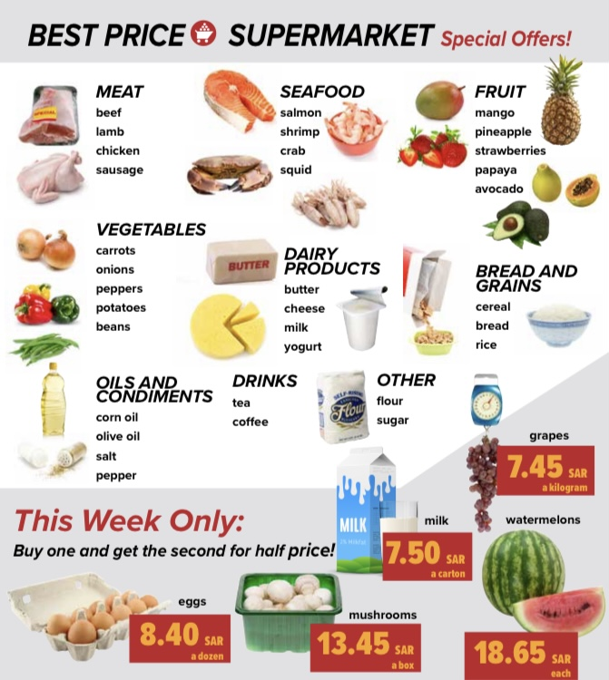

listen
How much is one kilogram of grapes?
How much is a watermelon?
How much are two cartons of milk?

Slide 16
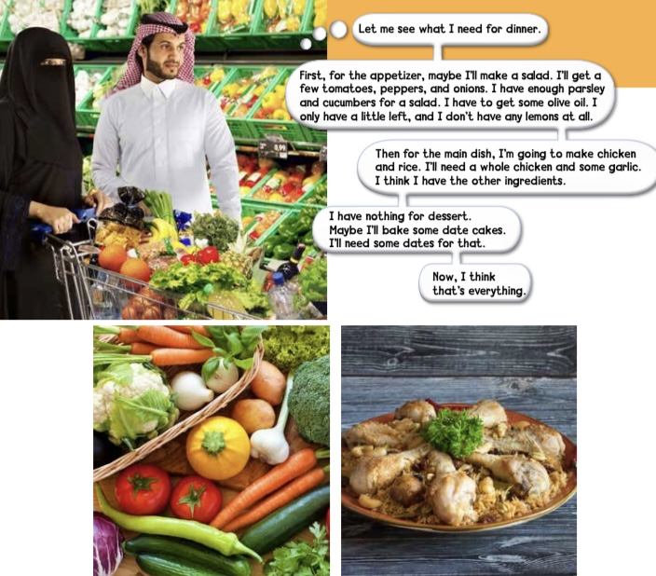
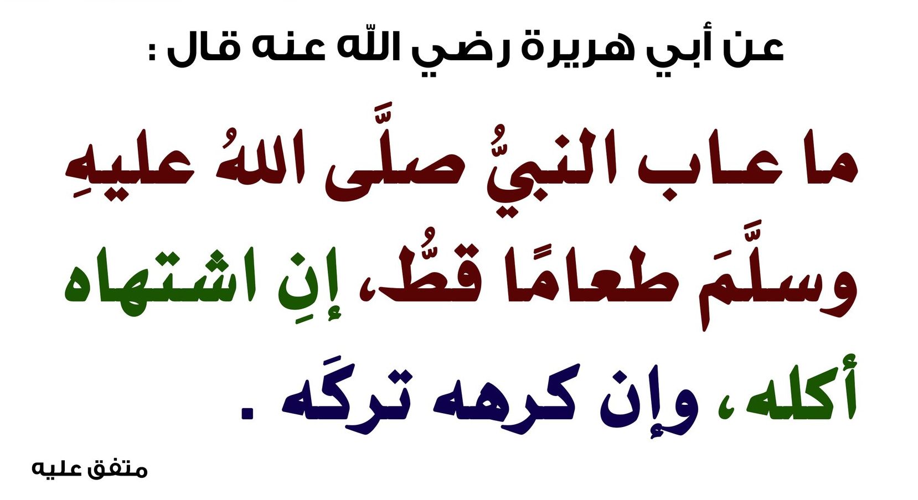
Where are they ?
What will she probably make for the appetizer?
What is she going to make for the main dish ?

Slide 17
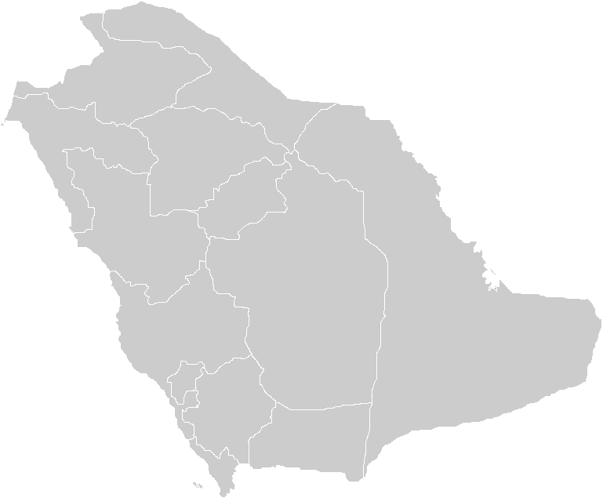
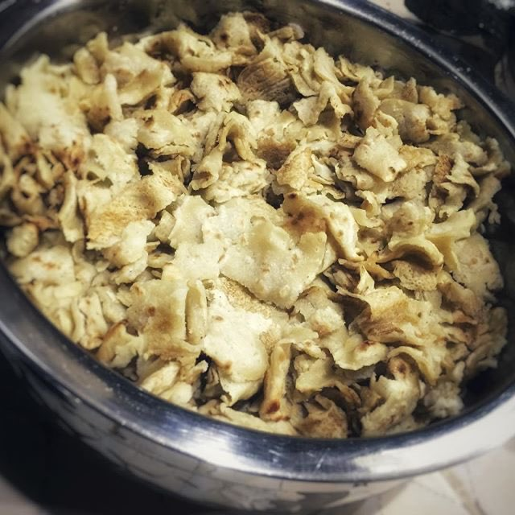
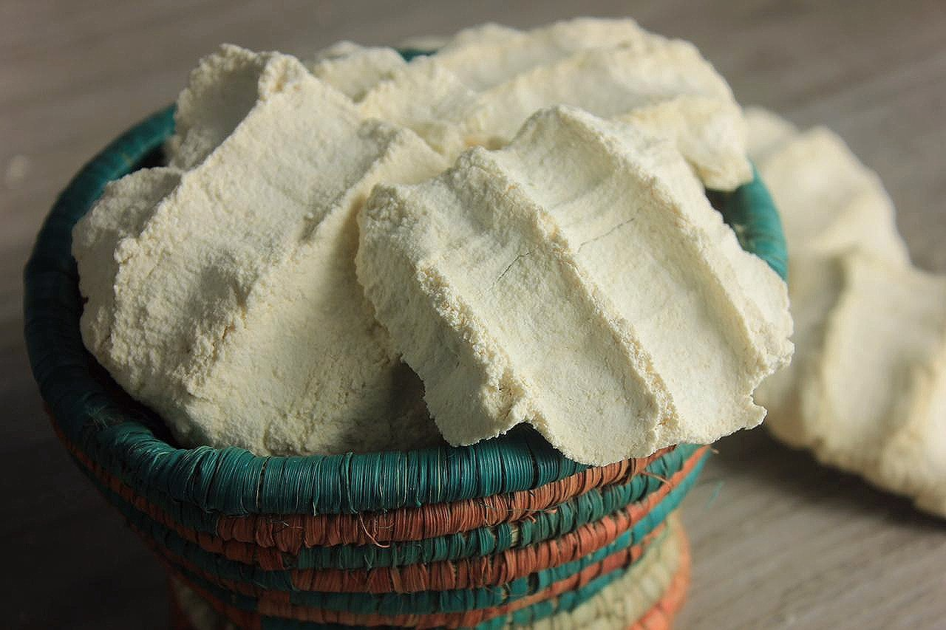
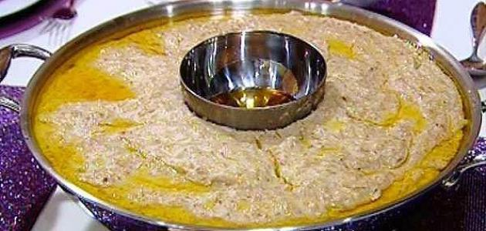
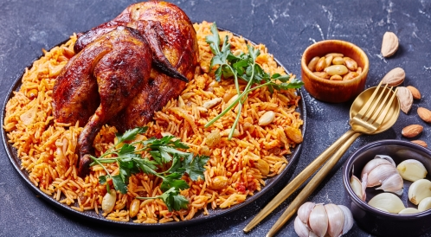
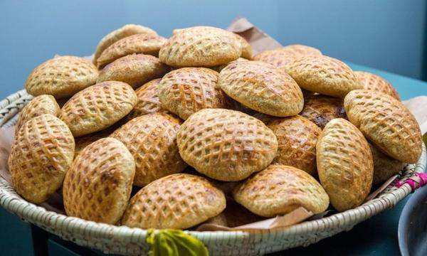
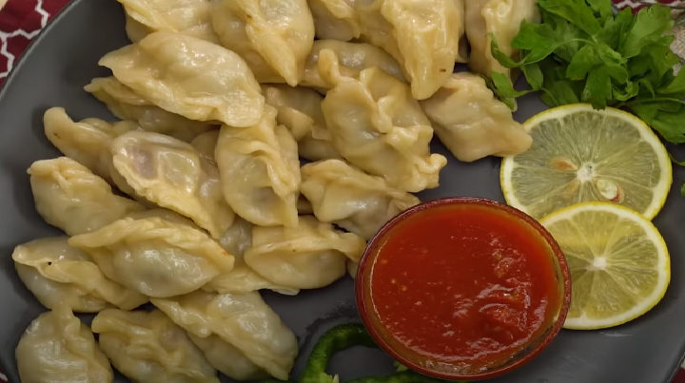
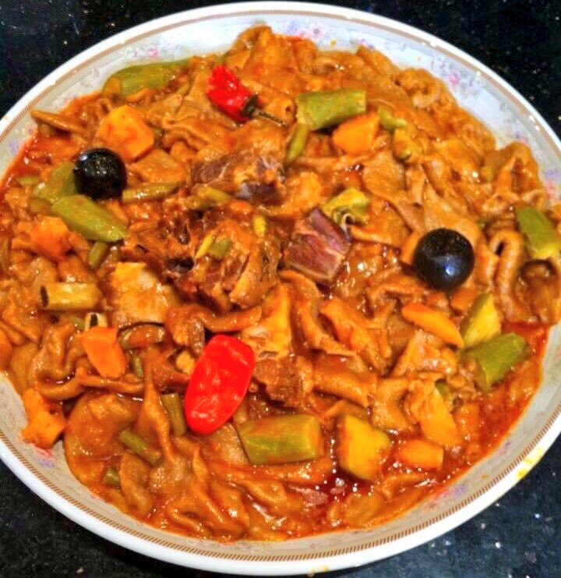
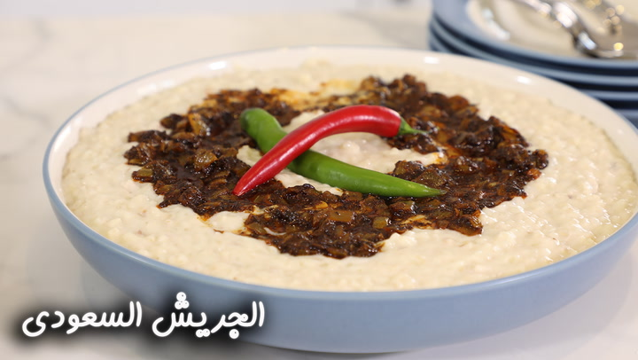
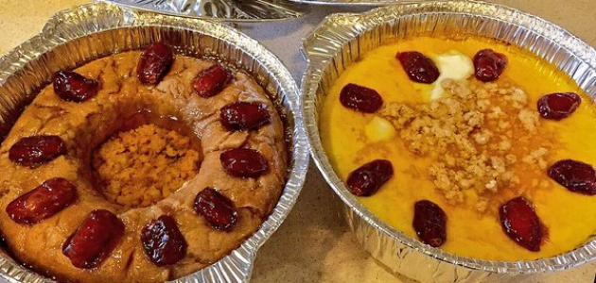
List some
Traditional dishes
in your country

Slide 18
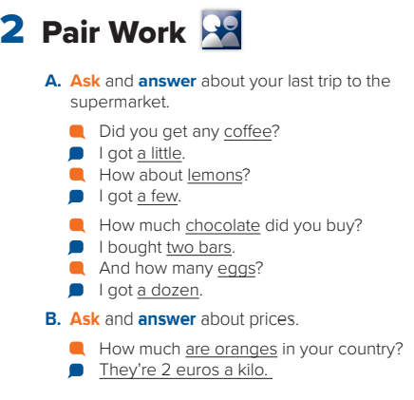

Slide 19
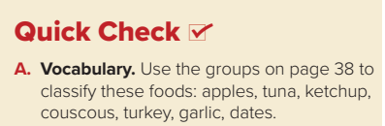
Oils and condiments
Bread and grains
meat
seafood
vegetables
fruits
garlic
apple , date
couscous
ketchup
turkey
tuna

Slide 20
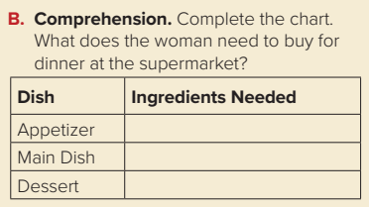
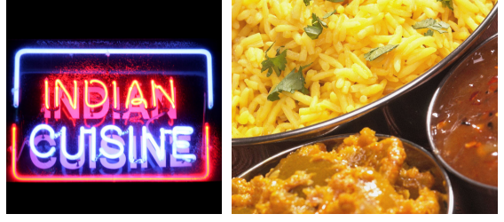
tomatoes, peppers, onions, olive oil, lemons
a whole chicken, some garlic
dates

Slide 21

Search on the internet about Nutritional value
Salman
Milk
Avocado

Slide 22
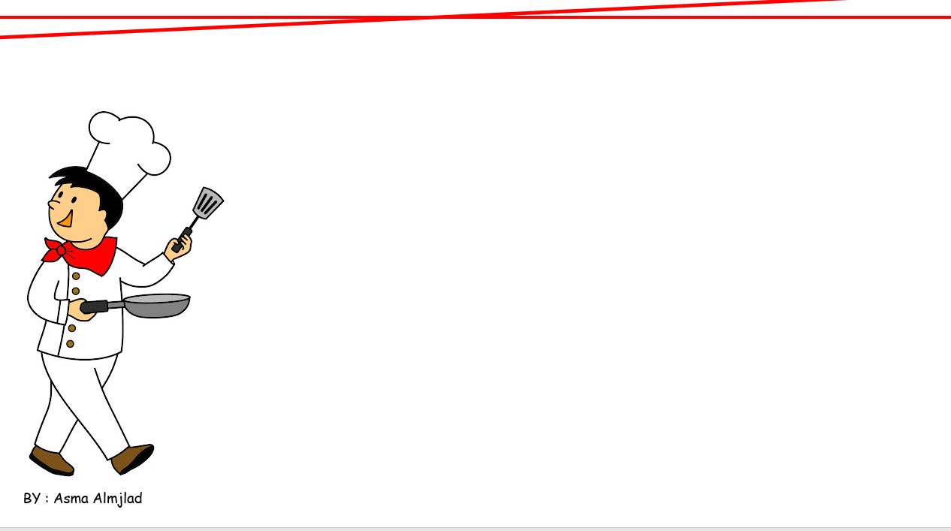
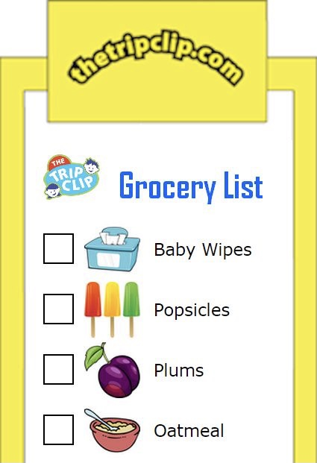
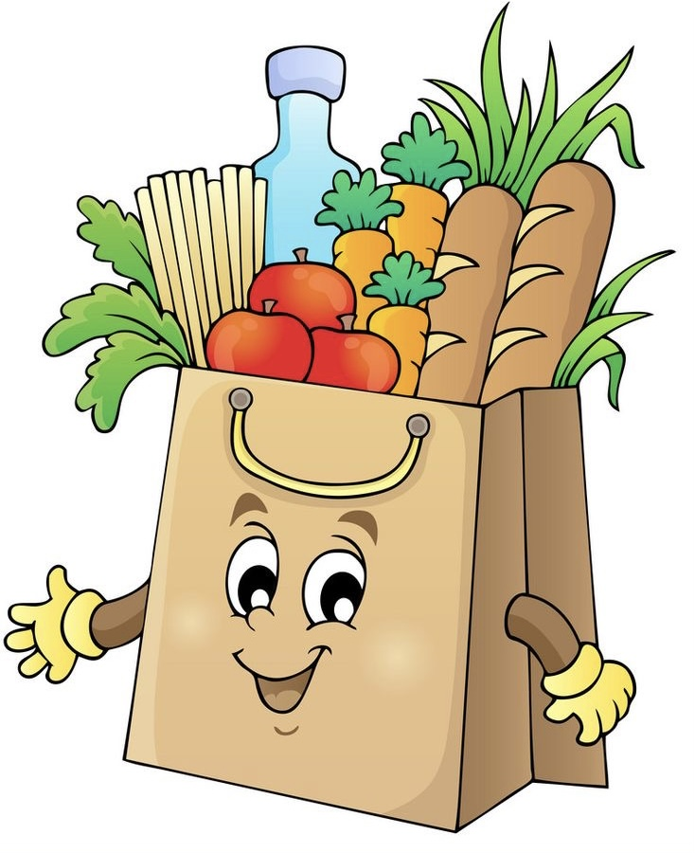
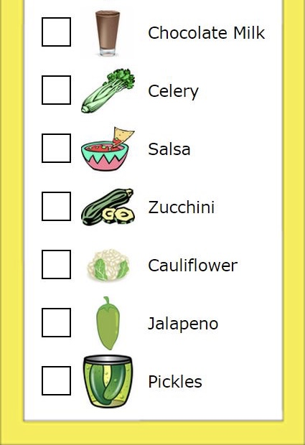
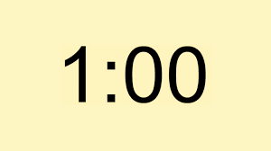
Prepare
the shopping list

Slide 23
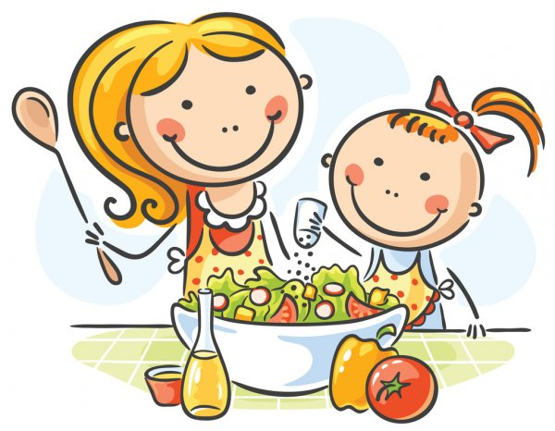


Slide 24
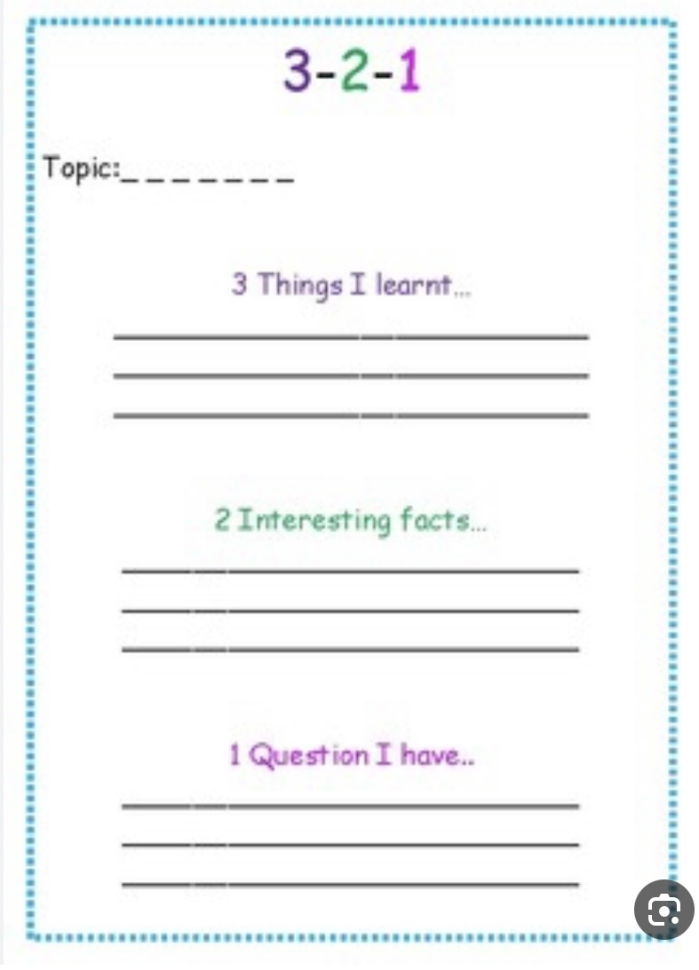

Slide 25


Slide 26


H.W
A- B
185

Slide 27


