Slide 1
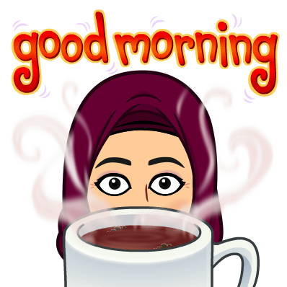
Good Morning
Mega Goal 2.1

Slide 2
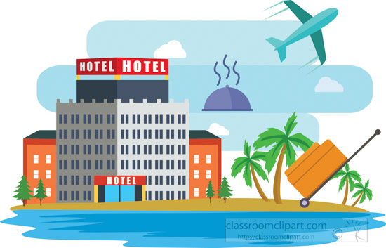
Good Morning
Mega Goal 2.1
Unit -3-
Far and Away
Listening
Pronunciation
Conversation
Vocabulary Building

Slide 3
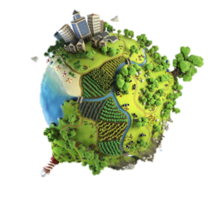
Unit -3-
Far and Away
Listening
Pronunciation
Vocabulary Building
Good Morning
Mega Goal 2.1

Slide 4
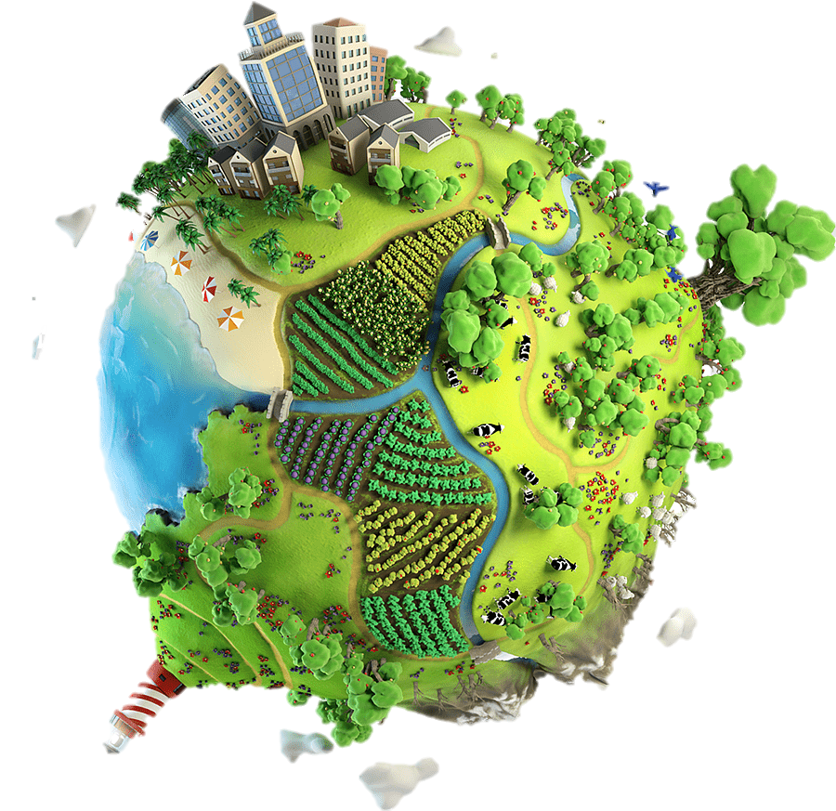
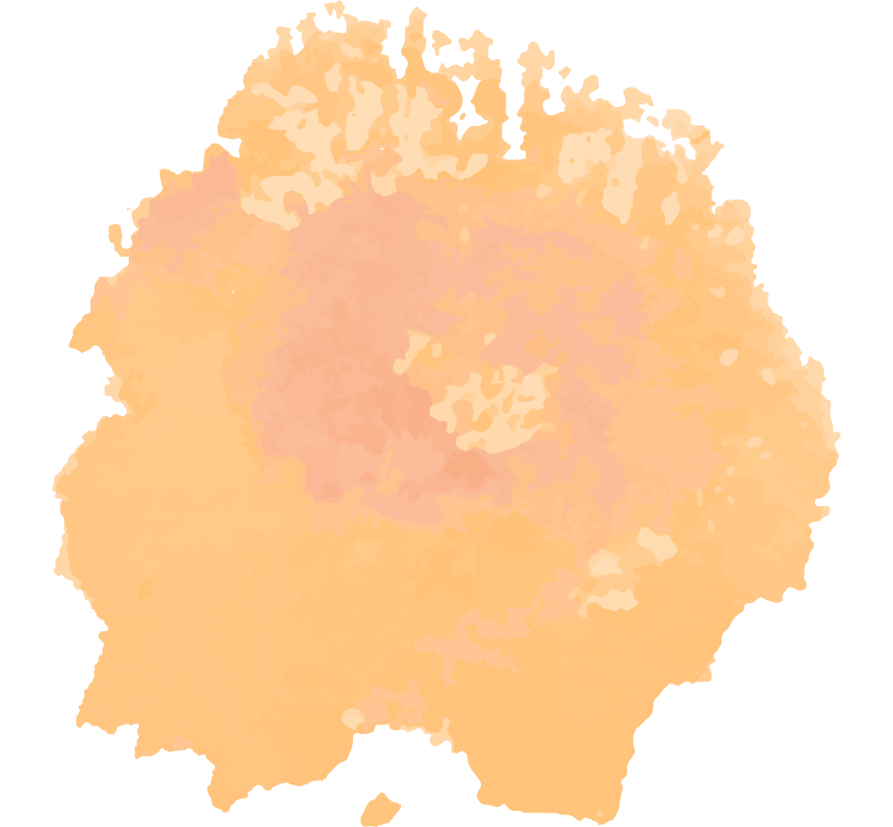

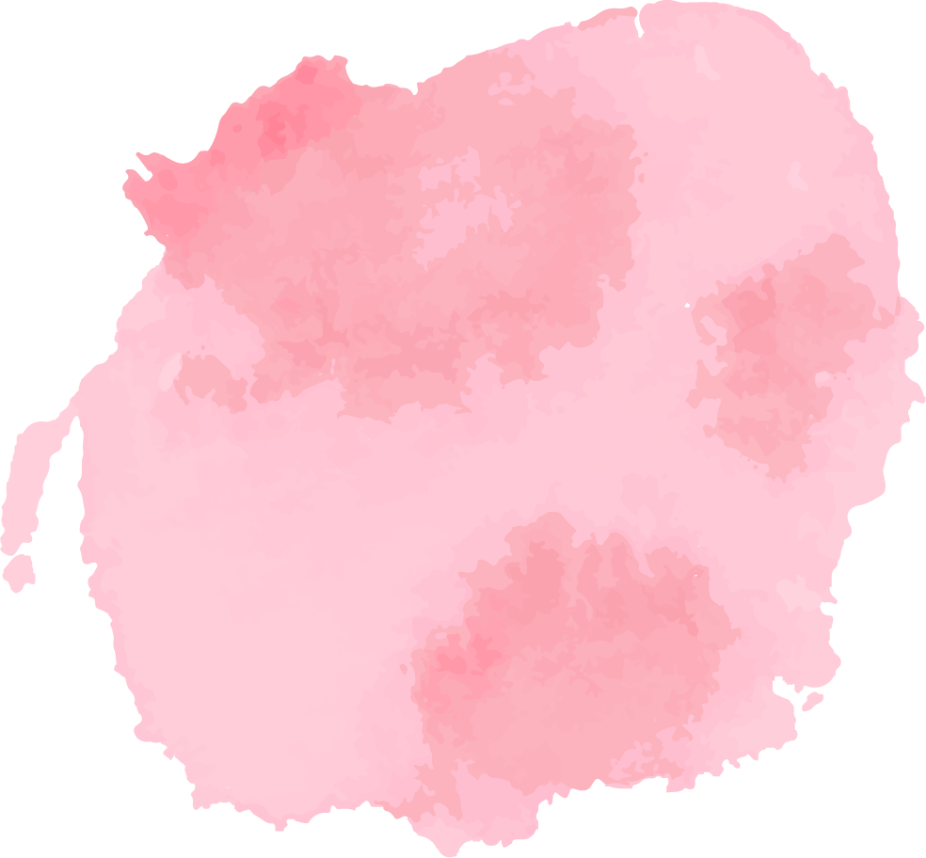
Objectives:
1
2
3
Name stuff to take along when traveling
Use the new words in a conversation .
Use the “ real talk " phrases in new sentences
4
5
Declining special requests.
Make special requests

Slide 5


Slide 6
Listening
Good Morning
Mega Goal 2.1

Slide 7
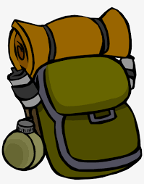
Have you ever gone on a backpacking trip?
Listening

Slide 8


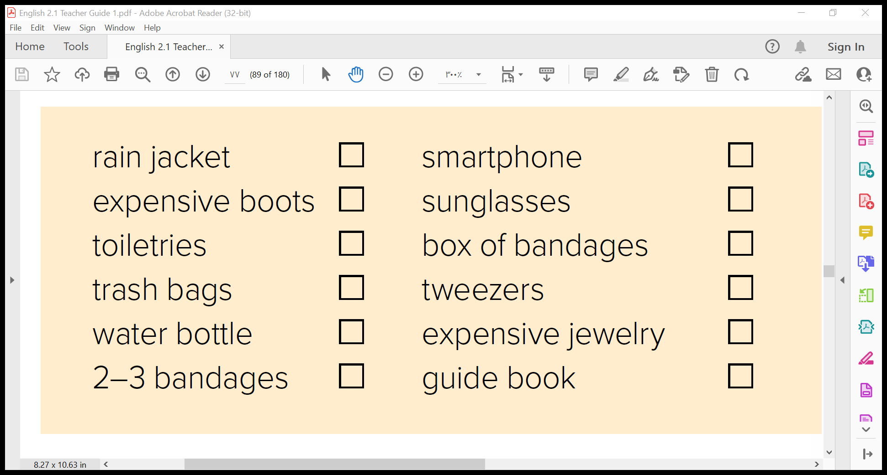
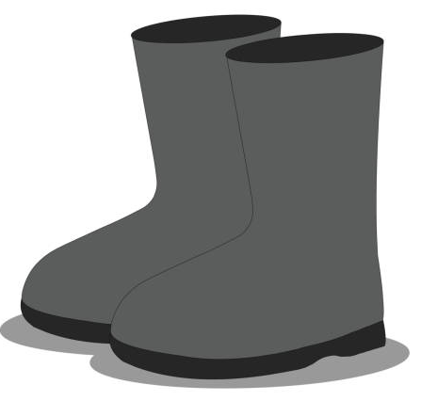
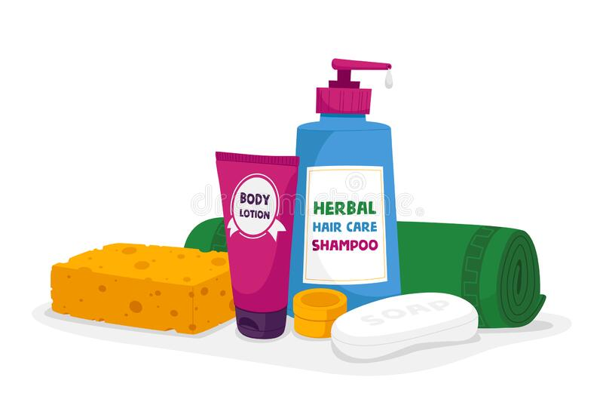
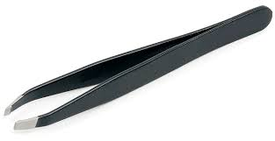

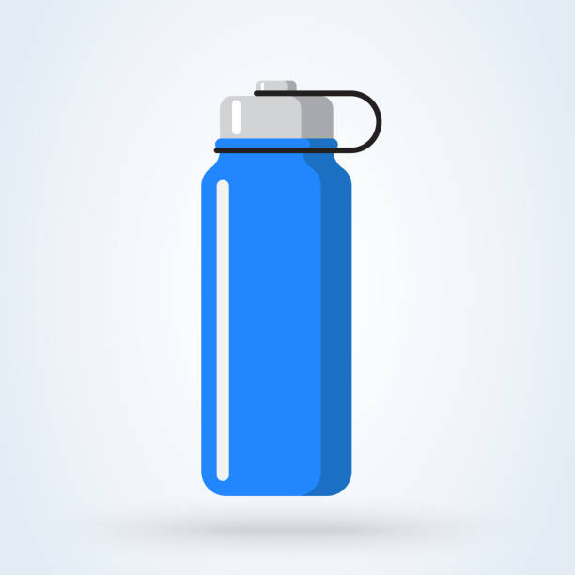
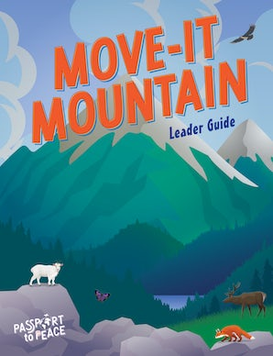

Study these Words

Slide 9



Listen to the experienced traveler talk about what
to pack for a backpacking trip through Europe.
Tick the items he recommends bringing.

Slide 10
Pronunciation

Slide 11
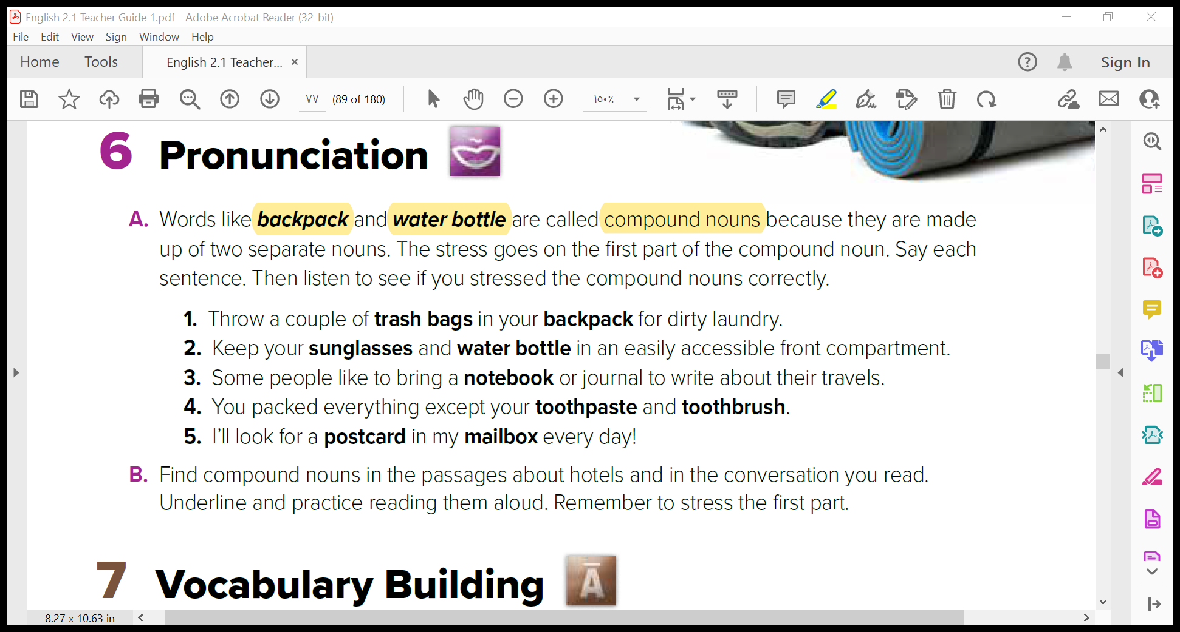
Pronunciation

Slide 12
Vocabulary Building
Good Morning
Mega Goal 2.1

Slide 13
A. You will see these words in the reading on pages 40 and 41.
Match the words with their meanings.
1. ______ pristine a. the action of cutting down trees to clear forests
2. ______ preserve b. distinguishing traits or qualities
3. ______ conservation c. something that causes a person to act
4. ______ incentive d. abundantly green, fertile
5. ______ deforestation e. careful protection of something
6. ______ characteristics f. to keep safe from injury, harm, or destruction
7. ______ remote g. lessening, diminishing
8. ______ reduction h. geographically isolated
9. ______ lush i. not spoiled
i
f
e
c
a
b
h
g
d
Vocabulary Building

Slide 14


