Slide 1
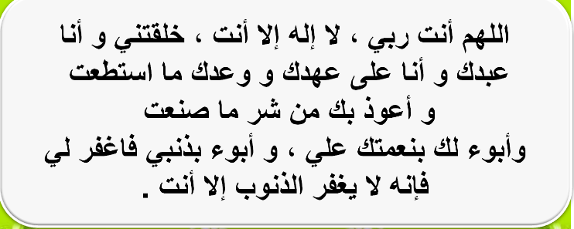

Slide 2


Good Morning

Slide 3
Unit-4-
The Art of Advertising
L1 Listen & Discuss
Pair Work L2

Slide 4


L1 Listen & Discuss
Objectives:
1
Recall a favorite advertisement
2
Compare two different advertisements
3
List words that describe (the car-suit case -the suitcase)
4
Ask and answer about a product)
5
Choose words that are related to a picture
6
Use the term "standard" correctly
7
Find out how a statement is correct
8
Write reasons why a product is special

Slide 5
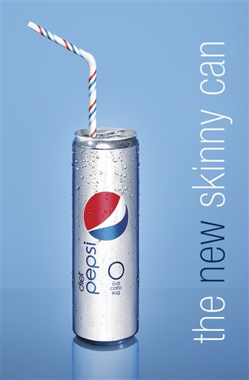


L1 Listen & Discuss

Slide 6

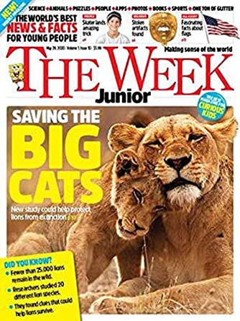

Slide 7
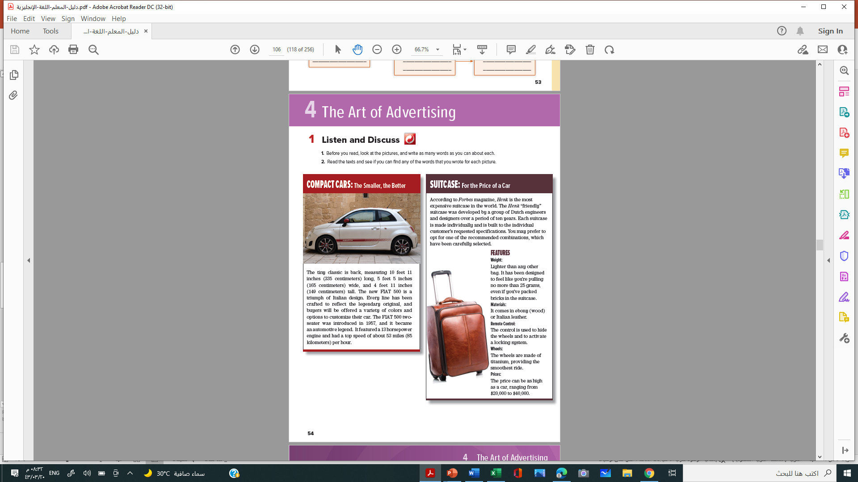
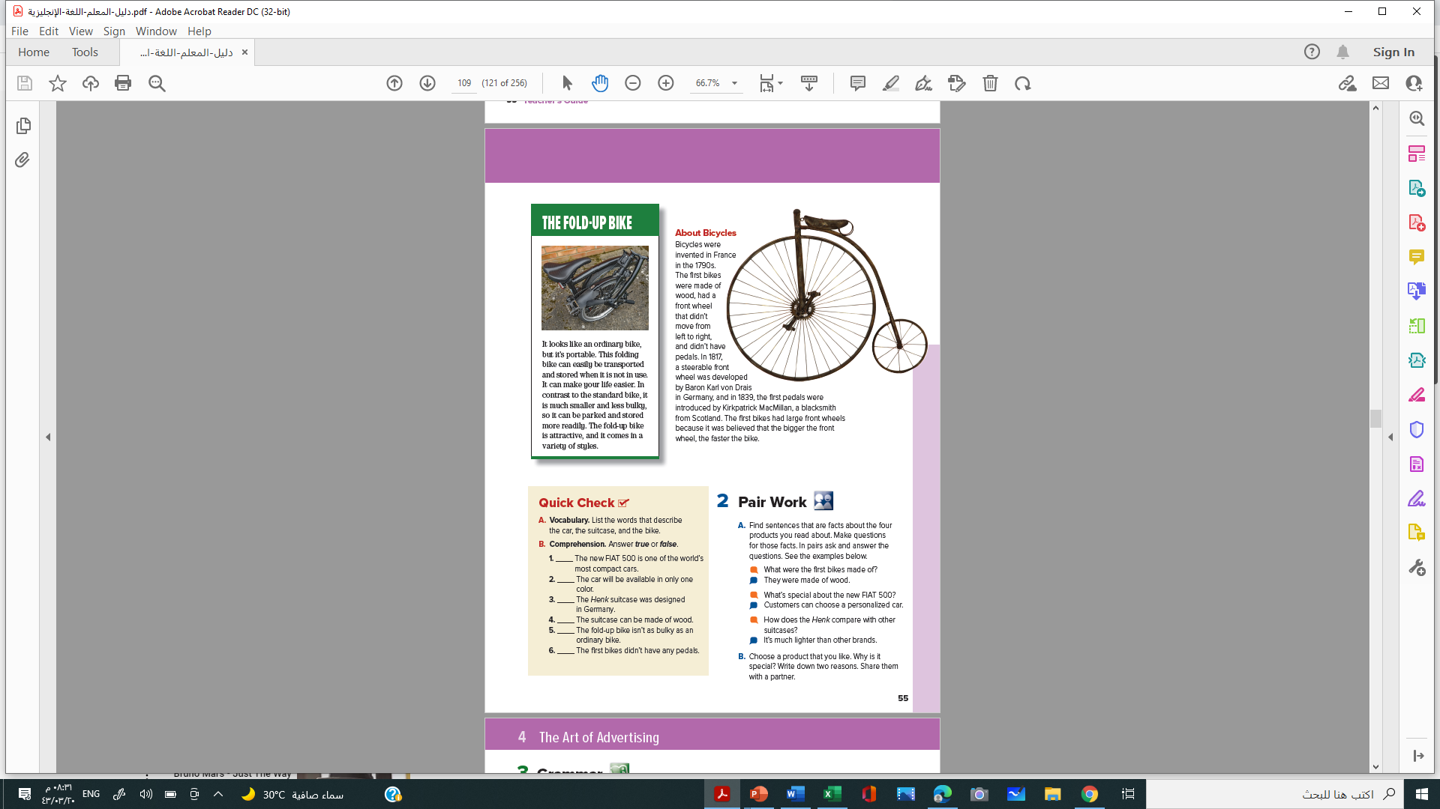

Student Book
P.48-49

Slide 8


Skimming
1. Before you read, look at the pictures, and write as many words as you can about each.
2. Read the texts and see if you can find any of the words that you wrote for each picture.

Slide 9
Scanning
1. What is each photo of?
2-How would you describe the product in each ad?
3-How is the old bicycle at the top of page 55 different from bicycles today?

Slide 10
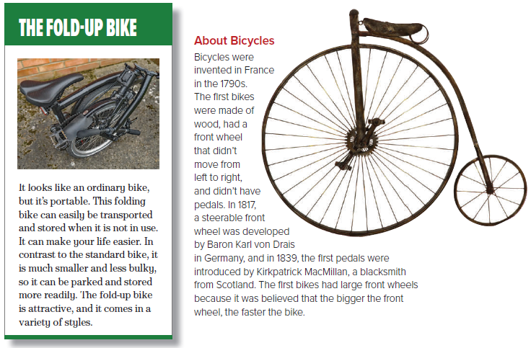

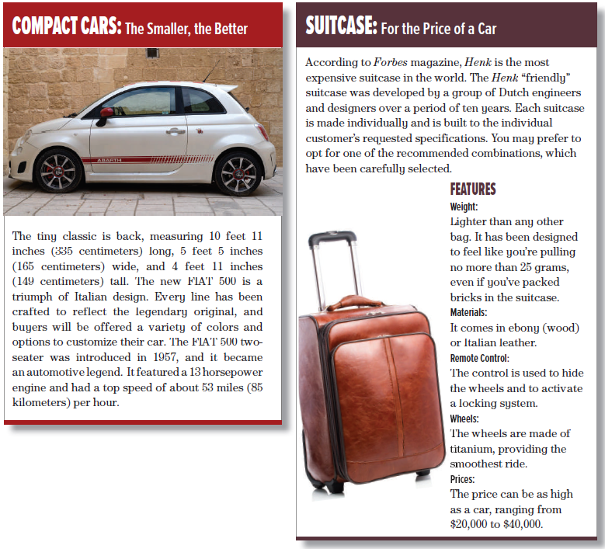


Slide 12
Quick Check
A. Vocabulary.
List the words that describe the car, the suitcase, and the bike.
Car: tiny classic, new
Suitcase: most expensive, “friendly,” lighter than any other bag, price as high as a car
Bike: portable, smaller and less bulky, attractive

Slide 13
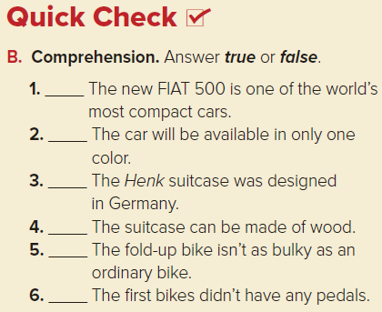
T
F
F
T
Pair Work. L2
T
T

Slide 14
Pair Work. L2

Slide 15

A-Find sentences that are facts about the four products you read about. Make questions for those facts. In pairs ask and answer the questions. See the examples below.
What were the first bikes made of?
They were made of wood.
What’s special about the new FIAT 500?
Customers can choose a personalized car.
How does the Henk compare with other suitcases?
It’s much lighter than other brands.
B. Choose a product that you like. Why is it special? Write down two reasons. Share them with a partner

Slide 16

يا بَنِي آدَمَ خُذُوا زِينَتَكُمْ عِندَ كُلِّ مَسْجِدٍ وَكُلُوا وَاشْرَبُوا وَلَا تُسْرِفُوا ۚ إِنَّهُ لَا يُحِبُّ الْمُسْرِفِينَ (31)

Slide 17


