Slide 1


5
Unit:3
Lesson:1

Slide 2
Today is Sunday
The date is 24/02/1442 A.H
sports and activities

Slide 3
Let’s revise
Phonics
(oa-ow) (ou-ow)

Slide 4

Playing game Strategy
By
Quizizz
Open the app and write
the code
Then answer
sports and activities

Slide 5
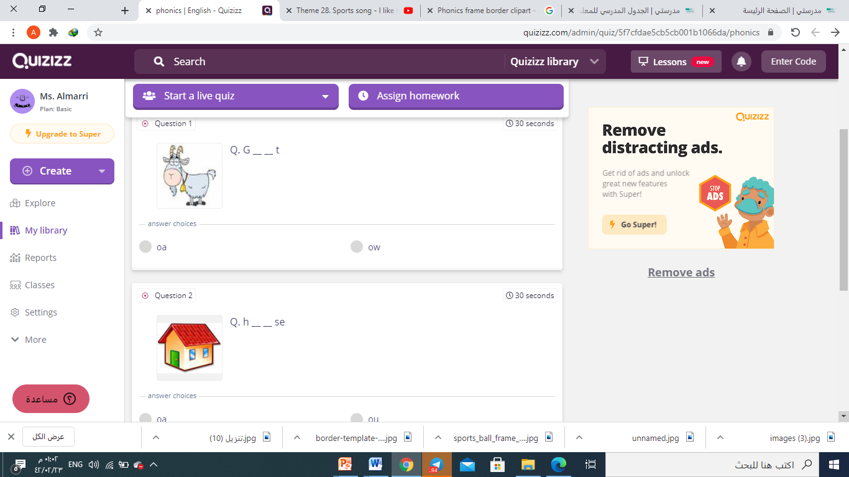
sports and activities

Slide 6
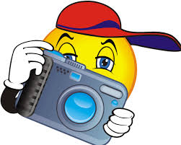
Camera Shot Strategy
Watch the video and
Try to shot some information
in your mind

Slide 7
Unit:3
Lesson:1
Sports and activities
Pages: 18-19

Slide 8
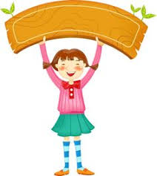
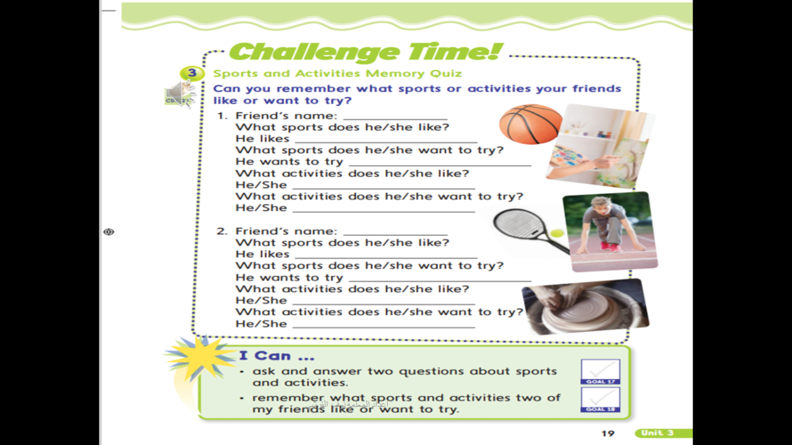
At the end of the lesson :

Slide 9
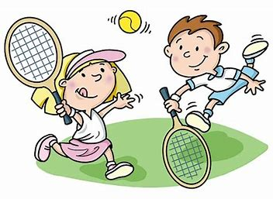
Common Sports
tennis

Slide 10

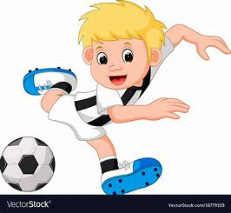
Common Sports
football

Slide 11
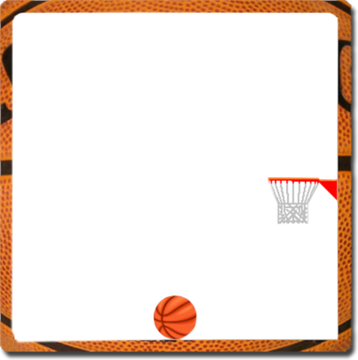
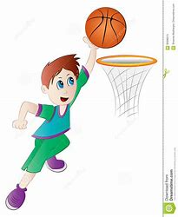

Common Sports
basketball

Slide 12
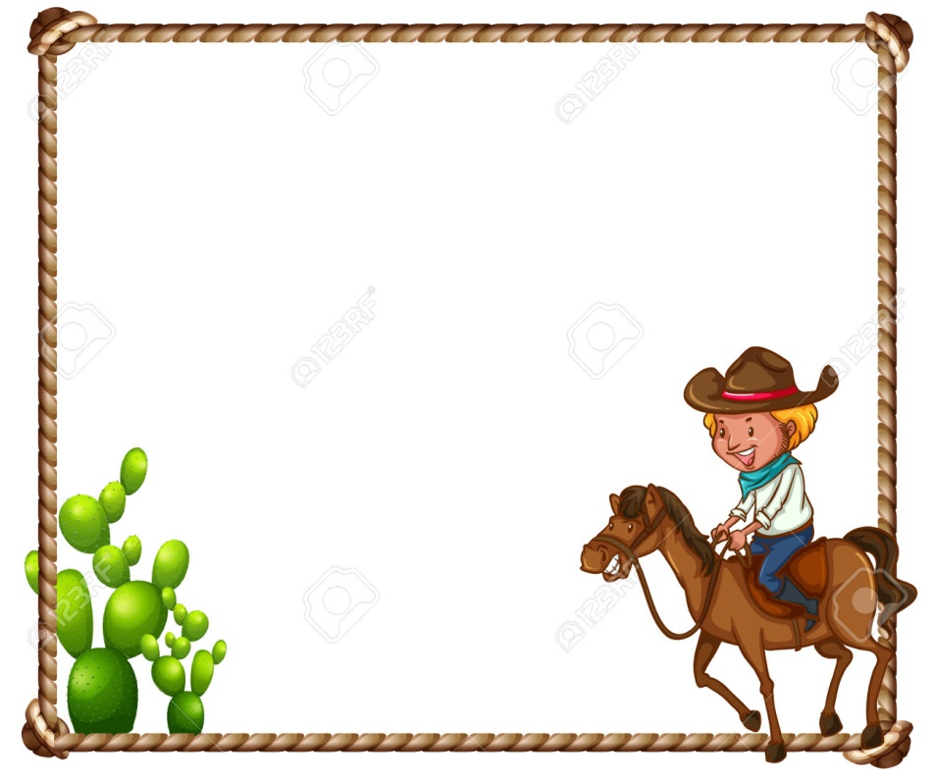
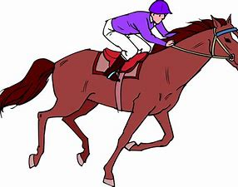
Common Sports
Horse riding

Slide 13


Slide 14

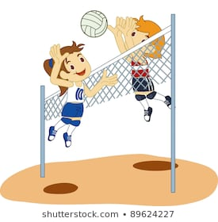
Common Sports
volleyball

Slide 15

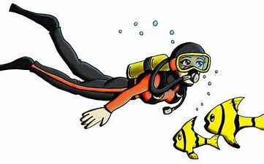
Dangerous Sports
Scuba diving

Slide 16
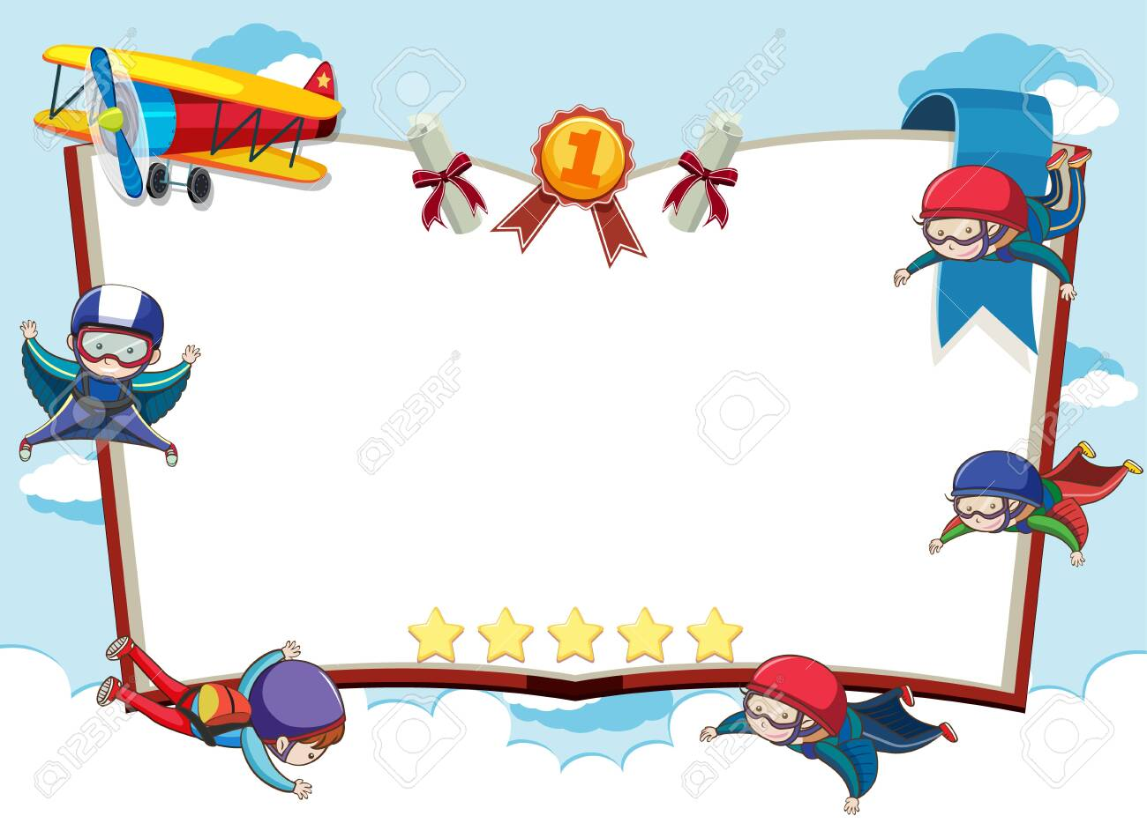
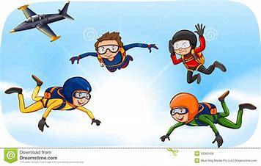
Dangerous Sports
Sky diving

Slide 17
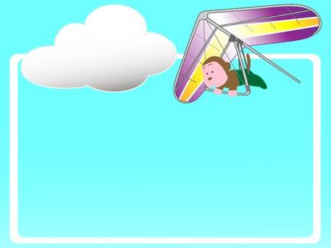
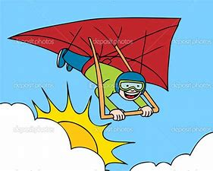
Dangerous Sports
Hang gliding

Slide 18
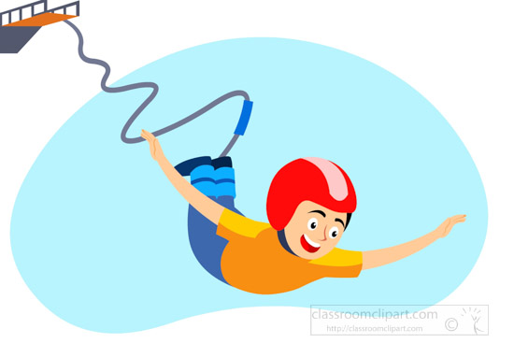
Dangerous Sports
Bunjee jumping

Slide 19
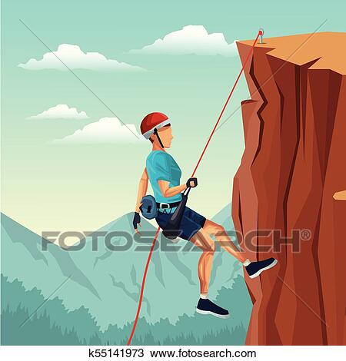
Dangerous Sports
rock climbing

Slide 20
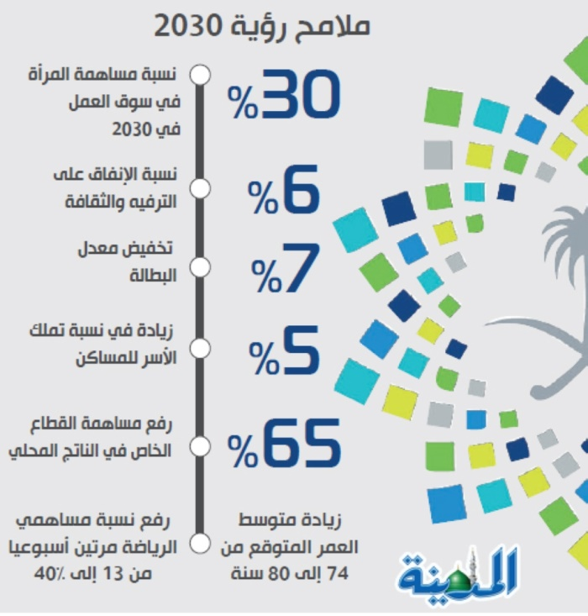


Slide 21
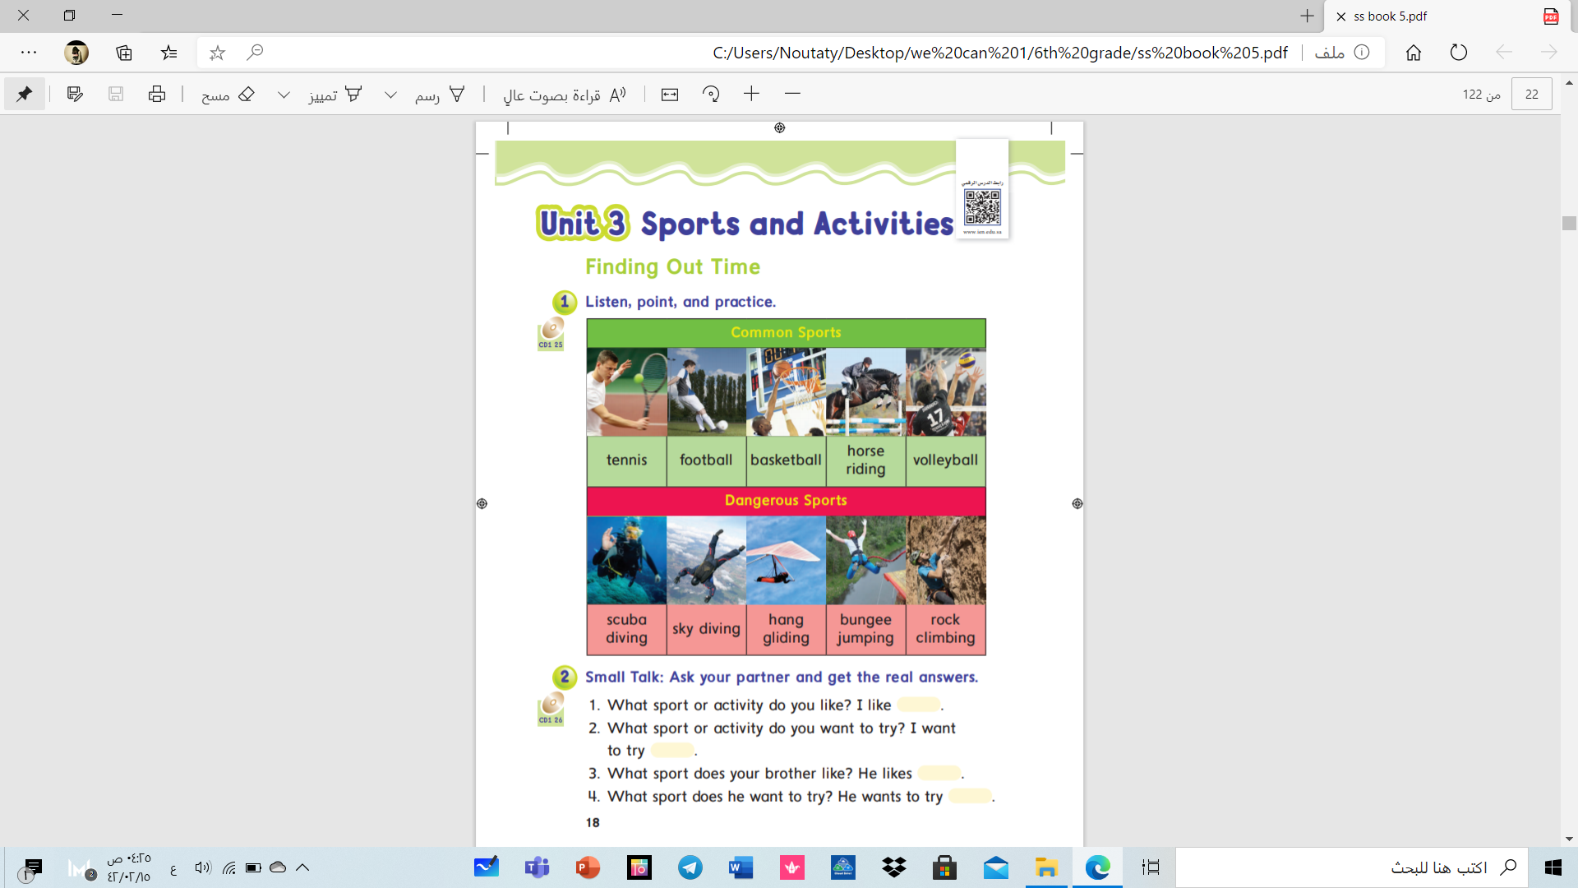

sports and activities

Slide 22
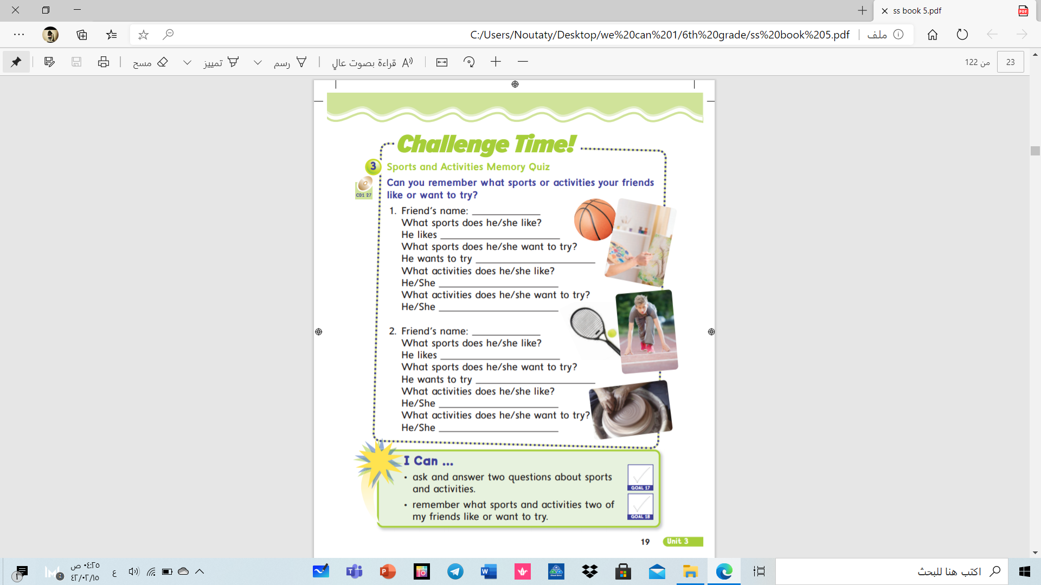

Slide 23
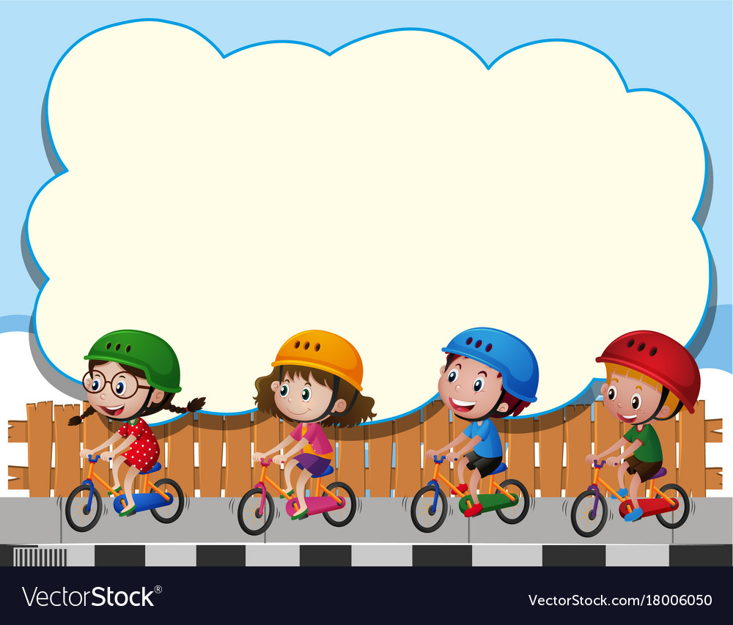
Dangerous Sports
What sport or activity do you like?
I Like _______________
What sport or activity do you want to try?
I want to try__________
rock climbing

Slide 24
What sport or activity does your sister like?
She Likes _______________
What sport or activity does she want to try?
She wants to try__________

Slide 25
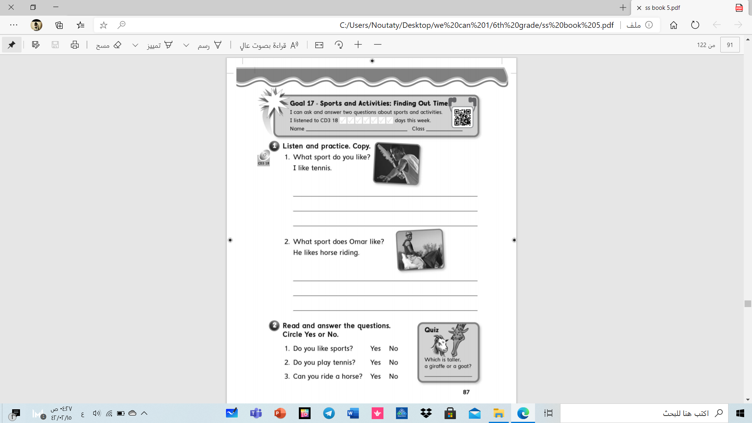

Slide 26
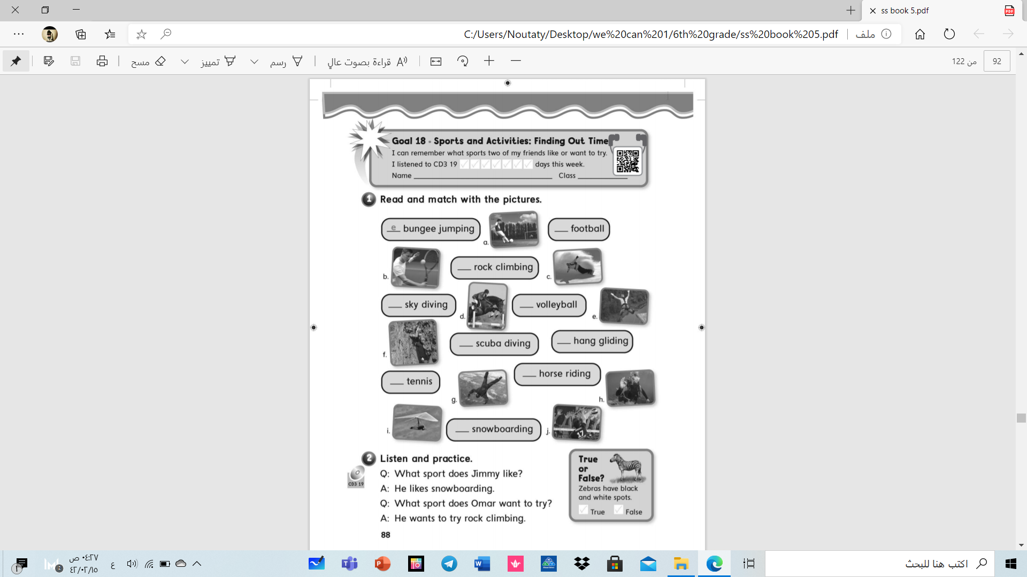

Slide 27
Have a nice day .
Miss.Aljazi

