Slide 1
Mega Goal 2.1
Unit 3
Far & Away
L7: Vocabulary Building
Flash Cards
Designed and done by T. Talal Alhazmi
Done by T. Talal Alhazmi

Slide 2


not spoiled
pristine
to keep safe from injury, harm, or destruction
preserve
careful protection of something
conservation
something that causes a person to act
incentive
deforestation
the action of cutting down trees to clear forests
characteristics
distinguishing traits or qualities
geographically isolated
remote
lessening, diminishing
reduction
lush
abundantly green, fertile
Done by T. Talal Alhazmi

Slide 3
Mega Goal 2.1
Done by Talal Alhazmi

Slide 4
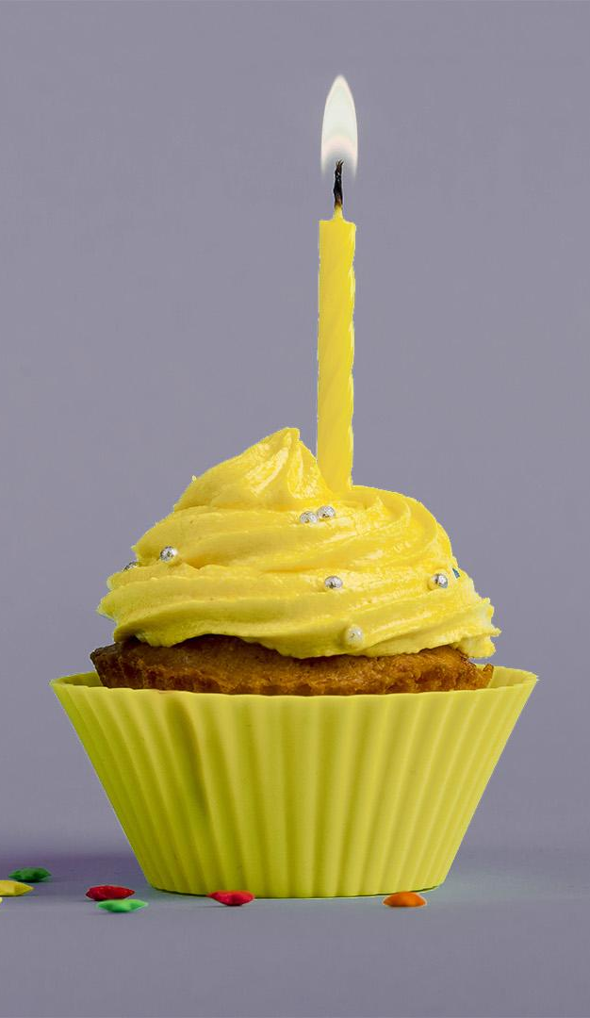
Term of use
License Agreement
This PowerPoint project, including game slides and associated content is a copyrighted to Teacher. Talal Alhazmi.
Do not submit copies or modifications of this project to any website that requires sign in or paid subscription.
You may download the PowerPoint, make archival copies, and customize the project only for your personal use or use within your school and not for resale.
Don’t allow to delete my name.

