Slide 1


Unit 4
What do I need to buy?
Writing
PRESENTATION BY: SLIDECORE

Slide 2

بسم الله الرحمن الرحيم
Day
Date

Slide 3
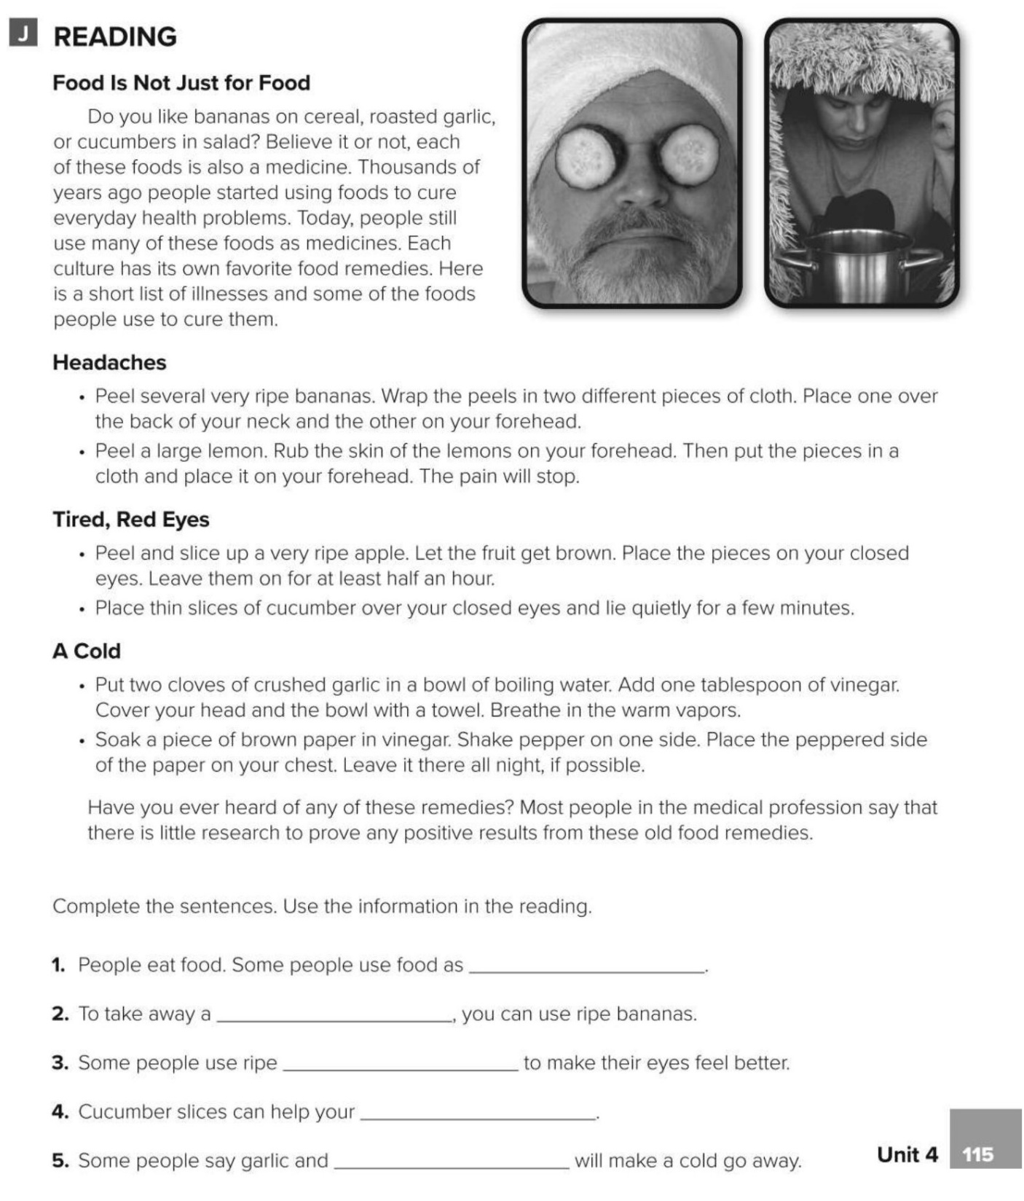
medicines
headache
apples
eyes
vinegar

Slide 4
Learning Objectives
use sequence words to show the order
01
write favorite meal ingredients & directions
02
write a recipe of meal & illustrate it.
03

Slide 5
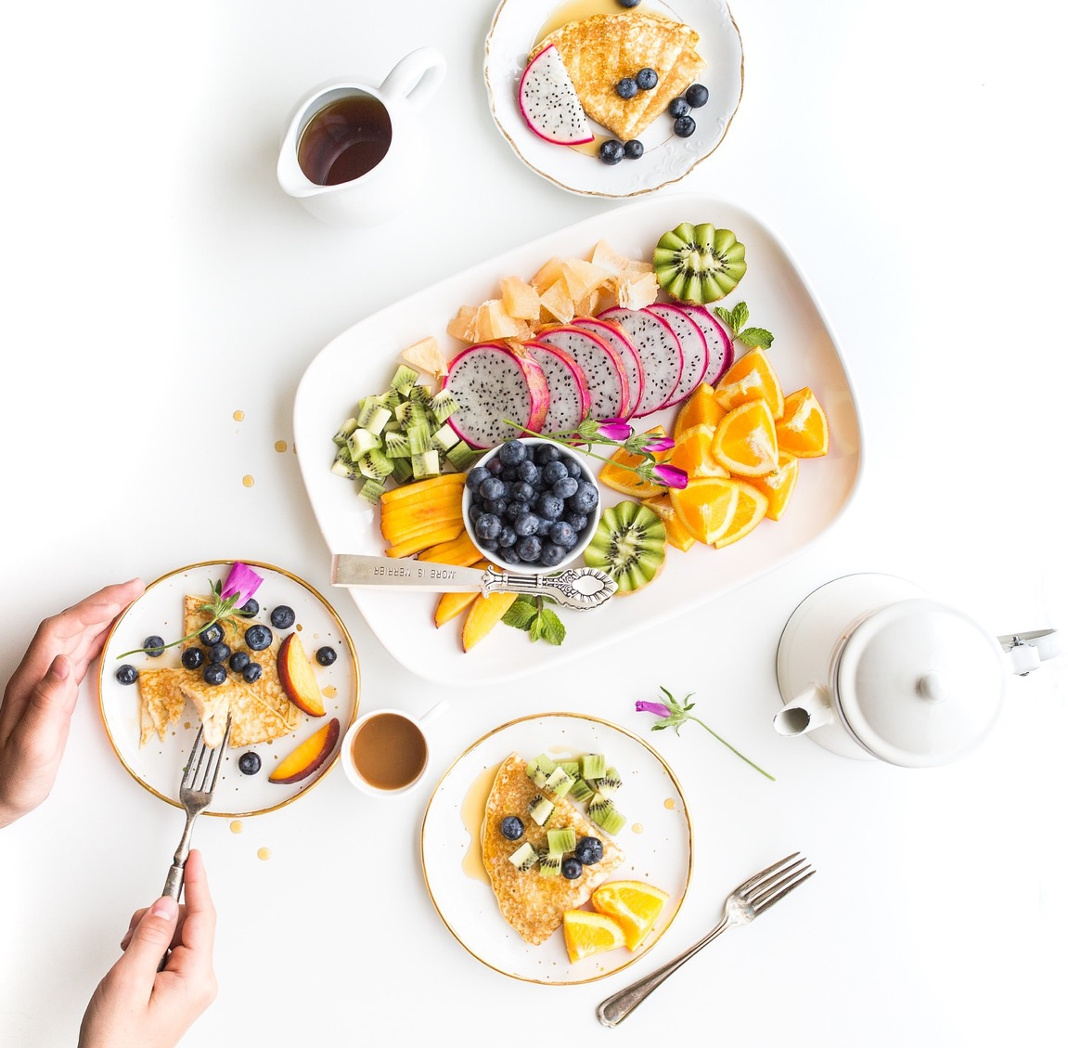

PRESENTATION BY: SLIDECORE

Slide 6
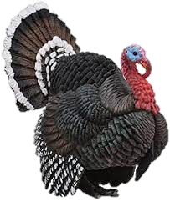
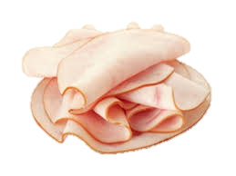
Vocabulary
Turkey

Slide 7
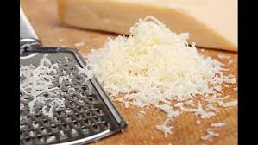
Vocabulary
Grated paremeasn
cheese

Slide 8
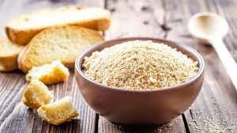
Vocabulary
Bread crumbs

Slide 9
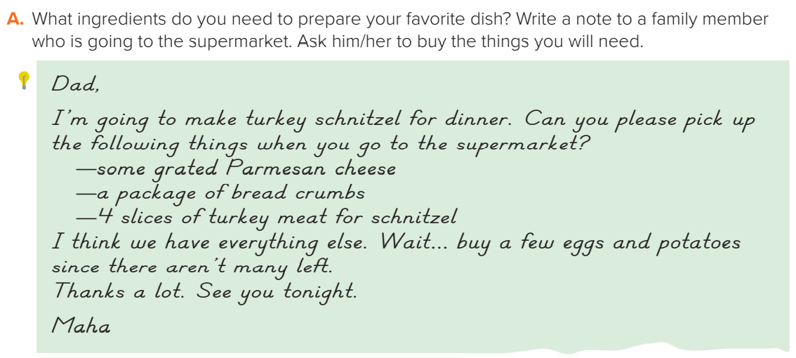
PRESENTATION BY: SLIDECORE
Page:40

Slide 10

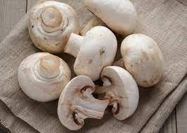
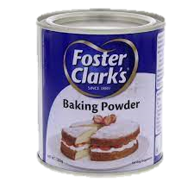
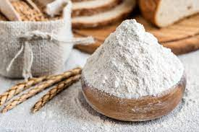
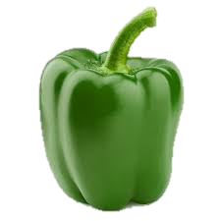
Mom,
I’m going to make pizza for dinner. Can you please pick up the following things when you go to the supermarket?
— baking powder
— a bag of flour
— some green pepper
- Some mushrooms
I think we have everything else.
Thanks a lot. See you tonight.
Maha
PRESENTATION BY: SLIDECORE

Slide 11
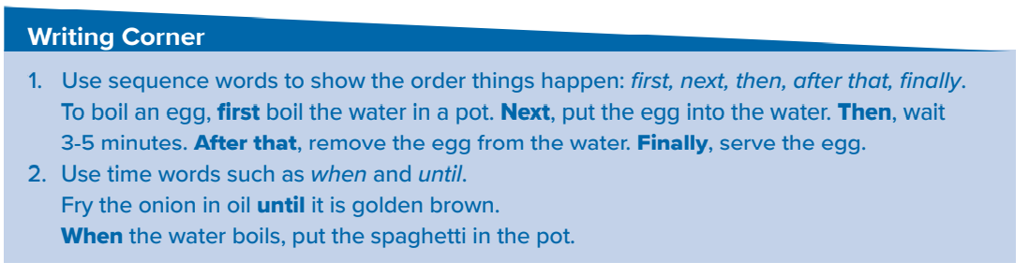
PRESENTATION BY: SLIDECORE

Slide 12
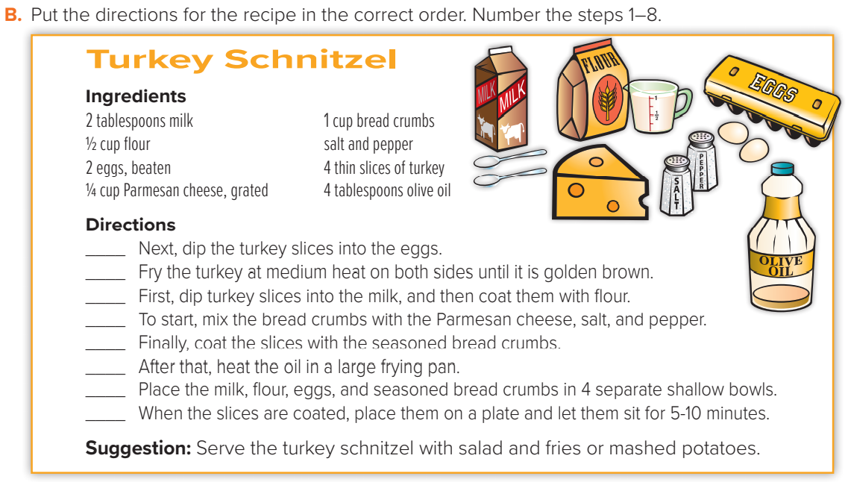
4
8
3
1
5
7
2
6
PRESENTATION BY: SLIDECORE

Slide 13
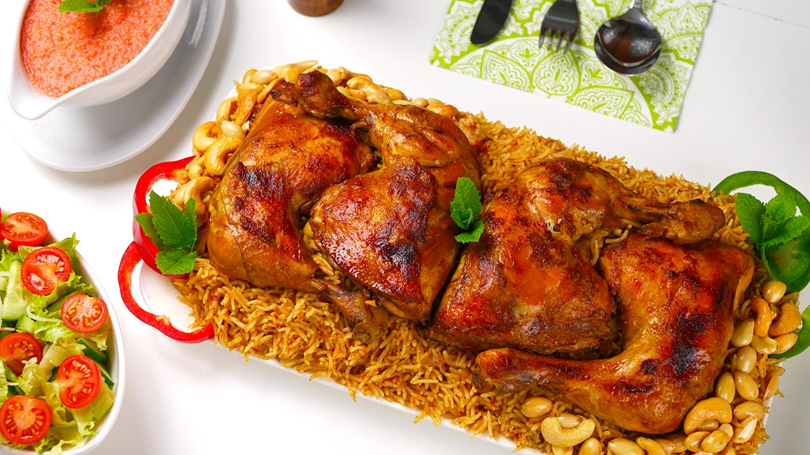
Ingredients
1 chopped onion
2 cloves garlic
1 whole chicken, cut into 8 pieces
¼ cup tomato mash
2 table spoon of tomato paste
Salt & mixed kabsa spices
3 ¼ cups hot water
2 ¼ cups unrinsed basmati rice
First, Heat some oil in a large pot over medium heat and stir in the garlic and onion until the onion has softened for 5 minutes.
Next, add the chicken pieces and brown them over medium-high heat about 10 minutes.
Then, Mix in the tomato mash and stir in the tomato paste with the kabsa spices .and add the hot water and cook for 30 minutes
After that, gently stir in the rice and cover the pot until the rice dry and its grains are separate.
Finally put the rice into a large serving plate and arrange the chicken pieces on top. Serve it with hot sauce and fresh salad
PRESENTATION BY: SLIDECORE

Slide 14
Homework
P.190(K)

Slide 15
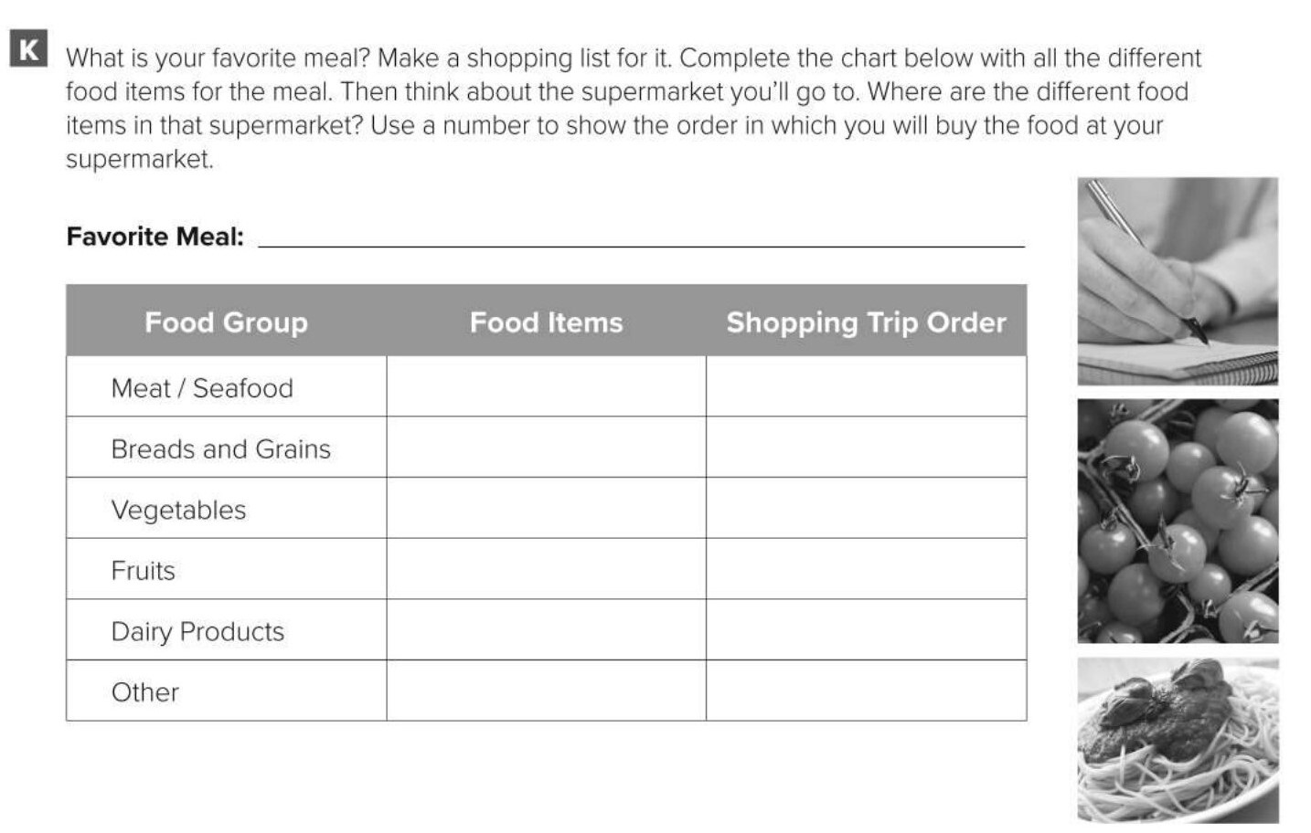
roasted chicken with salad and fries.
chicken
3
bread
1
lettuce, tomatoes,potatoes
2
cheese
4

