Slide 1
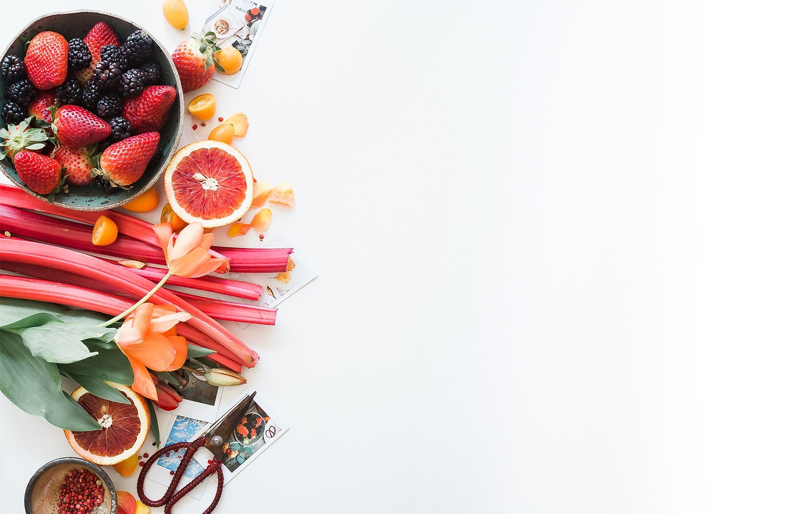
بسم الله الرحمن الرحيم
Day
Date

Slide 2

Unit 4
VENU
What do I need to buy?
PRESENTATION BY: SLIDECORE

Slide 3
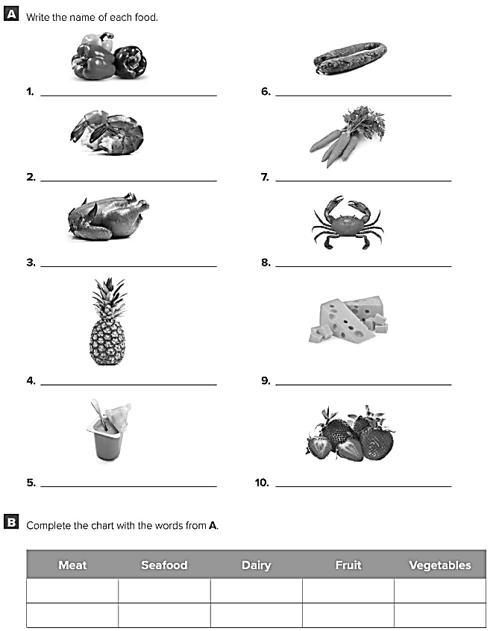
Peppers
Sausage
Shrimp
Carrots
Chicken
Crab
Pineapple
Cheese
Yoghurt
Strawberries
Chicken
Shrimp
Yoghurt
Pineapple
Peppers
Sausage
Crab
Cheese
Strawberries
Carrots

Slide 4
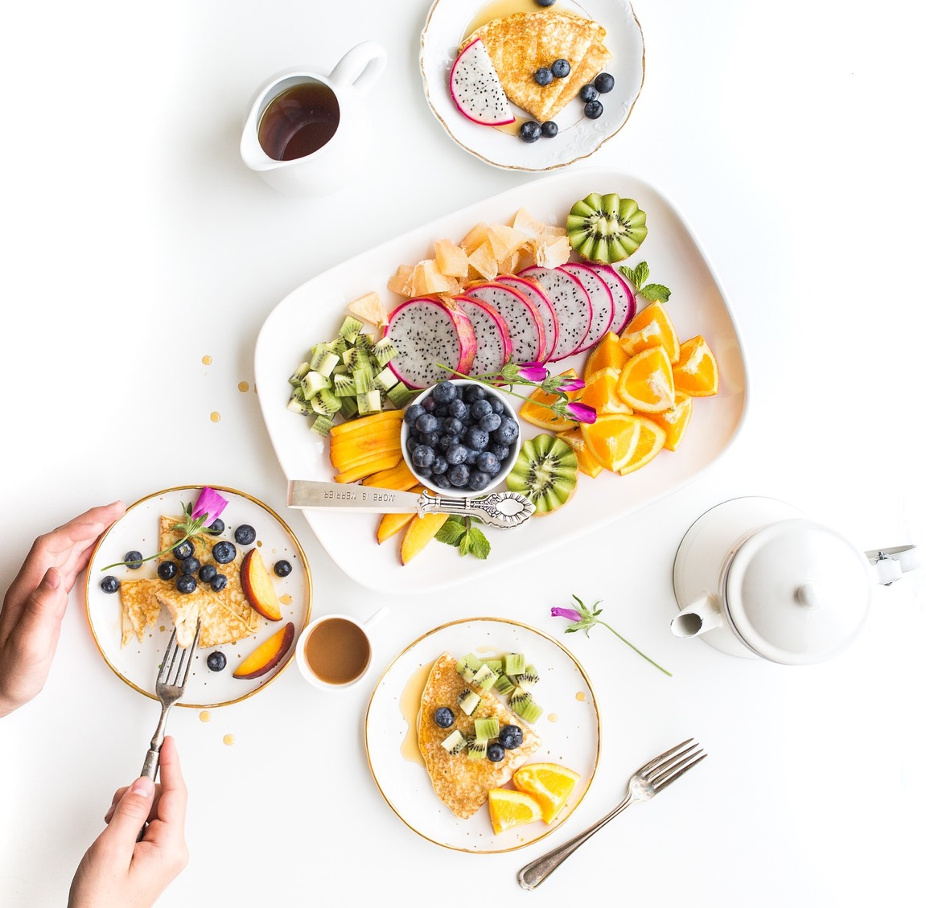




Grammar
PRESENTATION BY: SLIDECORE

Slide 5

PRESENTATION BY: SLIDECORE

Slide 6
Learning Objectives
use pronouns in sentences correctly
02
differentiate between countable and uncountable nouns
01
Ask questions using How much…, or How many..
04
use quantity expression correctly
03
05
use sequences words in meaningful sentences.

Slide 7
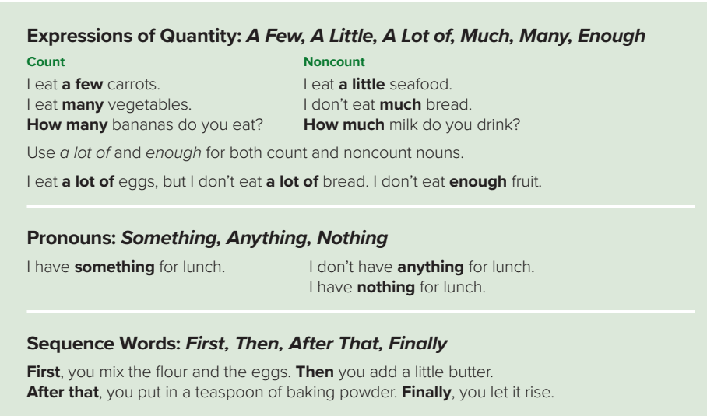
PRESENTATION BY: SLIDECORE
Page:35

Slide 8

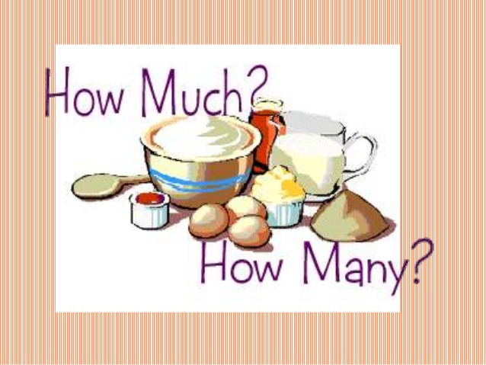
Expression of Quantities :
Many – a few
Much – a little
A lot of
- enough
PRESENTATION BY: SLIDECORE

Slide 9
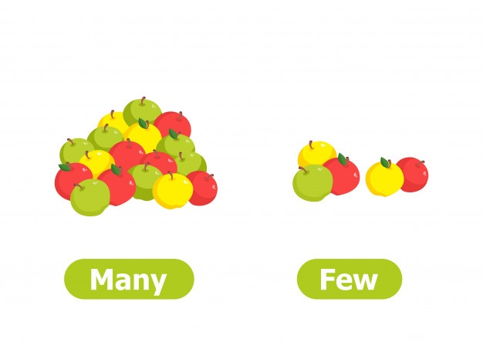

For Countable nouns :
How Many apples are there ?
There are many apples.
There are a few apples.
A few
PRESENTATION BY: SLIDECORE

Slide 10

Give me examples of countable nouns !!
PRESENTATION BY: SLIDECORE

Slide 11


For noncountable nouns :
How much water do you have ?
I have much water.
I have a little water.
Much
A little
PRESENTATION BY: SLIDECORE

Slide 12
Give me examples of noncountable nouns !!
PRESENTATION BY: SLIDECORE

Slide 13
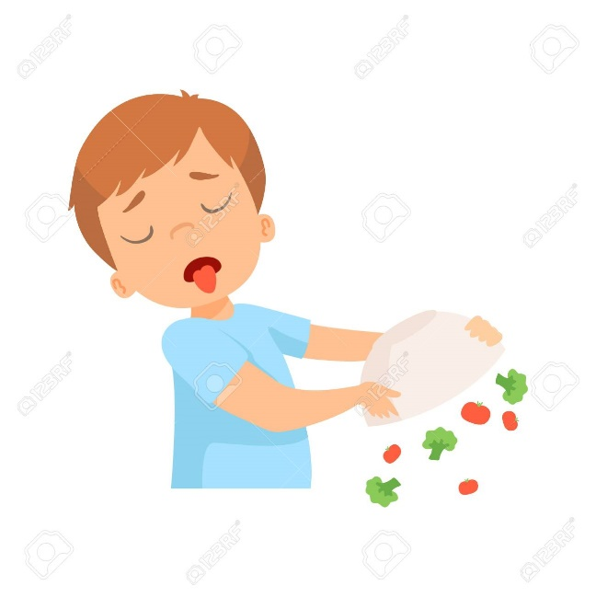
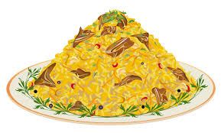
Enough and a lot of come with both countable and uncountable nouns.
He doesn’t eat enough salad.
I eat a lot of rice.
PRESENTATION BY: SLIDECORE

Slide 14
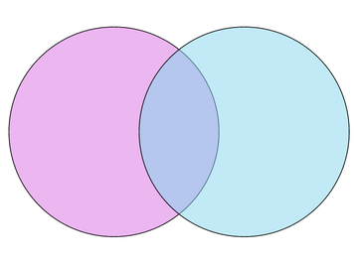
Venn diagram:
countable
uncountable
Many
A few
Much
A little
A lot of
enough
How many ….?
How much …..?
PRESENTATION BY: SLIDECORE

Slide 15


Let’s practice :
1- I read ……………………..books ( many – much )
2-There is too ……………….. Rain ( much – many )
PRESENTATION BY: SLIDECORE

Slide 16
Pronouns :
Something … Affirmative sentence
Anything … Negative sentence
Nothing … means negative (affirmative sentence)
I have something for dinner
I don’t have anything for dinner
I have nothing for dinner
PRESENTATION BY: SLIDECORE

Slide 17
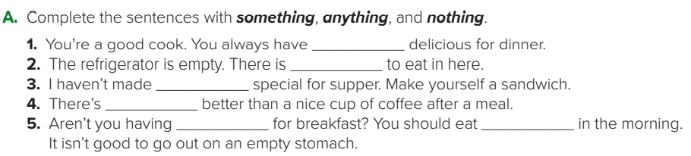
something
nothing
anything
nothing
anything
something

Slide 18
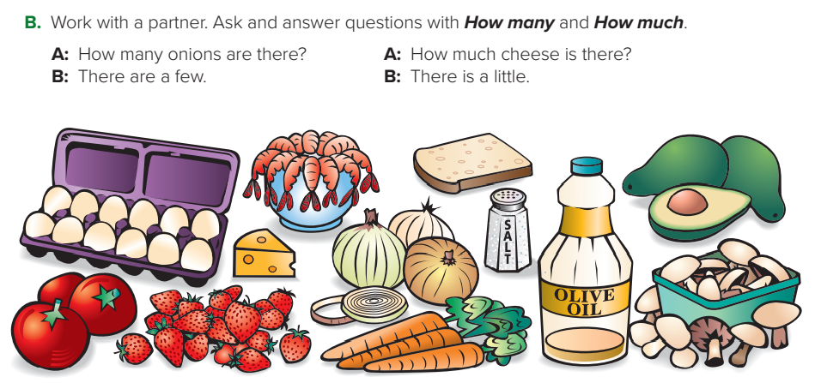
A: How many strawberries are there?
B: There are many.
A: How much oil is there?
B: There is a little.
A: How many carrots are there?
B: There are a few.
A: How many tomatoes are there?
B: There are a few.
A: How much salt is there?
B: There is a lot.
A: How many mushrooms are there?
B: There are a lot.

Slide 19
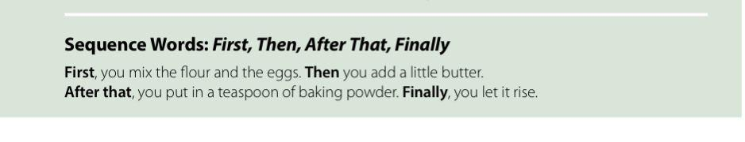
Sequence words:
PRESENTATION BY: SLIDECORE

Slide 20
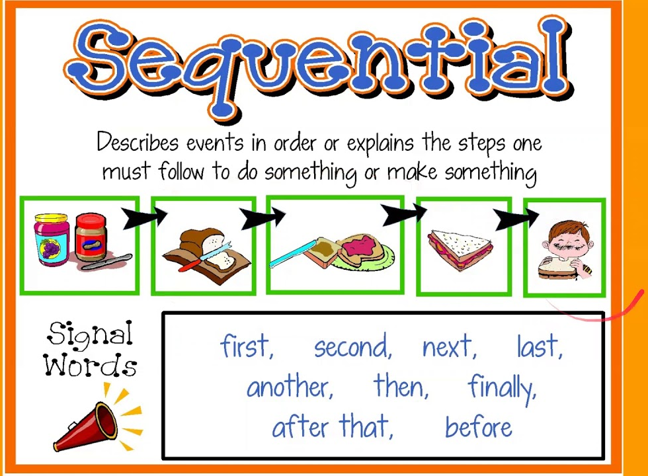

Slide 21
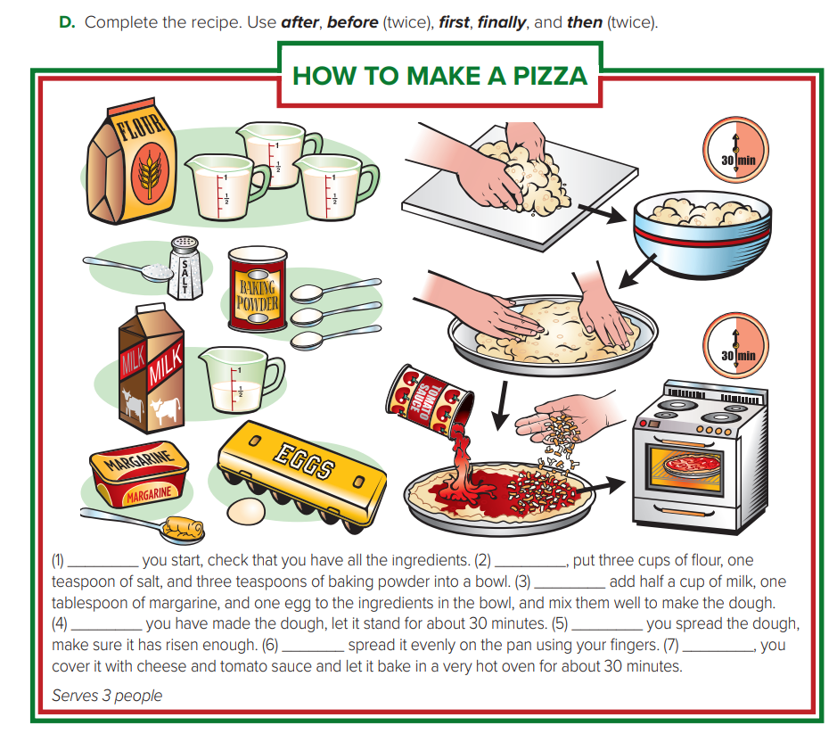
1. Before
2. First
3. Then
4. After
5. Before
6. Then
7. Finally

Slide 22
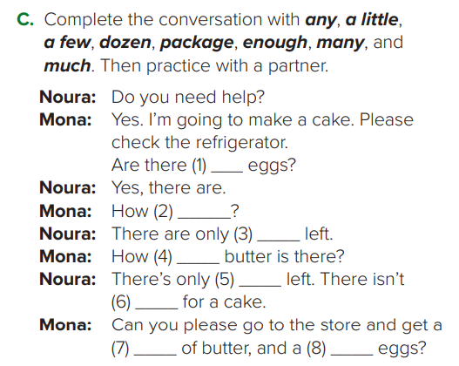
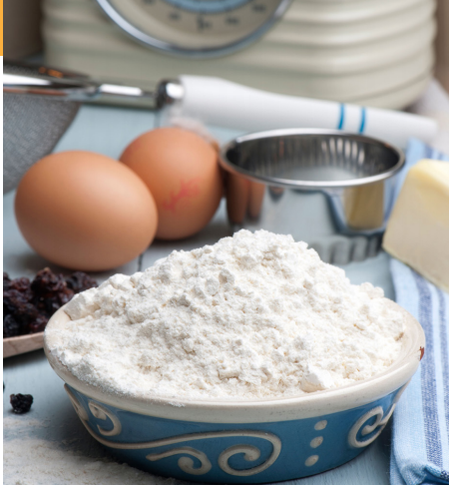

Slide 23


Any
Negative
Question
Are there any eggs?
There is not any lemon.

Slide 24
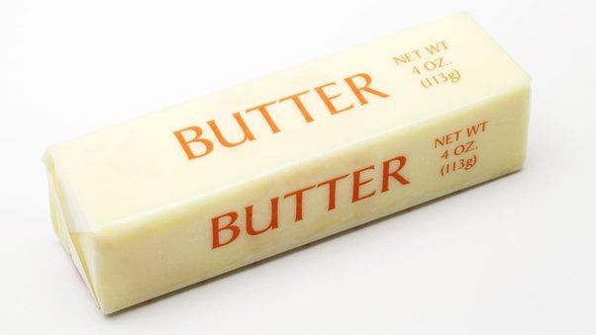
Package
A package of butter.

Slide 25
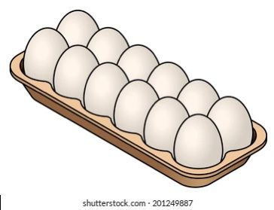
Dozen:12
A dozen of eggs.

Slide 26
any
many
a few
much
a little
enough
package
dozen

Slide 27
Homework
p.186-187

Slide 28
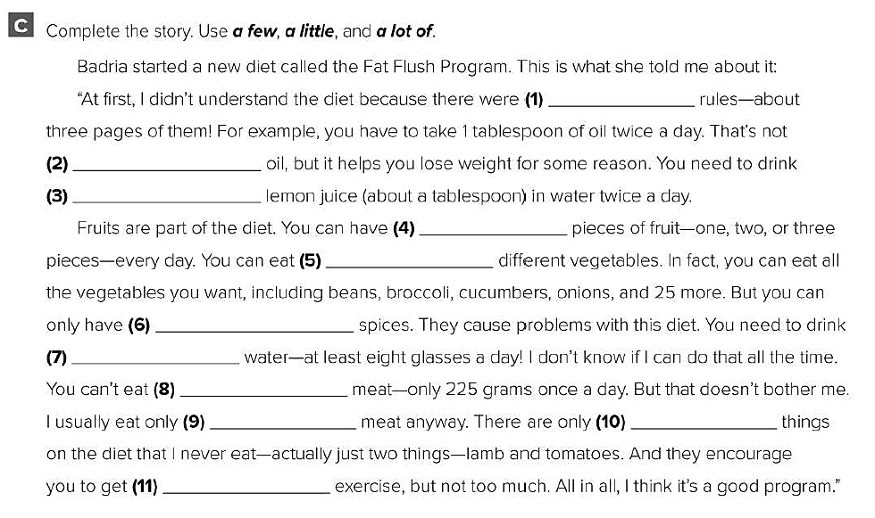
a lot of
a lot of
a little
a few
a lot of
a few
a lot of
a lot of
a little
a few
a little

Slide 29
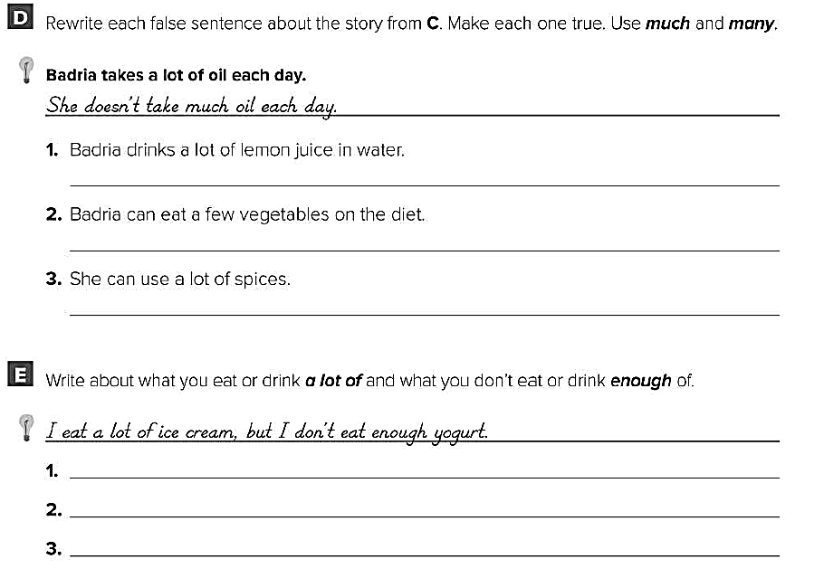
Badria doesn’t drink much lemon juice in water .
Badria can eat many vegetables on the diet .
She can’t use a lot of spices .
I eat a lot of meat , but I don’t eat enough vegetables .
I eat a lot of cookies , but I don’t eat enough fruit .
I drink a lot of soda , but I don’t drink enough water .

