Slide 1


Slide 2


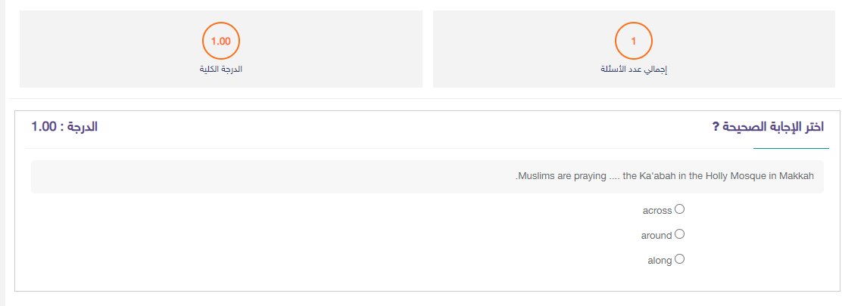
HOMEWORK

Slide 3

VENU
Unit 4
What do I need to buy?
Lesson
1
PRESENTATION BY: SLIDECORE

Slide 4
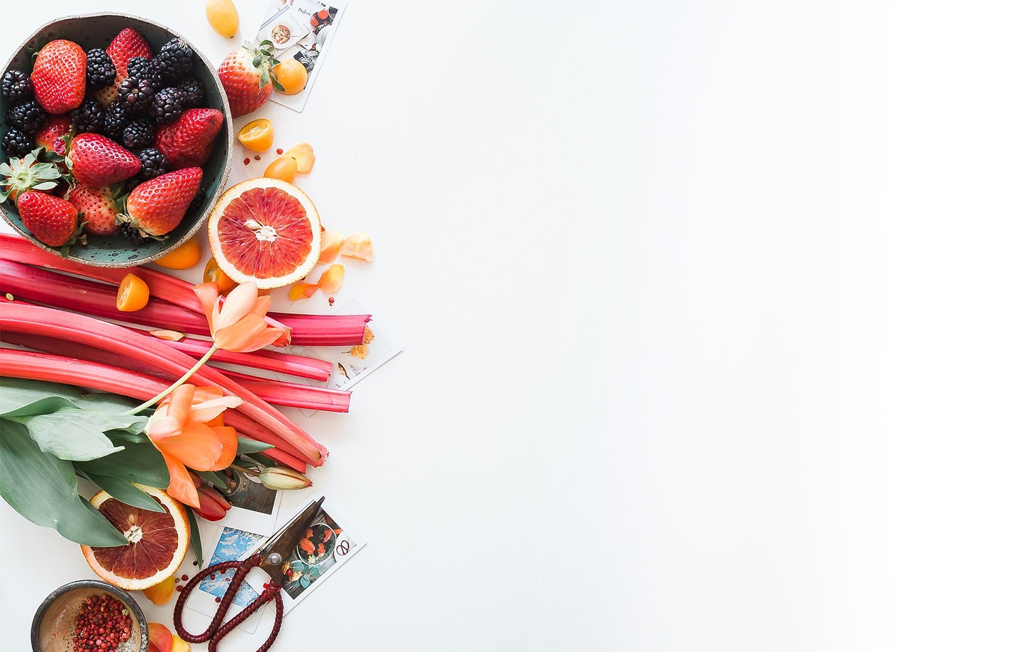
بسم الله الرحمن الرحيم
Day
Date

Slide 5
Learning Objectives
2
classify food into categories (Food groups)
1
discuss buying food habits
3
2
value the blessing of having various types of food.
3

Slide 6


A- Circle the odd word:
1- Mango, Banana, Tomato, Strawberry.
2-Coffee, cappuccino, tea, tuna.
B- Name 3 supermarket:

Slide 7
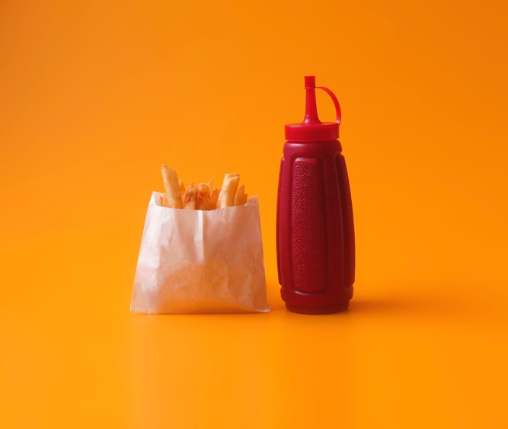
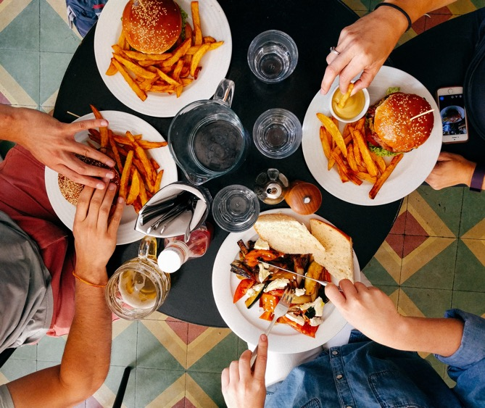
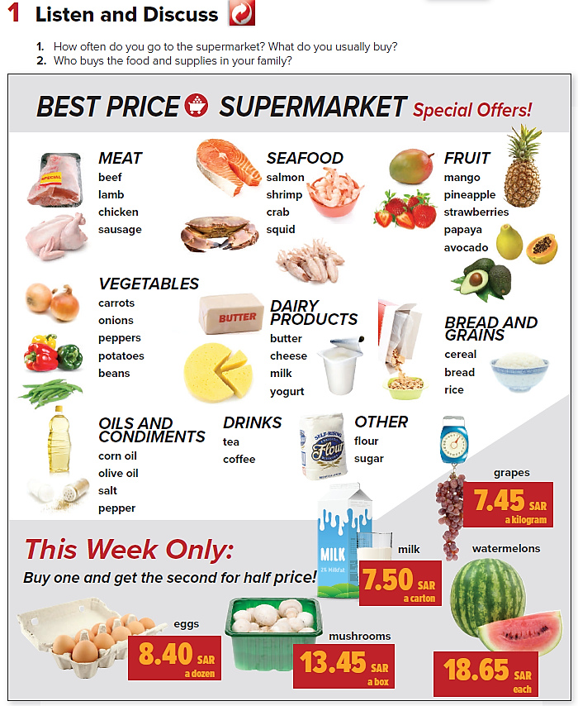

Page:38

Slide 8

PRESENTATION BY: SLIDECORE

Slide 9
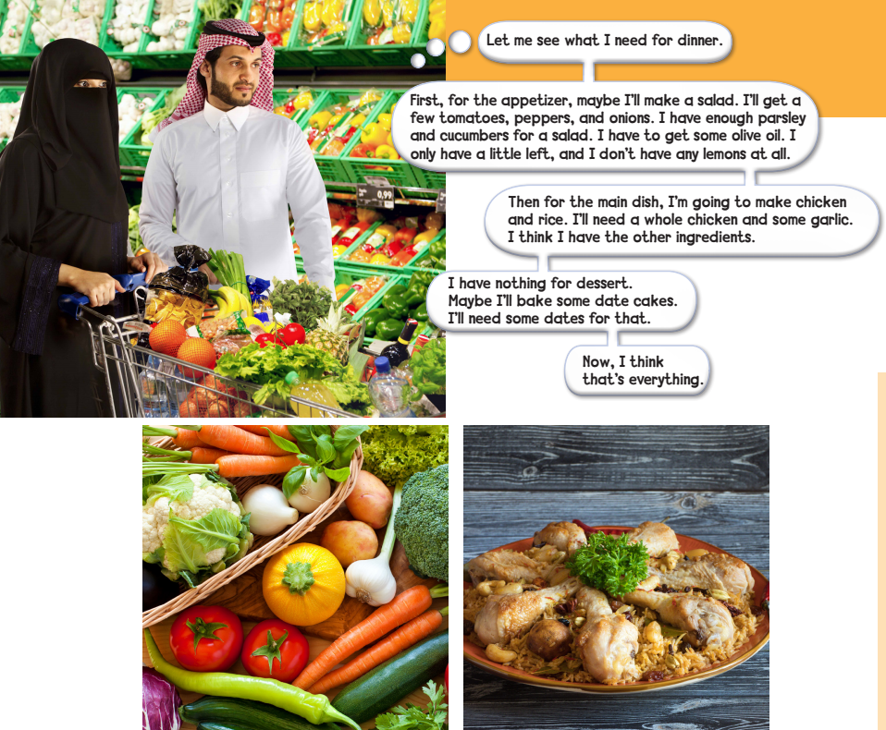
Where are they?
What are they probably thinking about?
What appetizer/main dish/dessert do you most often eat?
What is she probably going to make for the appetizer?
What about for the main dish? (chicken and rice) And the dessert?
Page:39
PRESENTATION BY: SLIDECORE

Slide 10
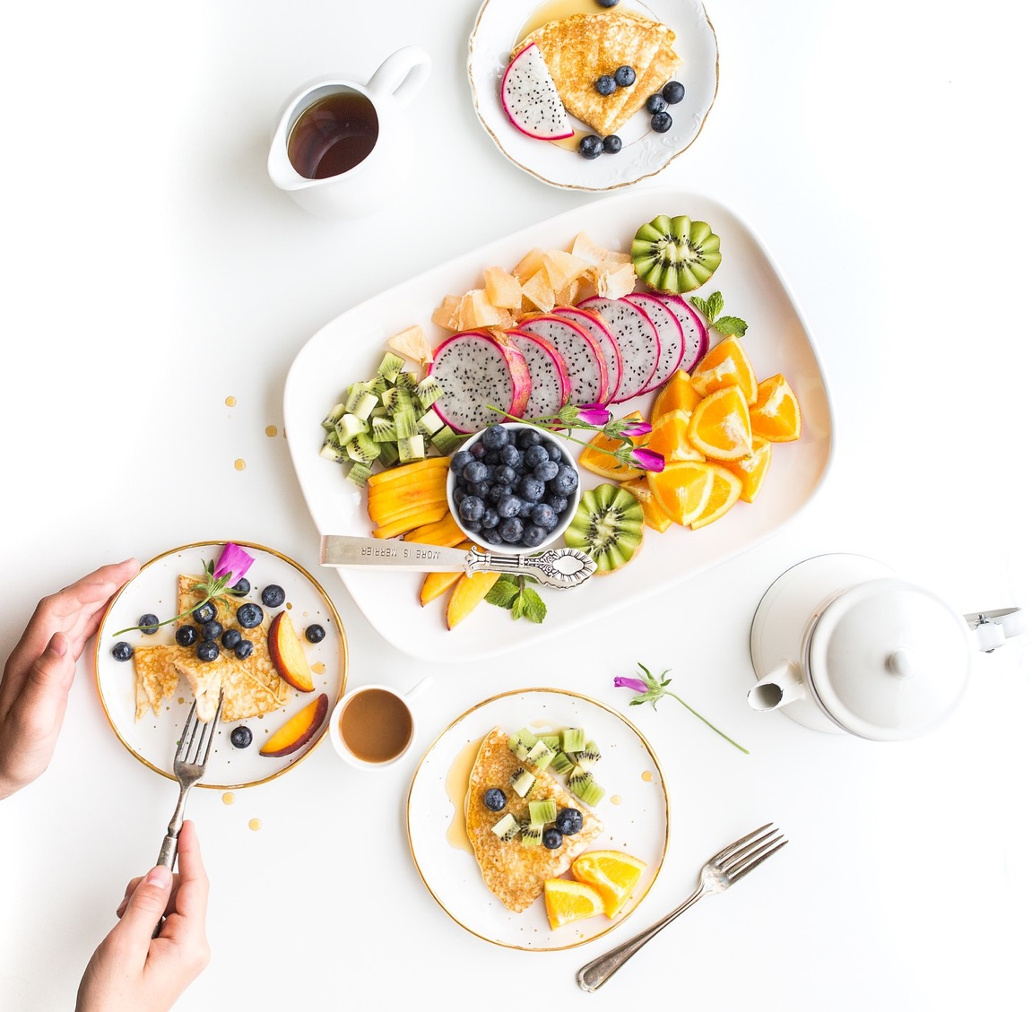

PRESENTATION BY: SLIDECORE

Slide 11
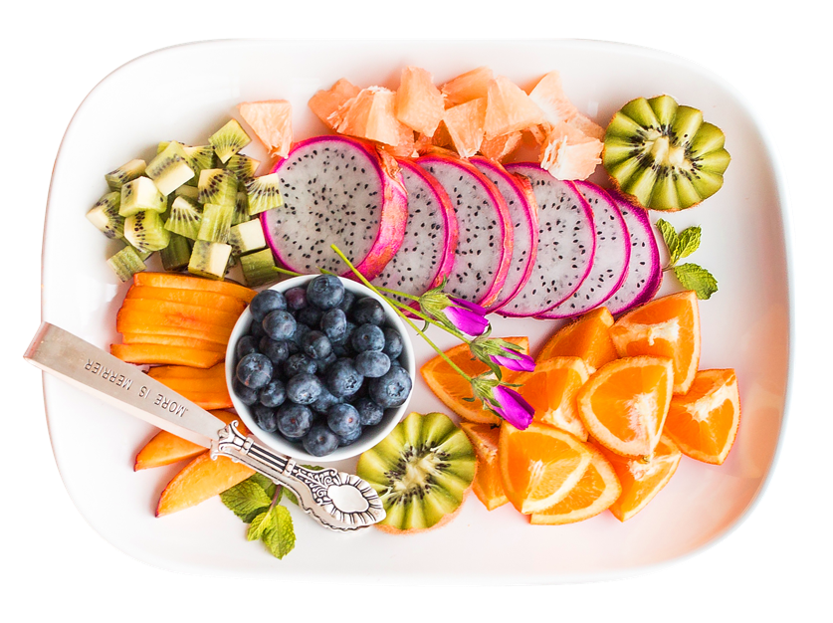
Vocabulary
appetizer

Slide 12
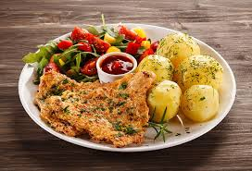
Vocabulary
Main dish

Slide 13
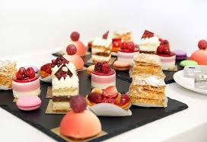
Vocabulary
dessert

Slide 14
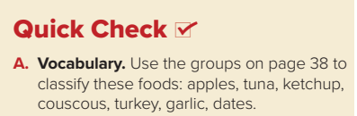
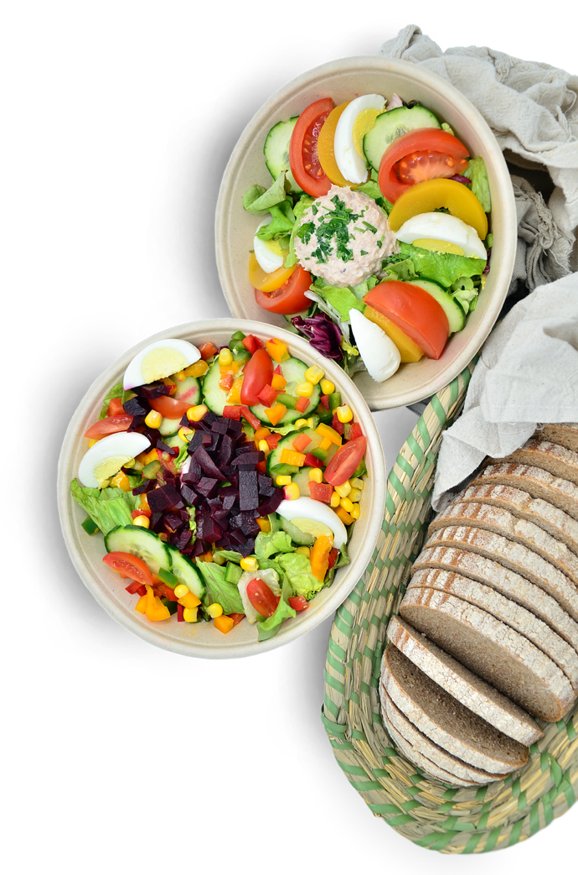
Fruit: apples, dates
Seafood: tuna
Oils and Condiments: ketchup
Meat: turkey
Vegetables: garlic
Bread and Grains: couscous

Slide 15
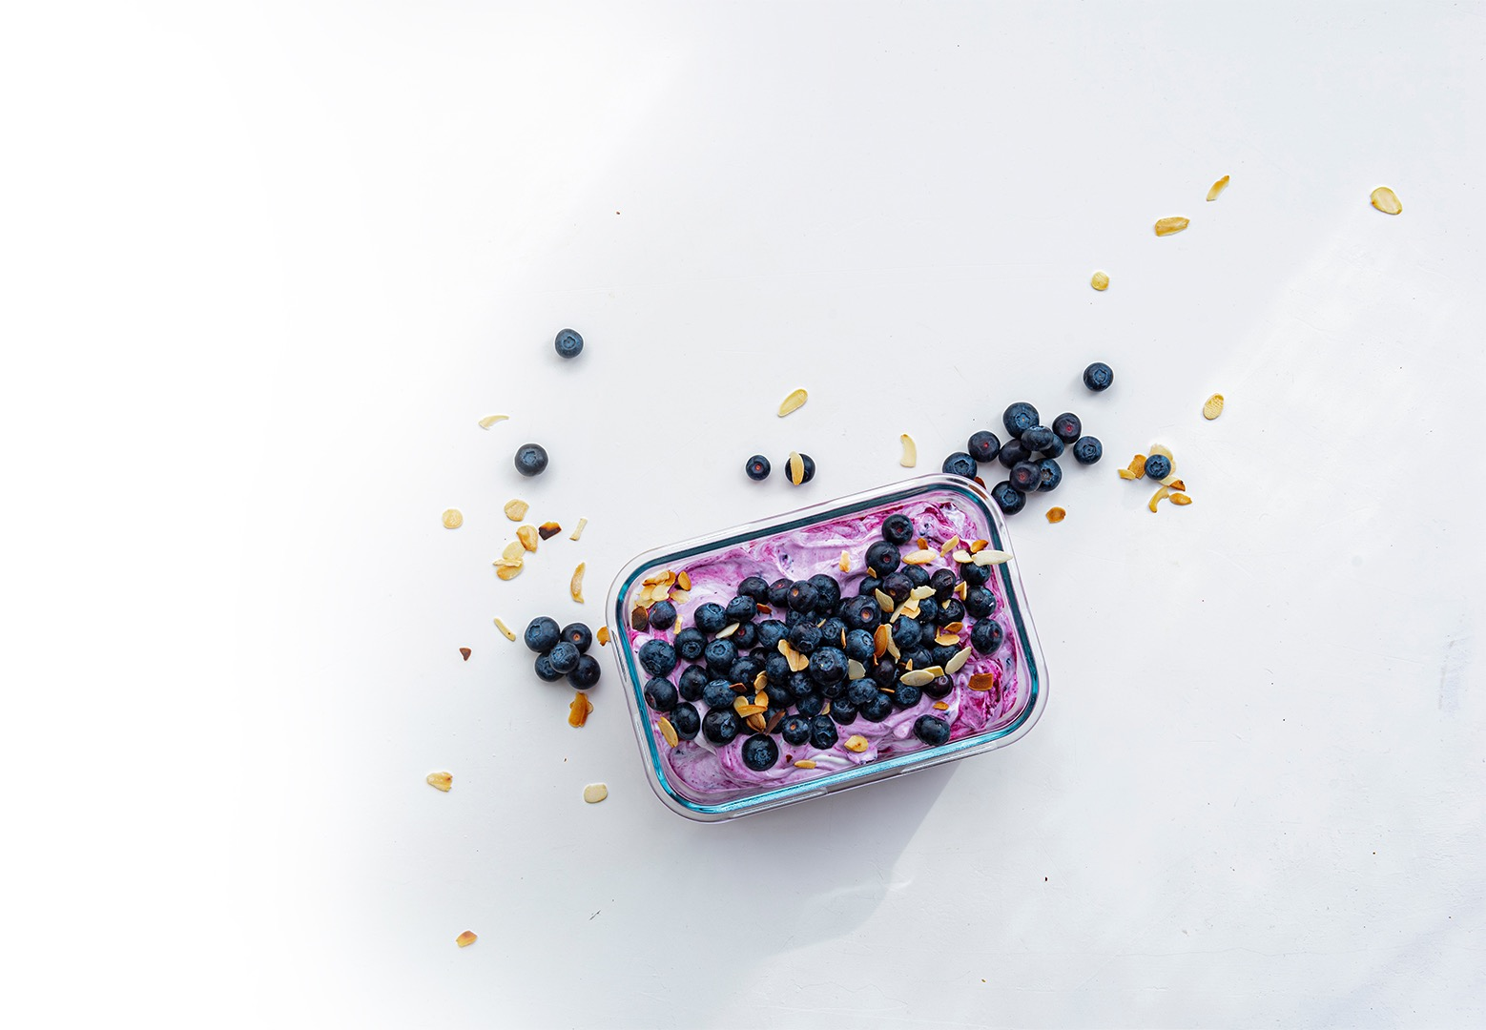
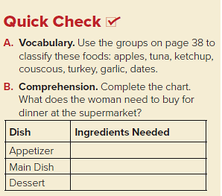
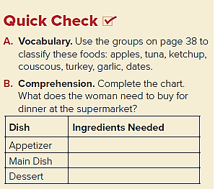
tomatoes, peppers, onions, olive oil, lemons
a whole chicken, some garlic
dates

Slide 16





Slide 17



Drinks
Tea, coffee, water & juice are … …
Bread & grains
Meat

Slide 18

Vegetables
Crab, shrimp, squid& fish are … …
Fruit
Seafood

Slide 19
Seafood
Milk, yogurt, cheese &butter are … …
Bread & grains
Dairy products

Slide 20


This is shrimp.
True
False

Slide 21

This is squid.
False
True

Slide 22


Appetizers
Caesar salad, dynamite shrimp, green salad are … …
Main dishes
Desserts

Slide 23
Main dishes
Name some main dishes.

Slide 24
Appetizers
Apple pie, cheesecake , tiramisu & fruit salad are … …
Main dishes
Desserts

Slide 25
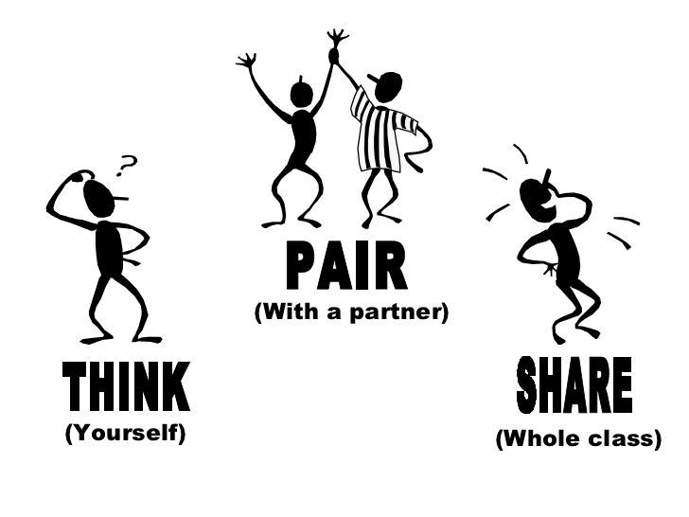

Slide 26
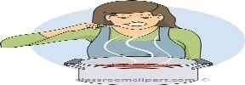
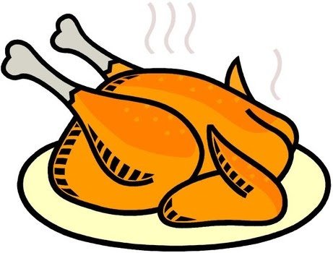


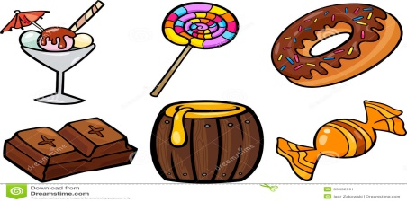
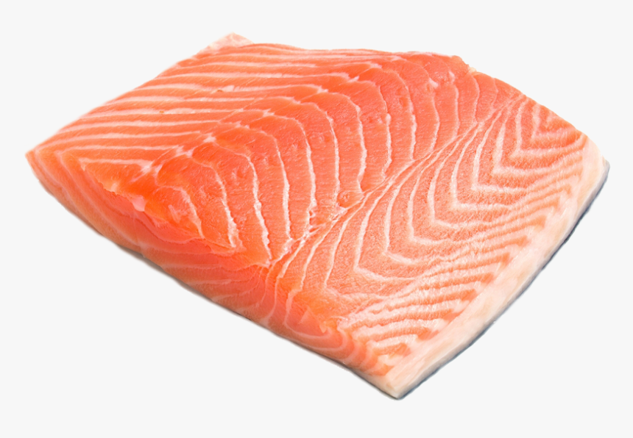

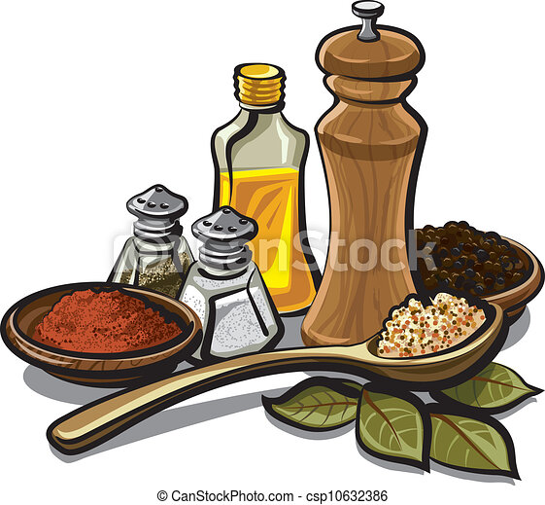

Think- pair-share _ 1 min
Classify these foods?
1
2
3
4
5
6
7
8

Slide 27
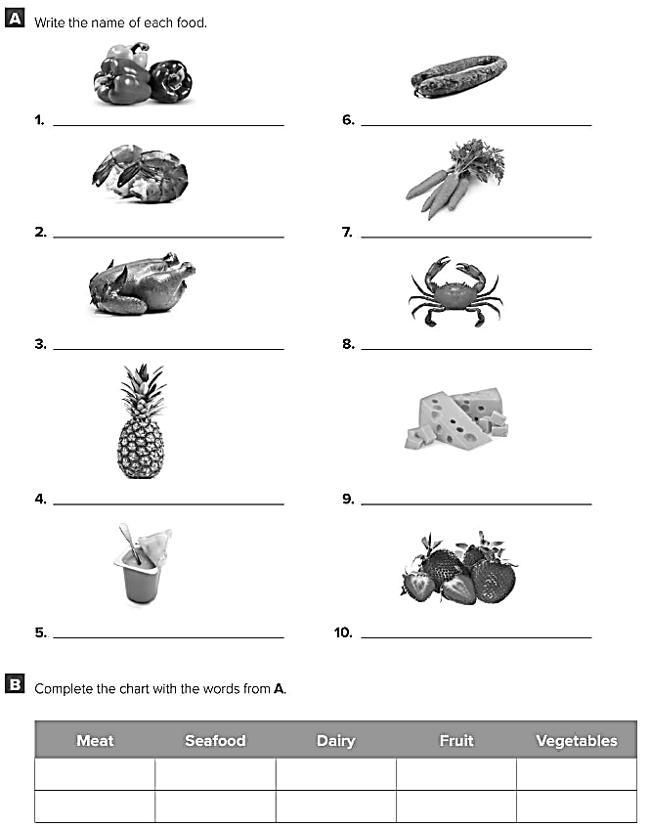
Peppers
Shrimp
Shrimp
Peppers

Slide 28


HOMEWORK
One Q
in School.madrasati.sa Platform
The time will be end at 11: 50 p.m.

