Slide 1
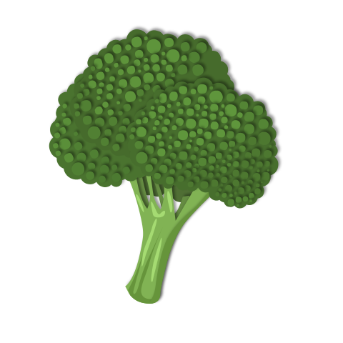

Unit 4
What Do I Need to Buy?
T. Shareefa M.

Slide 2
Objectives:
Talk about foods, buying foods, and planning meals
Create a conversation about food shopping and describing quantities

Slide 3
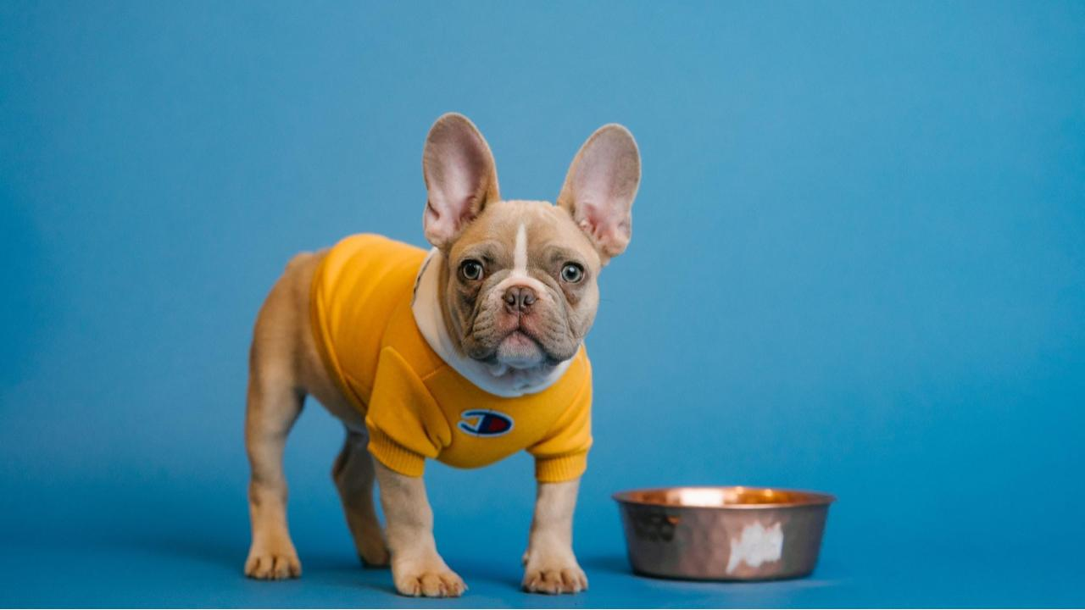
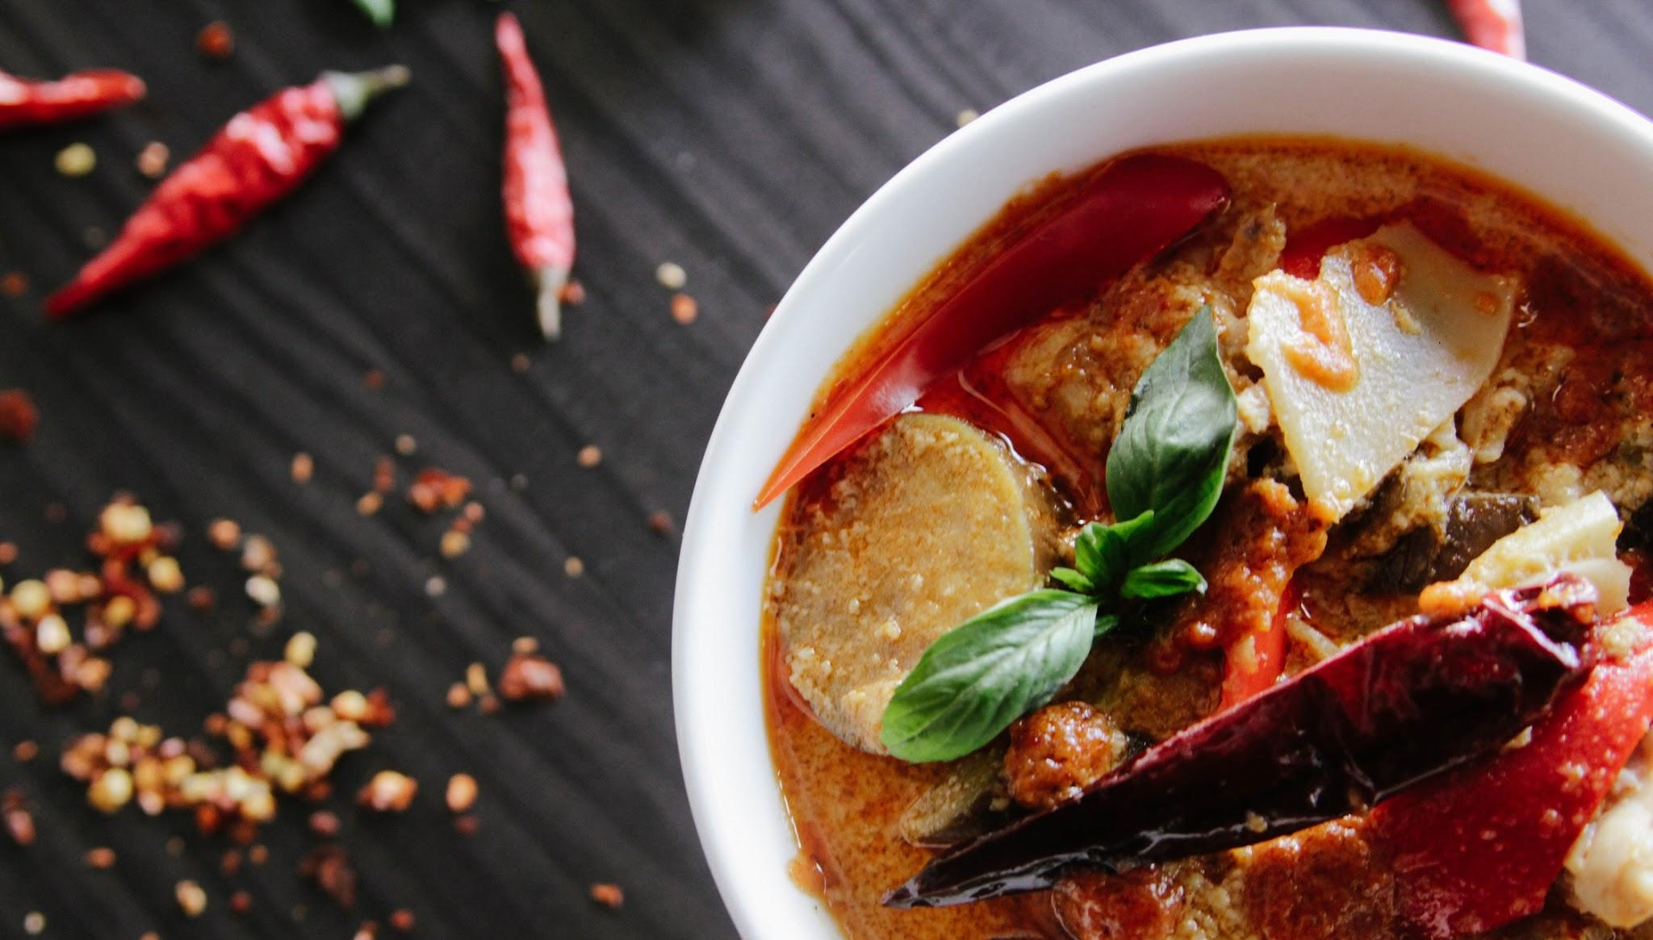
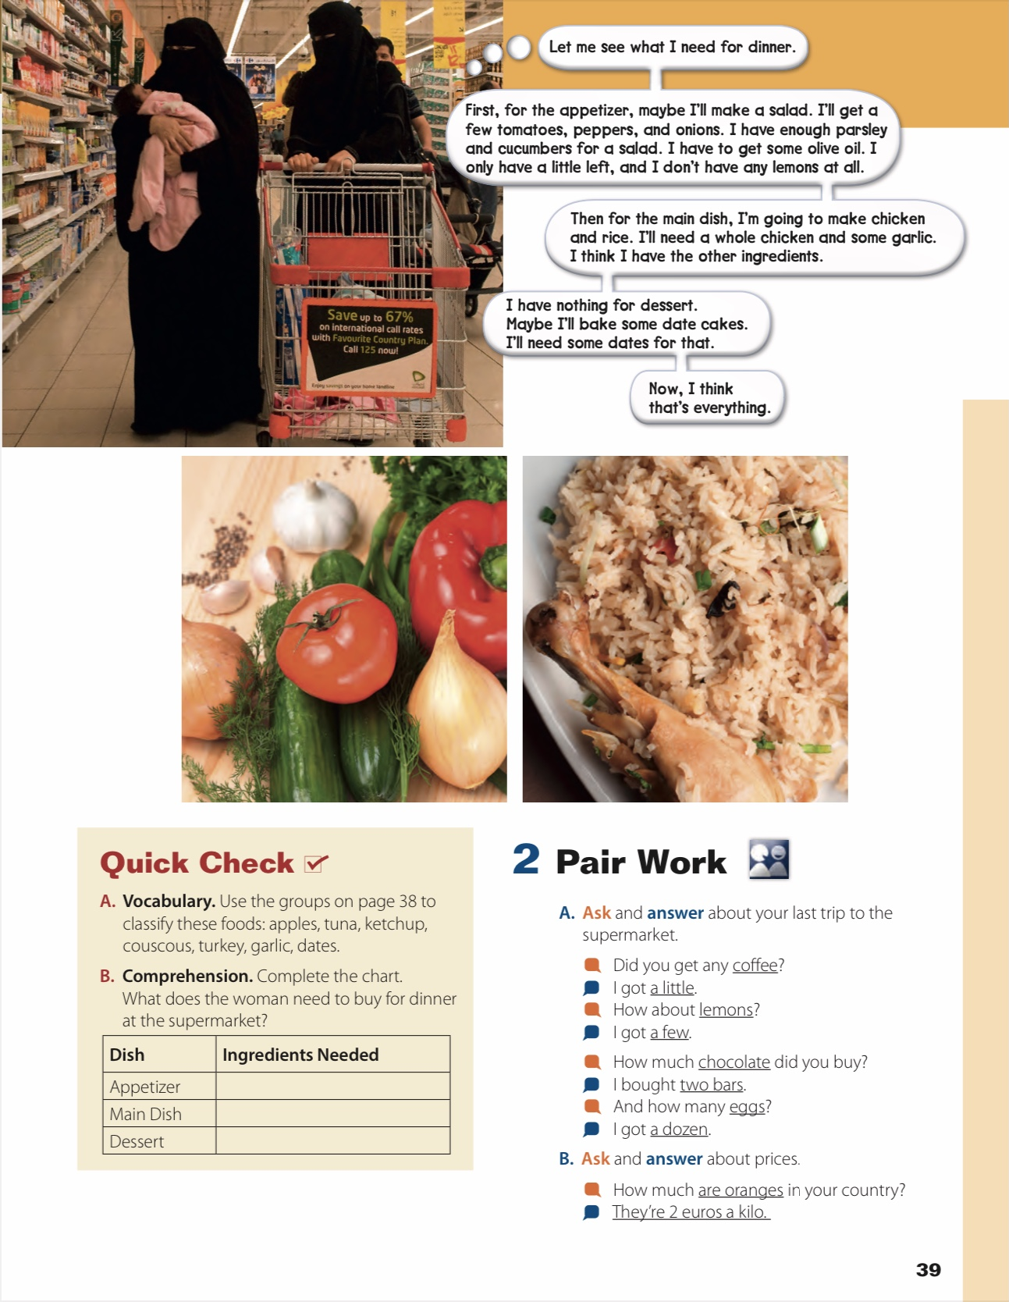
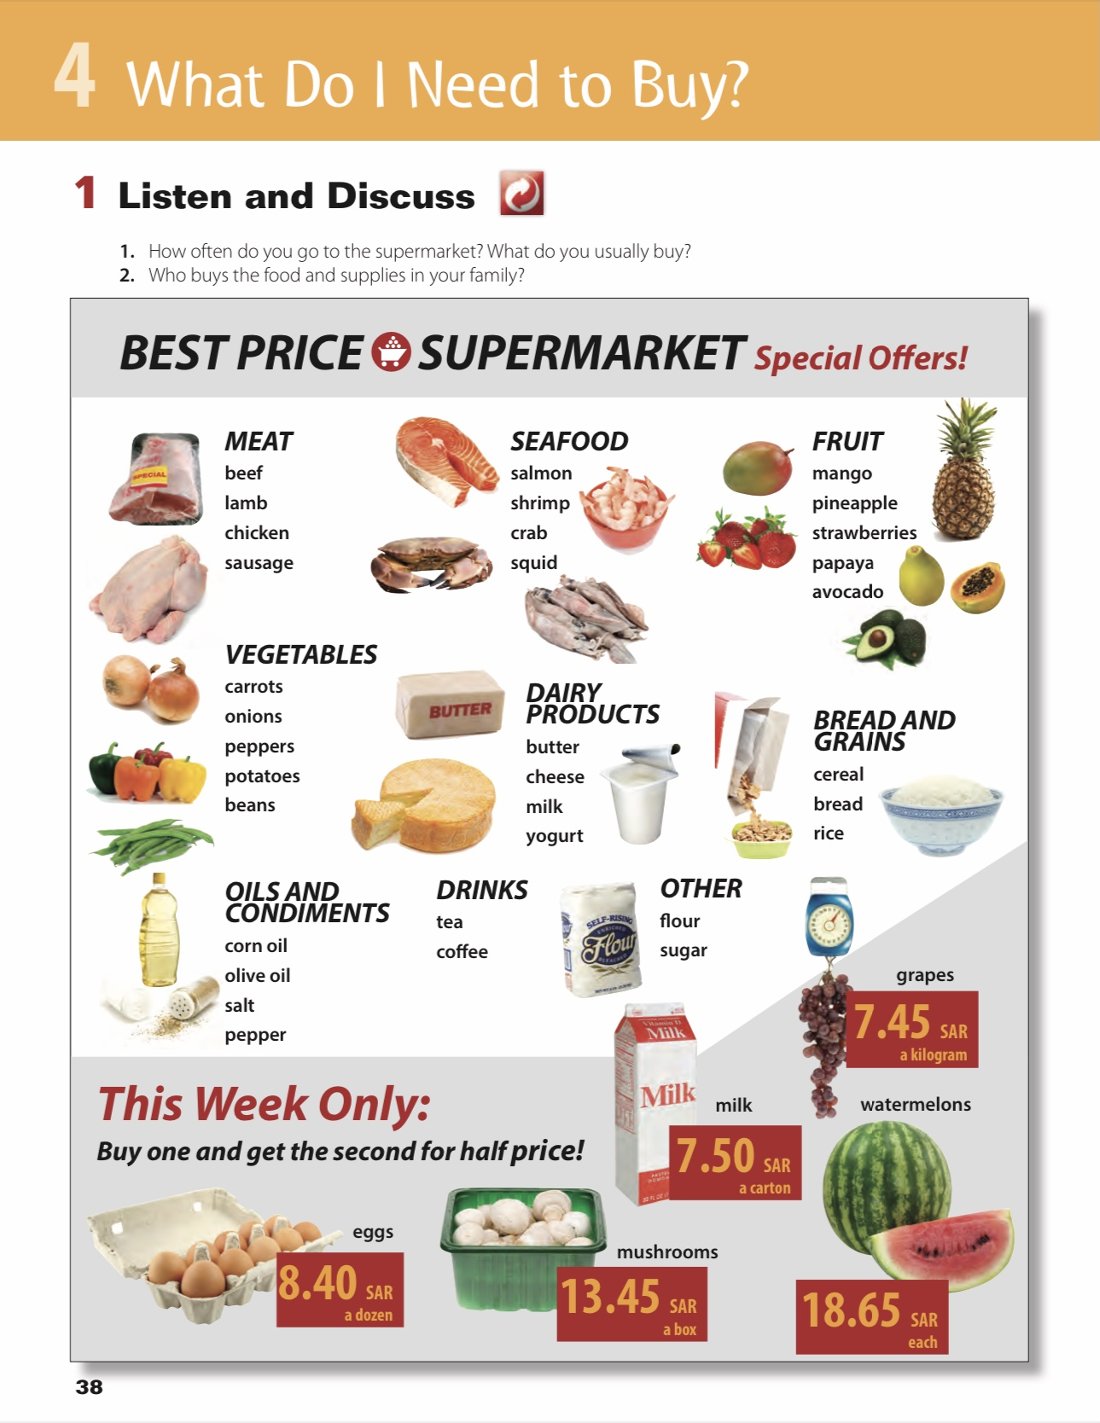
Page
38 - 39

Slide 4
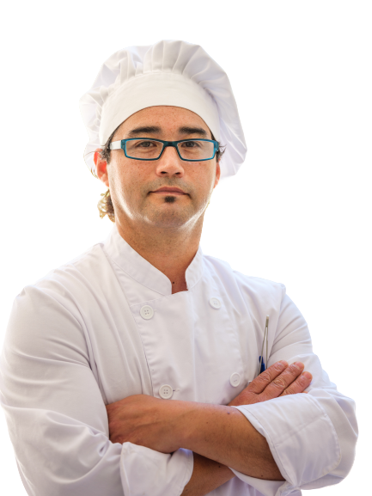

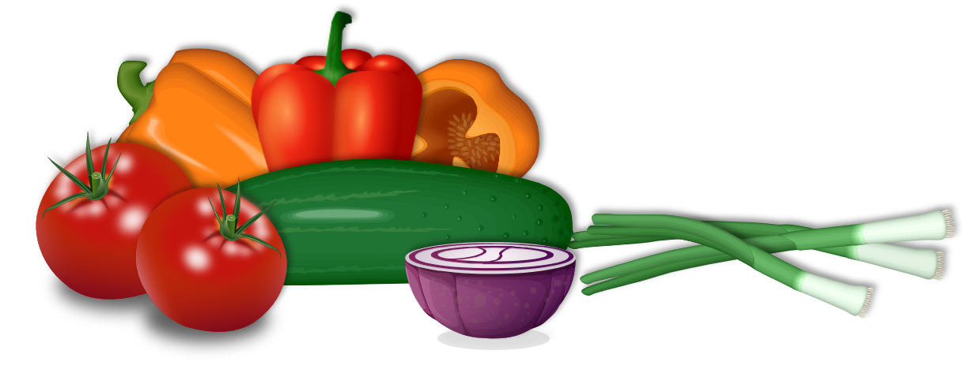
How often do you go to supermarket ?
What do you usually buy?

Slide 5
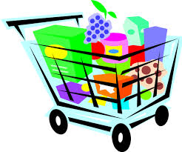
Who buys the food and supplies in your family?

Slide 6
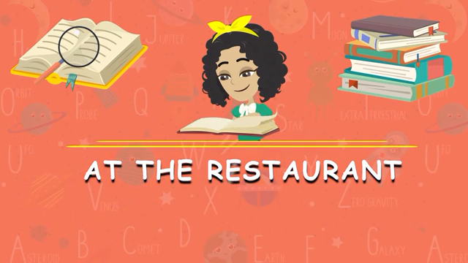
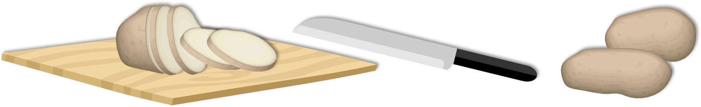

Slide 7

Menue
Appetizer
Main dish
Dessert
Drinks
French fries
Salad
Beef burger
Spaghetti
Ice cream
Cake
Apple pie
Soda
Water
Orange juice

Slide 8


Slide 9
What kind of food do you like ?
What kind of food you don’t like ?

Slide 10

How much is one kilogram of grapes?
(7.45 sar)
a watermelon?
(18.65 sar)
How much is a box of mushrooms?
(13.45 sar)
How much is a carton of milk?
(7.50 sar)
How much are 12 eggs?
(8.40 sar)

Slide 11
Where are the women?
(the supermarket)
What are they probably thinking about?

Slide 12
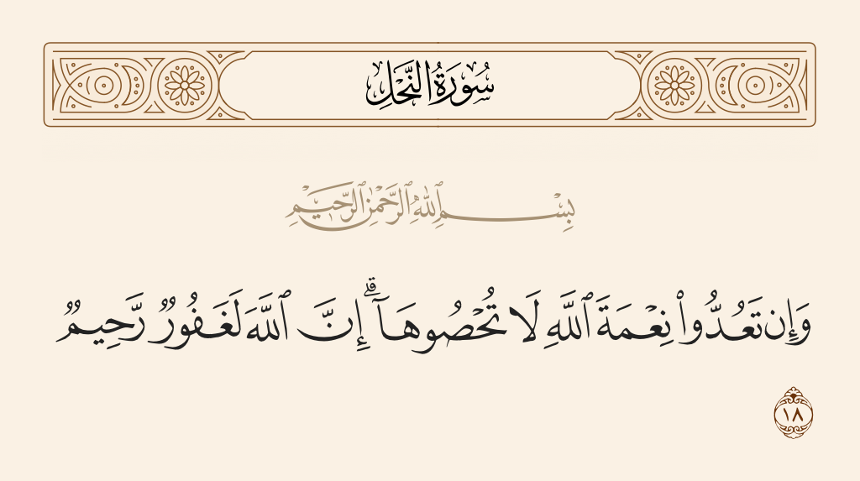
“
﴿ And if you would count the graces of Allah, never could you be able to count them. Truly! Allah is Oft-Forgiving, Most Merciful. ﴾

Slide 13
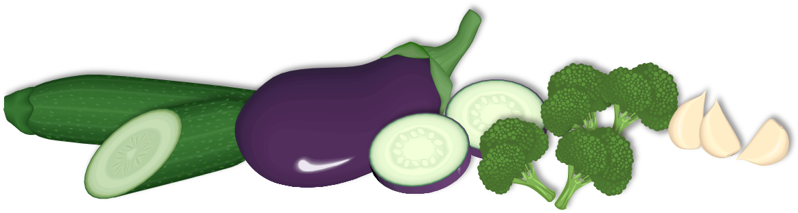
Answers:
Fruit: apples, dates
Seafood: tuna
Oils and Condiments: ketchup
Meat: turkey
Vegetables: garlic
Bread and Grains: couscous

Slide 14

Answers:
Ingredients
Appetizer:
Tomatoes, peppers, onions,olive oil, lemons
Main Dish:
A whole chicken, some garlic
Dessert:
Dates

Slide 15

Homework

Slide 16


Have a nice day

