Slide 1


Super goal 1
Unit 4
Lesson 5 writing
اعداد المعلم / يحيى المنقري متوسطة المأمون بالهفوف

Slide 2

Learning Objectives
*By the end of this lesson, Ss will be able to:
1- answer the questions about themselves .
2- write a paragraph about their country

Slide 3


Slide 4
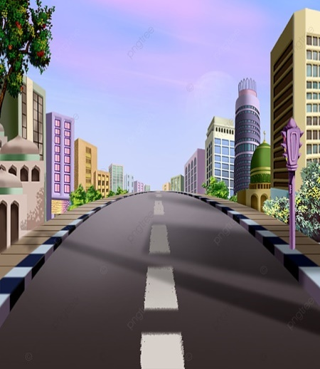




parentheses
Dash
Street

Slide 5
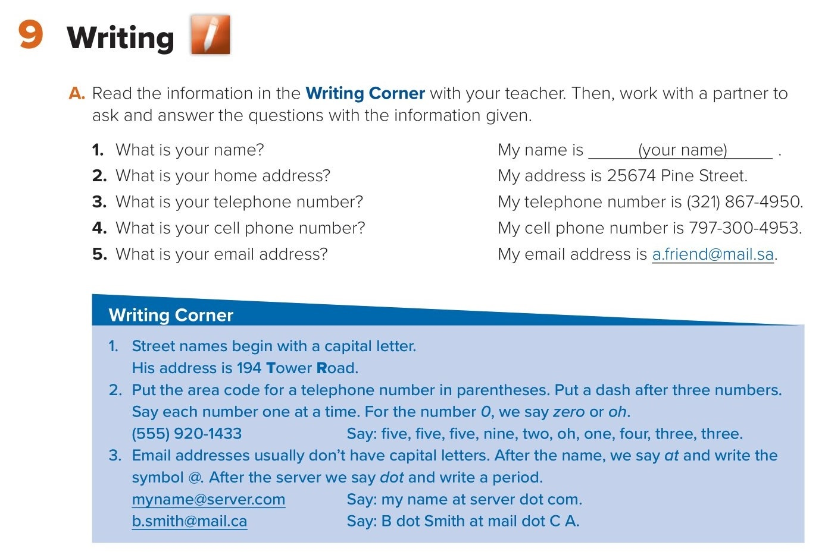
-
( )
.
@

Slide 6
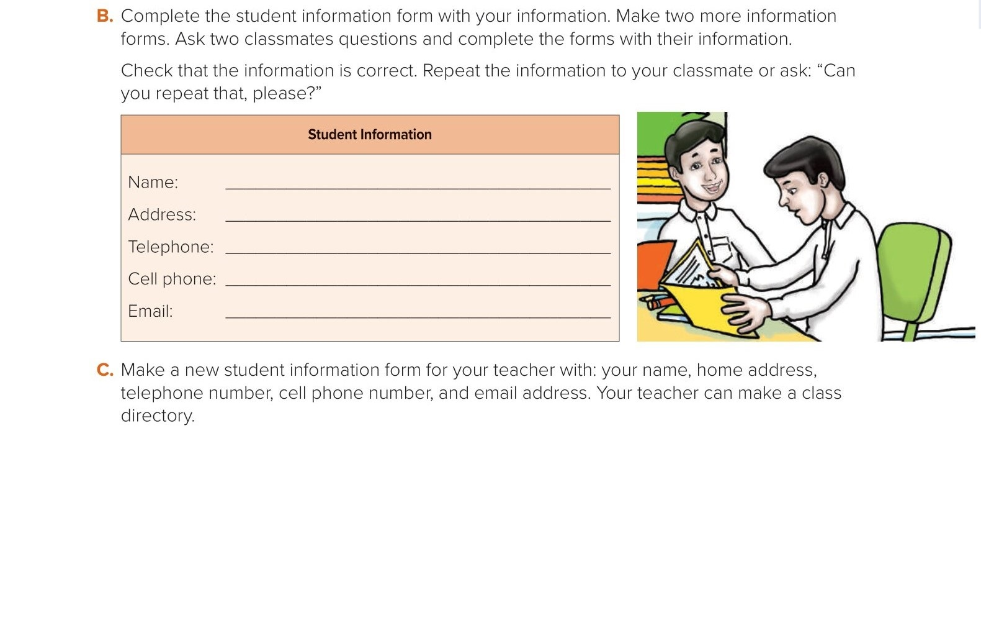
e.g.
My name is ( Ahmed Ali )
My address is 763-74 trade street
My telephone number is ( 432 ) 557-82
My cell phone number is 696-300-53
My email address is a.friend@mail.sa

Slide 7
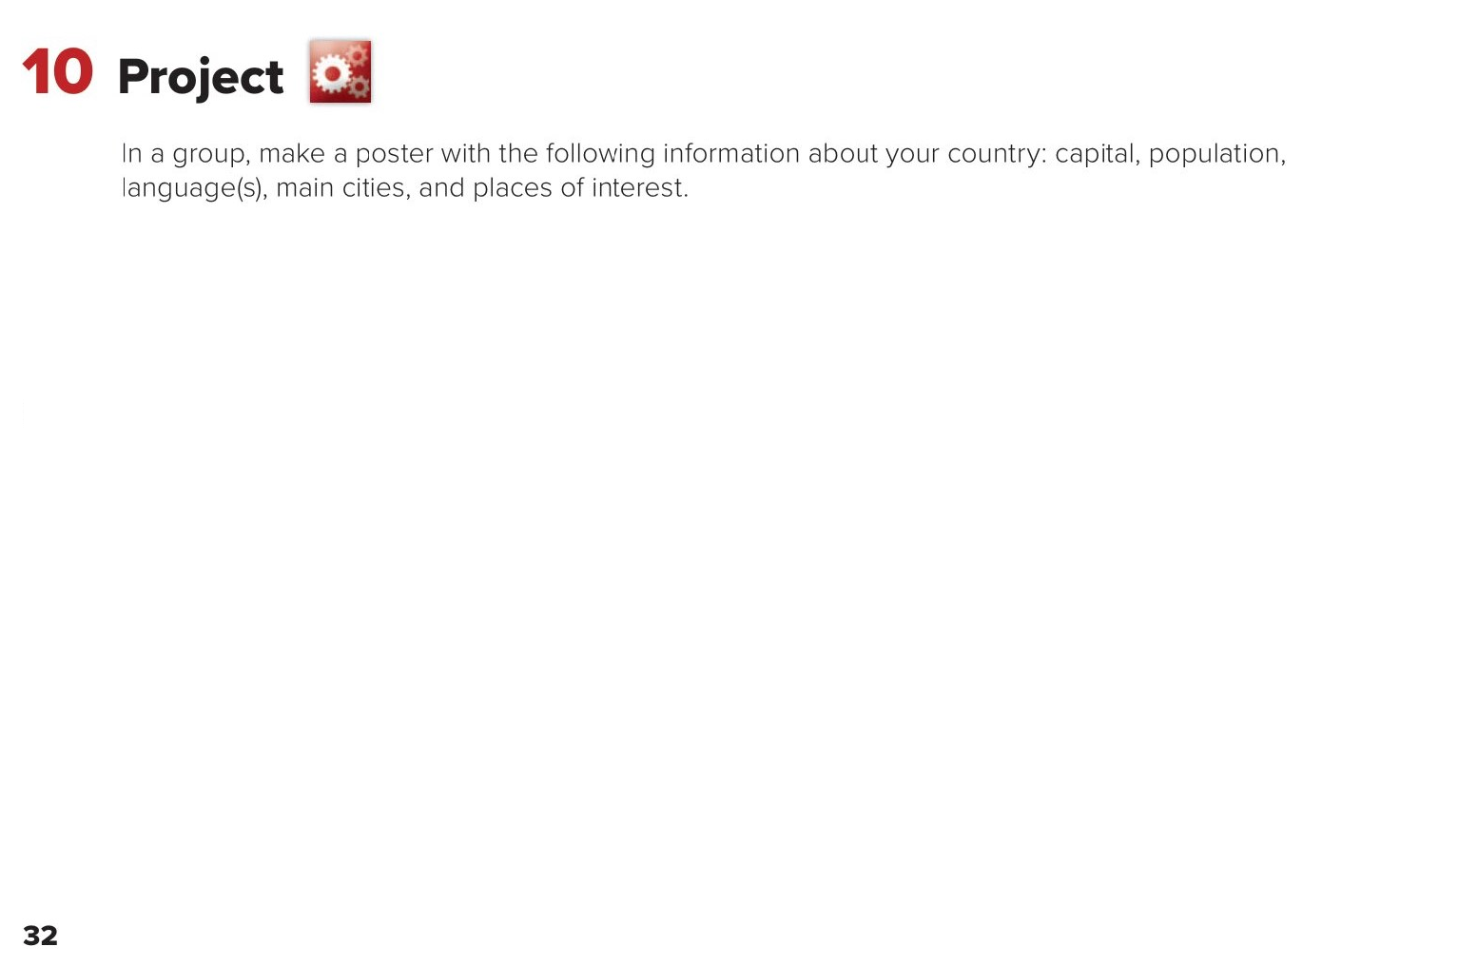
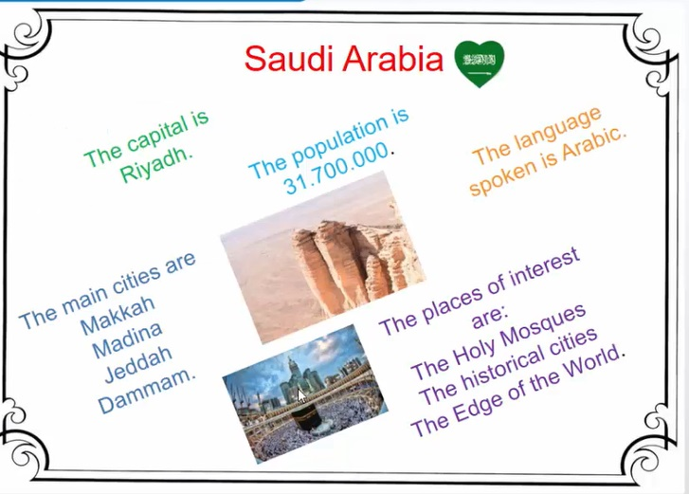

Slide 8
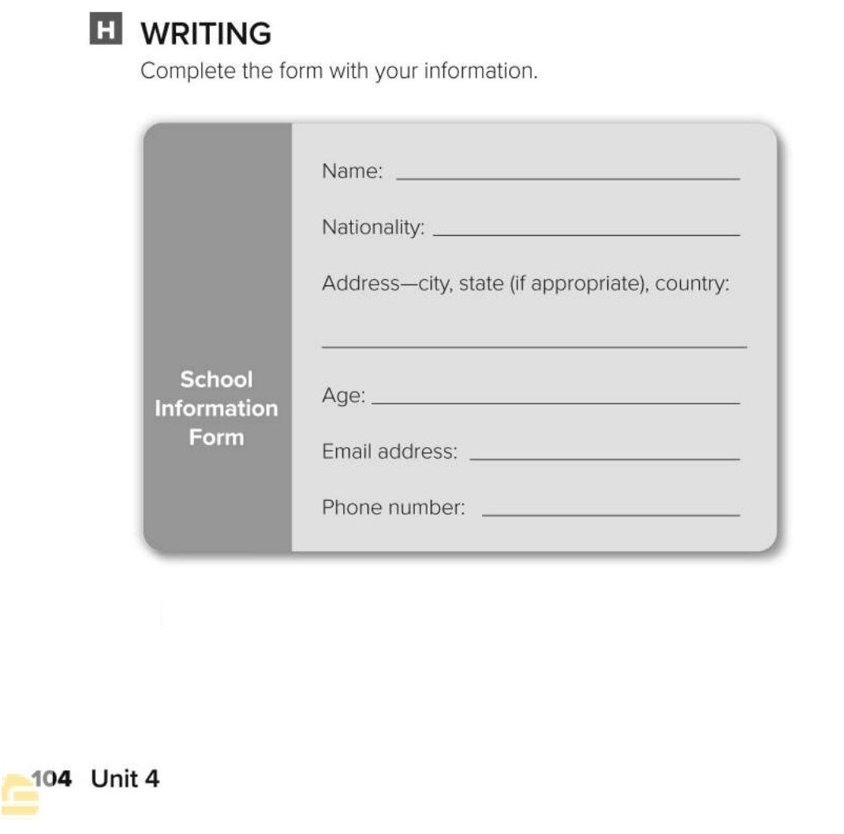
Naif Abdullah
Saudi
Riyadh, Saudi Arabia.
13
a.friend@mail.sa.
(243) 832-3452

Slide 9
Choose the correct answer :
1-
My address is …….
a.friend@mail.sa.
25674 Prince Street
2-
3-
dash
Full stop
at
parentheses

Slide 10


Slide 11


Back

Slide 12


Back

