Slide 1
Mega Goal 2.1
U: 3
Far and Away
Conversation
By: Yousef Hilal Alyazedi

Slide 2
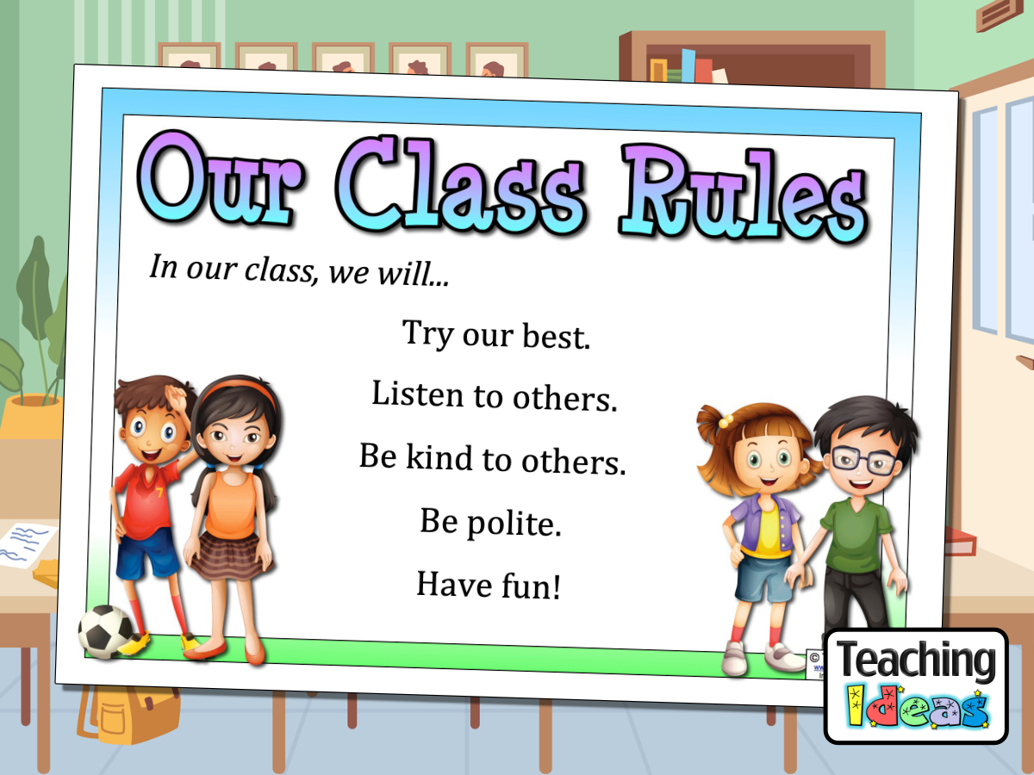

Slide 3

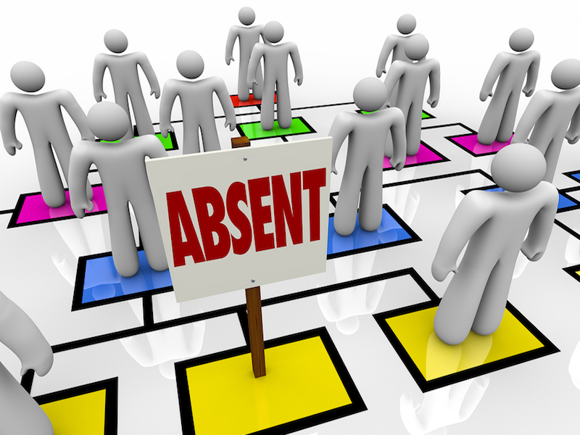

Slide 4


Lesson Objectives
The students will be able to :
1 – Name stuff to take along when traveling .
2 – Use the new words in a conversation .
3 – Use the “ real talk " phrases in new sentences .
4 – Make special requests .
5 – Declining special requests .
6 – Match words with their meanings .

Slide 5
Books Closed

Slide 6
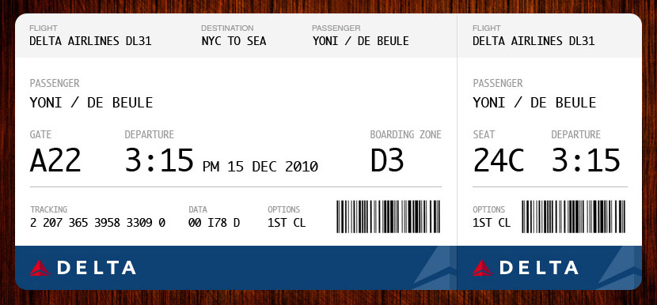
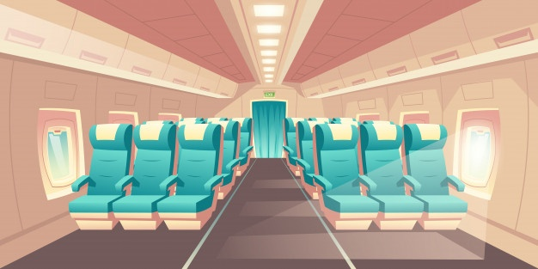
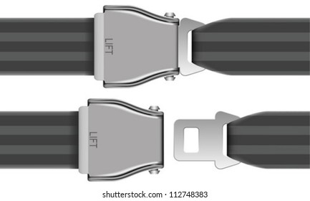
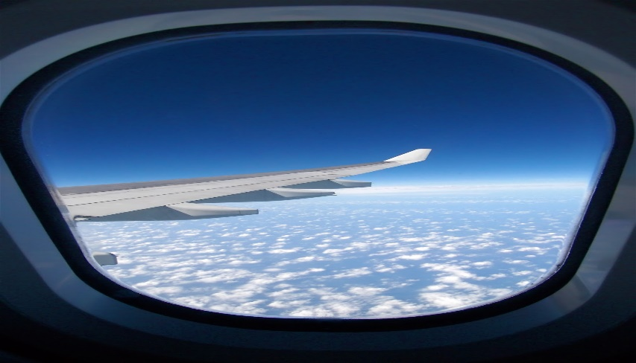
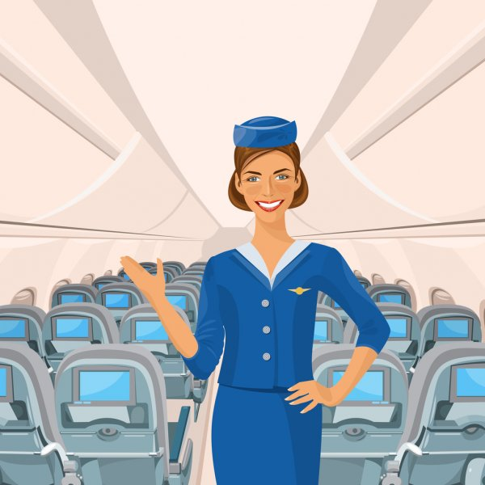
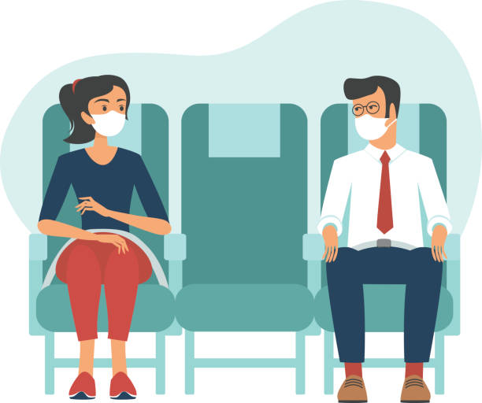
Discuss the following pictures :
Boarding pass
seatbelt
isle
Passenger
window
Attendant

Slide 7
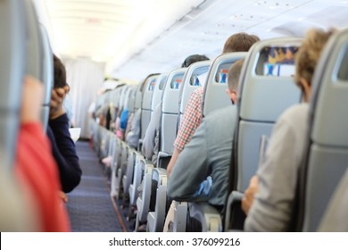
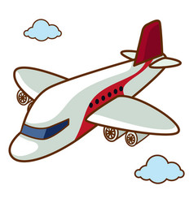
What do you do when you board a plane ?
Do you have to sit in your assigned seat ?
Where do you like to sit—by a window or on the aisle ?

Slide 8

Listening Time
You are going to listen to an attendant and a passenger on the plane .

Slide 9
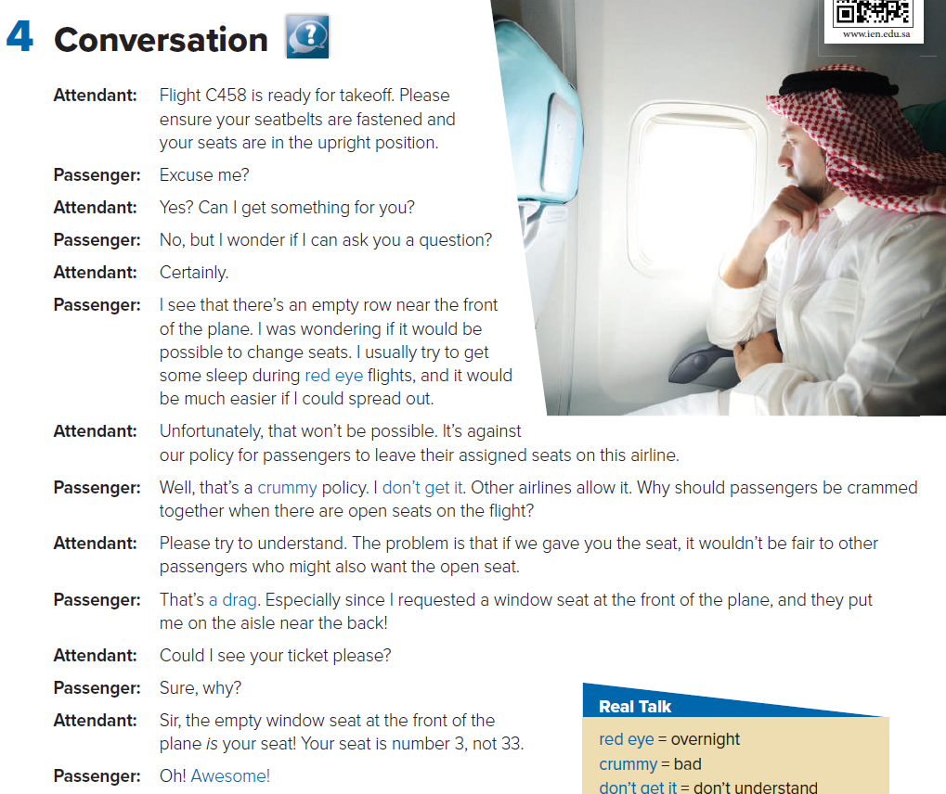


Keep UR books closed

Slide 10
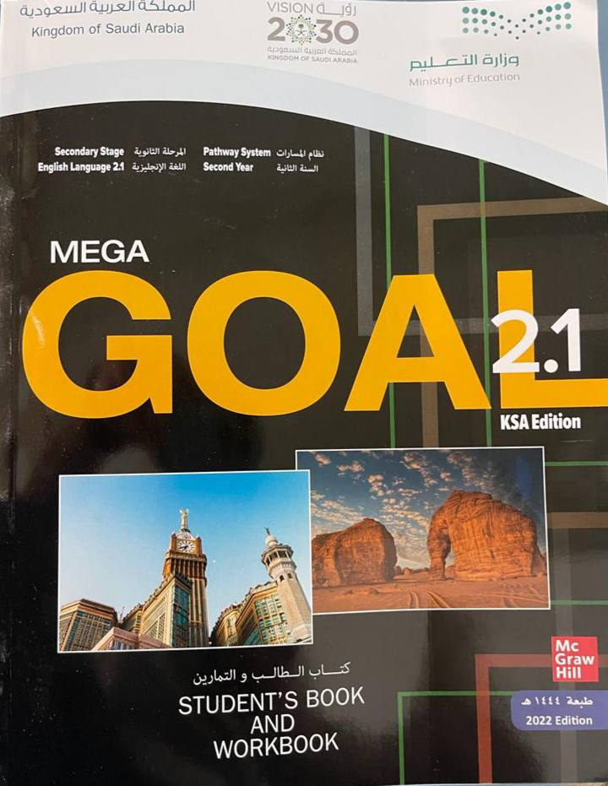

Open your Student’s book at page: 38

Slide 11
Listen “ N” Read

Slide 12
How many characters in this conversation ?
Who are they ?
Where are they talking about ?
What are they talking about ?

Slide 13
What is your opinion of the man’s request?
Was it OK to ask for the seat change ?
What do you think of the airline policy ?

Slide 14
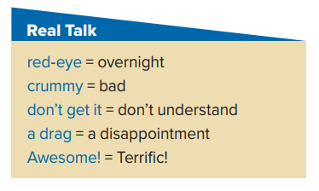
He was running to catch a red-eye to New York .
I had a crummy flat when I first came here .
Why don’t you allow to change my seat ? I don’t get it .
Our holiday was a bit of a drag .
Their last celebration was really awesome .

Slide 15
Why do you think that overnight flights are called red-eye flights ?
Because overnight travelers are usually very tired and have red eyes .
Are the expressions crummy and a drag formal or informal expressions ?
They are informal. Crummy especially is not very polite and should be used with care .
What doesn’t the passenger get ?
He doesn’t know why he can’t sit in the open seat .
Why does the passenger say Awesome! at the end of the conversation ?
He’s happy that he will get the seat he wanted .

Slide 16
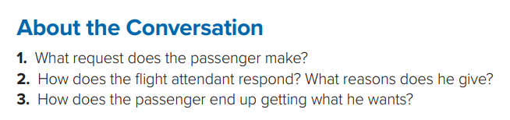
1- He would like to change seats .
2- He says that changing seats won’t be possible because it wouldn’t be fair to other passengers. It’s also against the policy of the airline .
3- The passenger was in the wrong seat to begin with. He moves to his assigned seat, which is the one that he wanted .

Slide 17
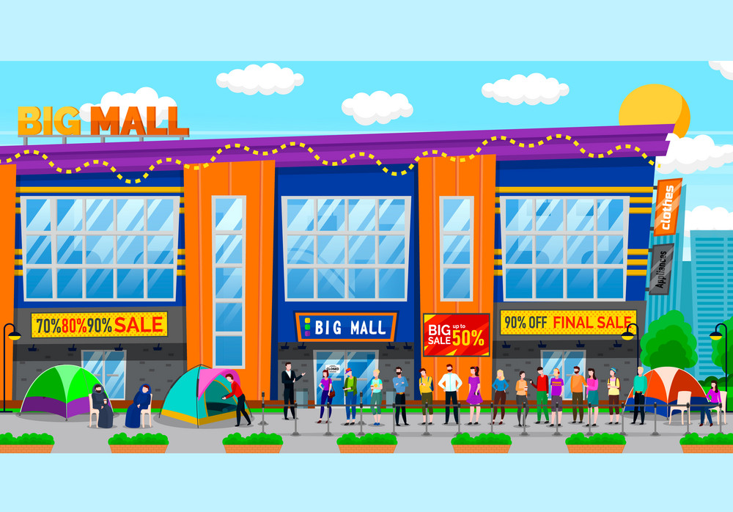
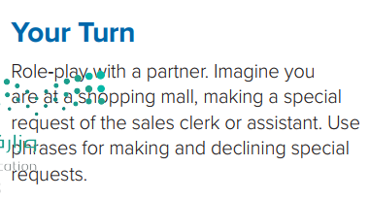
Your Turn

Slide 18
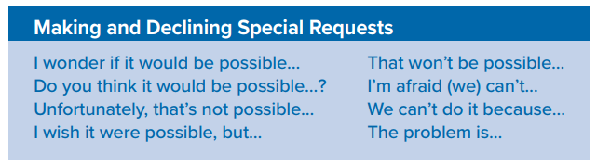
These are expressions for Making and Declining Special Requests
Using phrases like these makes the request sound more polite.

Slide 19
find examples of the phrases in the Conversation.

Slide 20

Workbook P. 106
Exercise G

Slide 21
