Slide 1

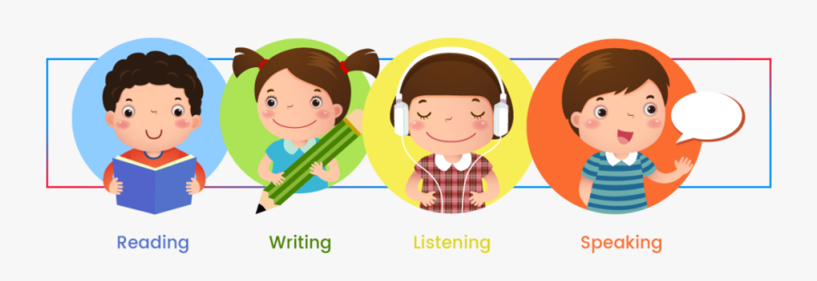

Slide 2
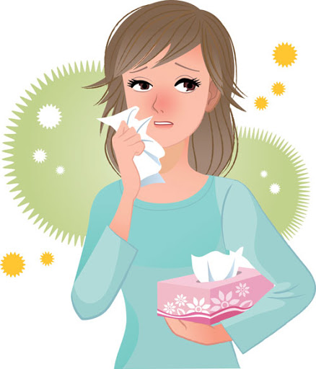
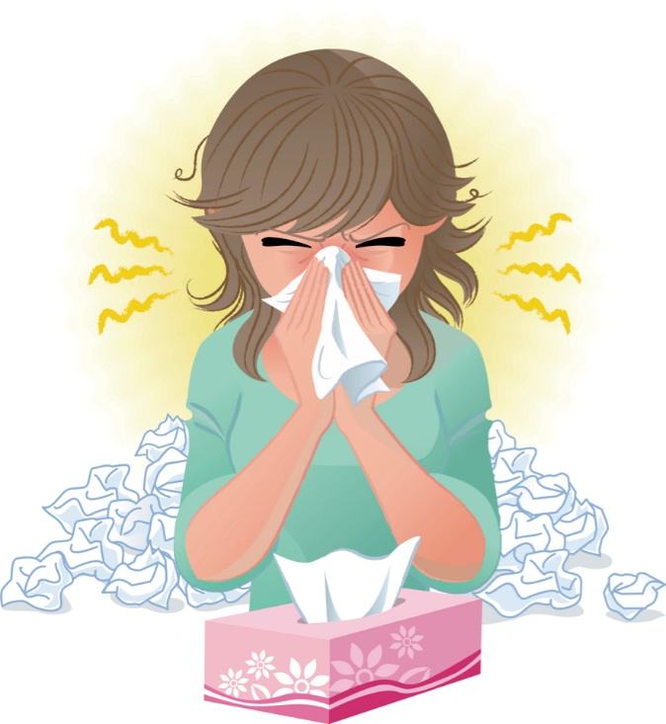

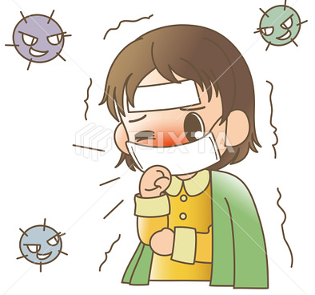
Covid 19
☺Avoid gathering !
☺We must wear a mask before
going out.
☺Social distancing is not a
choice, it is a must!
☺Keep a distance of 2 meters
to avoid accountability
☺wash hands constantly.

Slide 3


Slide 4
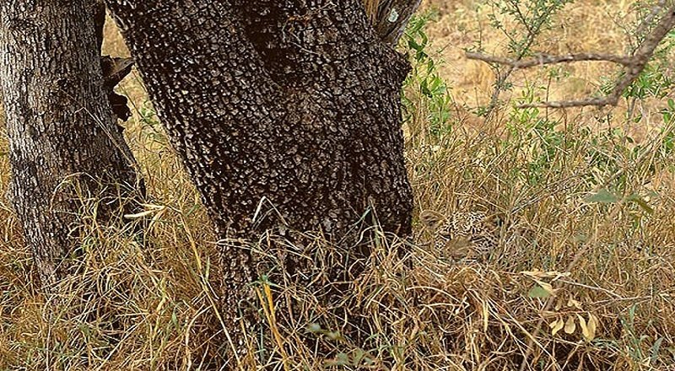

Slide 5



Today is Monday - 4- Favorite Pastime Date / 2nd –Rabiawal - Form , meaning and Function
♥
☺
- We are going to use gerunds and
infinitives as noun .
☺
♥

Slide 6
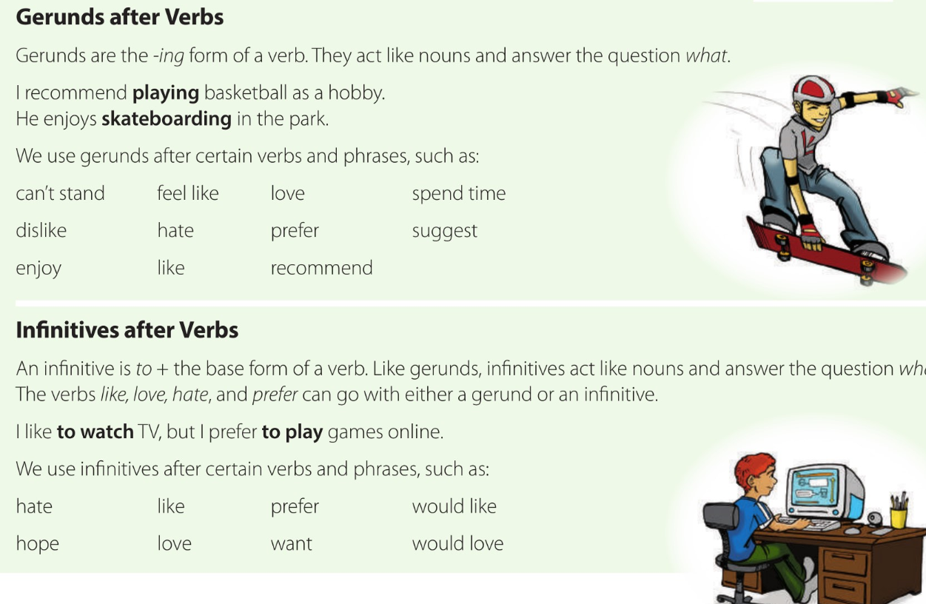
Page 33

Slide 7
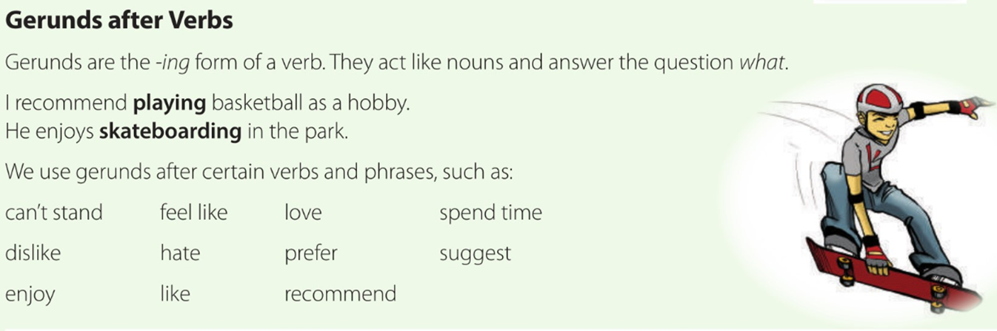
What is he doing ? Is it a pastime or hobby for you? You are familiar with the –ing form of verbs used with present progressive. E.g. She is painting . ing-form also can used as a noun. It calls a gerunds.
He is skateboarding .

Slide 8
GERUNDS
How to form them.
walking
Gerunds are nouns formed from verbs
talking
thinking
eating
Gerunds are defined as the ”ing” form of a verb. They have several functions .It can be subject or object.
Notes:
IS USED TO SHOW TWO EVENTS RELATING

Slide 9
GERUNDS
Can be used :
2
Like –love– enjoy – prefer – hate
Continue – start – finish – stop –begin
After certain verbs
Keep – avoid – imagine – practice – suggest – risk – spend(time)
Examples
Keep going and you will find the hotel.
He enjoys swimming in the sea.
Don’t stop running.

Slide 10
GERUNDS
Can be used :
3
After certain expressions
Don’t mind – can’t stand – be interested in – it’ worth – how about – can’t help – feel like - there’s no point
Examples
I can’t stand being sick.

Slide 11
Now we'll be challenging. Let's go.

Slide 12
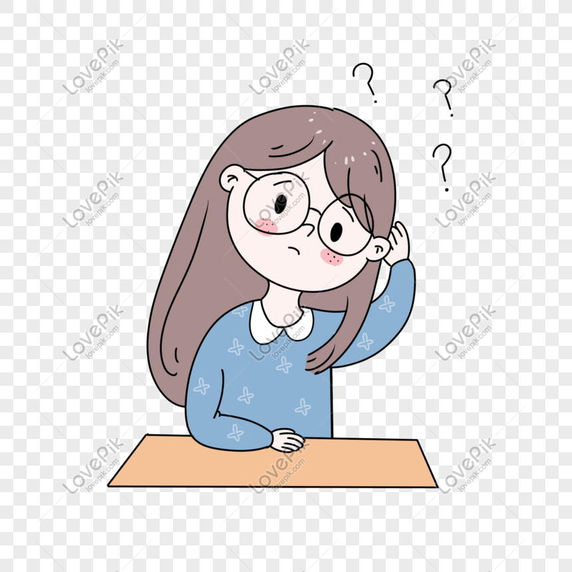
Are these sentences gerunds? Put T or F
They enjoy playing video games.
False
True

Slide 13
They are reading now
False
True

Slide 14

Arrange the next sentence
Football
We
Playing
prefer
We prefer playing football

Slide 15
Arrange the next sentence
likes
Sleeping
She
She likes sleeping

Slide 16

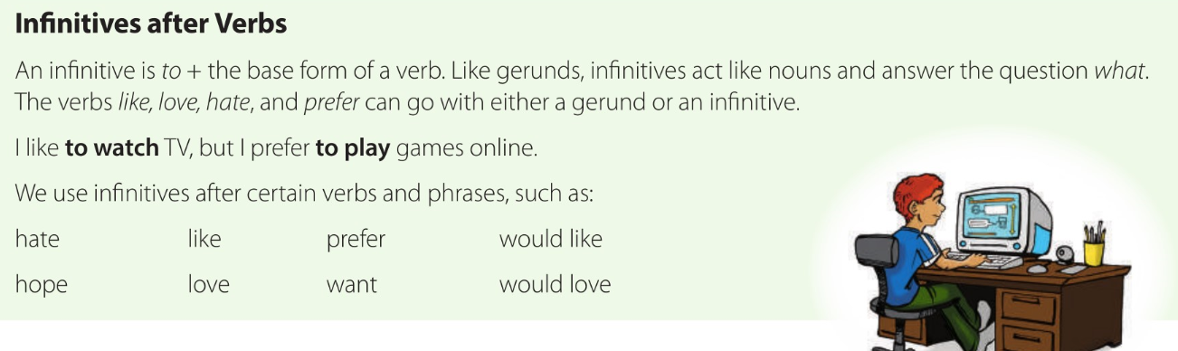
to + Verb
Page 33
The infinitives can also be used as nouns.
I would like to _____.
I would love to _____.
I hope to _____.

Slide 17
infinitive
to + verb = infinitive
Important Note: Because an infinitive is not a verb, you cannot add s, es, ed, or ing to the end.

Slide 18
2
When to use :
Verbs of thinking-saying - feeling
After certain verbs
Want – would like – would love- decide – forget – learn- teach – need- plan- promise- try- hope- manage -arrange – choose – offer – refuse - expect
I promised to study hard for the exam

Slide 19
Full infinitive or GERUND
The verbs:
like – dislike – love – hate – start – begin
No change in meaning
Full infinitive
Gerund
I like to eat chocolate.
I like eating chocolate.

Slide 20
Now use the link in your chat
https://wordwall.net/resource/5457212/choose-correct-answers

Slide 21

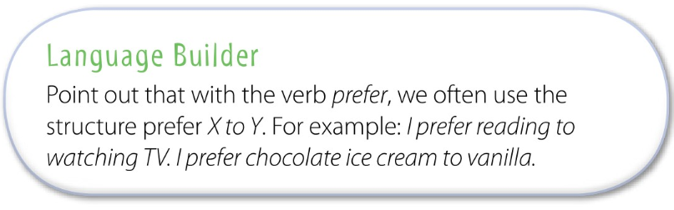

Slide 22
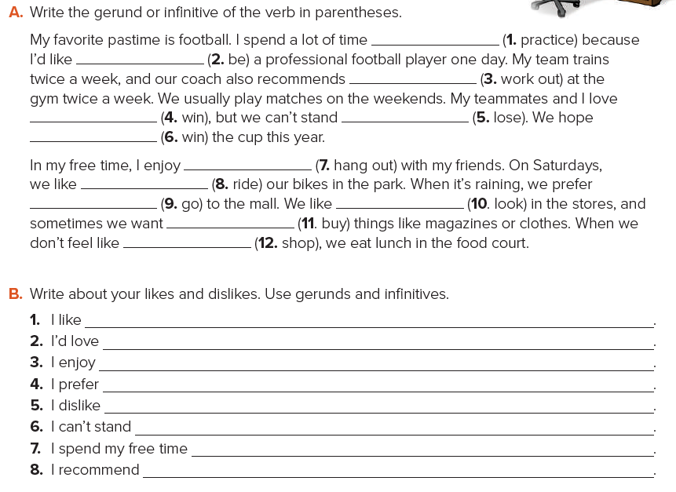
practicing
to be
winning/to win
to win
hanging out
riding/to ride
going/to go
to buy
shopping
working out
losing
looking/to look
I like playing video games.
I’d love to travel around the world.
I enjoy making model planes.
I prefer to send text messages.
I dislike watching TV.
I can’t stand cooking.
I spend my free time reading books.
I recommend working out at a gym.

Slide 23
Now use the link in your chat
https://www.menti.com/vssp7w924i

Slide 24
practicing
to be
winning/to win
to win
hanging out
riding/to ride
going/to go
to buy
shopping
working out
losing
looking/to look
I like playing video games.
I’d love to travel around the world.
I enjoy making model planes.
I prefer to send text messages.
I dislike watching TV.
I can’t stand cooking.
I spend my free time reading books.
I recommend working out at a gym.

Slide 25







Assign page 104 for additional reading and writing
practice.

Slide 26
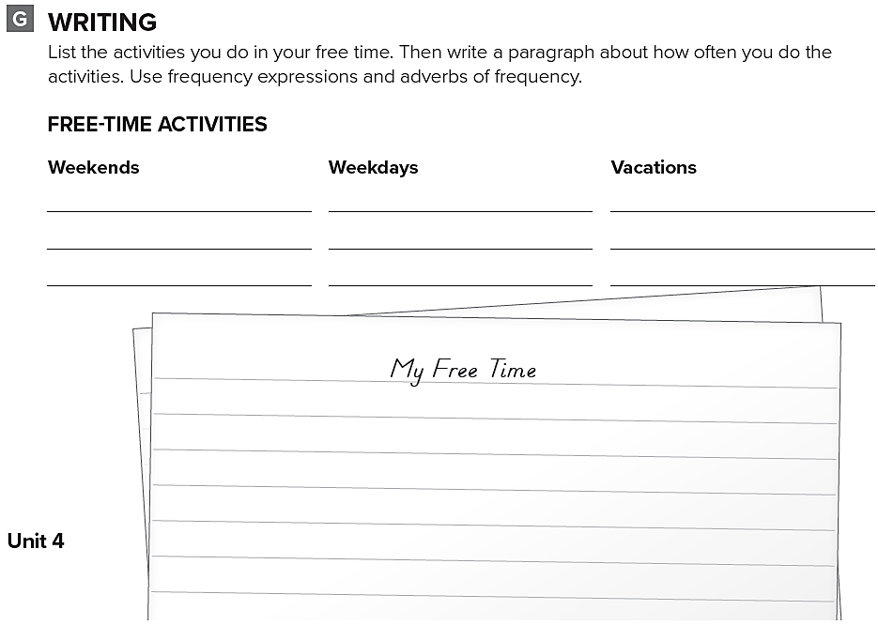
play football
go shopping
watch TV
play videogames
sailing
hiking
I usually play football with friends on weekends .
Also I sometimes go shopping .During weekdays I often watch TV at night, and play video games with my brother before dinner.
I sometimes go Sailing on vacations in summer. and I go hiking on spring vacations.

