Slide 1
U 4 Reading
Tr. Nora Khalid

Slide 2

Goals:
1- read for specific information using “scanning strategy” .

Slide 3

What’s your favorite hobby?

Slide 4
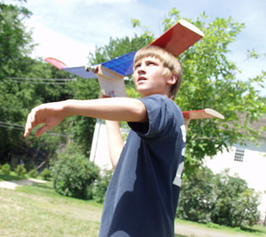
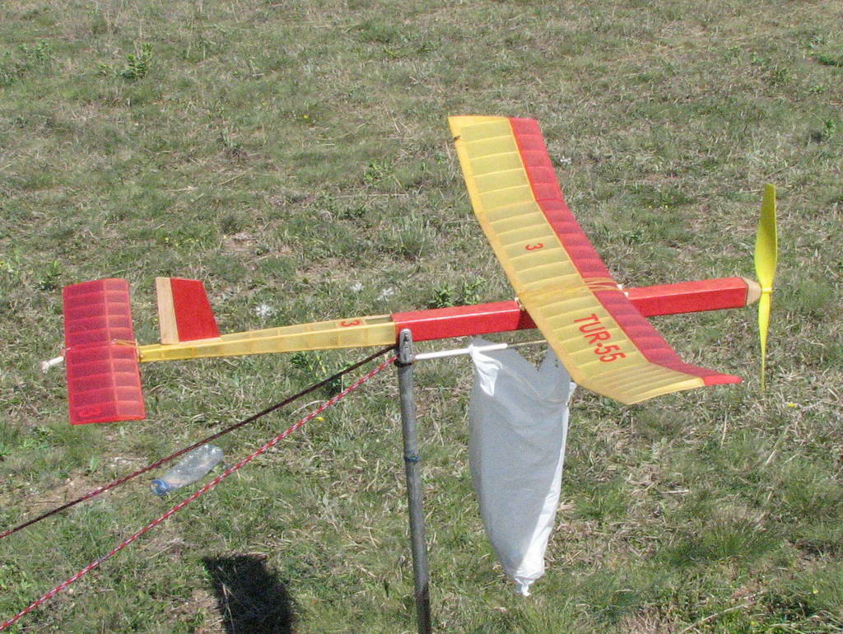
What can you see in these pictures?
Aeromodelling

Slide 5
Do you or anybody you know fly aeromodels?
What kinds of questions do you have about aeromodelling?

Slide 6
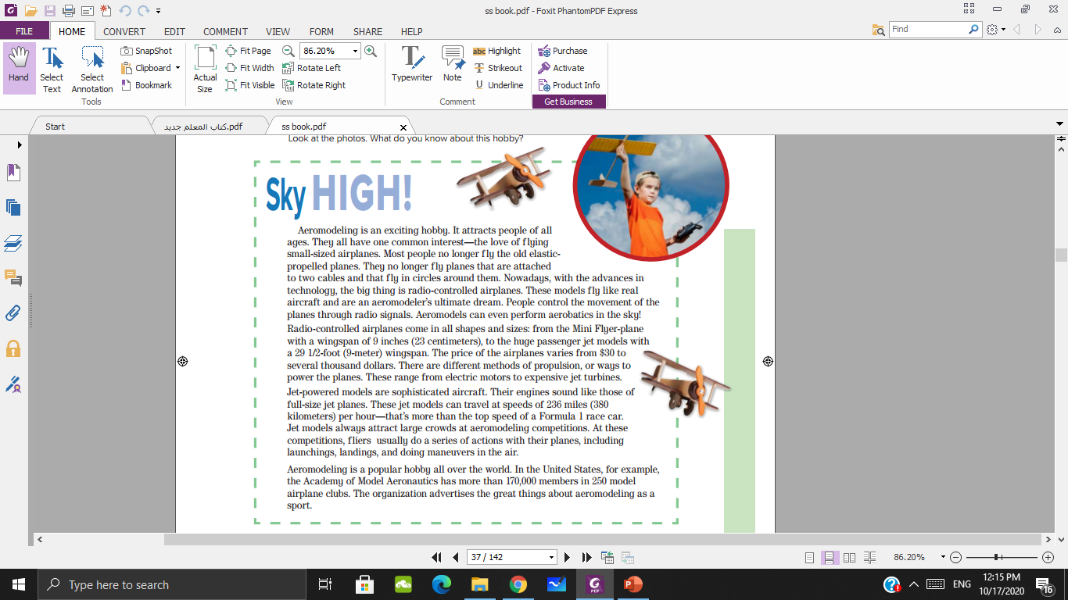
What’s the title?
How many paragraphs?

Slide 7


Slide 8
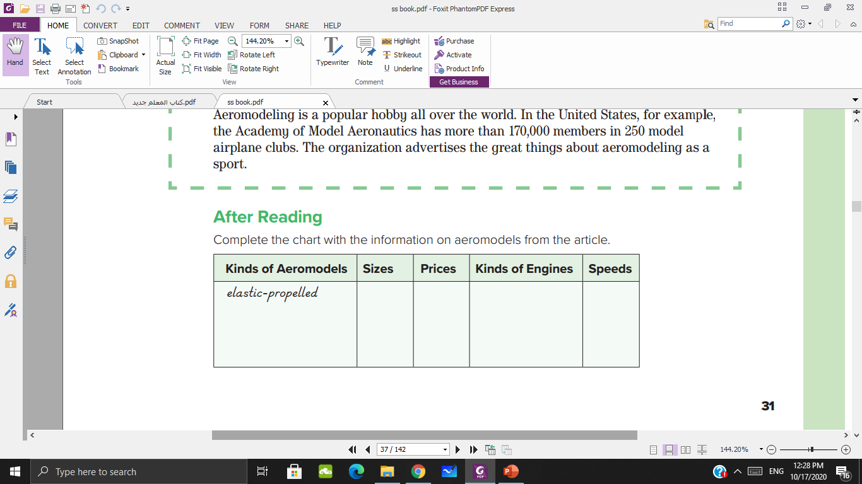
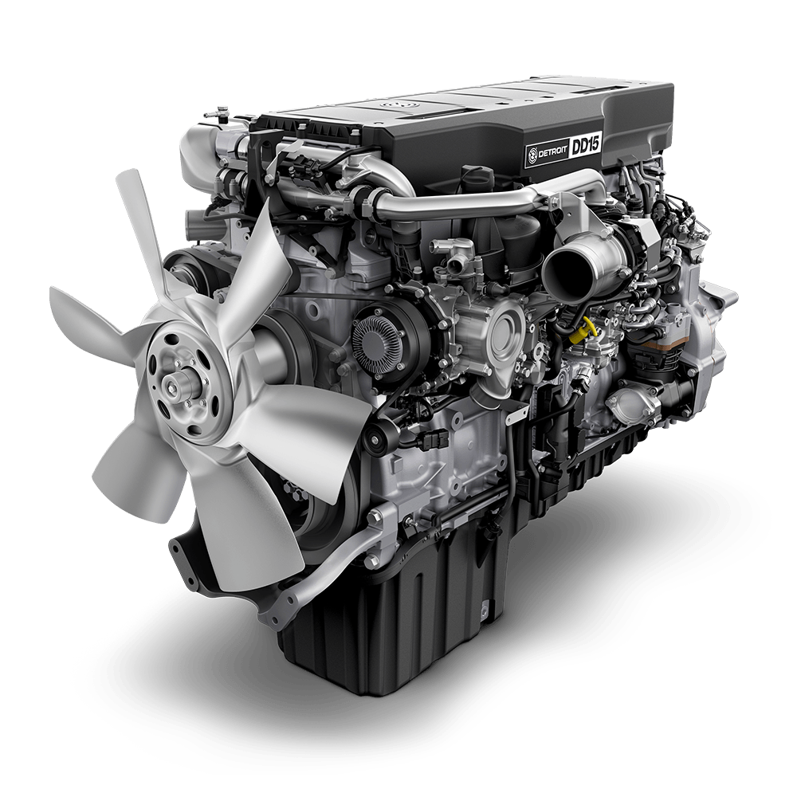



Dollar
$
Turbine
Electric
Per hour
miles
Centimeter
inches

Slide 9

Scanning strategy

Slide 11
planes attached to cables
radio-controlled
jet-powered
23 cm to 9 m
$30 to several thousand dollars
Electric motors to jet turbines
Up to 380 km per hour

Slide 12
How much does the hobby cost locally? Where can people get aeromodels?
Are there clubs or competitions anywhere in the country?

Slide 13
Thank you

