Slide 1


Slide 2


Good Morning

Slide 3
Mega Goal3.1
Influential People

Slide 4
Reading
Speaking

Slide 5
Goals:
1-Complete the chart with notes about how to be successful in life
2-Discuss how to be successful in life without depending on others
3-Classify the ideas according to the text
4-Scan & Skim the reading text for specific information about Sheik Suleiman Al-Rajhi
5-Find the meanings of new words in the text
6-Answer some questions about the passage
7-Indicate the most difficult business to establis
8-Name the common endowments in the Muslim world
9-Point out the reason Al-Rajhi decided to donate most of his fortune

Slide 6
Reading

Slide 7
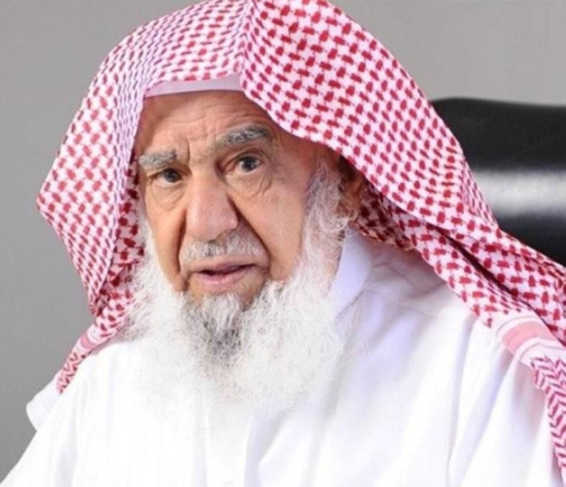
Sheikh Sulaiman bin Abdul-Aziz Al-Rajhi
He is a great philanthropist and a very successful businessman and billionaire who introduced Islamic banking into the world

Slide 8
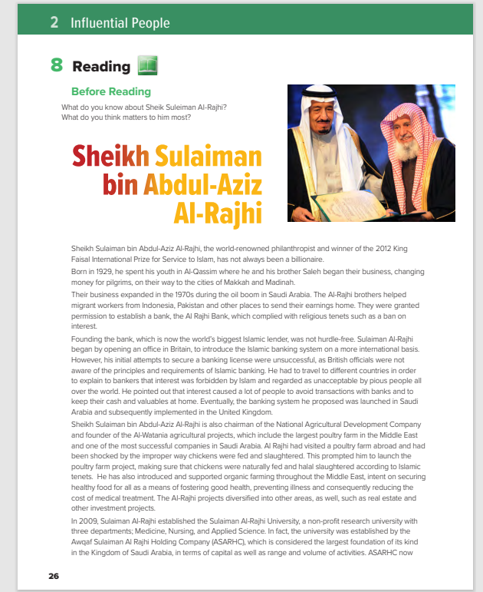
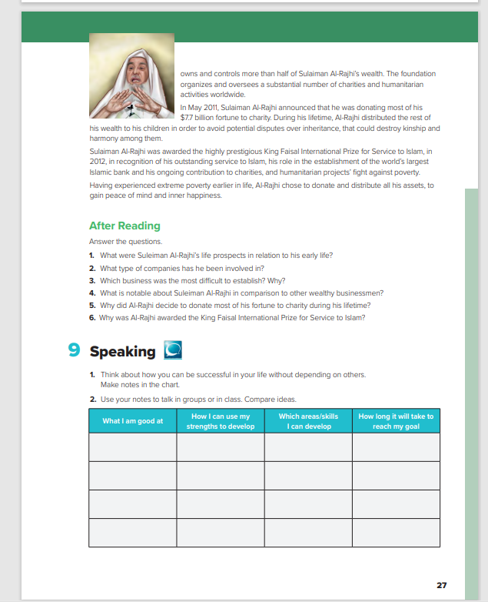

Students Book.
26_27

Slide 9
Where do you think this photo was taken?
Students may not know the exact answer but elicit that it was probably during an interview or awards ceremony
Does he look like a successful businessman?

Slide 10
READING STRATEGY
3 (Write 3 things you found out.)
2 (Write 2 interesting things.)
1 (Write 1 question you still have.)
Notes:
Tell students that they will read the text, and then follow the directions for the 3-2-1 activity on the board. Give students a specific amount of time to complete this activity

Slide 11


Slide 12

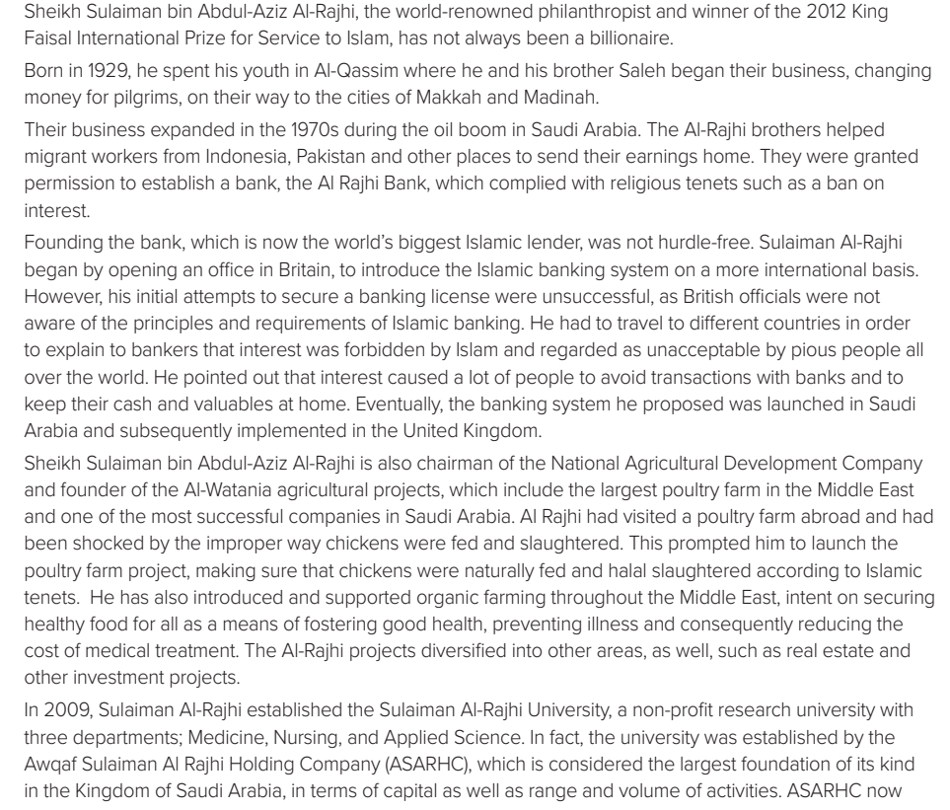
Which words are used to describe Sulaiman AlRajhi?
world renowned philanthropist, billionaire, successful businessman, dedicated, committed to..
Which were the main characteristics of the Al Rajhi Bank?
It complied with the tenets of Islam, such as a ban on interest.
What does the writer say about the process of founding the first Islamic bank?
It was not hurdle free
Notes:
Discuss with students what each word means in the context of the article. Ask questions, such as the following:

Slide 13
What is the role of Sheikh Sulaiman bin Abdul-Aziz Al-Rajhi in the Al-Watania agricultural projects?
He was the founder of Al-Watania.
Was the banking system that Al-Rajhi suggested launched for the first time in the UK?
(No, it was launched in Saudi Arabia and then implemented in the UK.)

Slide 14
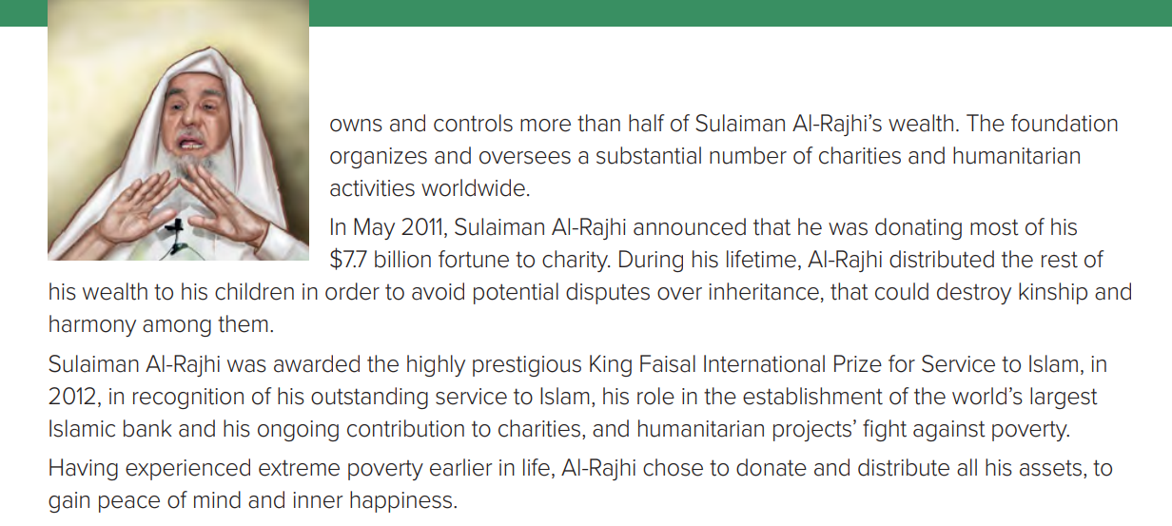
Why did he distribute the rest of his wealth to his children during his lifetime?
(In order to avoid disputes over inheritance.)
How did he gain peace of mind and inner happiness?
(By distributing his assets and becoming poor once again.)

Slide 15
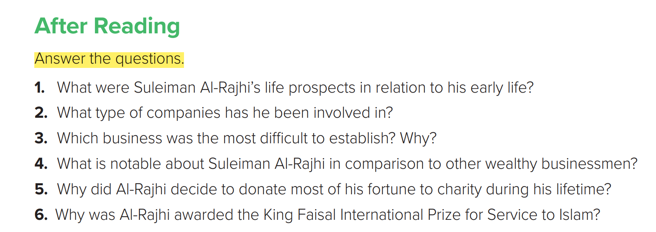
1.He did not seem to have much hope of becoming a billionaire.
2. Banking, agricultural development, organic farming, real estate, investment, health and more.
3. Islamic banking in the UK because British officials were not aware of the principles and requirements of Islamic banking.

Slide 16
4. His work and contribution to education, health and charities worldwide through ASARHC, the largest holding company of its kind in the Kingdom of Saudi Arabia.
5. Having been poor early in life, he was not afraid to donate and distribute his wealth so he could gain peace of mind and inner happiness.
6. He was awarded the prize in recognition of his outstanding service to Islam, his role in the establishment of the world’s largest Islamic bank and his ongoing contribution to charities.

Slide 17
Speaking

Slide 18
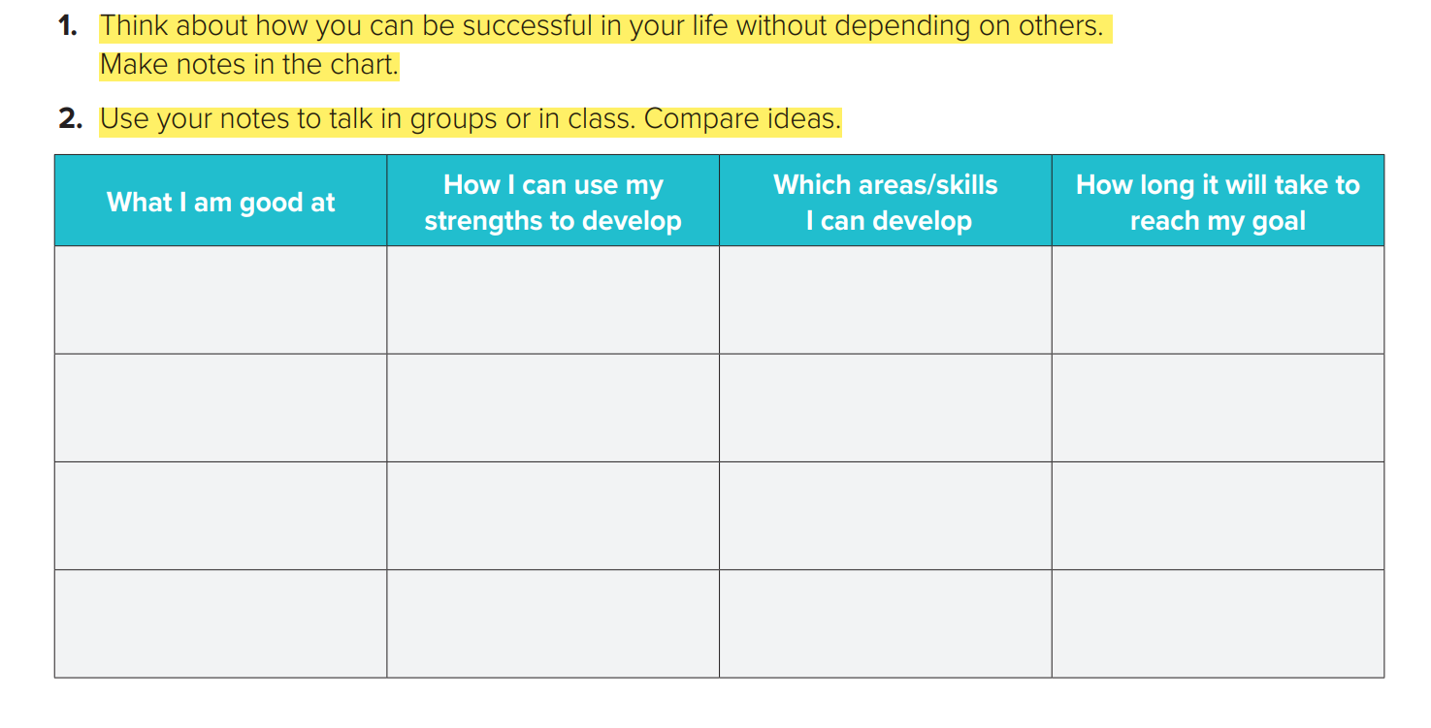


Slide 19
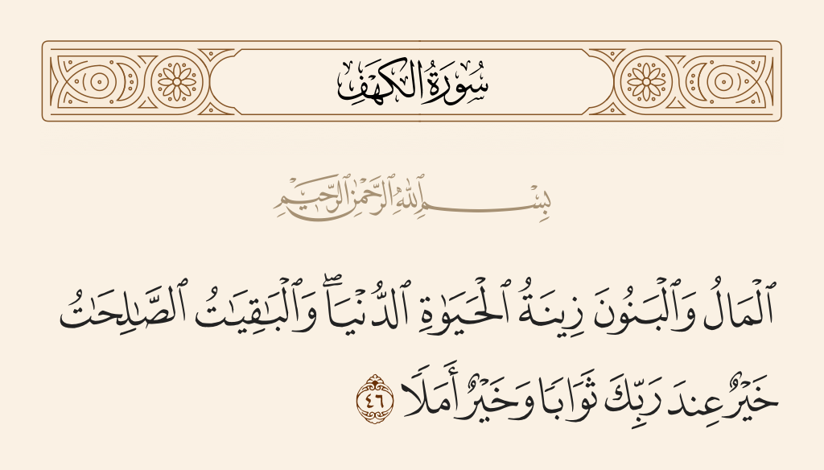

Slide 20


