Slide 1
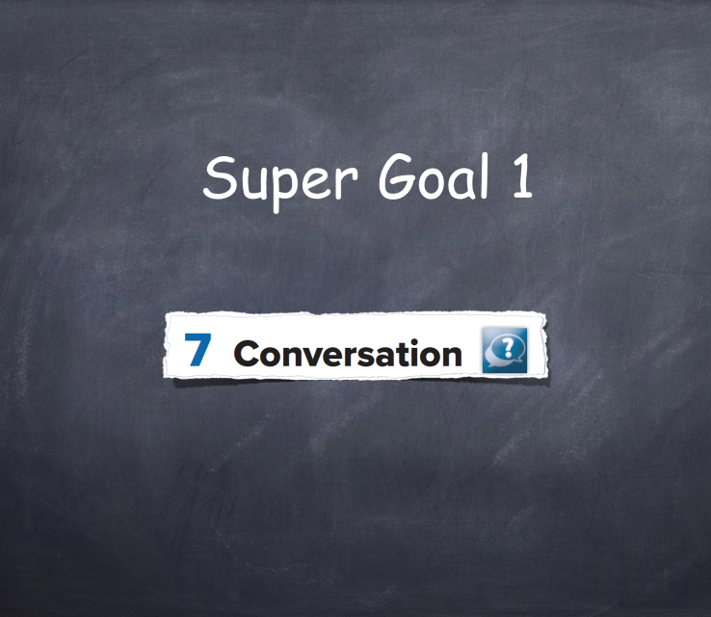

Slide 2

What animal that is not exist in our planet any more?

Slide 3
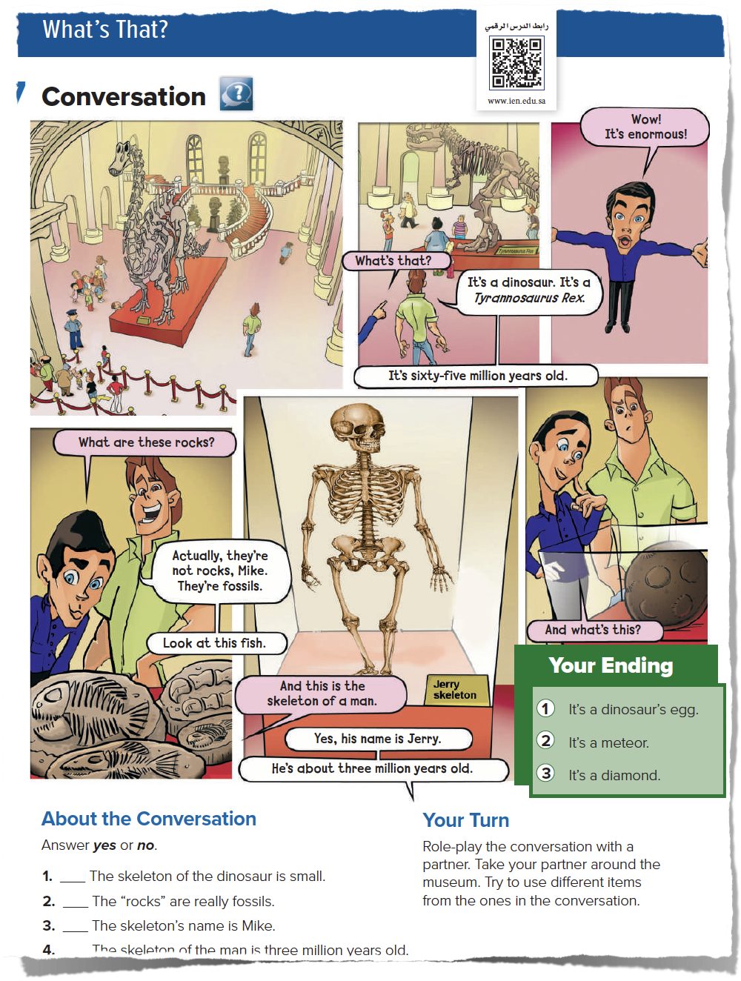
Page 22
Lesson’s Objectives

Slide 4
Today’s strategies
Picture Reading
Role play
Brainstorming

Slide 5
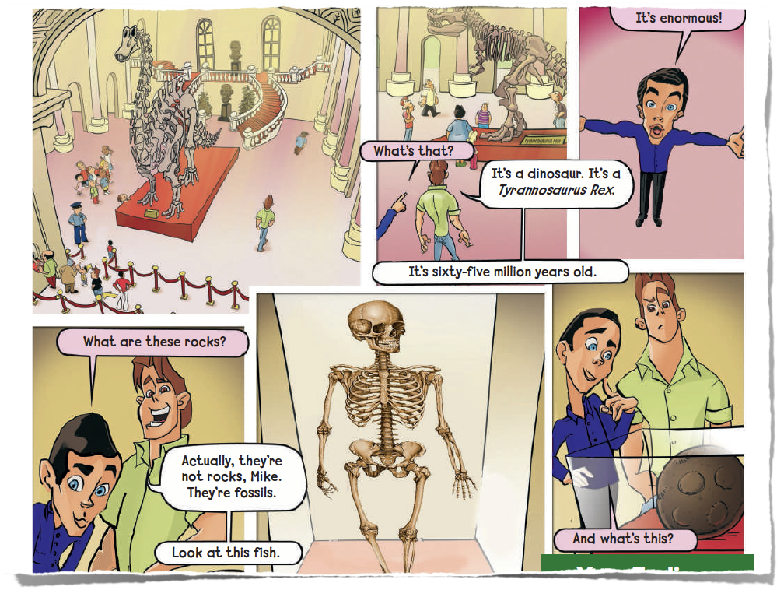
What do you see?
How many characters are there?
Where are these people?
Now listen to the conversation

Slide 6
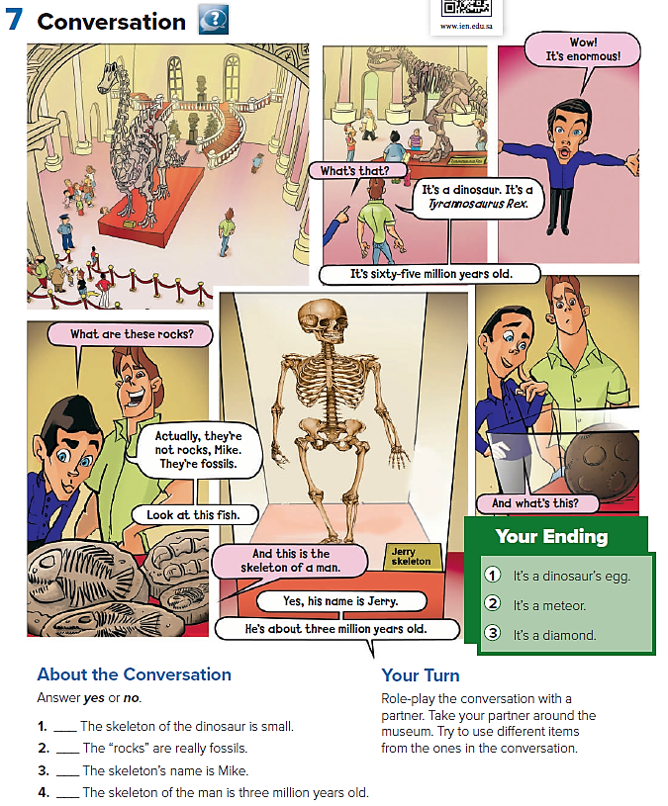


Slide 7
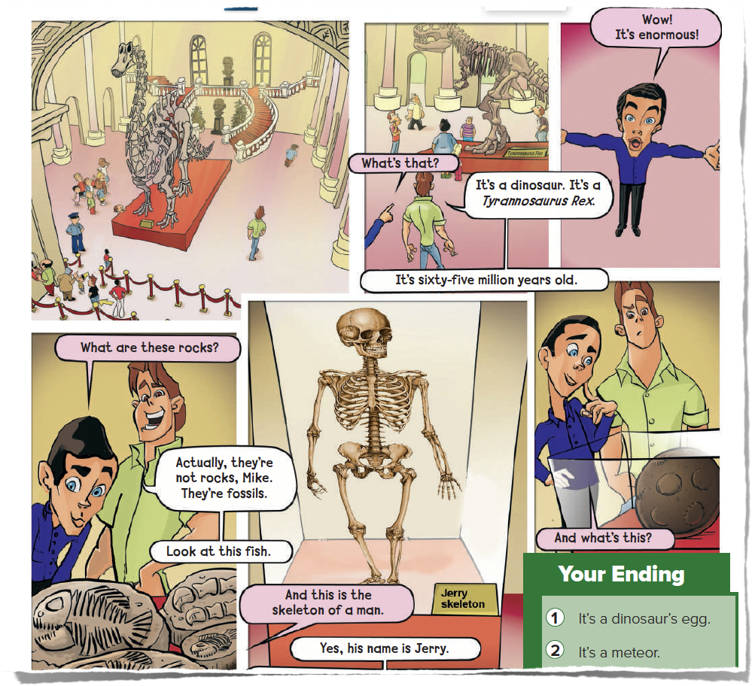
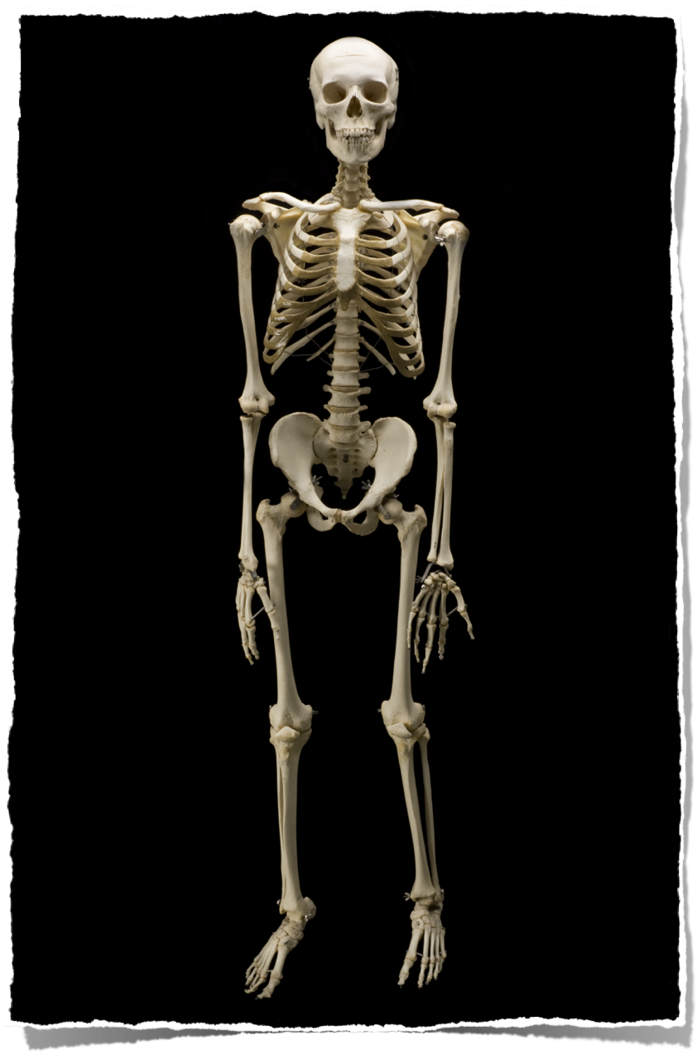




Slide 8
How many bones in your body?
206 bones

Slide 9
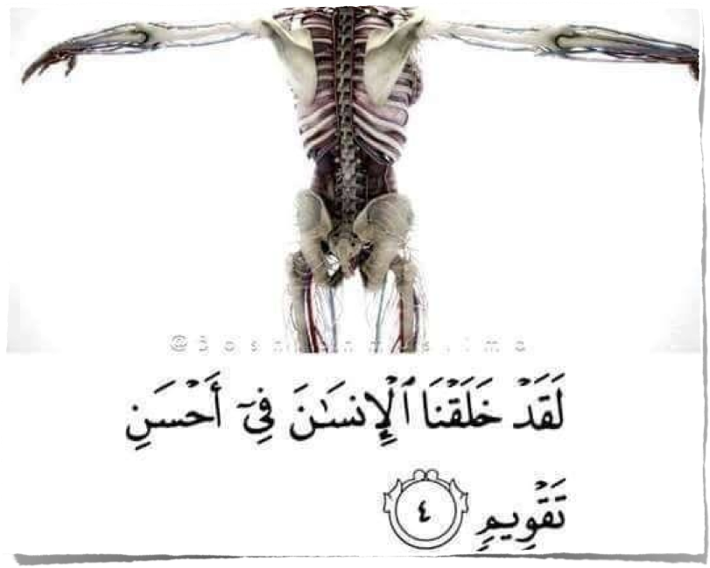

Slide 10
Do you know that there are fossils in Saudi Arabia?!

Slide 11
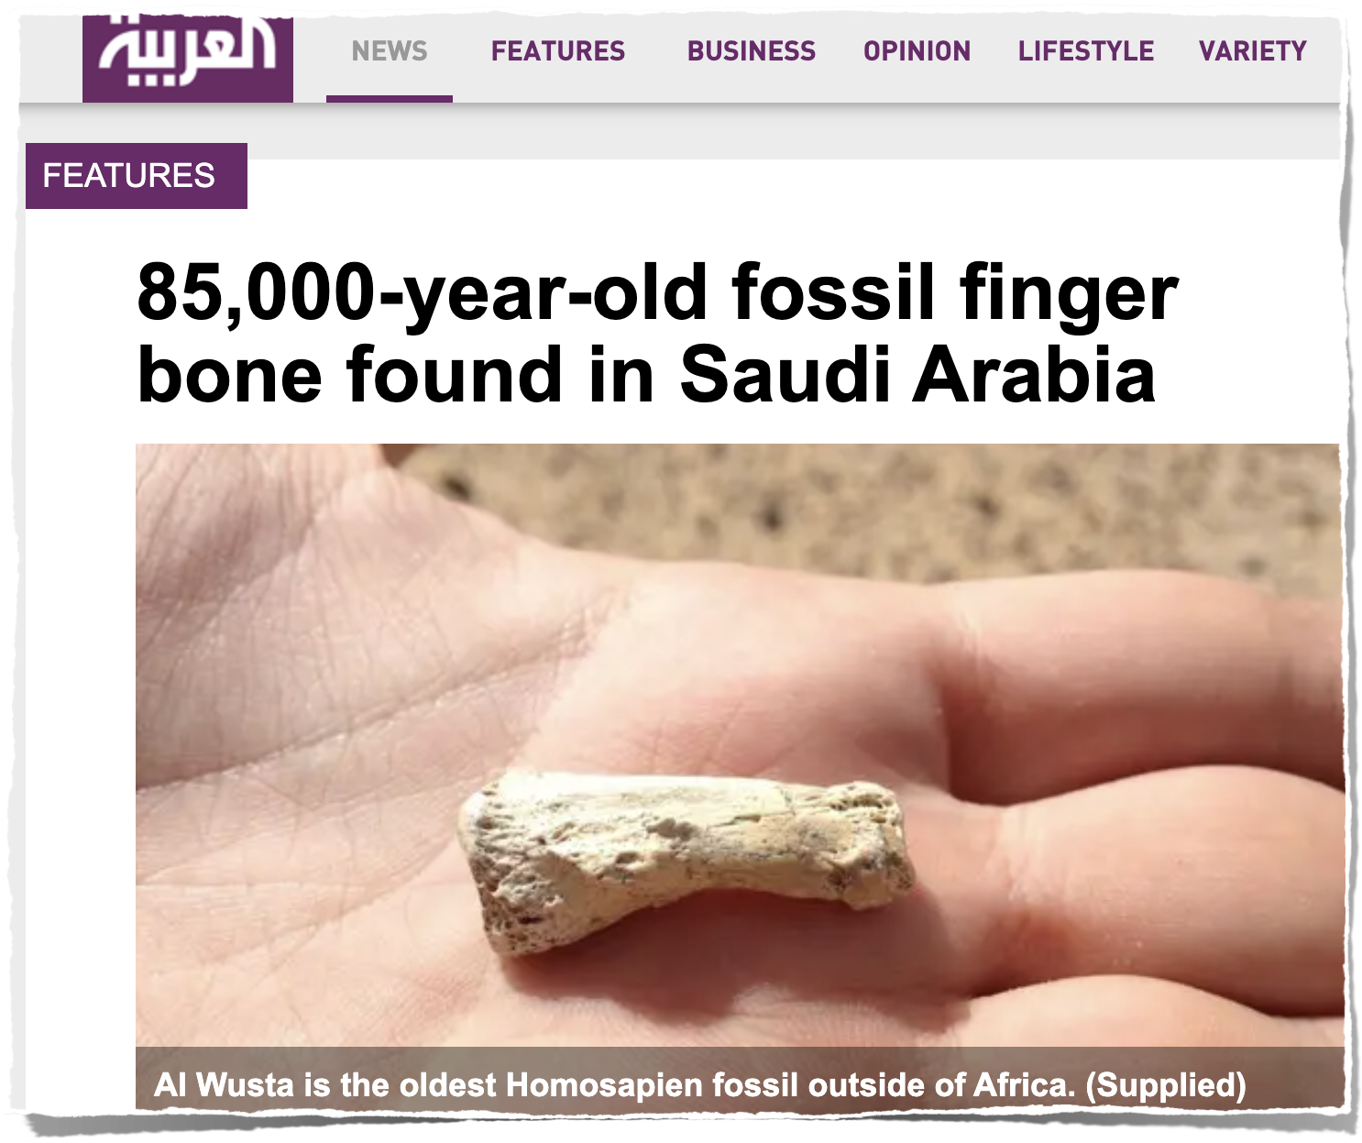

Slide 12
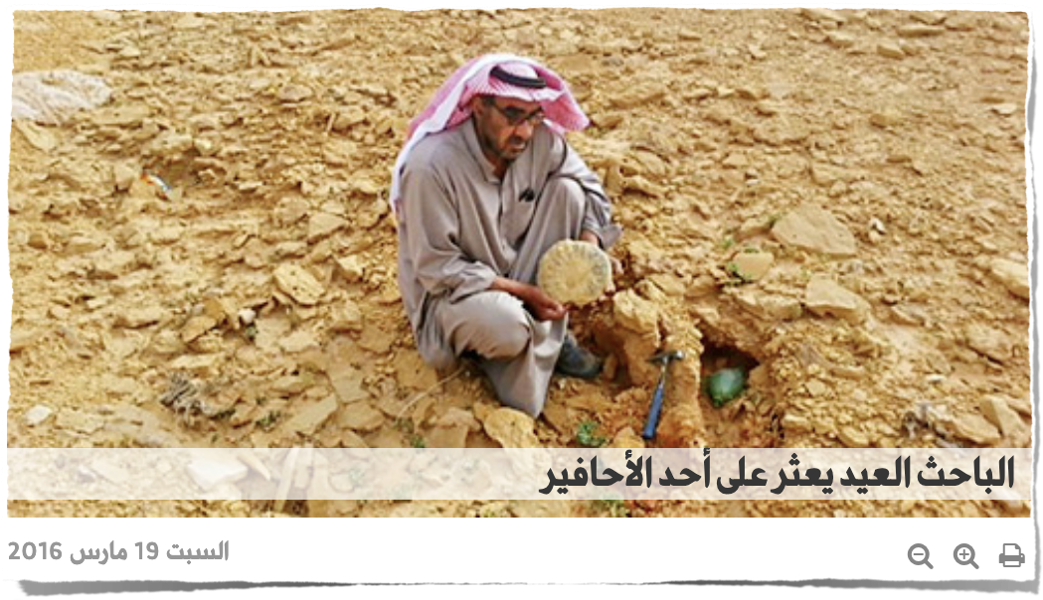

Slide 13
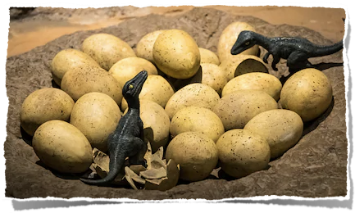
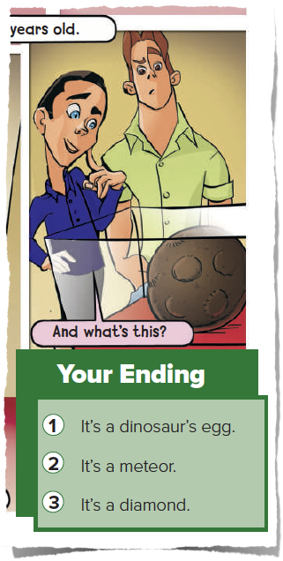
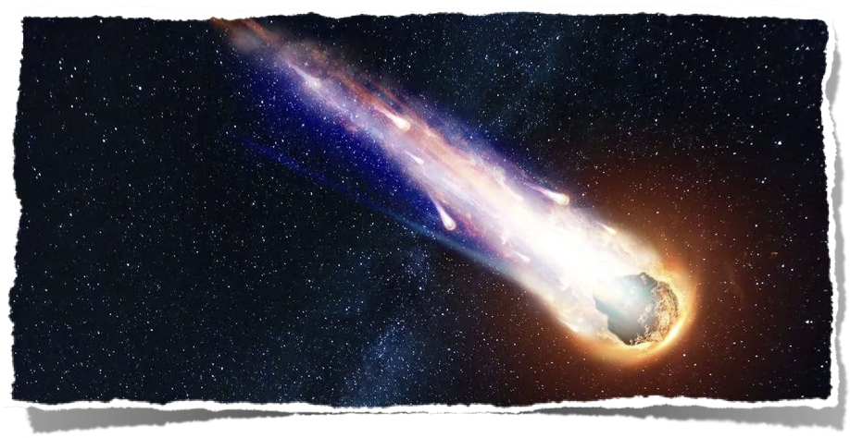
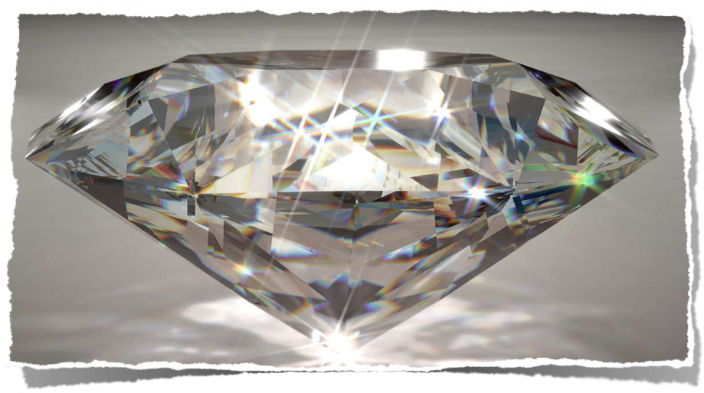
Which ending do you agree with?

Slide 14
It is time to read

Slide 15
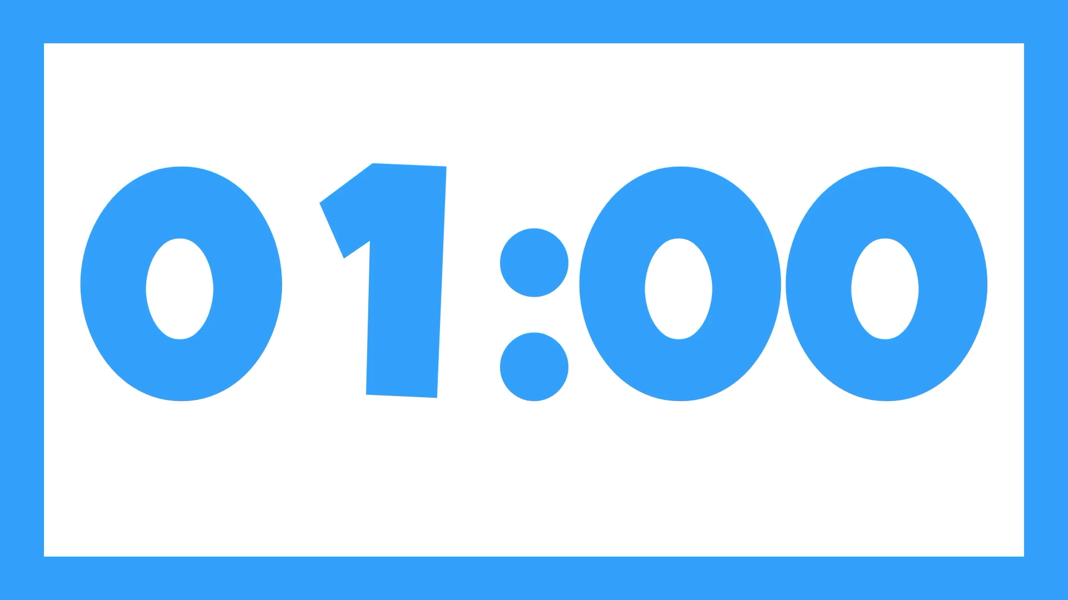
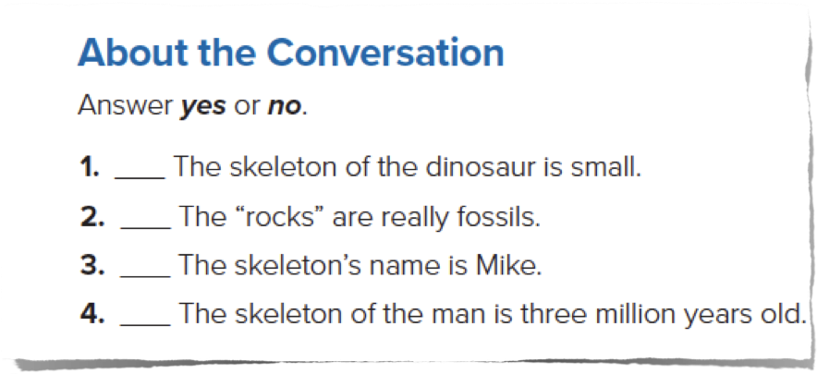
Page 22
No
Yes
No
Yes

Slide 16
The name of the dinosaur is : Tyrannosaurus Rex
True
False

Slide 17
What is this?
Skeleton

Slide 18
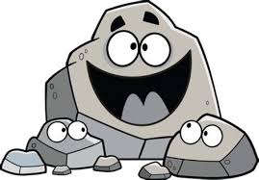
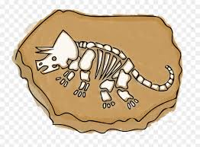
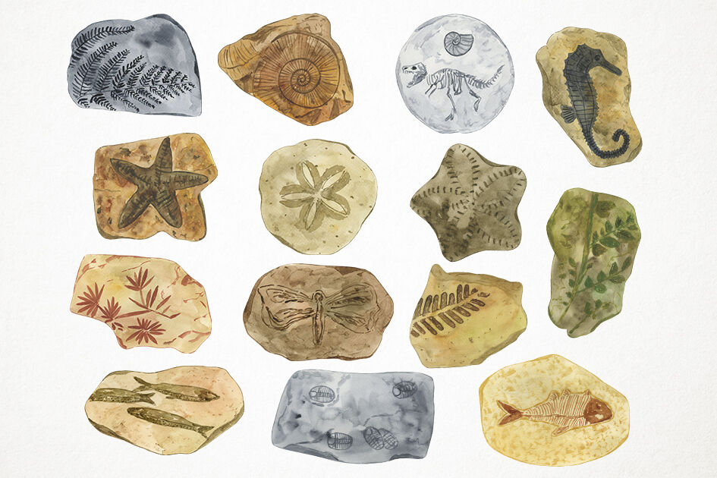
Match
Fossils
Rock

Slide 19
The skeleton's name is
Mike
Jerry

Slide 20
Find the word that means (very big) in the conversation.
Enormous

