Slide 1
Our lesson today is :
Unit 5
Grammar
Page : 42

Slide 2
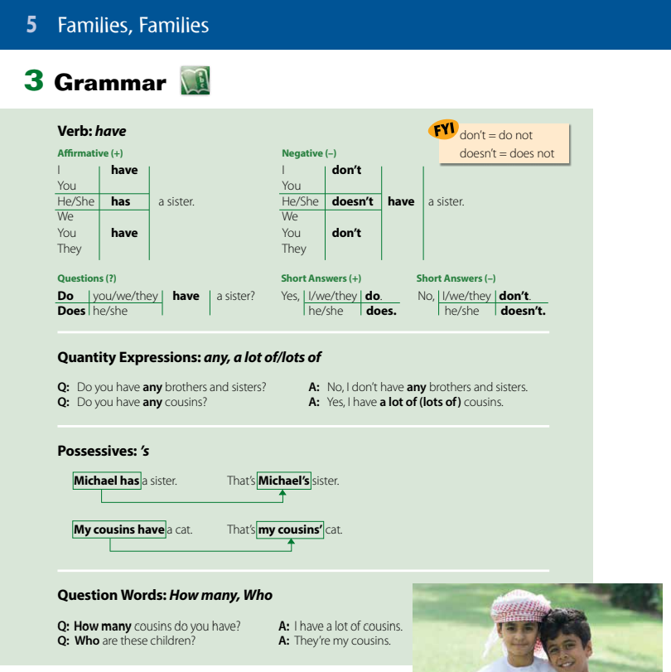
Page
42

Slide 3
Revision

Slide 4
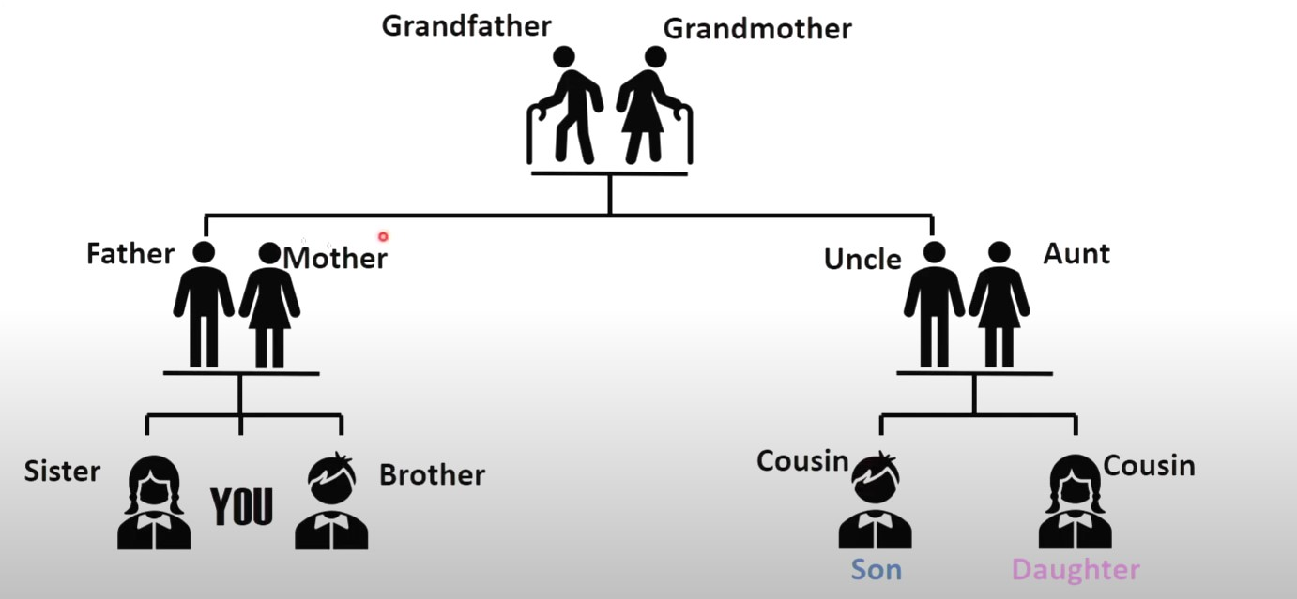
Family Tree
Grandparents
Parents

Slide 5
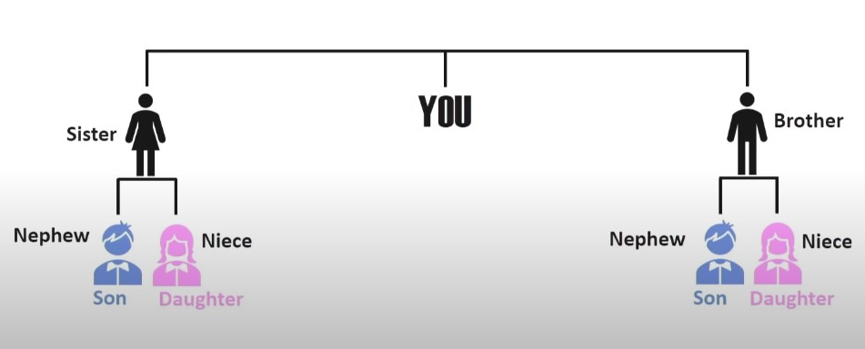

Slide 6

Verb Have
Have
Has
Affermative
I have a book.
You have a book.
They have a book.
We have a book.
He has a book.
She has a book.

Slide 7
I You we They
have
He She IT
has

Slide 8

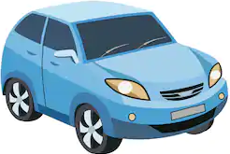
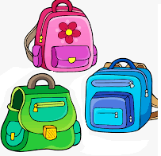

Choose ( have , has ) :
I ( have – has ) a ball.
He ( have – has ) a car.
We ( have – has ) three bags.
She ( have – has ) a pen.

Slide 9
Complete with ( have , has )
have
1- I _ _ _ _ _ seven books.
has
2- He _ _ _ _ _ _ a green jacket.
.

Slide 10
Verb have
في حالة النفي Negative
I have a book
You have a book
They have a book
We have a book
I don’t have a book.
You don’t have a book.
They don’t have a book.
We don’t have a book.
He has a book
She has a book
He doesn’t have a book.
She doesn’t have a book.

Slide 11
Make it negative
1- I have a blue shirt.
I don’t have a blue shirt.
2- She has a notebook.
She doesn’t have a notebook.

Slide 12

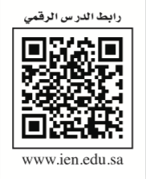
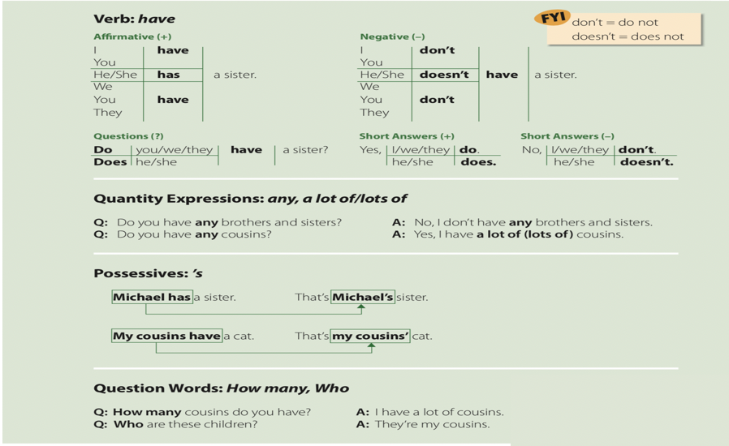
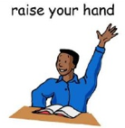
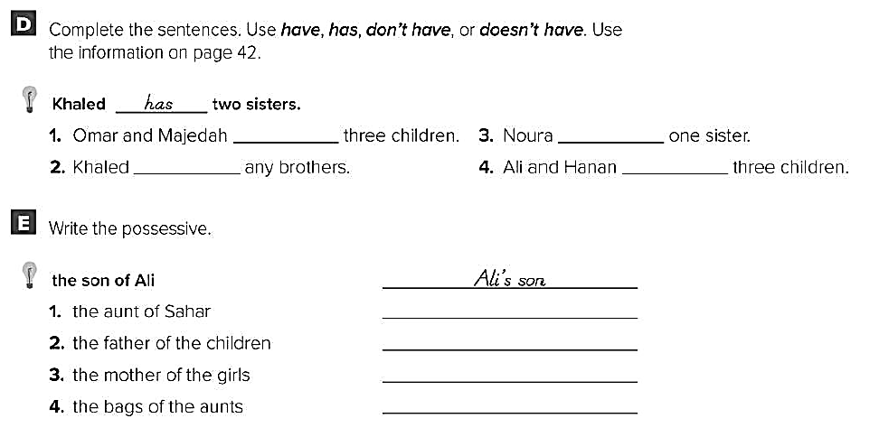
Page 42
have
has
doesn’t
have
have

Slide 13
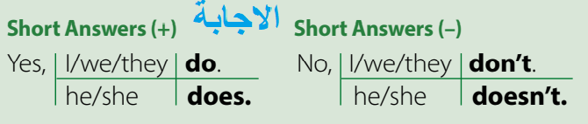
السؤالQuestions
Do
Do
Do
Do
I have a book
You have a book
They have a book
We have a book
?
?
?
?
Does
Does
He has a book
She has a book
have
?
have
?

Slide 14
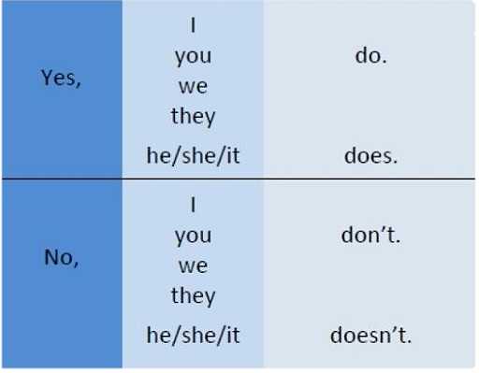

Slide 15
Make it a question
1- you have a blue shirt.
Do you have a blue shirt ?
2- She has a notebook.
Does she have a notebook ?

Slide 16
Quantity Expressions: any, a lot of
any
أي من
تستخدم في النفي والسؤال
a lot of
lots of
الكثير من
تستخدم في الجمل المثبتة
Do you have any brothers?
Yes, I have a lot of brothers.
No, I don’t have any brothers.

Slide 17
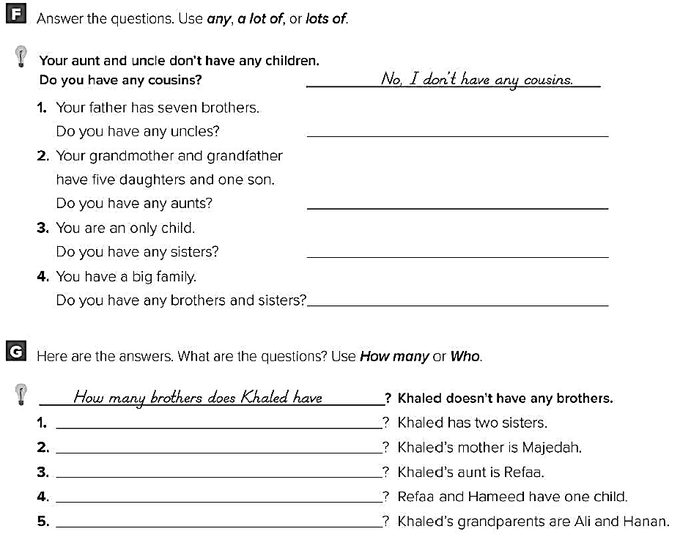
Page 42
Yes, I have a lot of/lots of aunts.
No, I don’t have any sisters.

Slide 18
Possessive s (اس) الملكية
1- اذا كان الاسم مفرد نضيف له ‘s لملكية الشيء اللذي يليه
Omar’s book.
كتاب عمر
قلم سارة
Sarah’s pen.
2- اذا كان الاسم جمع نضيف له فقط الفاصلة’ لملكية الشيء الذي يليه
Students’ books.
كتب الطلاب
سيارة أبناء عمي
My cousins’ car.

Slide 19
Page 42
Sahar’s aunt
The children’s father
The girls’ mother
The aunts’ bags

Slide 20
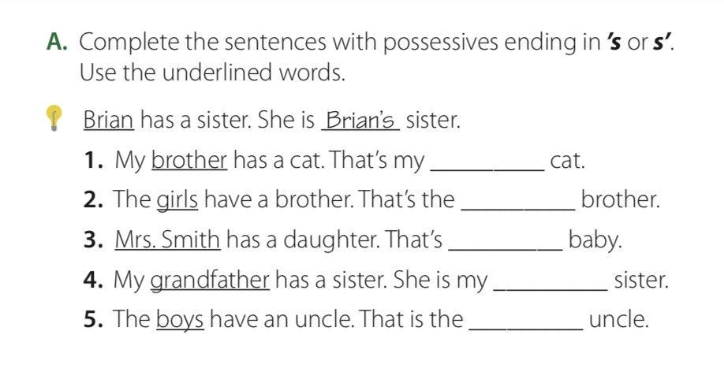
Page 42
brother’s
girls’
Mrs. Smith’s
grandfather’s
boys’

Slide 21
Question Words: How many, Who
كـــــم
How many brothers do you have ?
I have one brother.
من
Who are they?
They are my cousins.

Slide 22
Page 42
How many sisters does Khaled have
Who is khaled’s mother

Slide 23
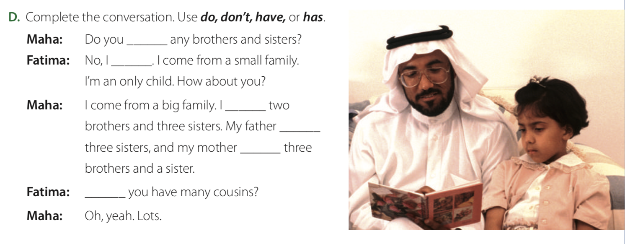
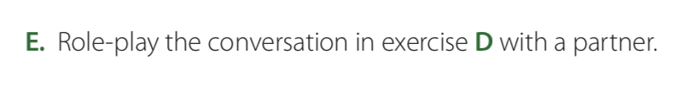
Page 43
have
don’t
have
has
has
Do

Slide 24




At the end of this lesson, students will be able , inshaa ‘Allaah’, to :
Complete the chart after listening to the information
Apply the correct pronunciation of " Do you “

Slide 25


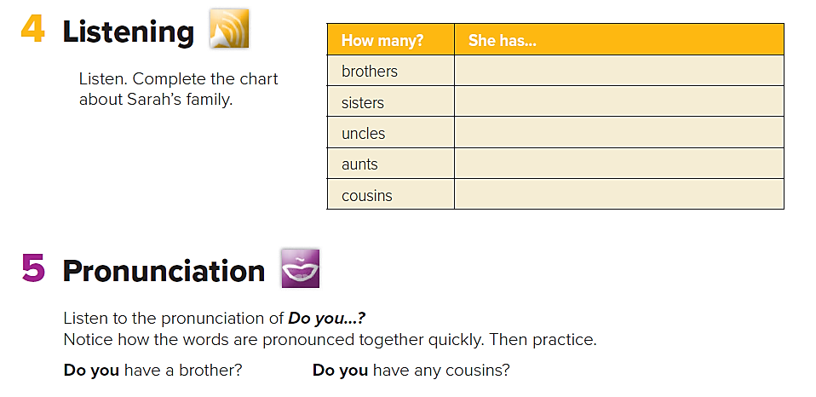
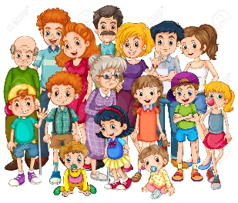
Page 43
three brothers
How many brothers does she have?
two sisters
How many sisters does she have?
seven uncles
How many uncles does she have?
seven aunts
How many aunts does she have?
twenty-one cousins
How many cousins does she have?
Is her family big or small?
Does her father have any brothers or sisters?
He is an only child.

Slide 26
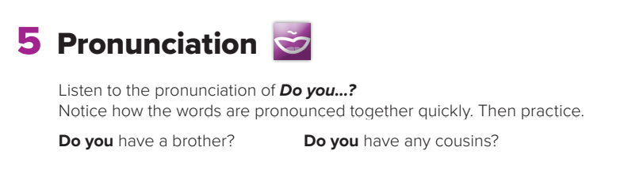
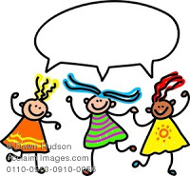

Page 43

Slide 27
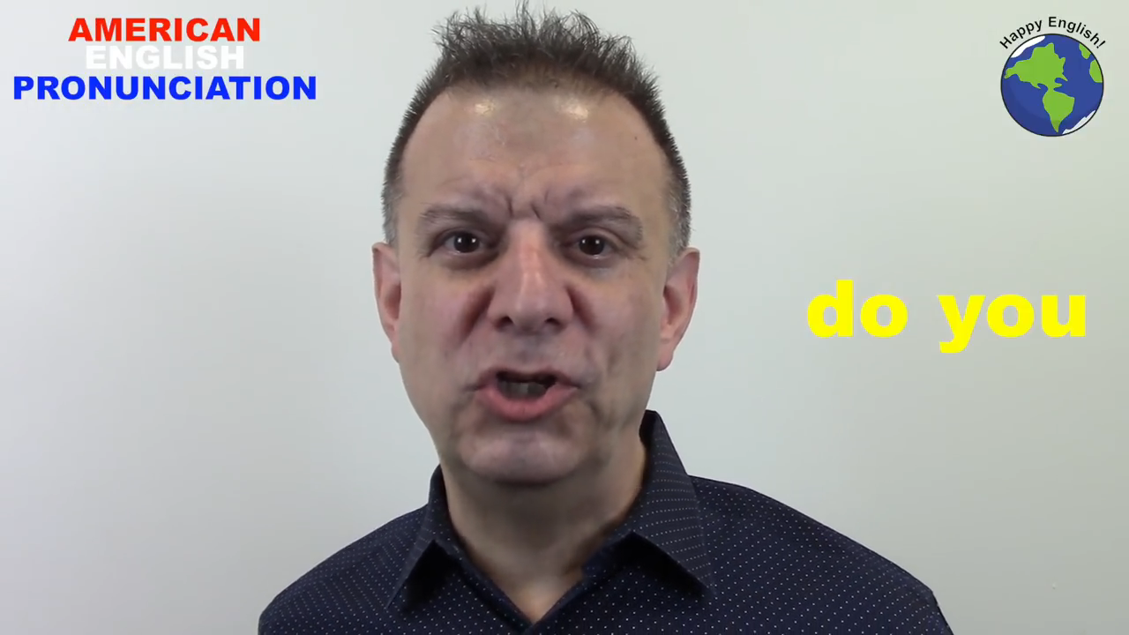
Do you have any brothers or sisters?
Do you read stories?

Slide 28
Thank you

