Slide 1

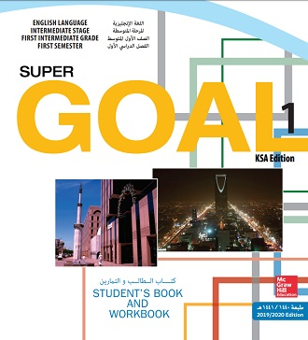
Unit 5
Families, Families
Lesson 4

Slide 2
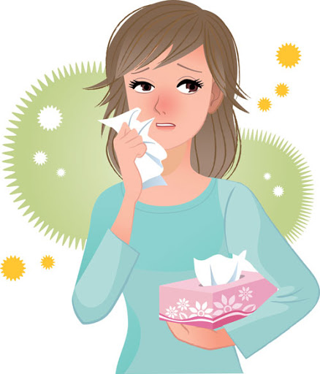
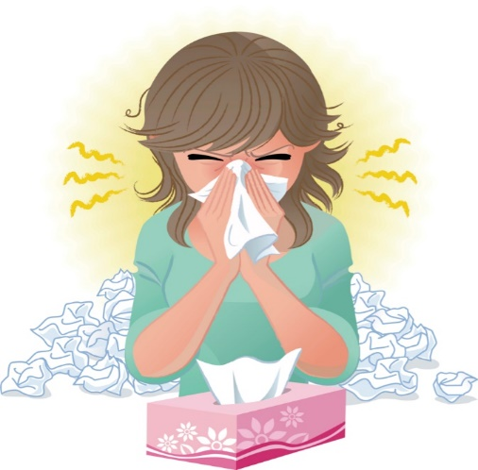
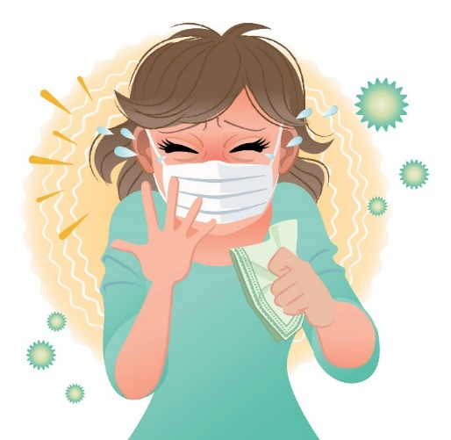
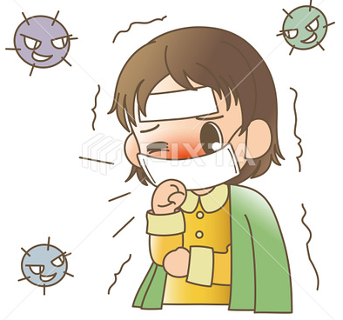
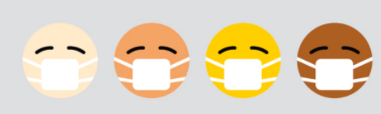
☺Avoid gathering !
Covid 19
☺wear a mask before going out.
☺Social distancing is not a choice, it is a must!
☺Keep a distance of 2 meters to avoid accountability
☺wash hands constantly.

Slide 3






Learning Objectives
create an imaginary family tree
use an apostrophe correctly
write names to make a family tree
write about the Saudi royal family

Slide 4
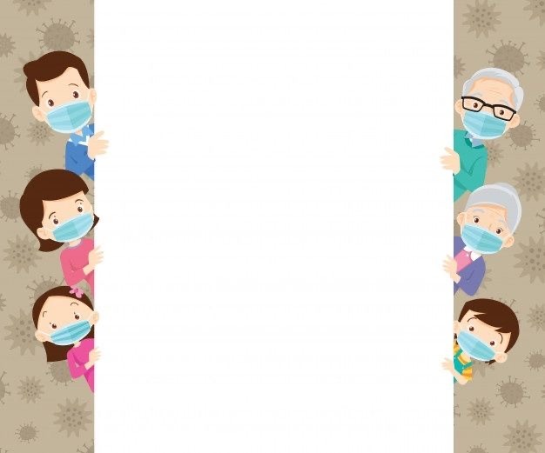
بسم الله الرحمن الرحيم
Day:
Date:

Slide 5
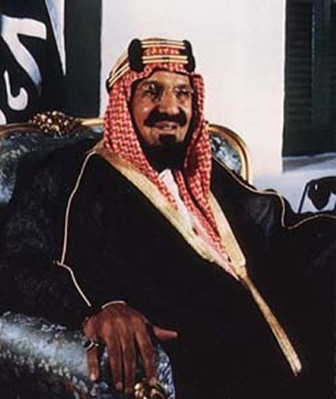
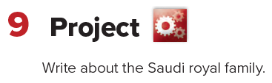
This is done as a homework :
Work in small groups. Look for information about the Saudi royal family. Then , bring the information to class and write the report as a group.

Slide 6
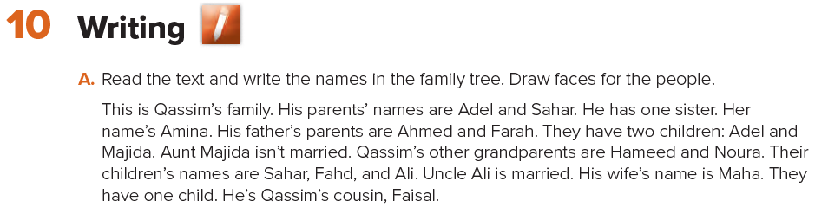

Slide 7
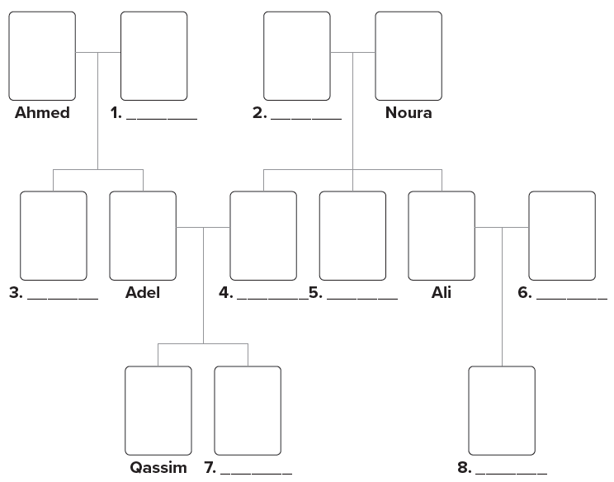
Farah
Hameed
Majida
Sahar
Fahad
Maha
Amina
Faisal

Slide 8
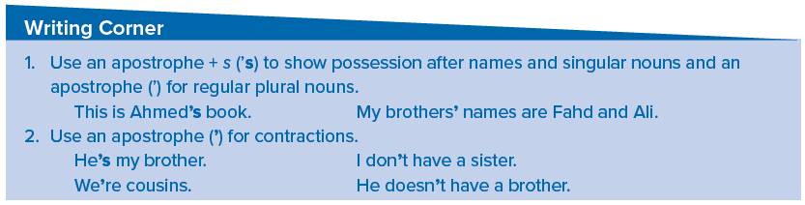

Slide 9
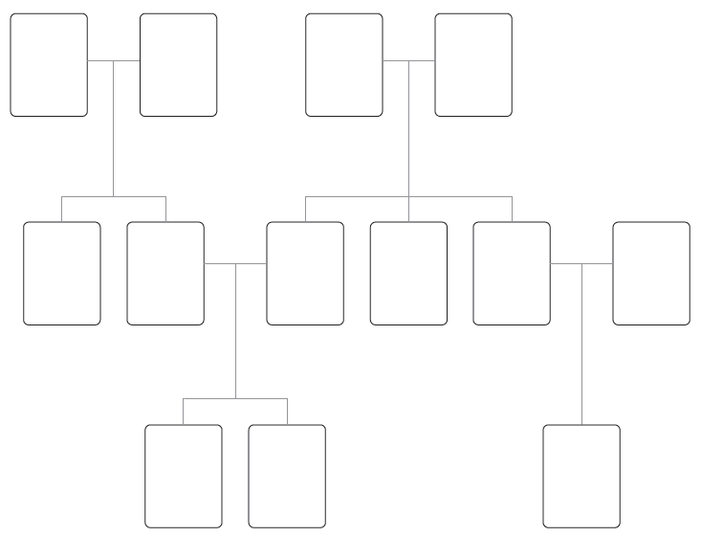

Slide 10
Homework
Page 110

Slide 11
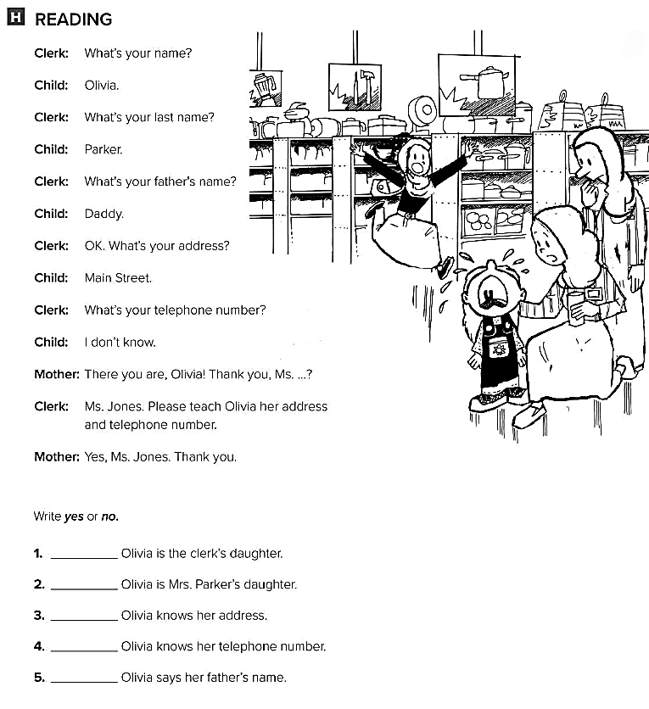
No
Yes
No
No
No

