Slide 1


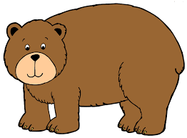
Aa
Bb
Apple
Bear

Slide 2


Cc
Dd
Cat
Duck

Slide 3
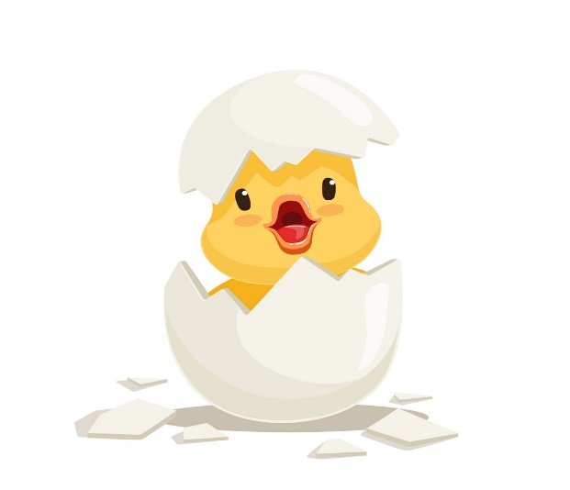

Ee
Ff
Egg
Fish

Slide 4
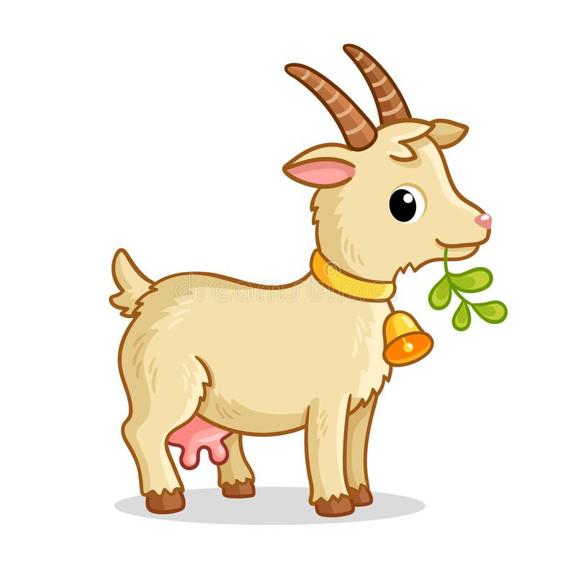

Gg
Hh
Goat
Hat

Slide 5


Ii
Jj
Ink
Jet

Slide 6
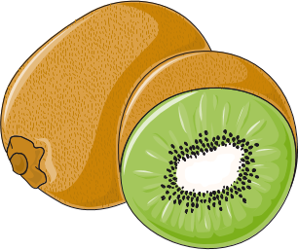
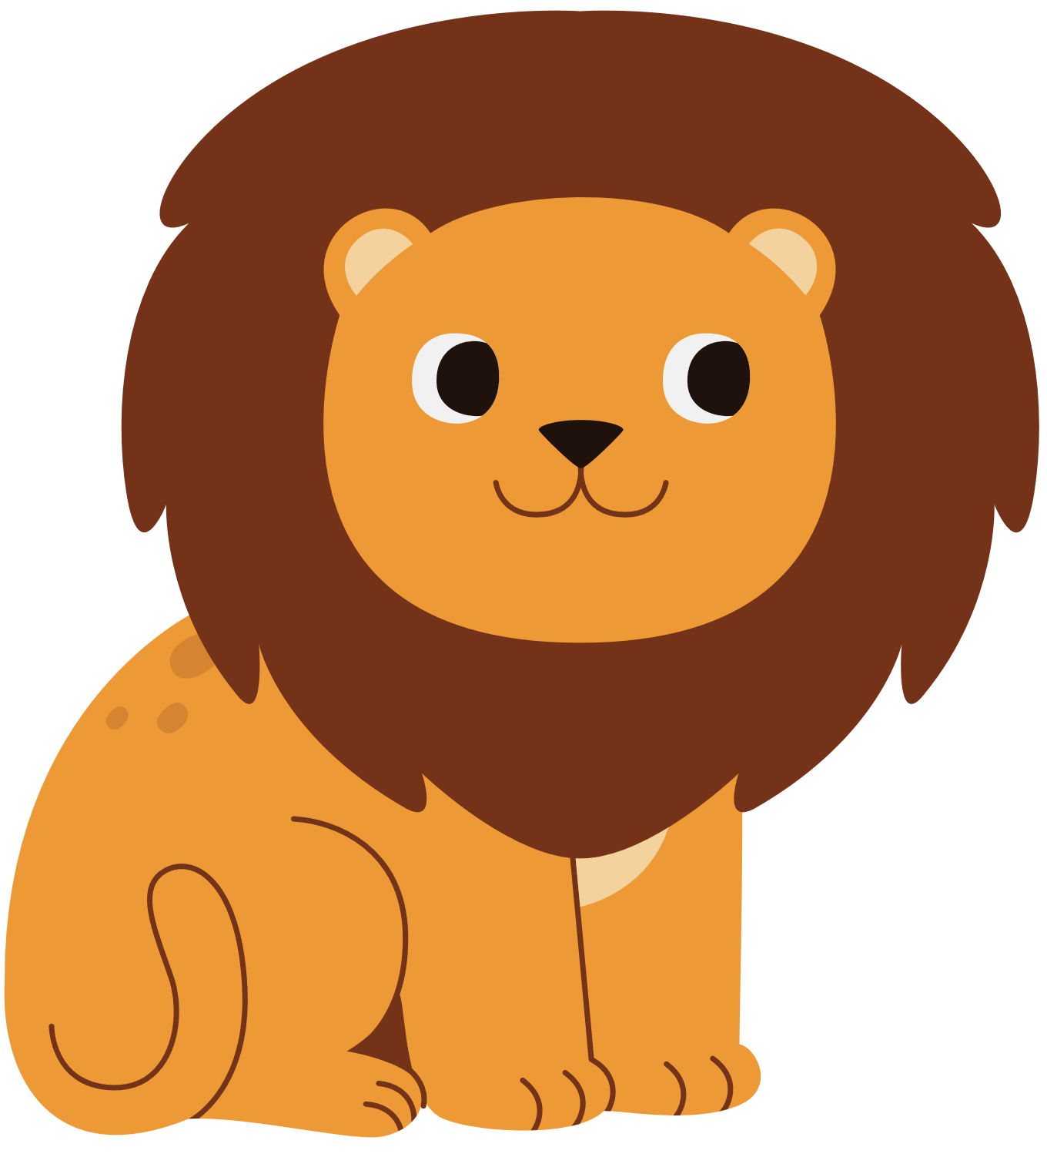
Kk
Ll
Kiwi
Lion

Slide 7
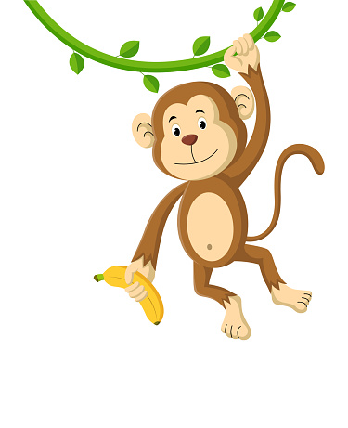

Nn
Mm
Monkey
Nest

Slide 8

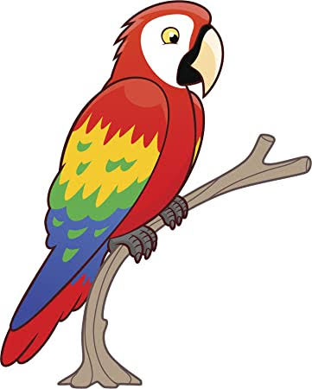
Oo
Pp
Octopus
Parrot

Slide 9
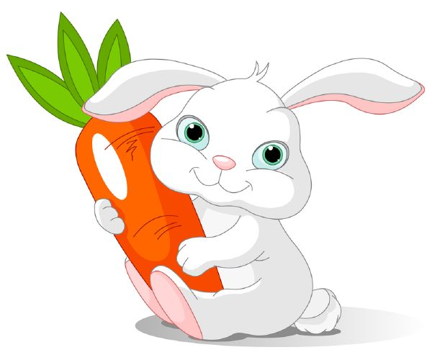
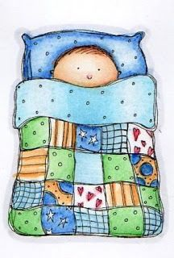
Qq
Rr
Quilt
Rabbit

Slide 10


Ss
Tt
Sun
Tiger

Slide 11


Uu
Vv
Umbrella
Vase

Slide 12
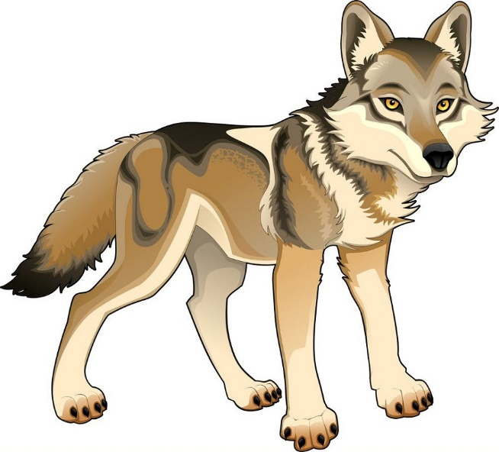

Xx
Ww
Wolf
fox

Slide 13
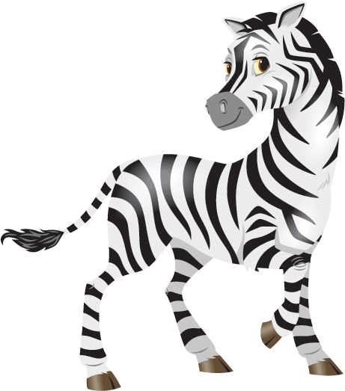
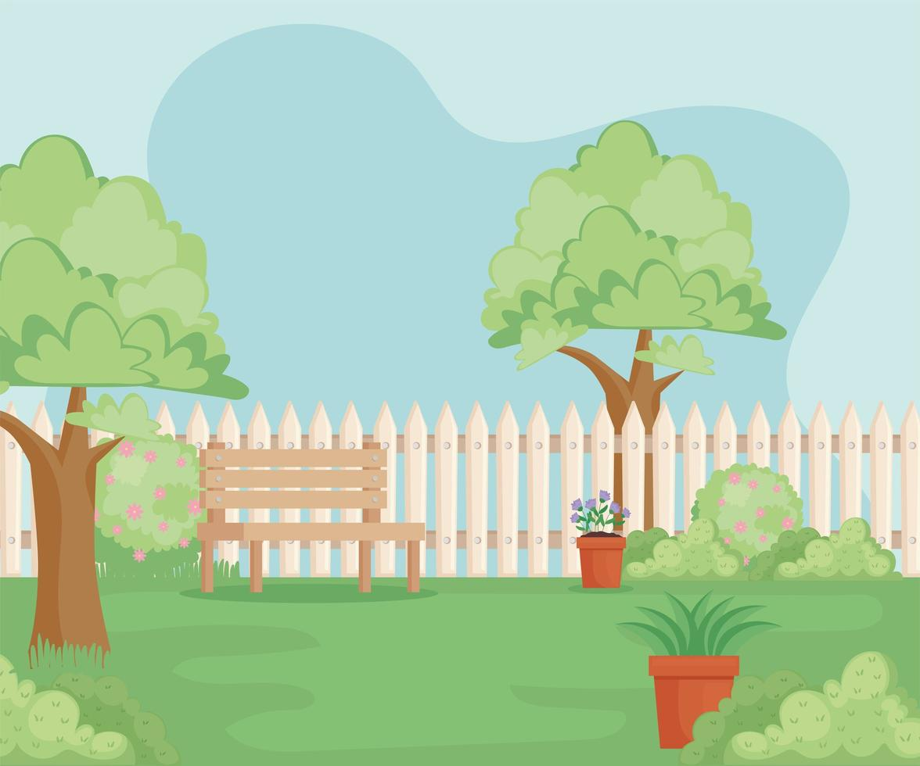
Yy
Zz
Yard
Zebra

