Slide 1














Slide 2



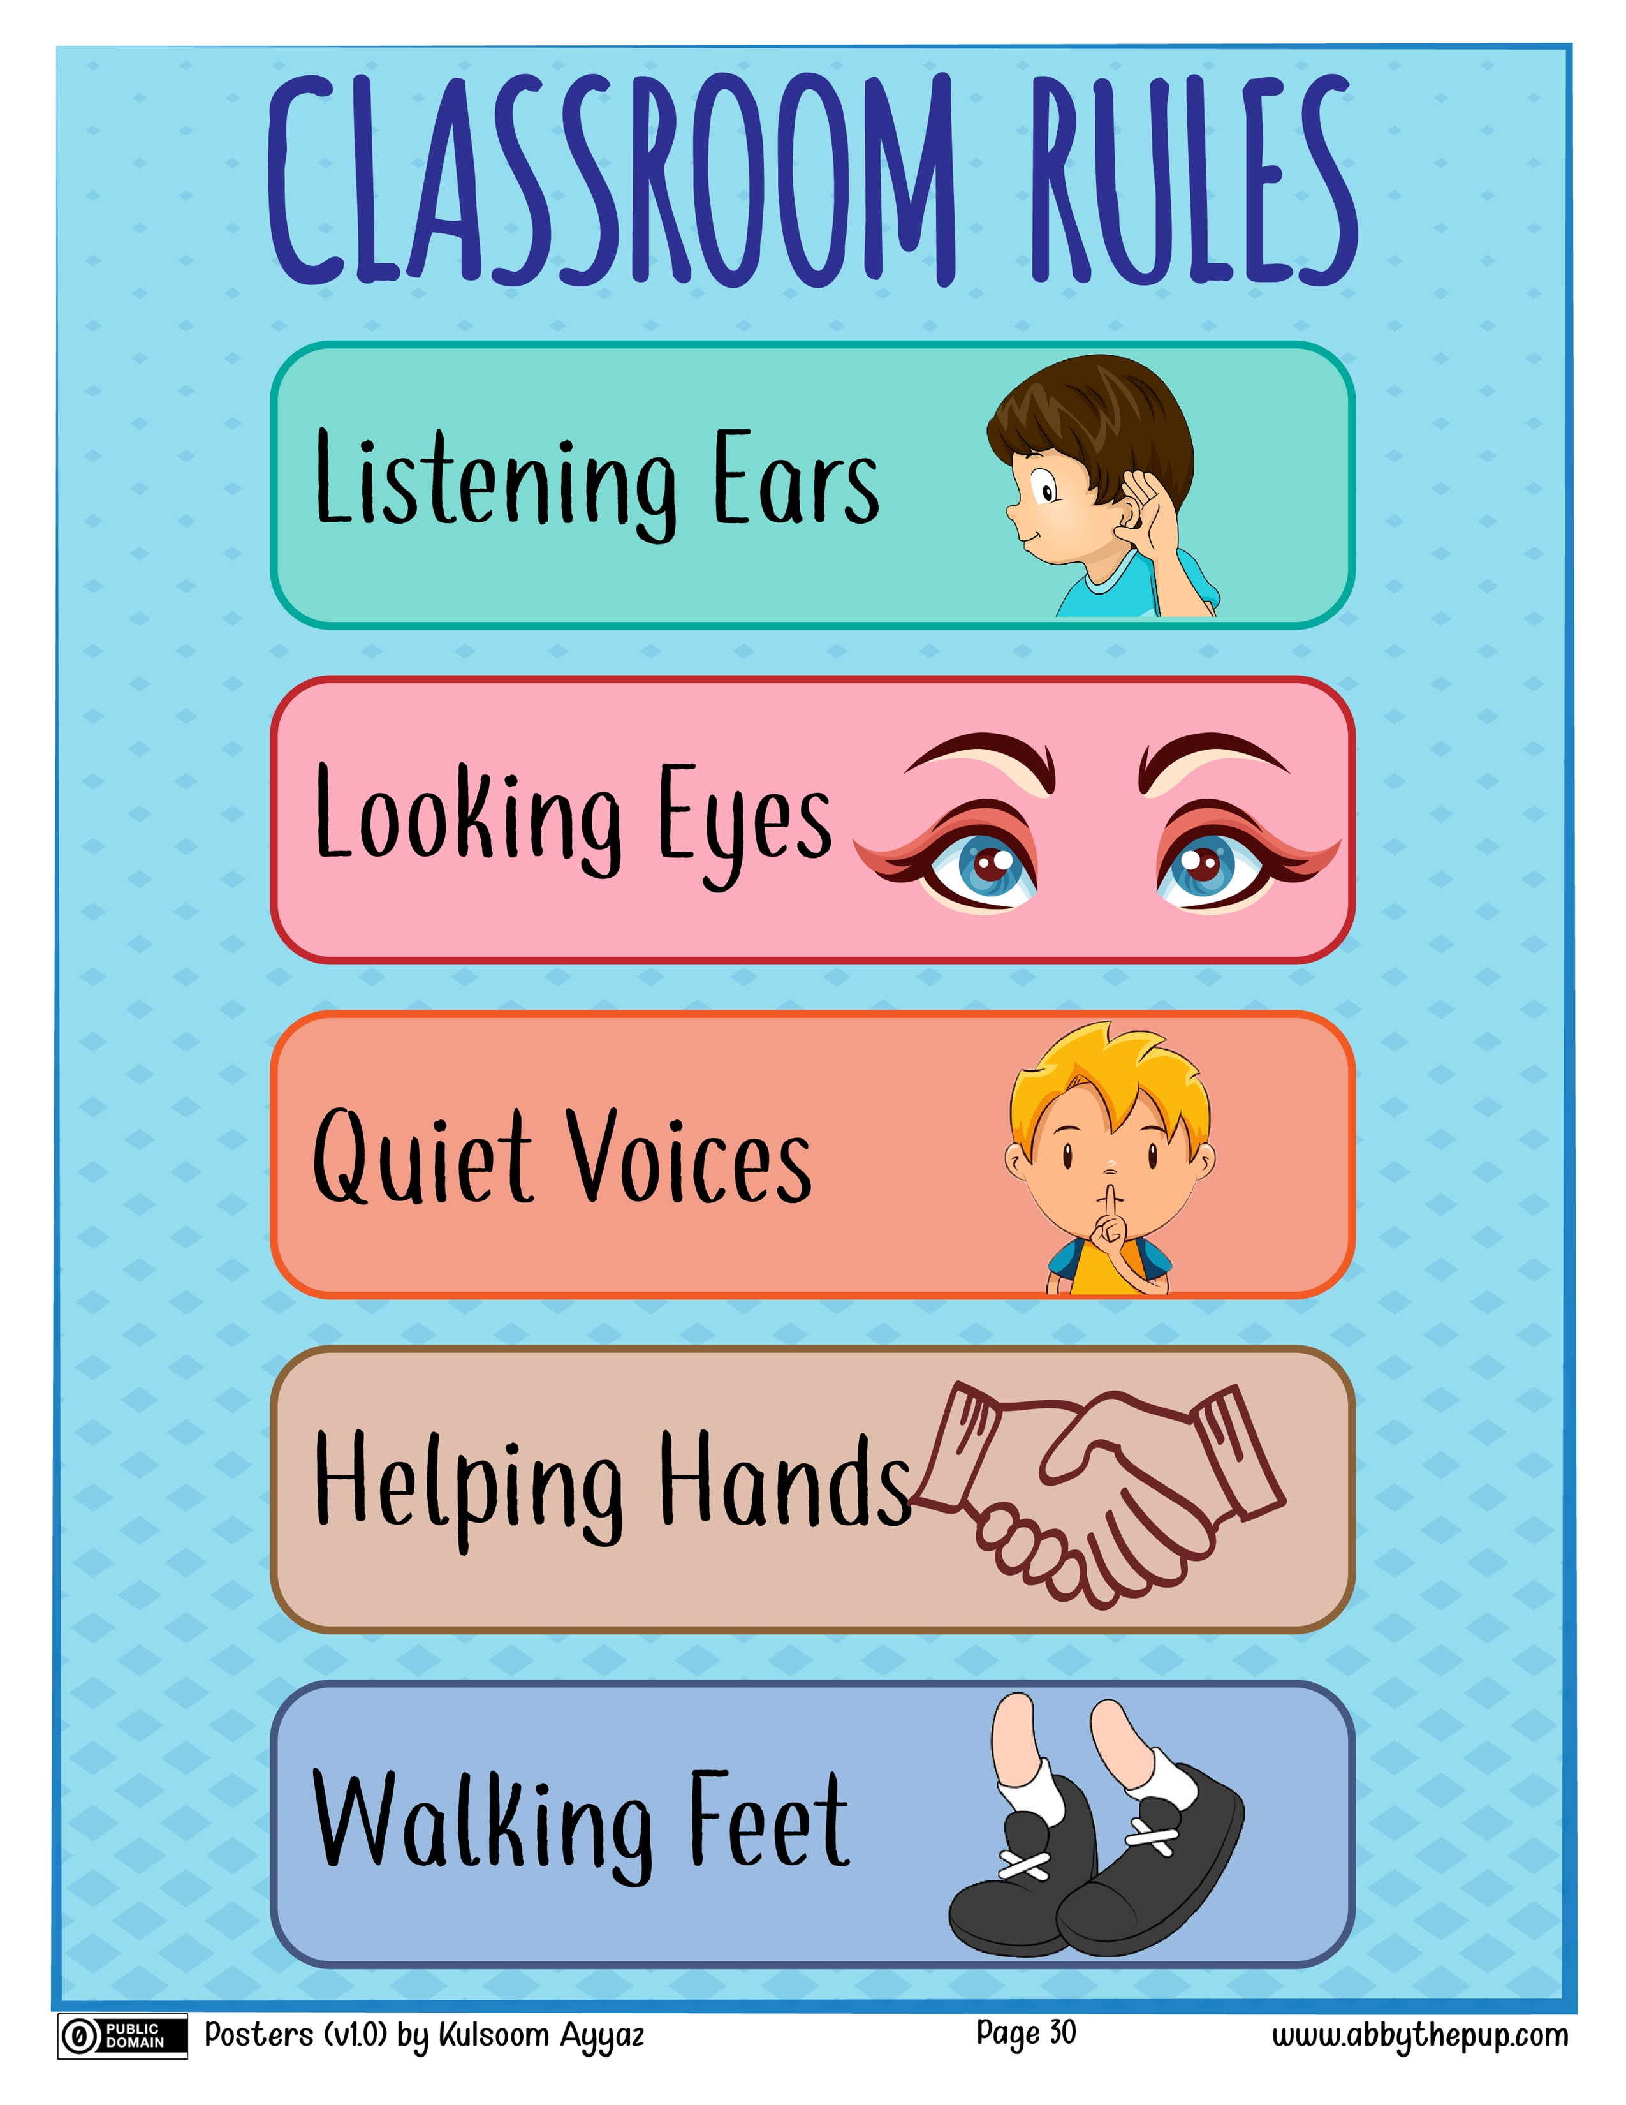





Slide 3

Good Morning
Wednesday
5/3/1445.H

Slide 4




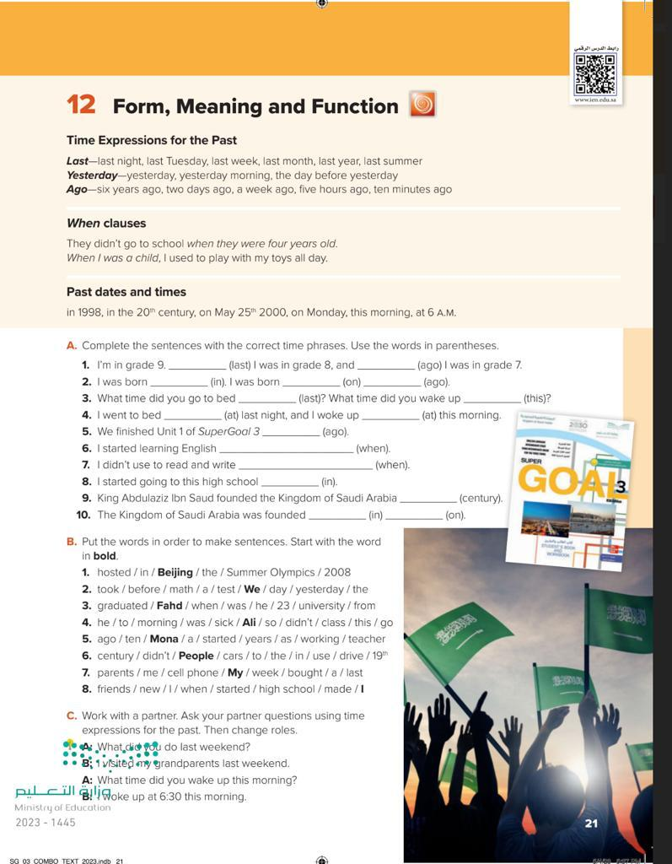

Form, Meaning and Function
Page:21

Slide 5





Use the correct time expression
Locate past dates and times in a sentence
Restructure sentences with (when)

Slide 6

Introduction
Choose the correct verb between brackets:
She ( walk - walking- walked ) to school yesterday.
We choose the past form why?
Because there is the past expression yesterday

Slide 7
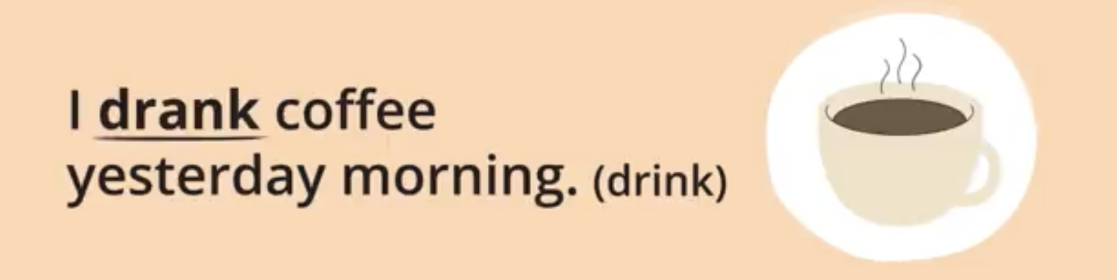
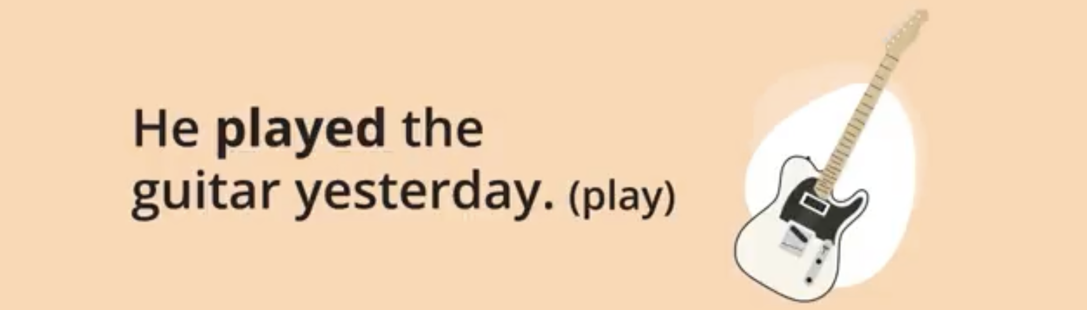

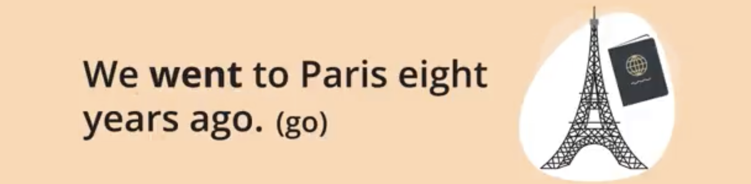
Read the sentences
Tell us what is the tense of each one
Underline the time expressions
Form sentences using time expressions

Slide 8

Religious objective
Choose :
Did you read Quran ( yesterday/ everyday)

Slide 9
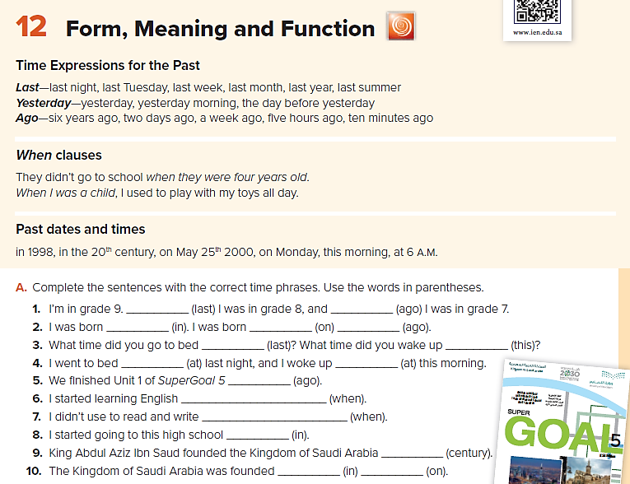

1
2
3
last year
Ago year
In 2013
On Monday
nine years

Slide 10
clause1
clause2
When I was a child, I used to play with dolls.
Past
Past
I used to play with dolls when I was a child.

Slide 11
Complete:
When I was a child, I ………………………….

Slide 12
In year/ century .
On full date / day.
At hour .
This morning .

Slide 13

National objective
The unification of Saudi Arabia was (in / on / at) 1351.H.

Slide 14
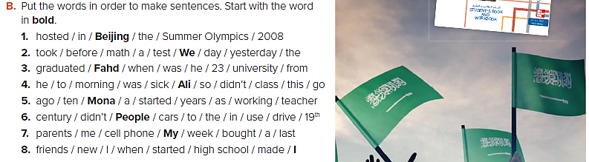
Beijing hosted the Summer Olympics in 2008

Slide 15
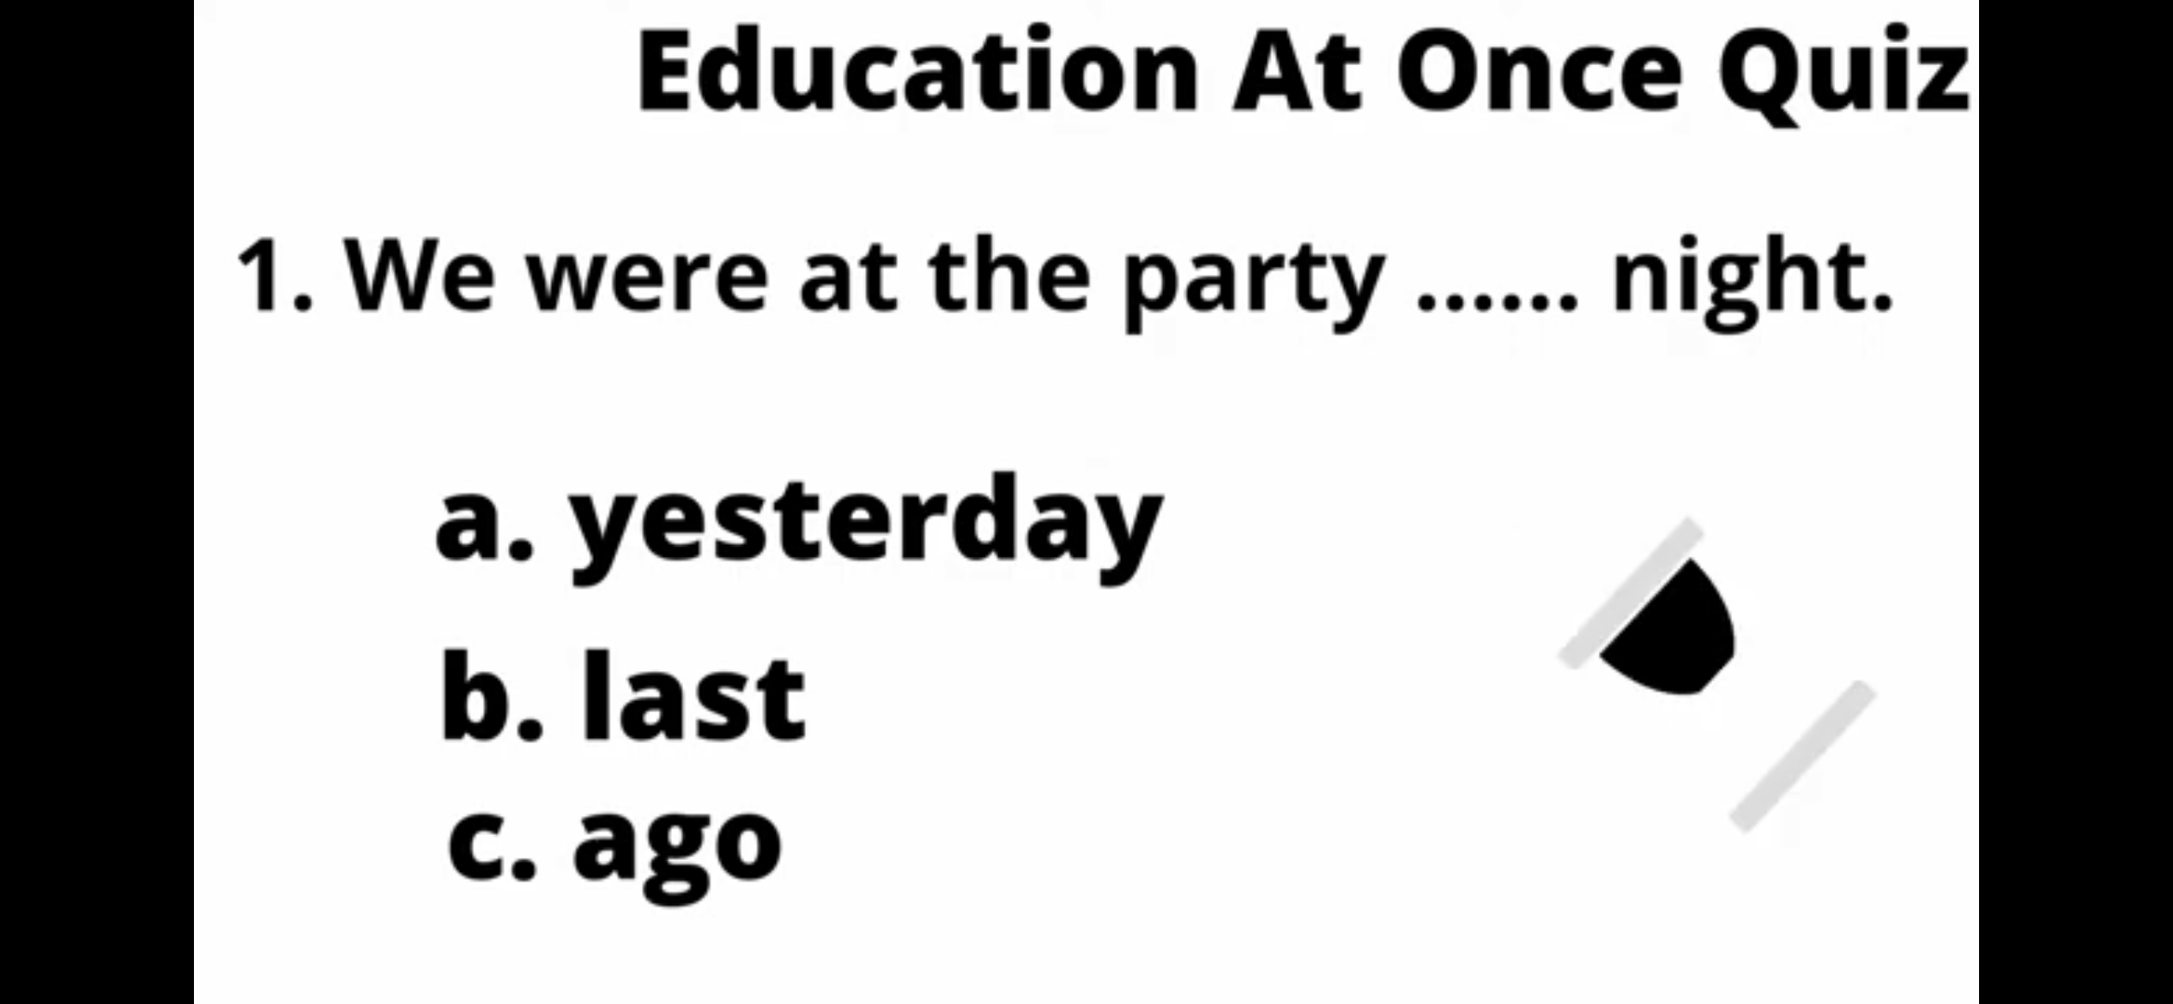
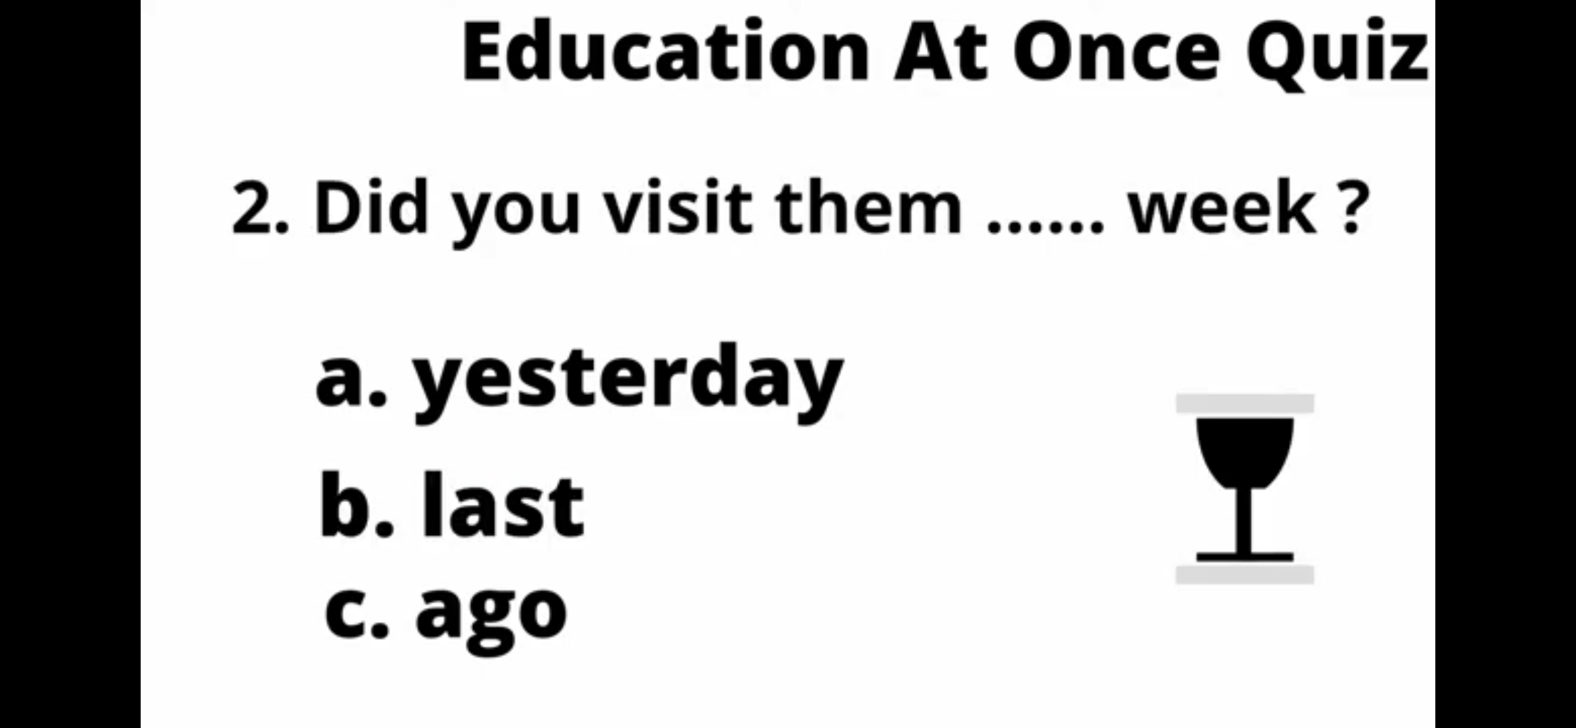
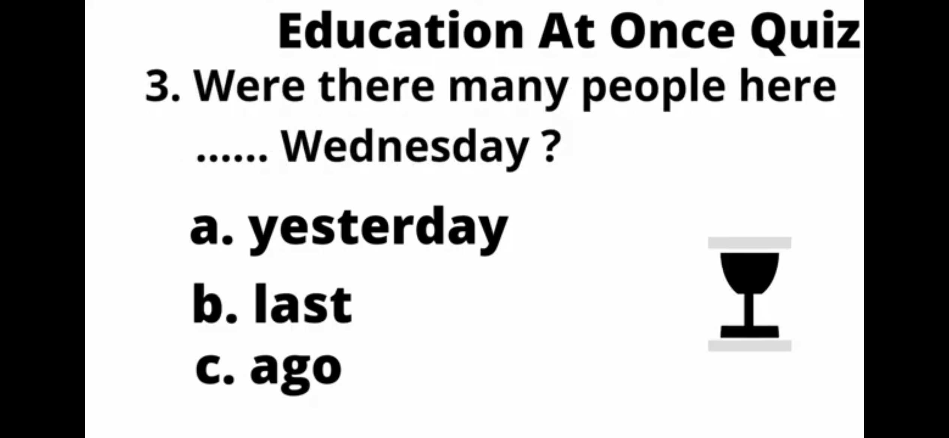
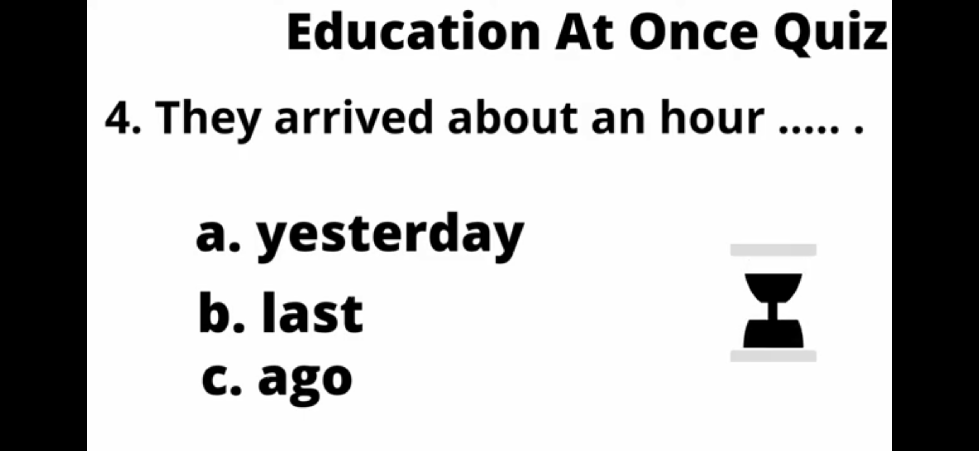
Evaluation
?

Slide 16

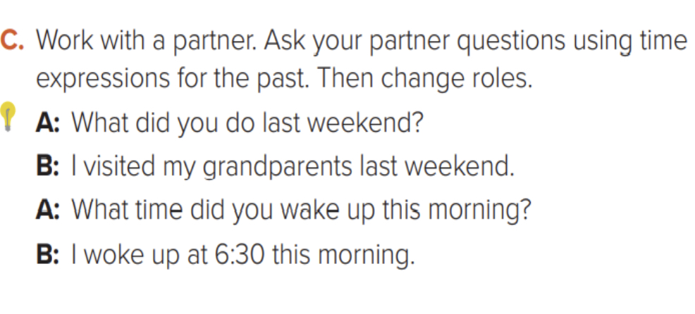
Homework

