Slide 1

Unit 3
When Are You Travelling?
Language in Context

Slide 2
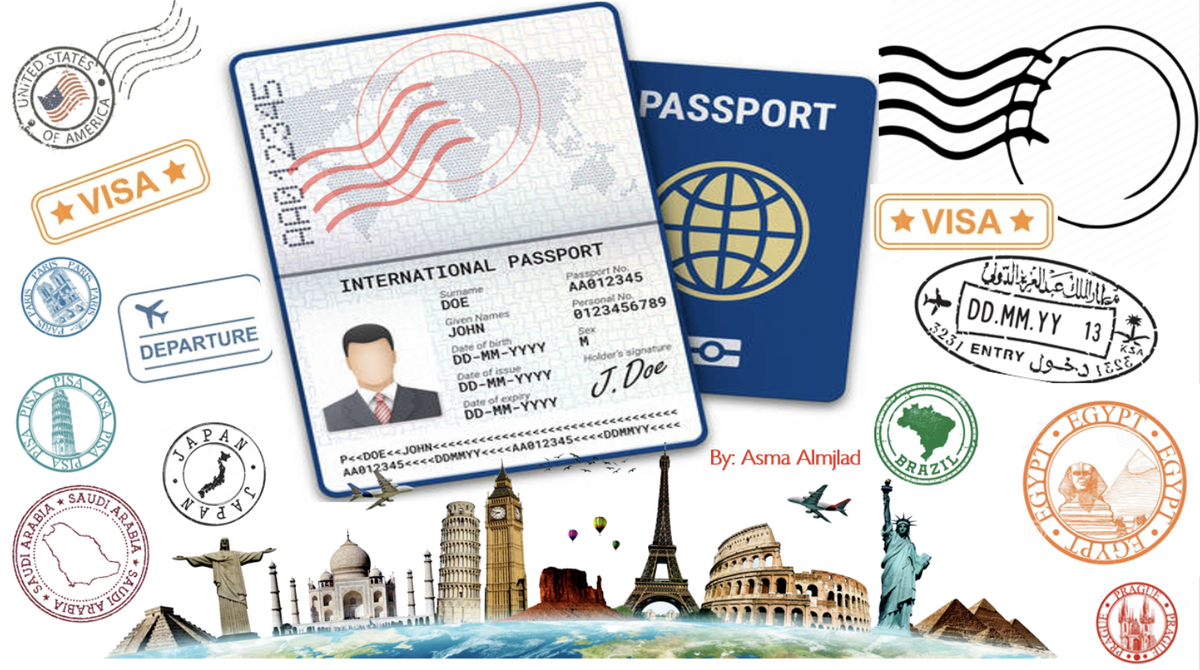

Slide 3
بسم الله الرحمن الرحيم
Day:
Date:

Slide 4


Learning Objectives
practice pronouncing (ing) correctly
List 8 items that you are going to need in travelling
listen for specific information
Answer personal questions

Slide 5
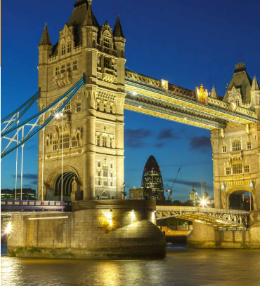
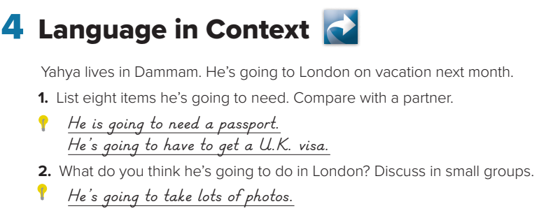
Page:26
He’s going to need a passport. He’s going to need a U.K. visa.
He’s going to need British pounds. He’s going to need warm clothes.
He’s going to need a hotel reservation. He’s going to need a camera.
He’s going to need comfortable shoes.

Slide 6
Page: 26
2. He’s going to go sightseeing. He’s going to go to the British Museum. He’s going to speak English.

Slide 7

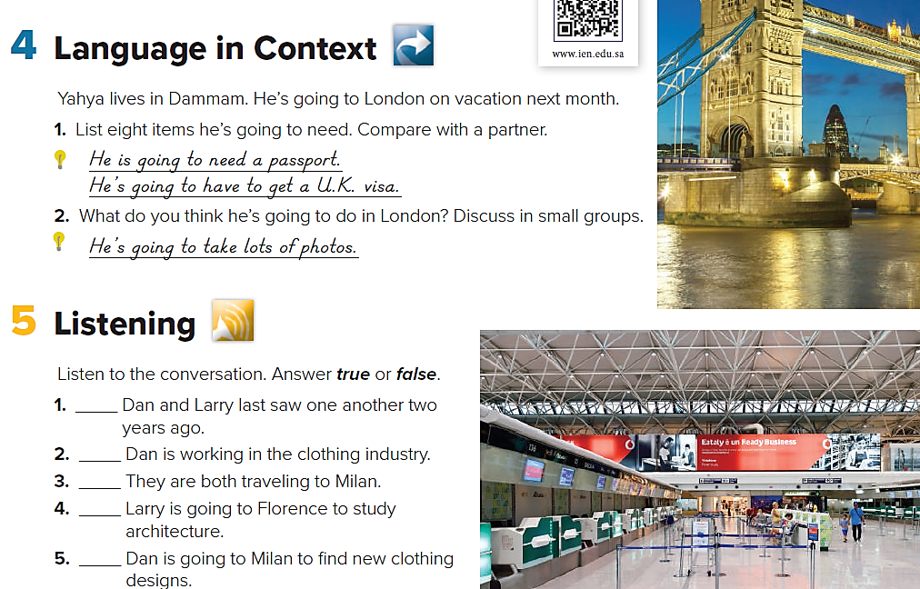
Page: 26
false
true
False
false
true

Slide 8
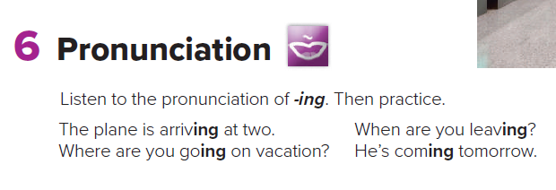
Page: 26

Slide 9
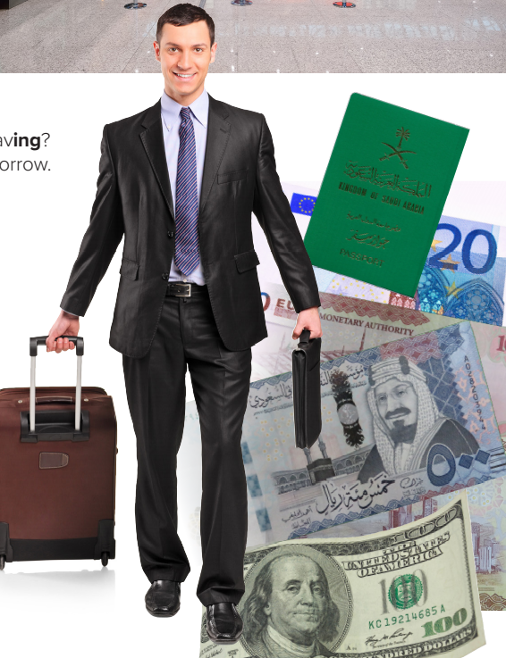
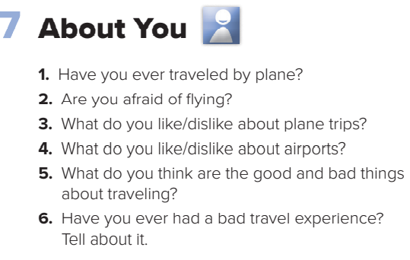
Page: 26

Slide 10

Homework
Workbook
Page 181
( SINGLE LARGE HEADER )

Slide 11
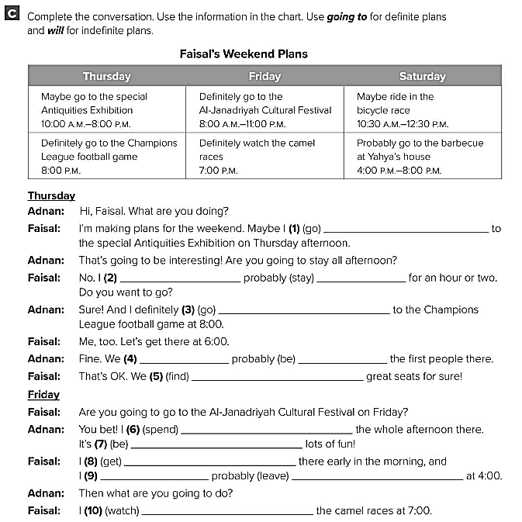
will go
will
stay
am going to go
will
be
are going to find
am going to spend
going to be
am going to get
will
leave
am going to watch

Slide 12
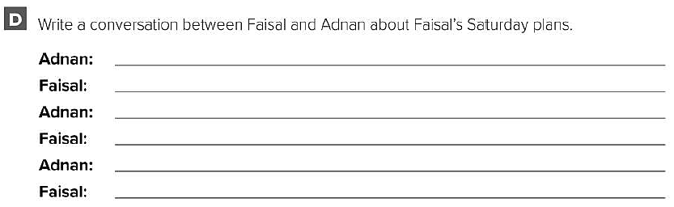
What are you doing on Friday ?
I’ll probably ride in the bicycle race .
What time is the race going to start ?
It’s going to start at 10:30 a.m.
What are doing on Friday afternoon ?
I’ll probably go to Yahiya's barbecue .

