Slide 1






4 About you
5 listening
6 pronunciation
7 conversation
Today:
Date:
- -1445
Page 21
By: Dalal Al-Juaid

Slide 2


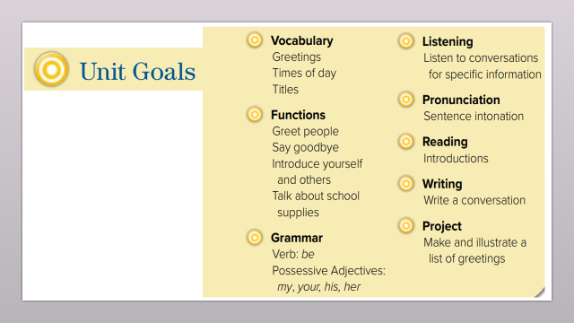
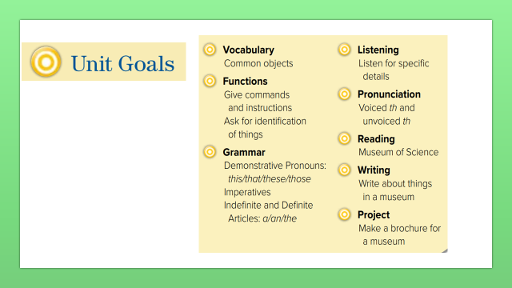
Answer personal information
Circle correct item after listening
Warm up
lesson
produce the different sounds of TH
New words
summative
answer questions about a conversation.
2-Pair work

Slide 3
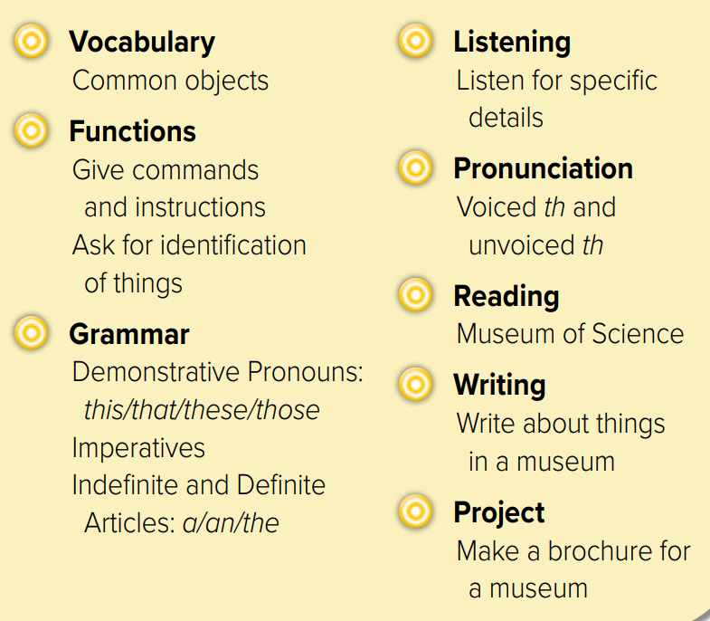
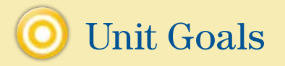

Slide 4
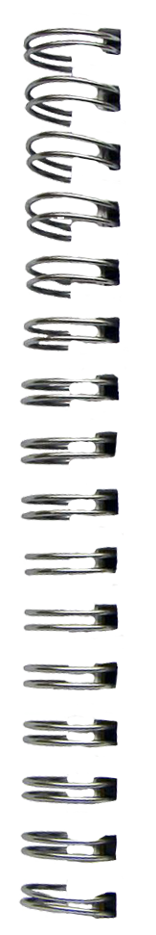

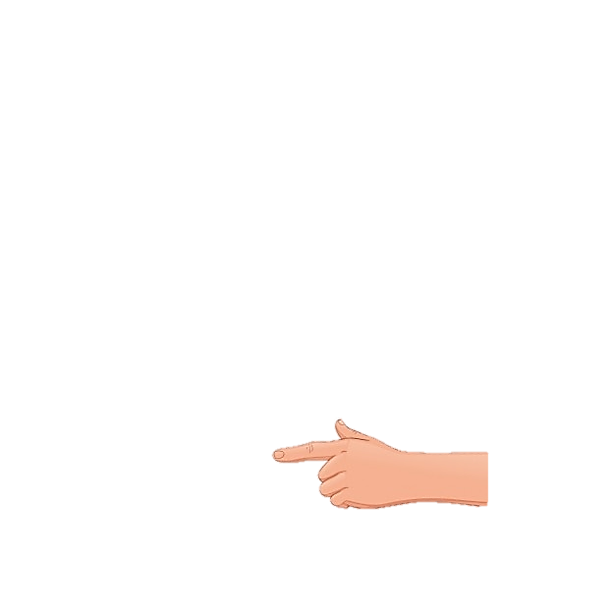
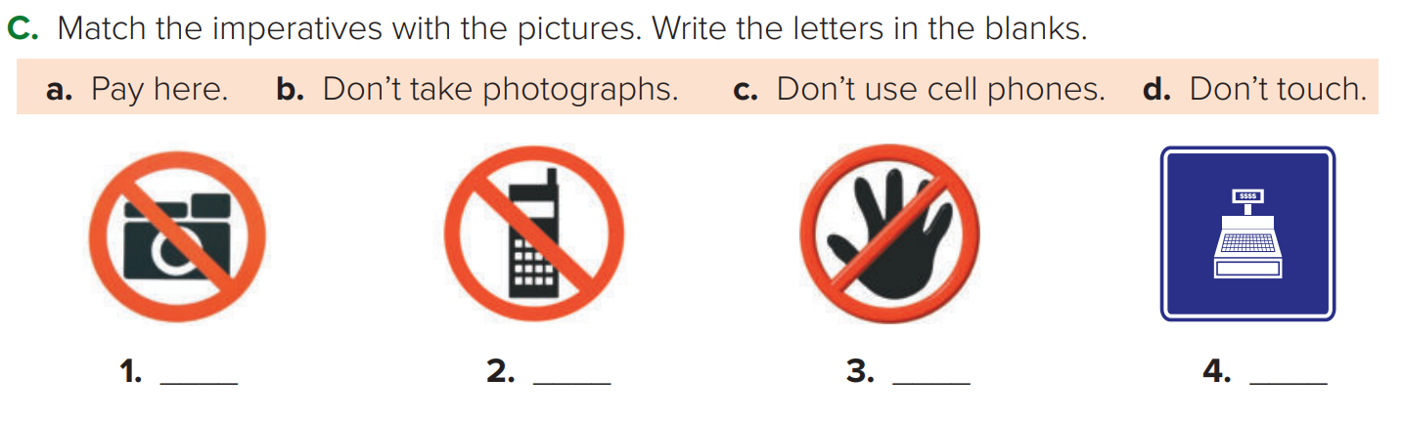



What’s this?
Revision
What are these?

Slide 5



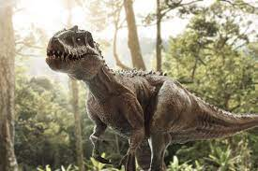
I’m animal
I’m very very big
I’m very old
I eat animals
Warm up
lesson
I have big eggs
New words
I don’t exist anymore
summative
I am in museums
2-Pair work

Slide 6




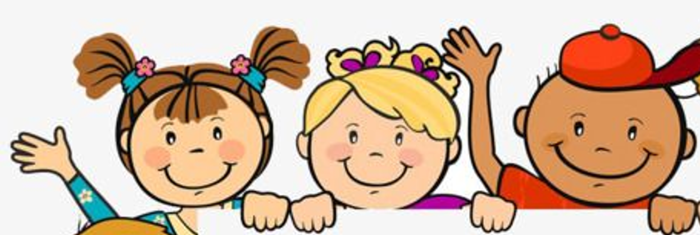
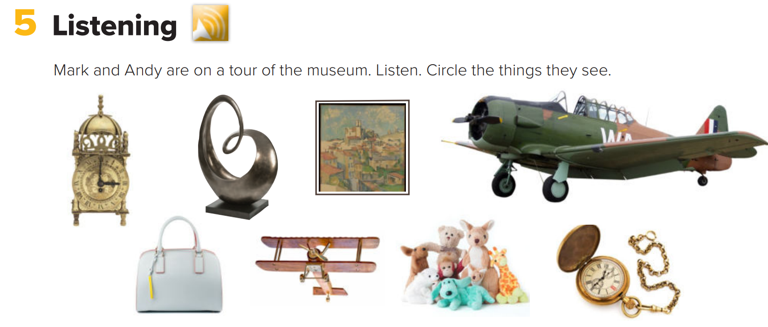
Page 21
Think pair share
What are these?
Warm up
lesson
New words
summative
2-Pair work

Slide 7


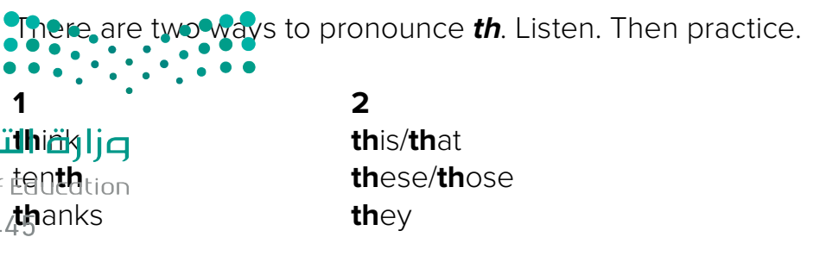

Page 21
Listen
think
This
Warm up
lesson
New words
summative
2-Pair work

Slide 8

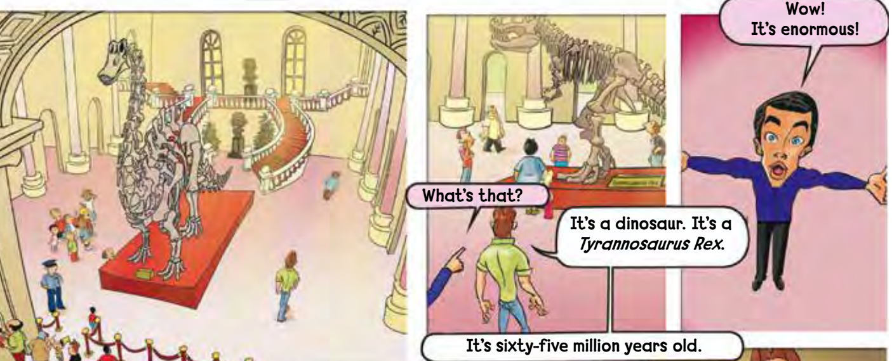
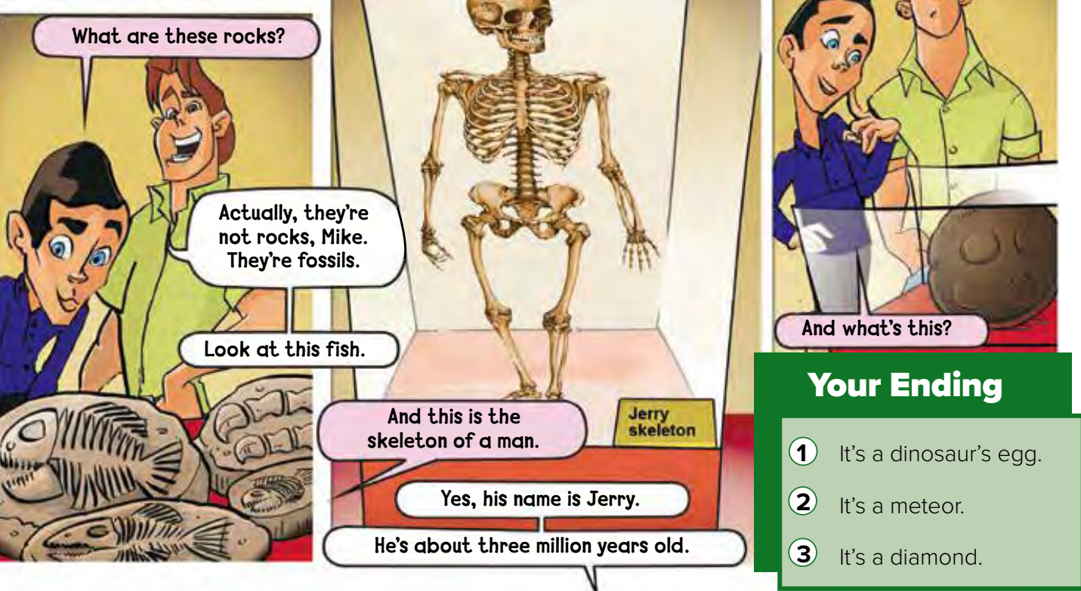
Page 22
Where are they?
Warm up
What’s the name of the dinosaur?
lesson
New words
How old is it?
summative
2-Pair work

Slide 9
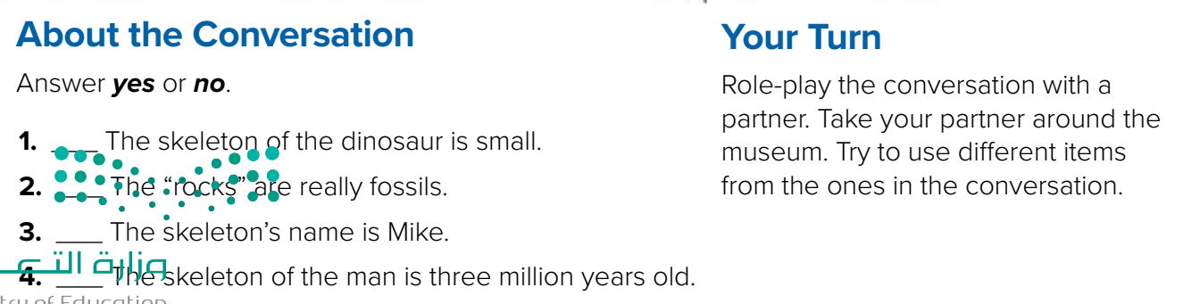
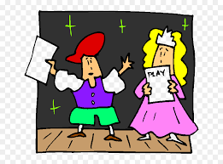
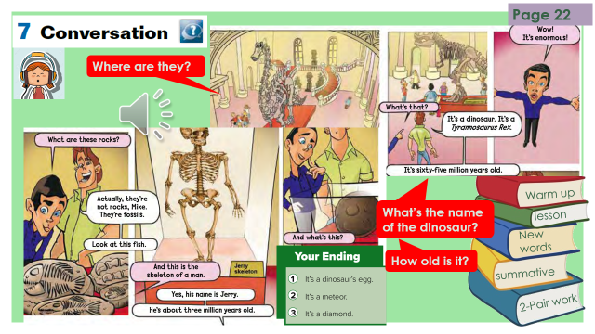
Think pair share
no
yes
no
yes
Warm up
lesson
New words
summative
Role paly
2-Pair work

Slide 10

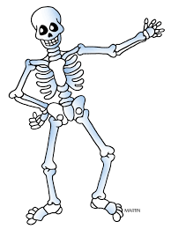


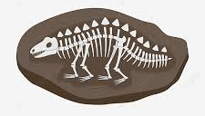

dinosaur
New Words
skeleton
rocks
fossils
Million
1000000
Very very big
enormous #
#
small

Slide 11


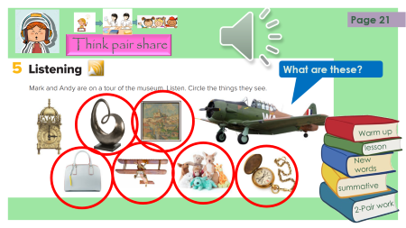
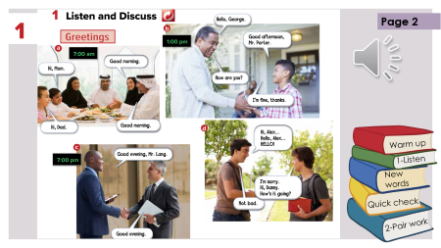
Lets play
Think pair share
Warm up
lesson
New words
summative
2-Pair work

Slide 12



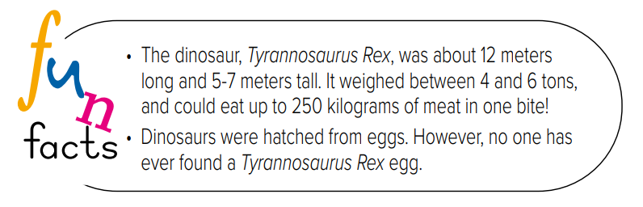
Make a question
Warm up
lesson
New words
summative
2-Pair work

Slide 13





page 197 Ex(E)
for practice grammar
Warm up
New words

Slide 14
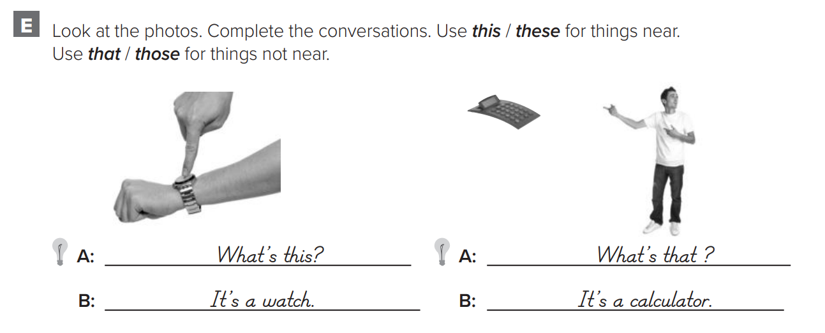
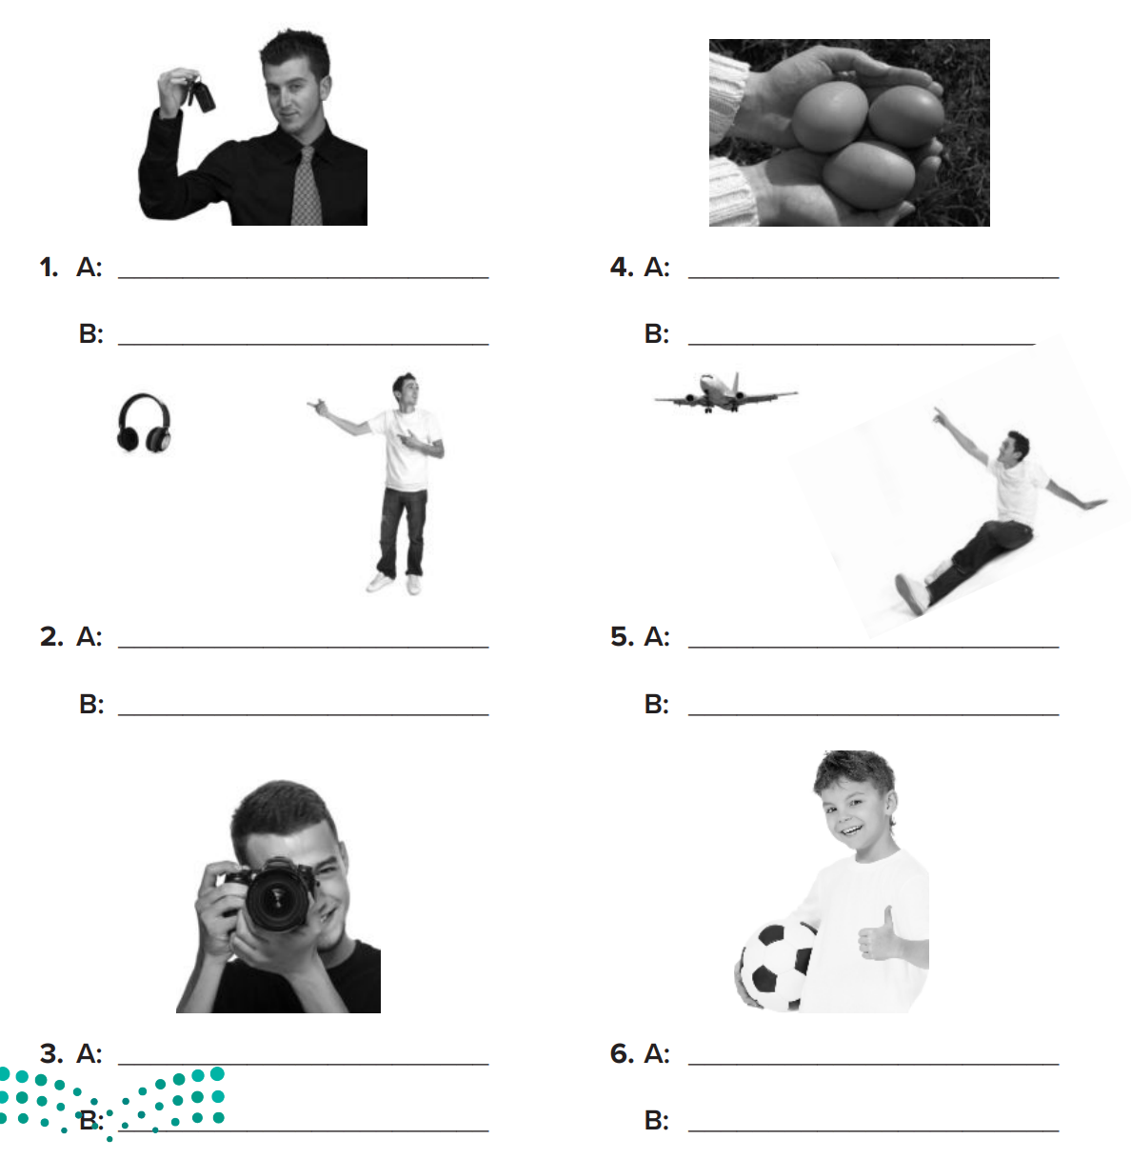
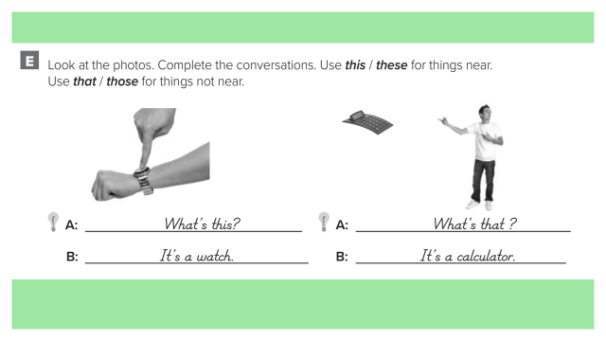
p.197
What are these?
What are these?
They’re keys.
They’re eggs.
What are those?
What is that?
Warm up
They’re headphones.
It’s an airplane.
New words
What is this?
What is this?
It’s a camera.
It’s a ball.

