Slide 1






3 grammar
Today:
Date:
- -1445
Page 20
By: Dalal Al-Juaid

Slide 2


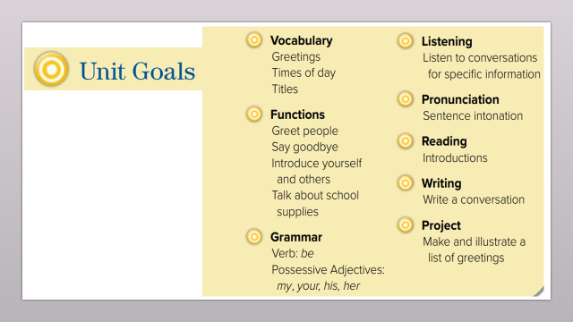
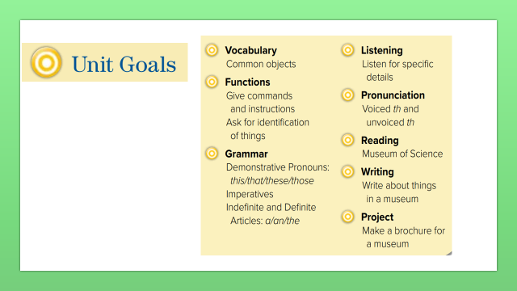
use the demonstrative pronouns
use imperatives ( + / - )
Warm up
1-Listen
use indefinite articles (a –an )
New words
Quick check
Make questions and answers
2-Pair work

Slide 3
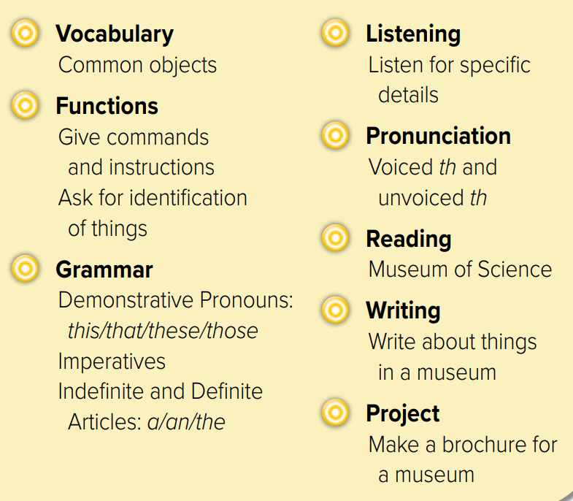
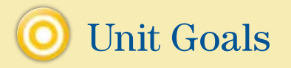

Slide 4
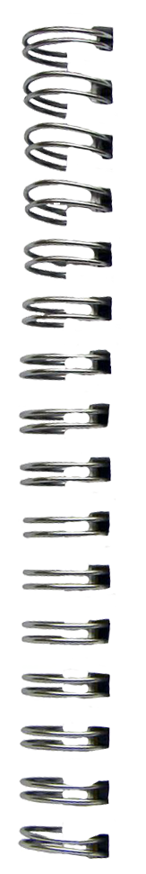
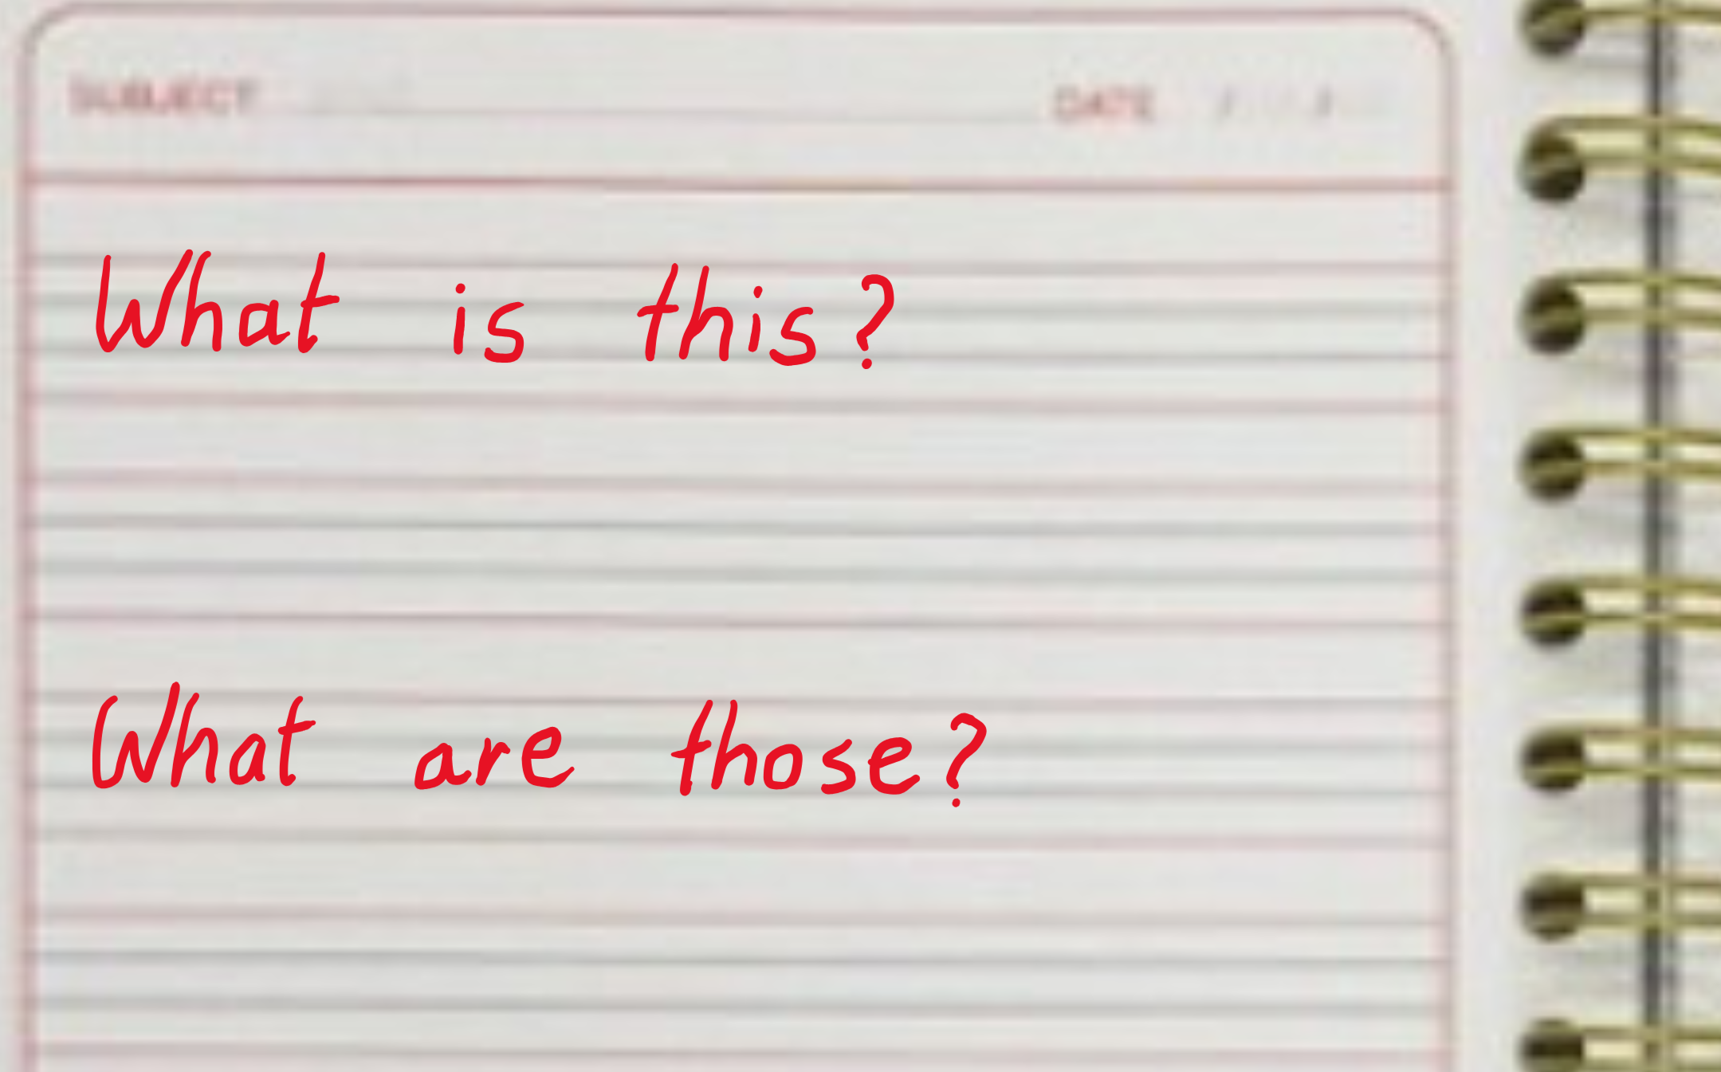


Revision

Slide 5


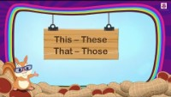

Warm up
1-Listen
New words
Quick check
2-Pair work

Slide 6

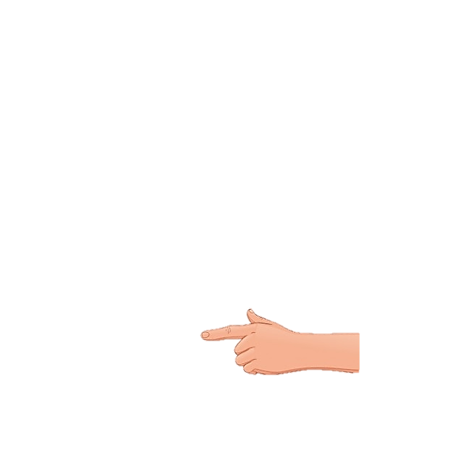

What’s this?
This is a book.
What are these?
Warm up
1-Listen
New words
These are books.
Quick check
2-Pair work

Slide 7

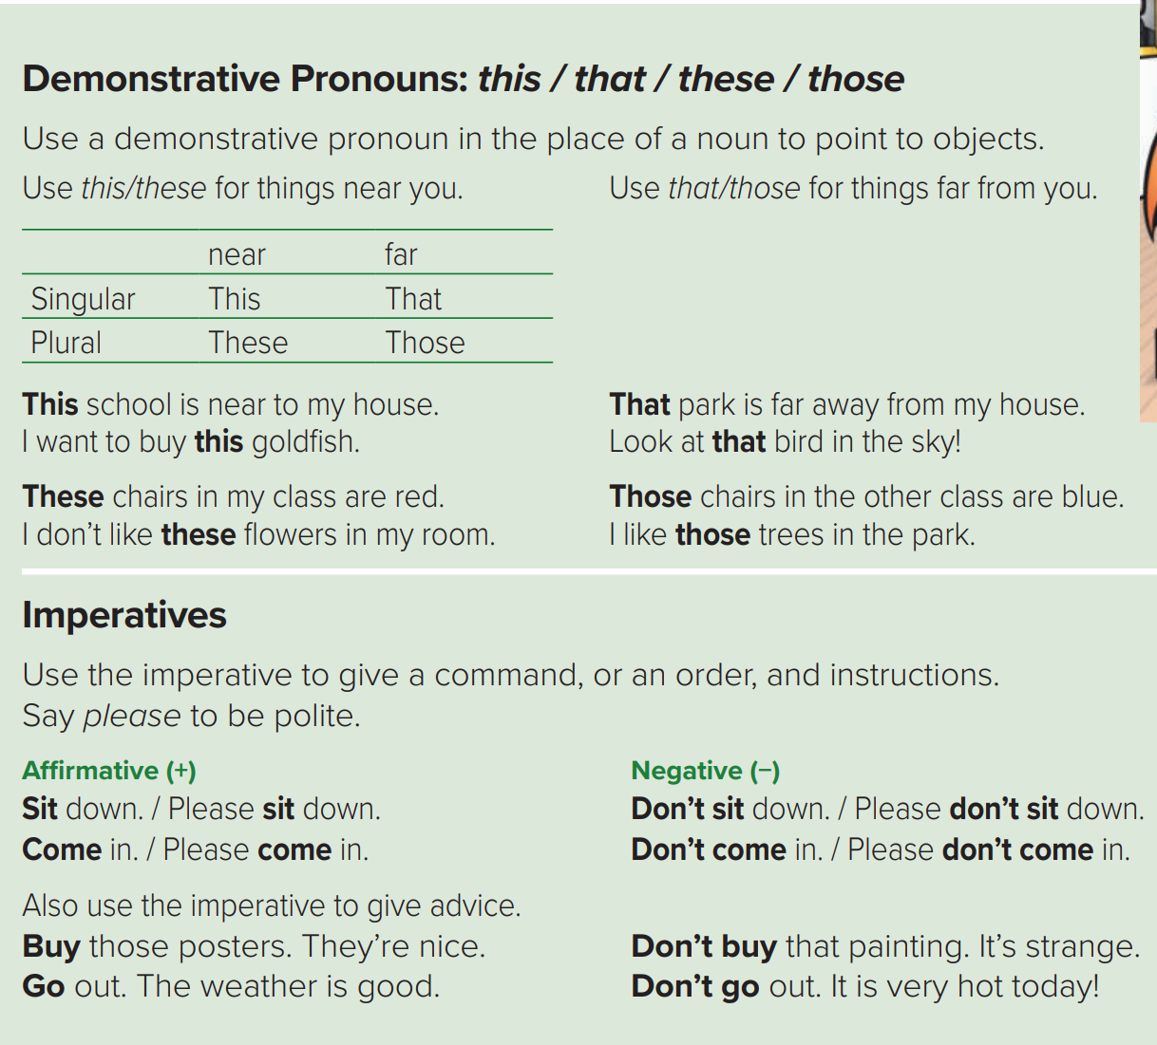












In place of NOUN
Page 20
Warm up
1-Listen
New words
Quick check
2-Pair work

Slide 8
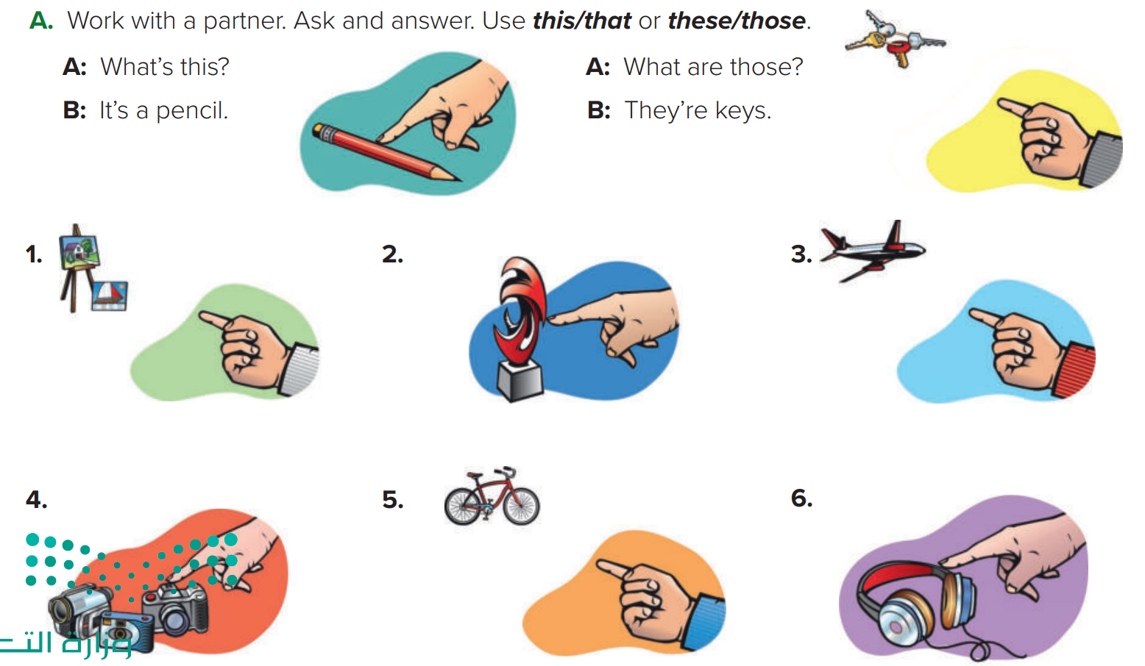



Page 20
Think pair share
What are those?
What’s this?
What’s that?
They’re paintings
It’s a sculpture
It’s an airplane
Warm up
1-Listen
New words
What are these?
What’s that?
What are these?
Quick check
They’re cameras
It’s a bicycle
They’re headphones
2-Pair work

Slide 9









Page 20
What’s this?
Warm up
1-Listen
New words
Make example
Quick check
2-Pair work

Slide 10
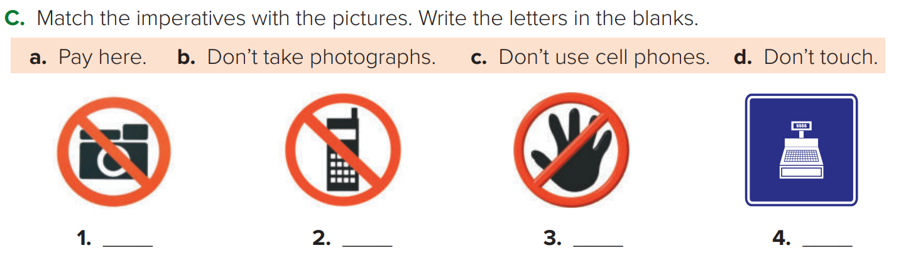




Page 21
Warm up
1-Listen
New words
Quick check
Think pair share
2-Pair work

Slide 11


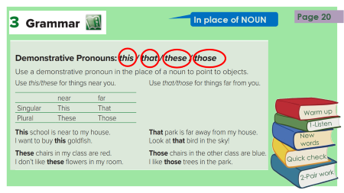
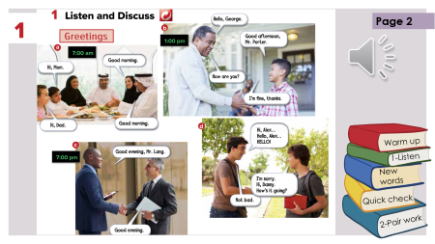
Lets play
Page 19
Think pair share
Warm up
1-Listen
New words
Quick check
2-Pair work

Slide 12



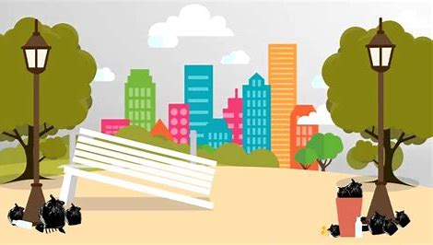
Make a question
Warm up
1-Listen
New words
Quick check
2-Pair work

Slide 13





page 196 Ex(C-D)
for practice grammar
Warm up
1-Listen
New words
Quick check
2-Pair work

Slide 14
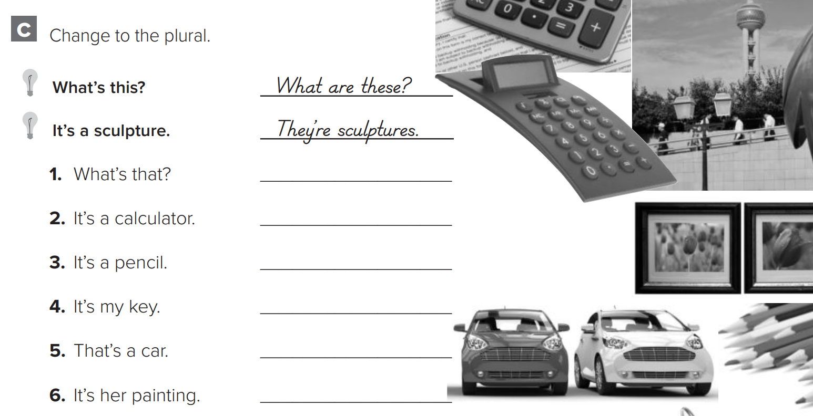
p.196
What are those?
They’re calculators
They’re pencils
Warm up
1-Listen
They’re my keys
New words
Those are cars
They’re her paintings
Quick check
2-Pair work

Slide 15
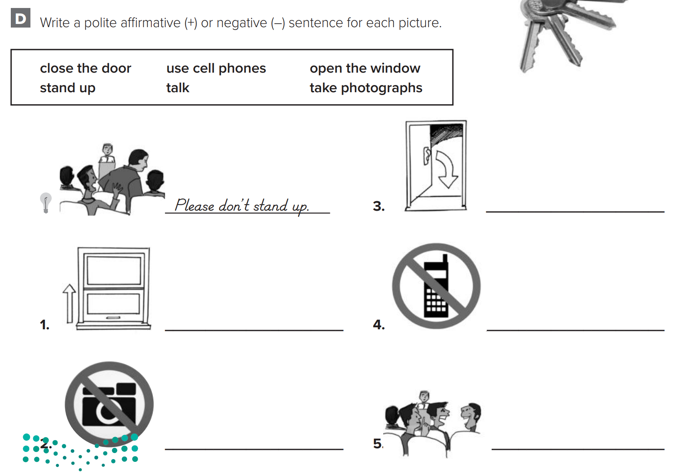
p.196
Please close the door
Warm up
Please open the window
Please don’t use cell phone
1-Listen
New words
Please don’t take photographs
Quick check
Please don’t talk
2-Pair work

