Slide 1

12th/ September/2023
Super goal 1
U: 2
What day is today?
Writing

Slide 2
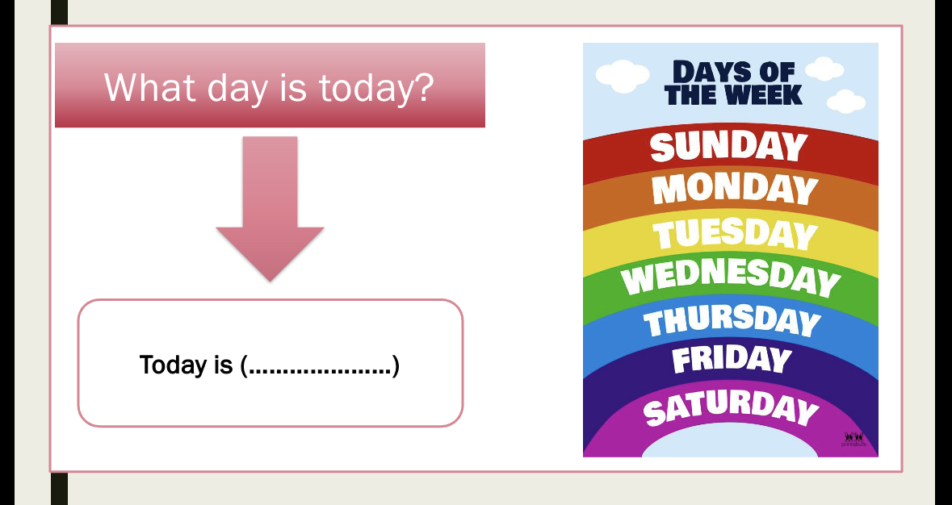

Slide 3
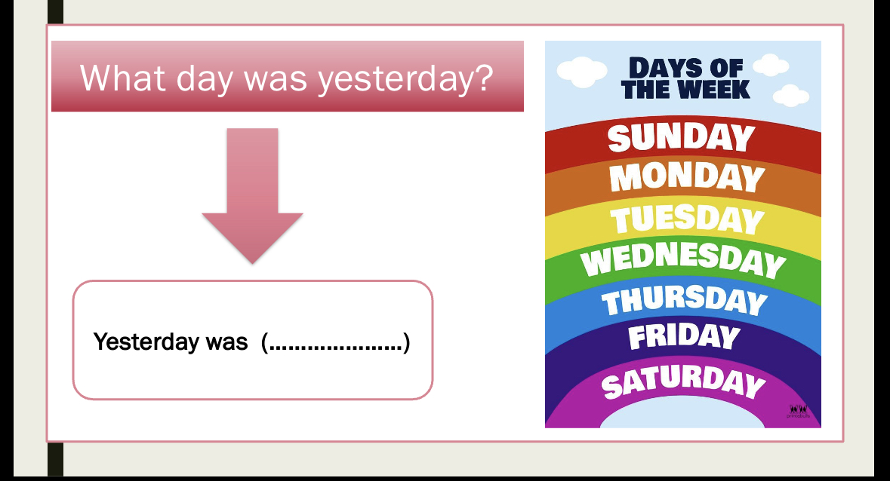

Slide 4


Slide 5
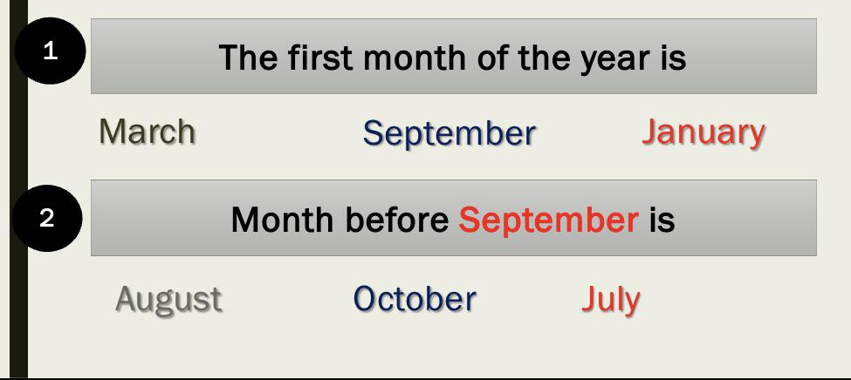

Slide 6

Learning objectives :
Learn the different between WH Q
Answer the question about the them
Learn when do we use Capital letters
Make a questions about general information.

Slide 7


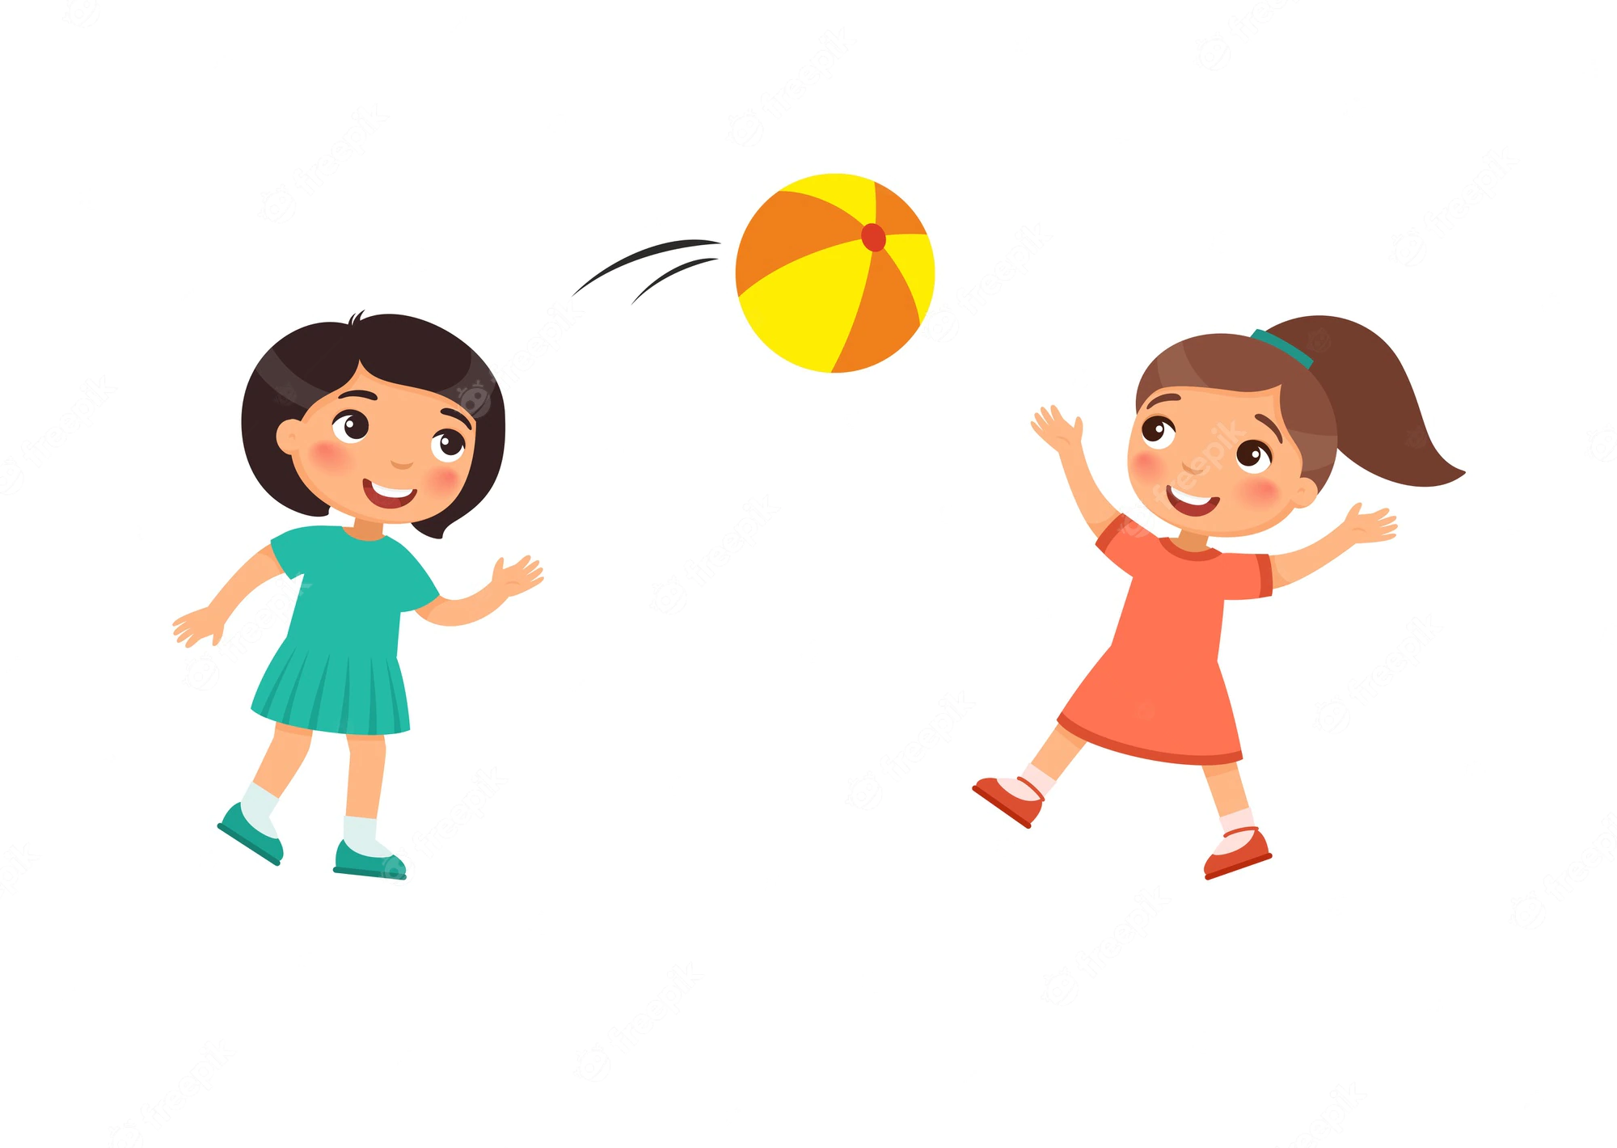
What is your name ?
Some information
Name of person or things
Action

Slide 8
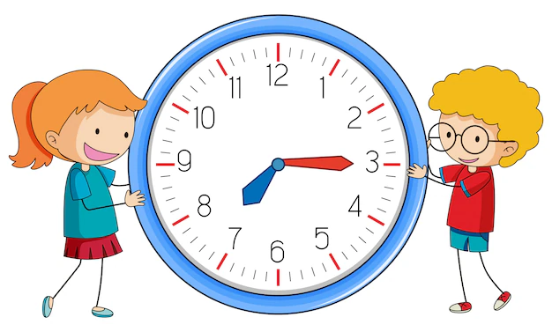
When is your birthday?
Time

Slide 9
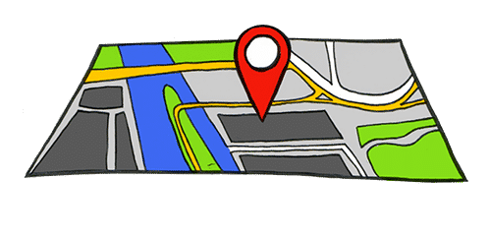
Where are you from?
Place

Slide 10
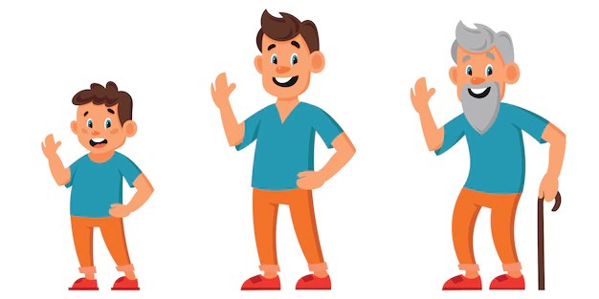
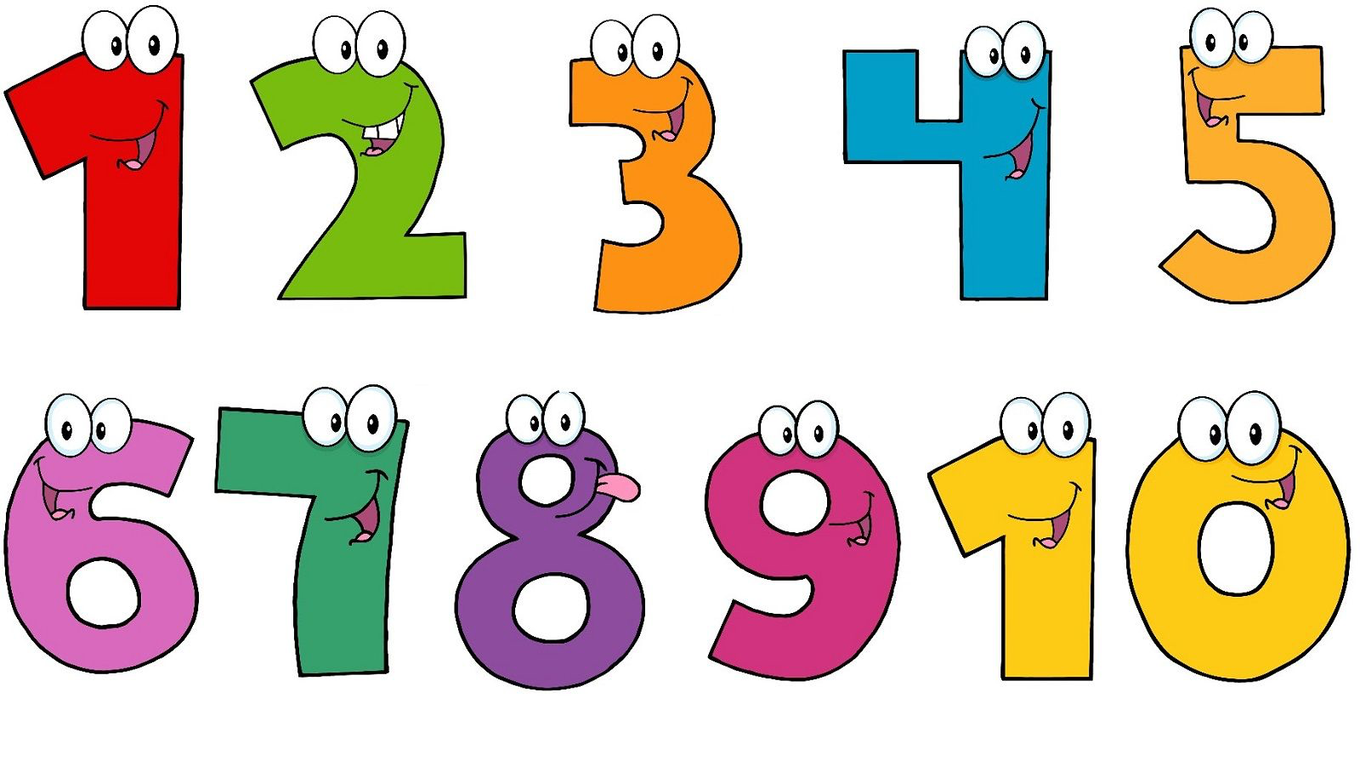
How old are you?
كيف ؟
Age
Quantity
How

Slide 11

Well done 👍

Slide 12
  https://www.youtube.com/watch?v=iZk-WVKOHDw

Slide 13
Open your books p16

Slide 14
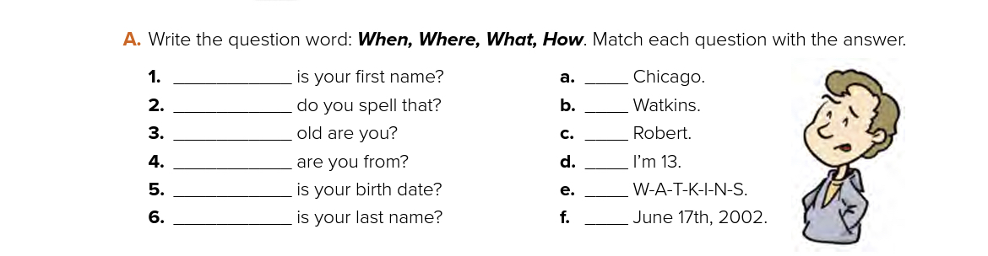
What
4
How
1
How
6
Where
3
When
2
What
5

Slide 15
Well done 👍

Slide 16

Writing Corner
Capitalisation

Slide 17



Name of people
Countries & Cities
Months & Days
Saudi Arabia
Nourah
August
Sunday
Riyadh
Layan

Slide 18
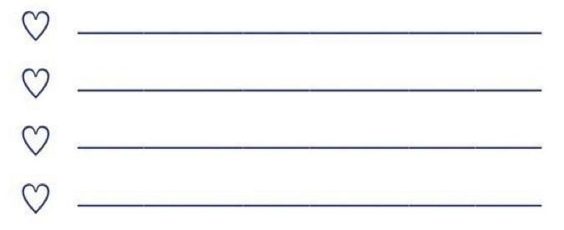
Who can write?
Day
Month
City
Name

Slide 19
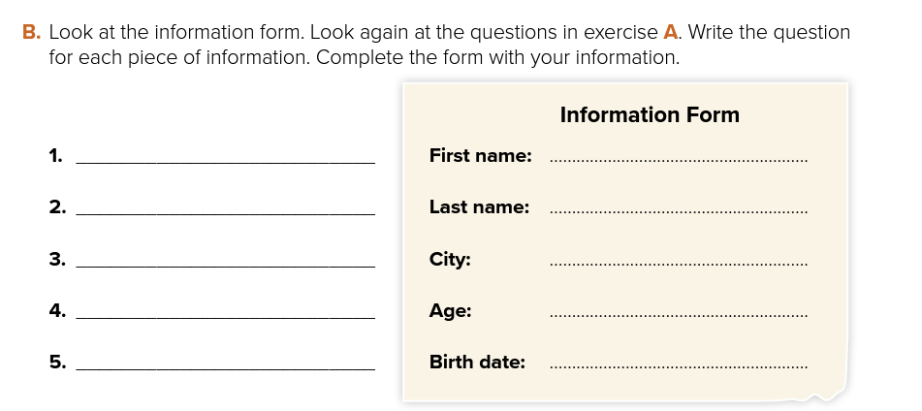
What is your first name?
What is your last name?
Where are you from?
How old are you?
When is your birth date ?

Slide 20
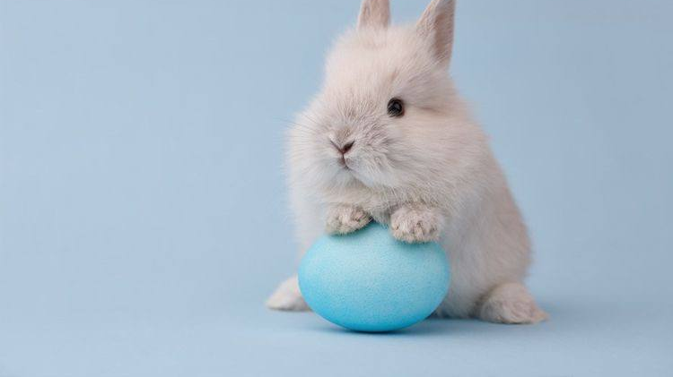
Thank you so much for listening!
See you tomorrow
H.W
P194 k

