Slide 1










T
H
A
N
K
S

Slide 2










U2: What Day Is Today?c
A
B
O
U
T
M
Y
P
E
T
Conversation
Page: 14

Slide 3



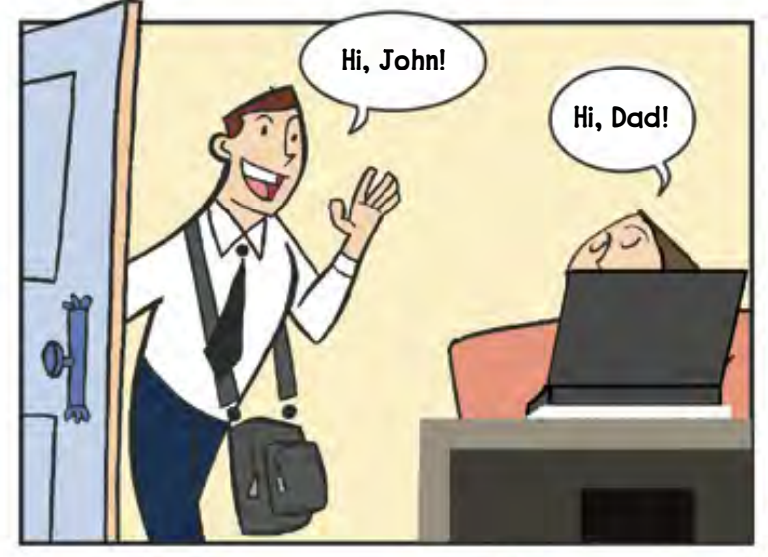





M
E
E
T
Who are the people
in the picture?
M
Y
P
E
T

Slide 4

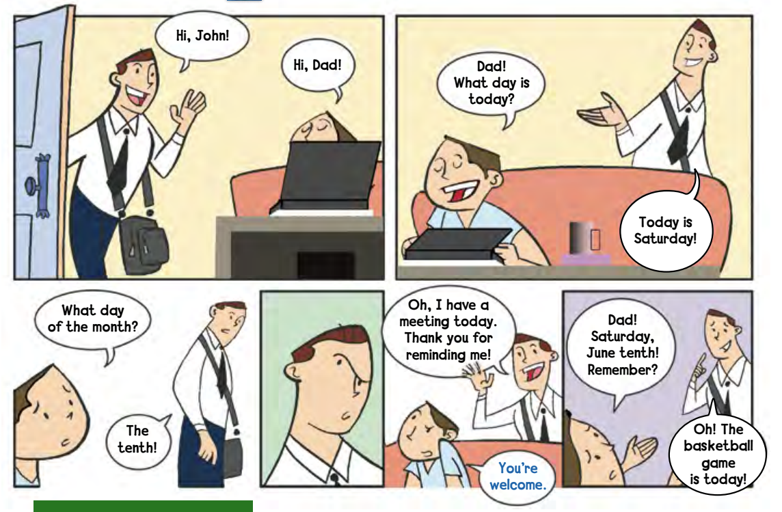

Slide 5
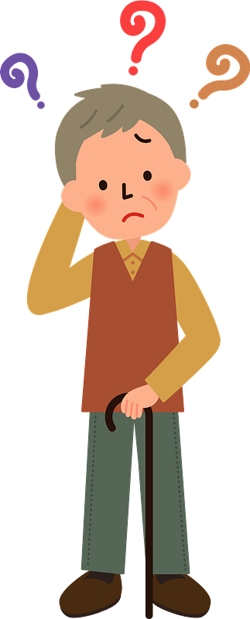


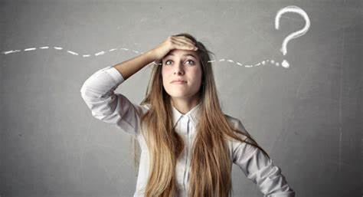

Forget
#
remember

Slide 6


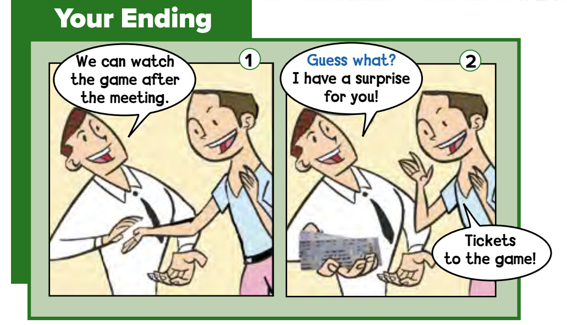



Guess what?
P
E
T
S
&
R
U
B
S

Slide 7




Guess what?
when we tell someone something that will surprise them

Slide 8






Slide 9







عبير العنزي

