Slide 1

Kingdom Of Saudi Arabia
Ministry Of Education
English For Intermediate Grade
1st Intermediate Grade
1st Term
المملكة العربية السعودية
وزارة التعليم
اللغة الإنجليزية للمرحلة المتوسطة
الصف الأول المتوسط
الفصل الدراسي الأول
Super Goal 1
Workbook
Unit 1
Good Morning
إعداد المعلم
أحمد سعيد بلغيث

Slide 2
Content
Pages
89
90
91
92
Exercises
A
B
C
D
E
F
G

Slide 3




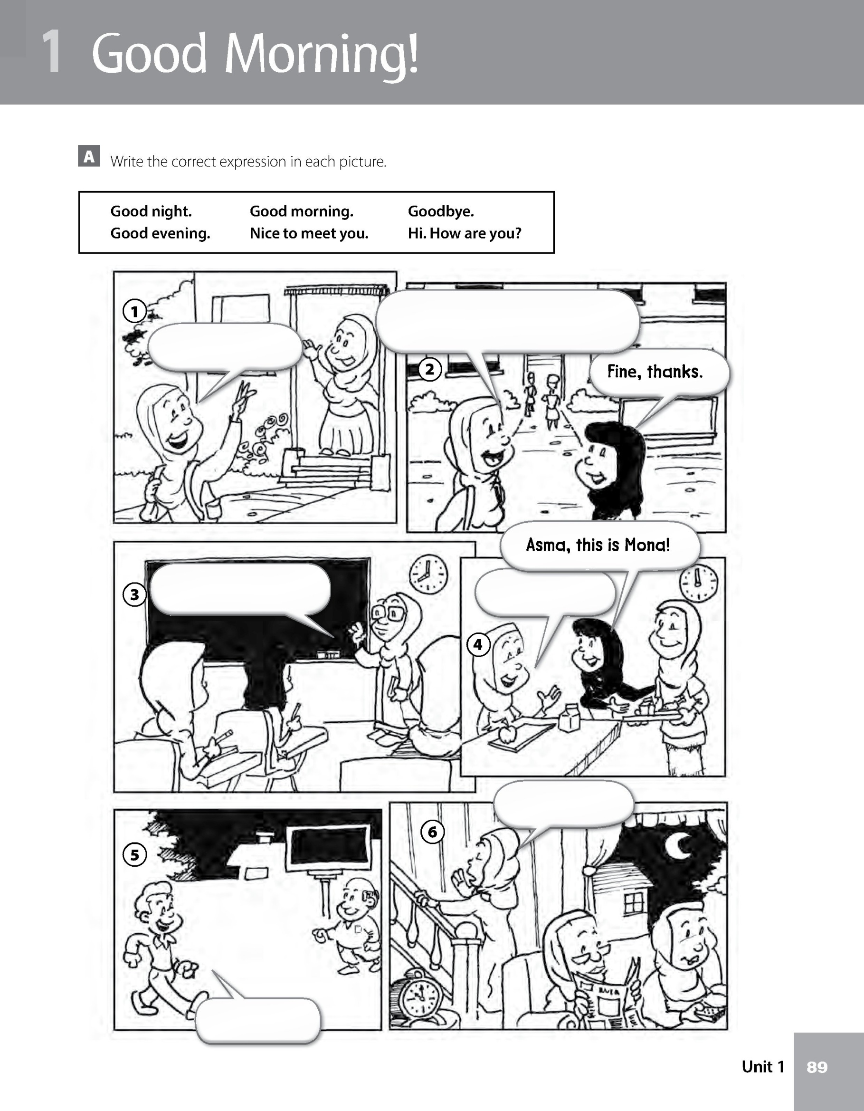

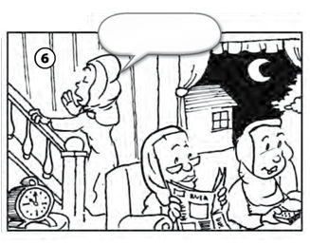
U1 : P 89
A
Write the correct expression in each picture.
Good night. Good morning. Goodbye.
Good evening Nice to meet you. Hi. How are you?
Hi. How are you?
Goodbye
Good evening
Good morning
Good night
Nice to meet you.

Slide 4

U1 : P 90
B
Complete the sentences. Use the correct form of the verb be.
Mrs. Rivera ____ Anita’s mom.
is
1. Omar ______ a student.
is
2. You ______ a teacher.
are
3. This ______ Jennifer. But her friend call her Jenny.
is
4. Mr. Bond ______ a good teacher.
is
5. Asma and Mona ______ best friends.
are
6. We ______ students.
are
7. He ______ Ahmed.
is
8. A: How ______ you?
B: I ______ fine, thanks.
are
am

Slide 5
U1 : P 90
C
Complete the sentences. Use contractions with be.
This is my friend, Saeed. ________ a student.
He’s
1. This is my first day here. ________ your new classmate.
I’m
2. This is my friend. ________ a student.
He’s
3. This is Mr. Lee. ________ the principal.
He’s
4. My name is Paul. ________ a student.
I’m
5. This is Mr. White and Mr. Cole. ________ teachers.
They’re
6. Our names are Adel and Fahd. ________ best friends.
We’re
7. You are my friend. ________ my best friend!
You’re
8. Saeed and Alex are friends. ________ classmates, too.
They’re

Slide 6
U1 : P 91
D
Complete the sentences. Use possessive adjectives.
He’s a student. ________ name is Sam.
His
1. This is my sister. ________ name is Amira.
Her
2. This is the teacher. ________ name is Mr. Martinez.
His
My
3. I’m a student. ________ name is Alan.
4. Daniel is a student. ________ friends call him Dan.
His
your
5. Hi. My name’s Yuko. What’s ________ name?
6. This is my mother. ________ name is Kate.
Her
My
7. Good morning, class! I’m your English teacher. ________ name is Ms. Johnson.
your
8. A: What’s ________ name?
B: My name’s Yasmin.

Slide 7
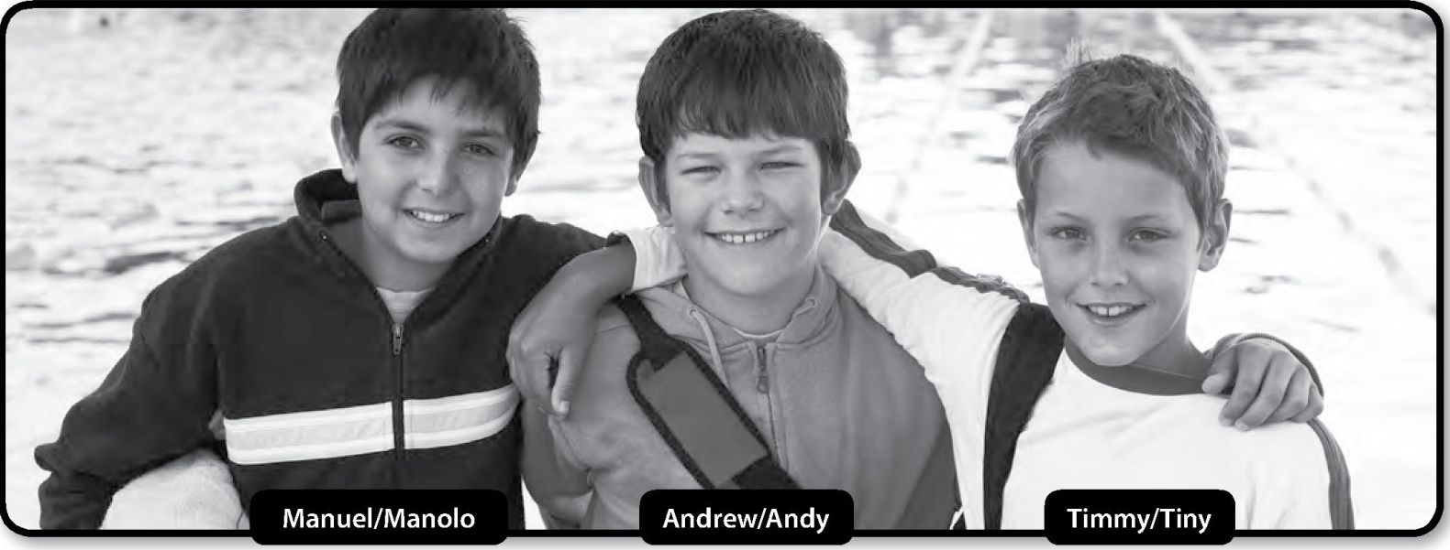
U1 : P 91
E
Complete the sentences. Use a form of the verb be or my, your, his, her.
Hello! My name (1) ________ Manuel. But (2) ________ friends call me Manolo. I (3) ________ a student. This is (4) ________ friend Andrew. (5) ________ friends call him Andy. He (6) ________ a student, too. Timmy (7) ________ my classmate. (8) ________ friends call him Tiny. Tiny means “small.” What’s (9) ________ name?
is
my
am
my
His
is
is
His
your

Slide 8
U1 : P 92
F
Unscramble the words. Write the letters in the boxes. Find the secret word!
1. o l s h o c
 |  | 1. | s | c | h | o | o | l
2. | s | t | u | d | e | n | t
 | 3. | s | p | e | l | l
 | 4. | m | e | e | t
 | 5. | f | r | i | e | n | d
6. | n | i | g | h | t
 | 7. | y | o | u | r
 |  | 8. | a | r | e
 |  | 9. | l | a | t | e | r
2. d e t n u s t
3. l p s e l
4. e t e m
5. d r e n I f
6. g n h i t
7. u y o r
8. r e a
9. e r a l t
The secret word is : _____________________
Super Goal

Slide 9
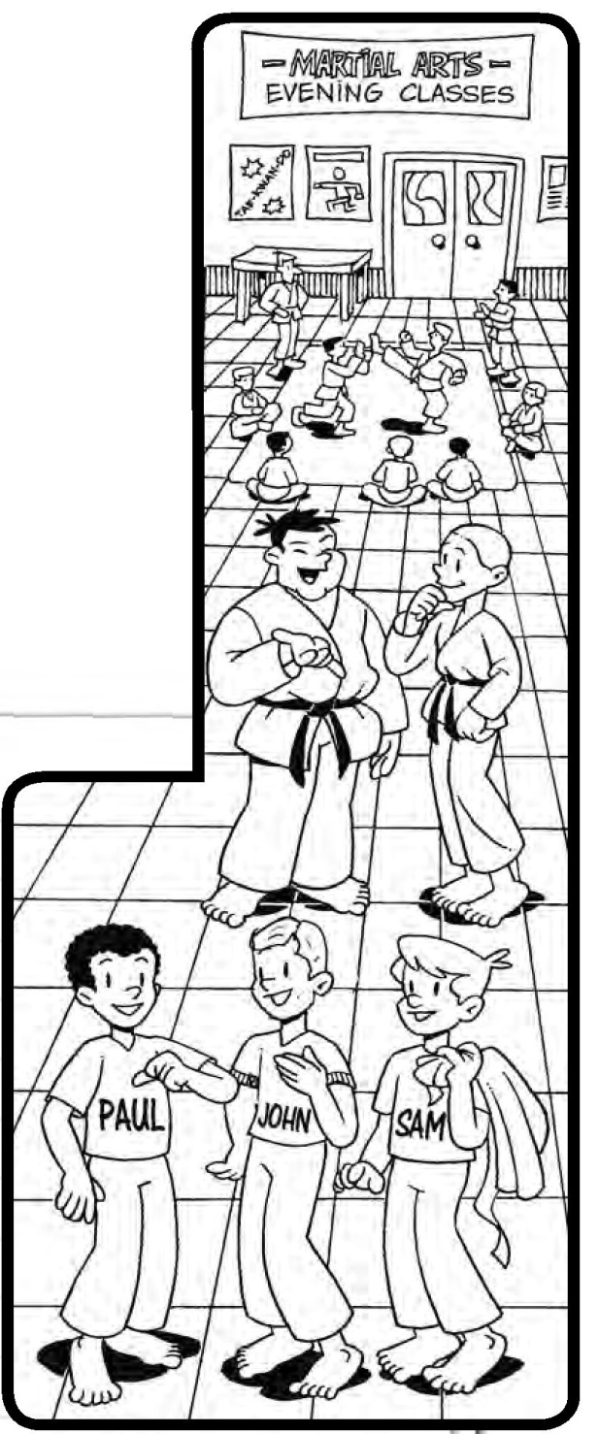
U1 : P 92
G
Writing
Look at the picture. Write a conversation.
Hi
Paul: ________. ________ Paul Wilson.
John: ________, Paul. ________ John.
This is ________ friend, Samuel.
But ________ friends call him ________.
Paul: _____________________, Sam.
Sam: _____________________.
Paul: Mr. Lee and Mr. Grant ________
the teachers.
________, Mr. Lee!
Mr. Lee:______________, Paul! ______________?
Paul: ________, thanks.
I’m
Hello
I’m
my
his
Sam
Nice to meet you
Nice to meet you, too
are
Hello
Good evening
How are you
I’m fine

