Slide 1

Super Goal 1

Slide 2

Warm up

Slide 3
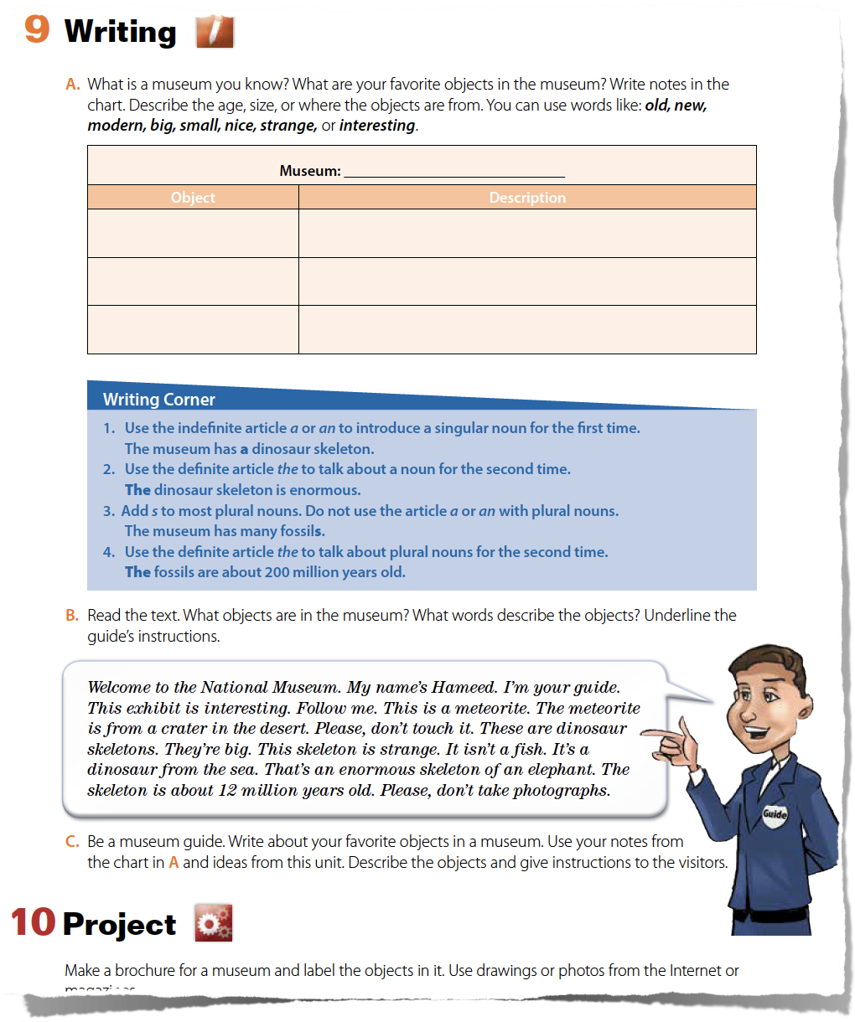
Page 24
What are the Lesson’s Objectives

Slide 4
  At the end of the lesson you will be able to :
  Read & Write about things in a museum.
  Organize your ideas.
  Establish the main idea.
  make a connection between ideas.
Lesson’s Objectives

Slide 5
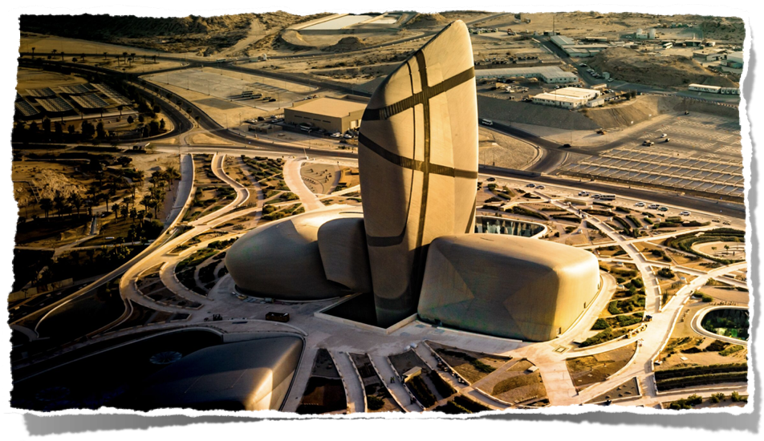
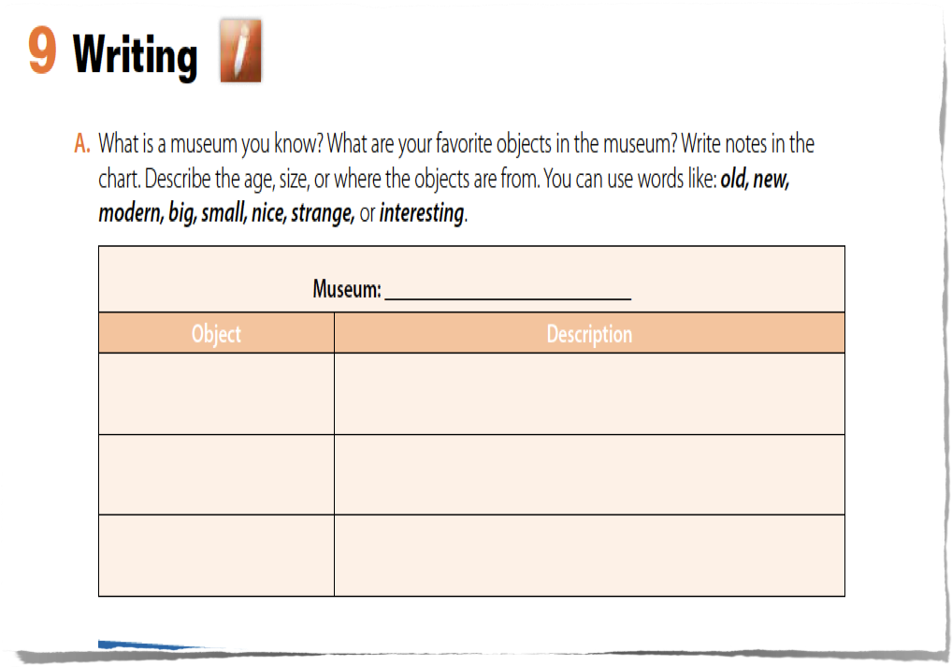
Ithra
Like the old Islamic art and interesting islamic pieces from the world
Paintings and
sculptures
Like the strange animals that found in Arabian Peninsula.
Animals
Interactive gallery
Like the modern and big screens with interesting sound effect.

Slide 6
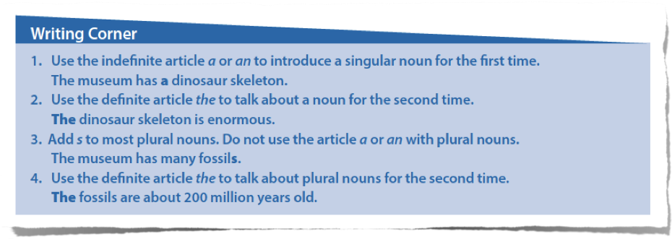
This is a classroom. The classroom is big.
That is an apple. The apple is red.

Slide 7
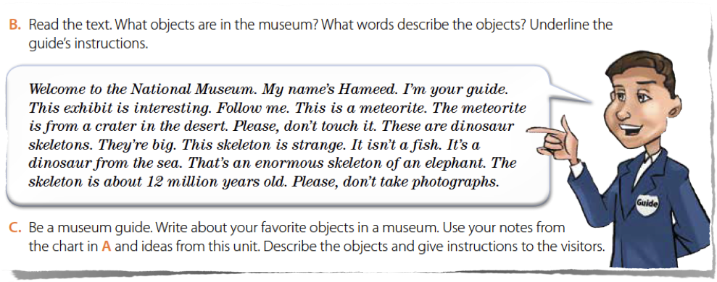
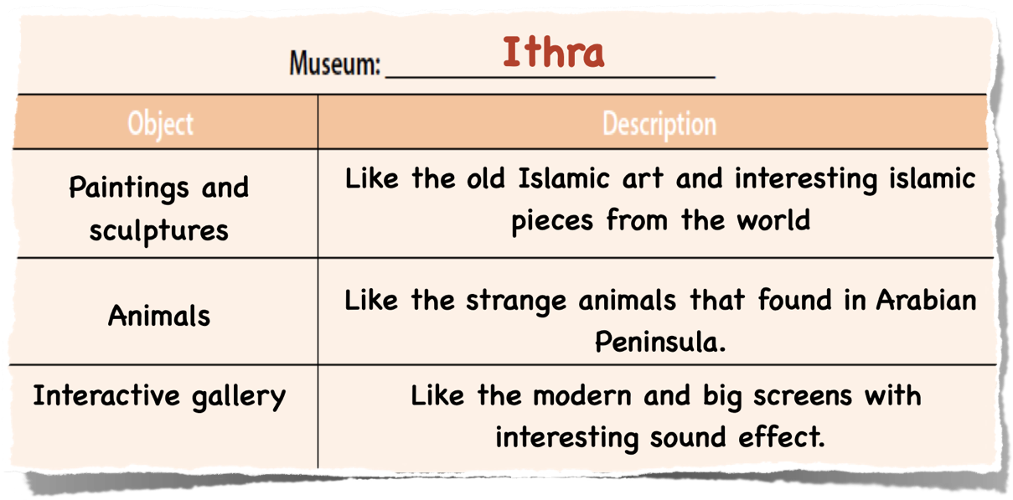

Slide 8
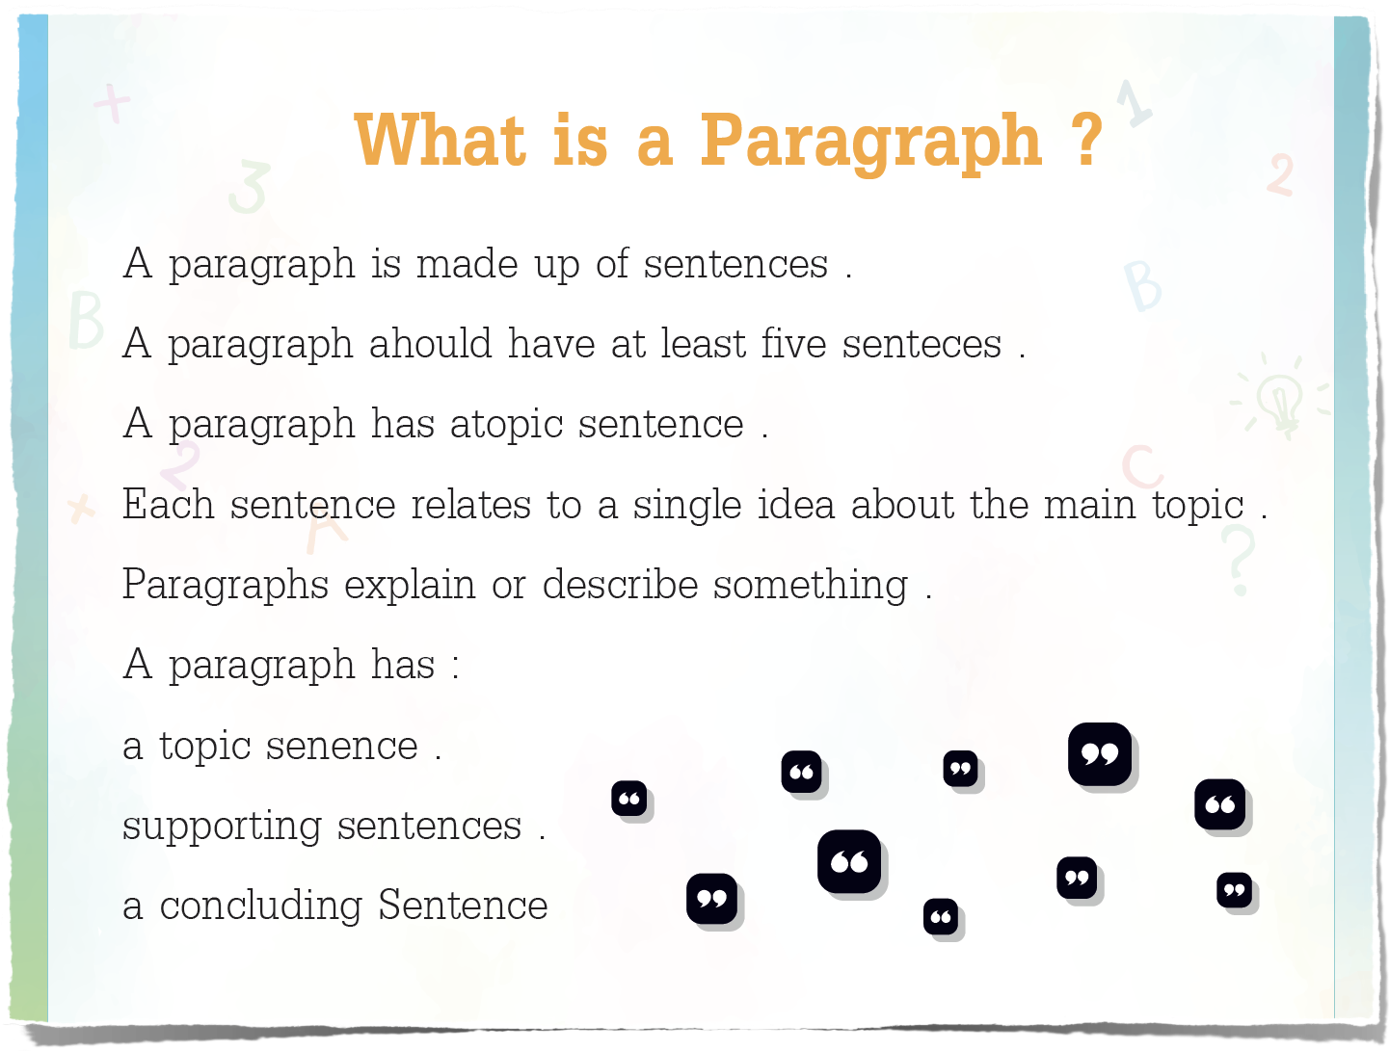

Slide 9
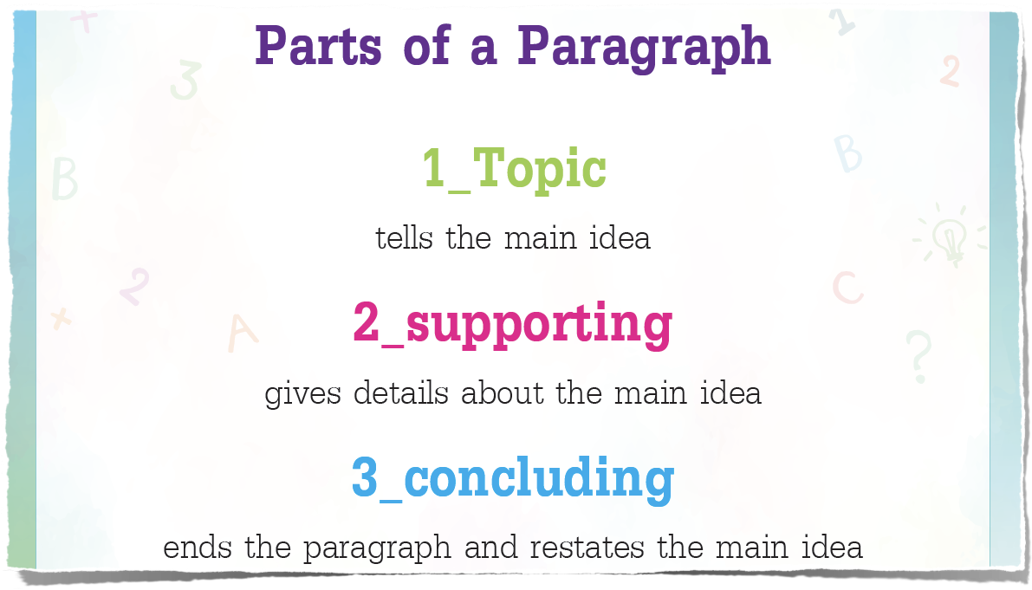

Slide 10
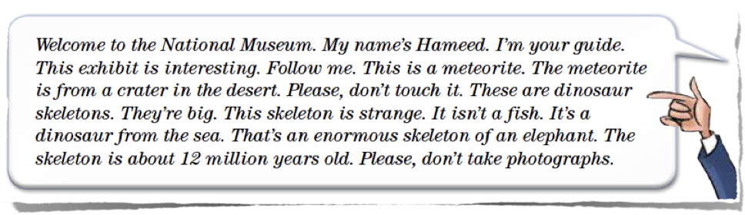
Where is the topic sentence?
Where is the supporting sentences?
Where is the concluding sentence?

Slide 11
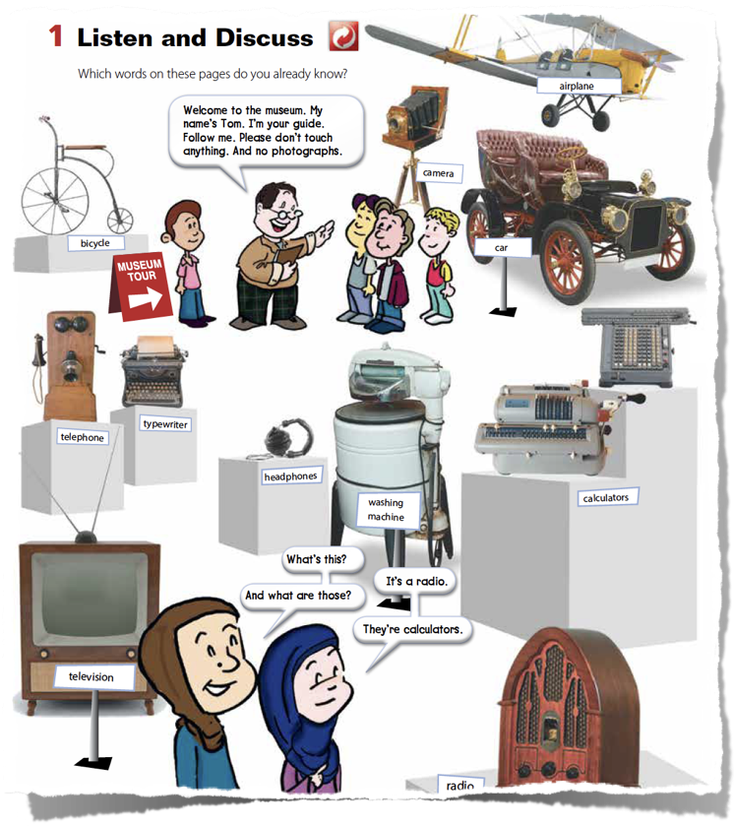
Write a topic sentence to show what the whole paragraph is going to be about.
How to start the paragraph:
Welcome to the __________ . My name is __________ I am your guide. I will show you my favorite objects in the museum . Follow me. This is a __________ . It is __________
Add some instructions.

Slide 12
“Homework”

Slide 13
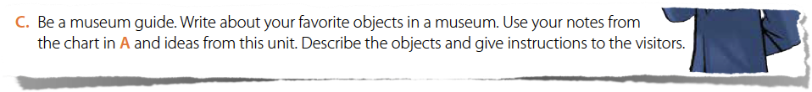
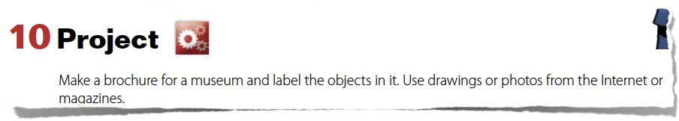

Slide 14
Presented by
Noha Al Jammaz
o

