Slide 1




Classroom rules
Use the “raise hand” button when you want to ask a question.
“Mute your mics” unless your teacher ask you to do otherwise.
Do not chat with your friends when the teacher is explaining.
Answer the questions your teacher ask you so that you don’t lose marks.

Slide 2
Our objectives for today’s lesson:
1-Differentiate between demonstratives pronouns (this , that, these ,those ).
2-Ask and answer questions using demonstrative pronouns.
3-Identify different commands.
4-Distinguish definite articles ;a , an .

Slide 3
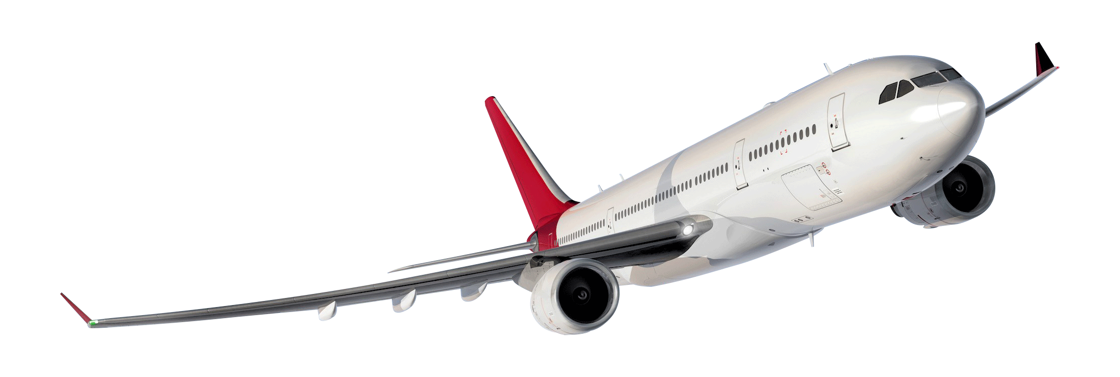

What’s that?
Grammar p. 20
هذه الصورة بواسطة كاتب غير معروف مرخصة بالاسم CC BY-SA

Slide 4


watch
bicycle
typewriter
Key chaine
telephone
car
radio
camera
What’s this?
tekhnologic

Slide 5
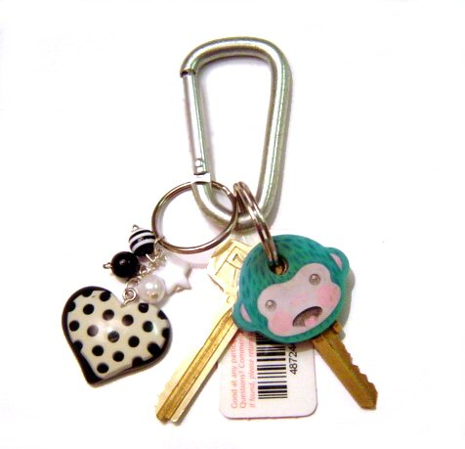
watch
bicycle
typewriter
Key chains
telephone
car
radio
camera
What are those?
tekhnologic

Slide 6


Slide 7



Demonstrative Pronouns:
Plural | singular
These (near) | This (near)
Those (far) | That (far)

Slide 8
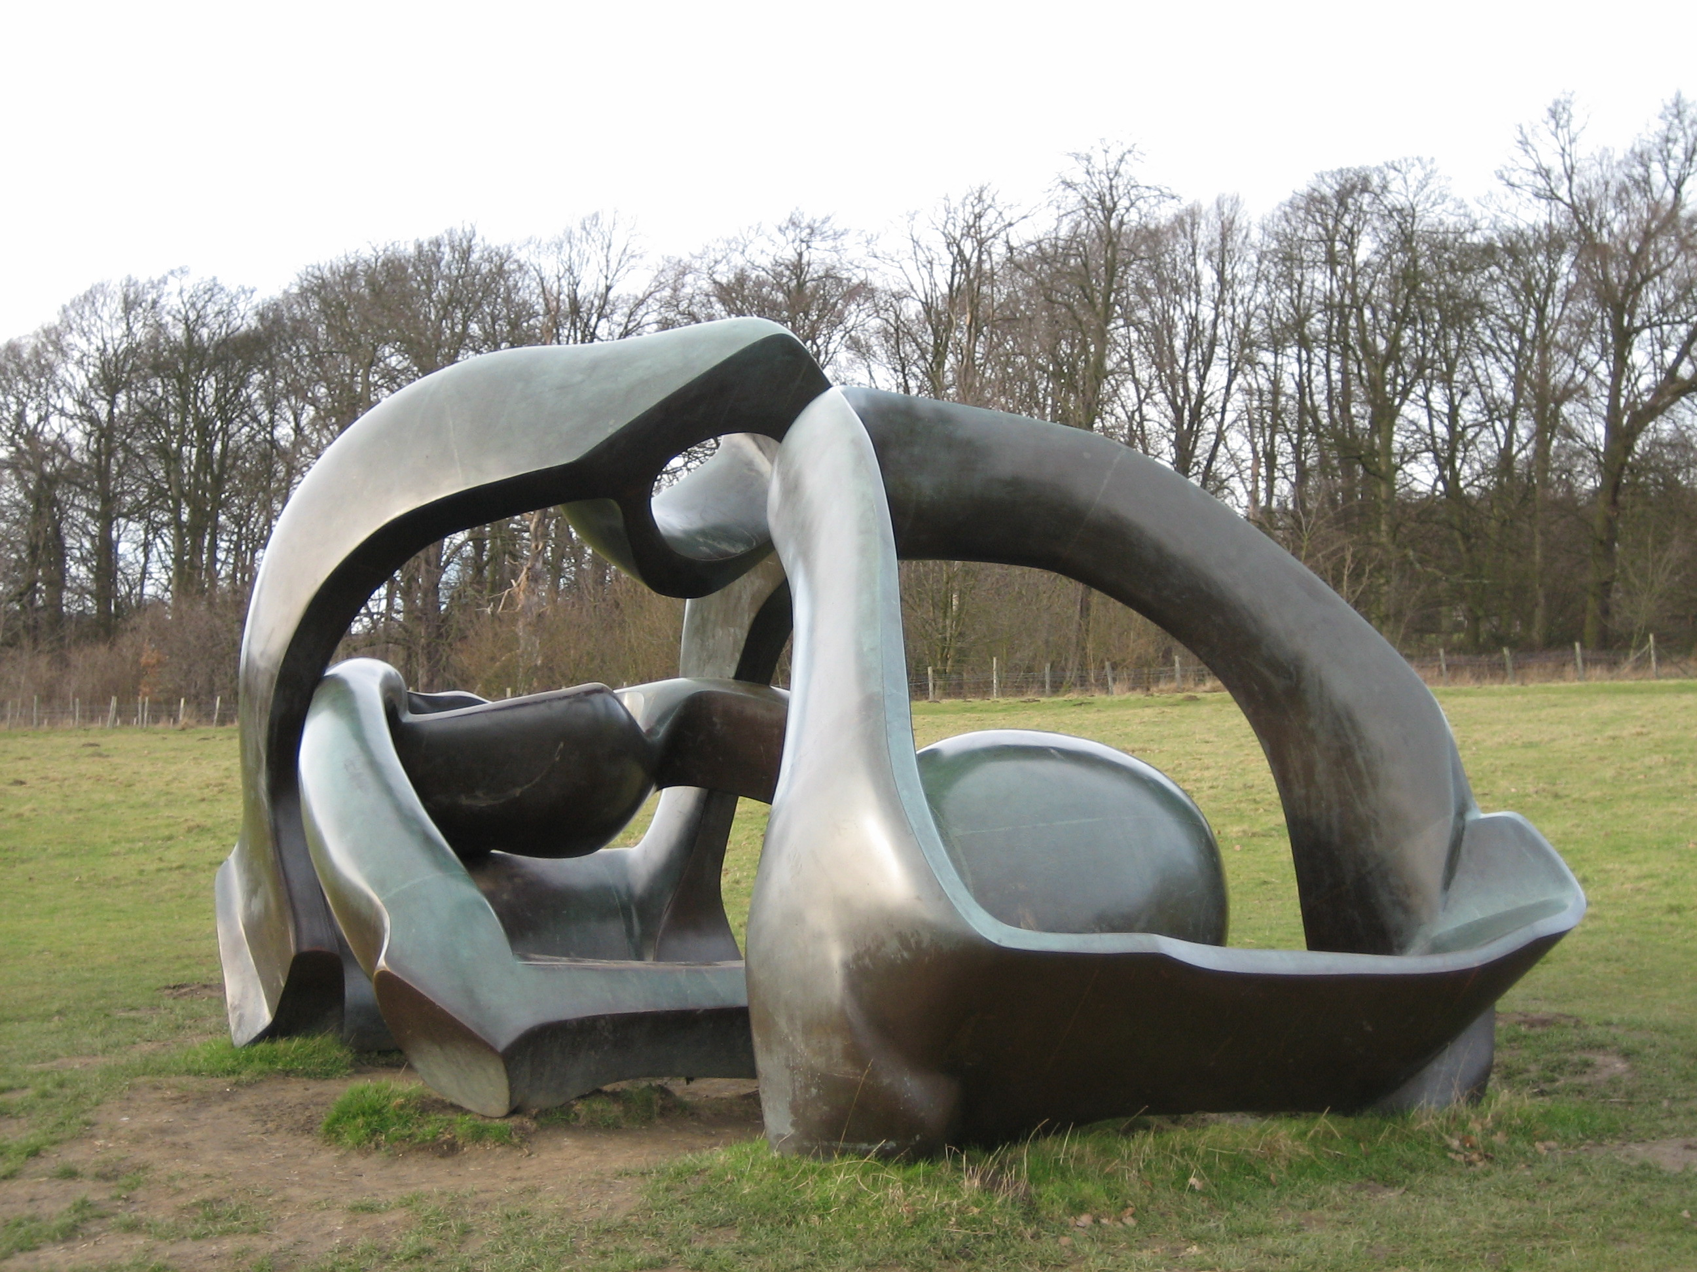
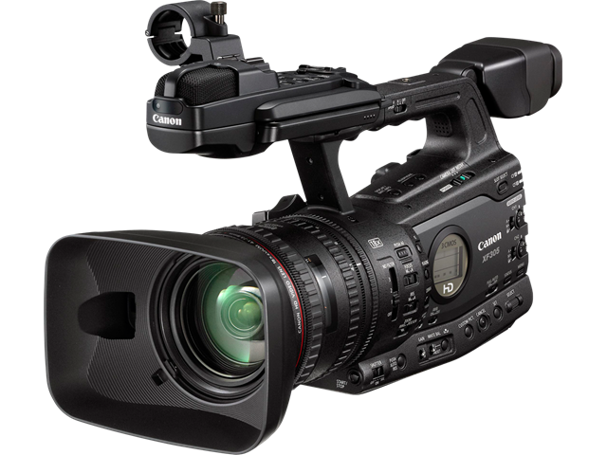

Demonstrative Pronouns:
Singular : this , that Plural : these, those.
Choose the correct demonstrative pronouns:
that
1- What’s…………………..?
-It’s a sculpture.
these
2- What are………………..?
-They are cameras.

Slide 9
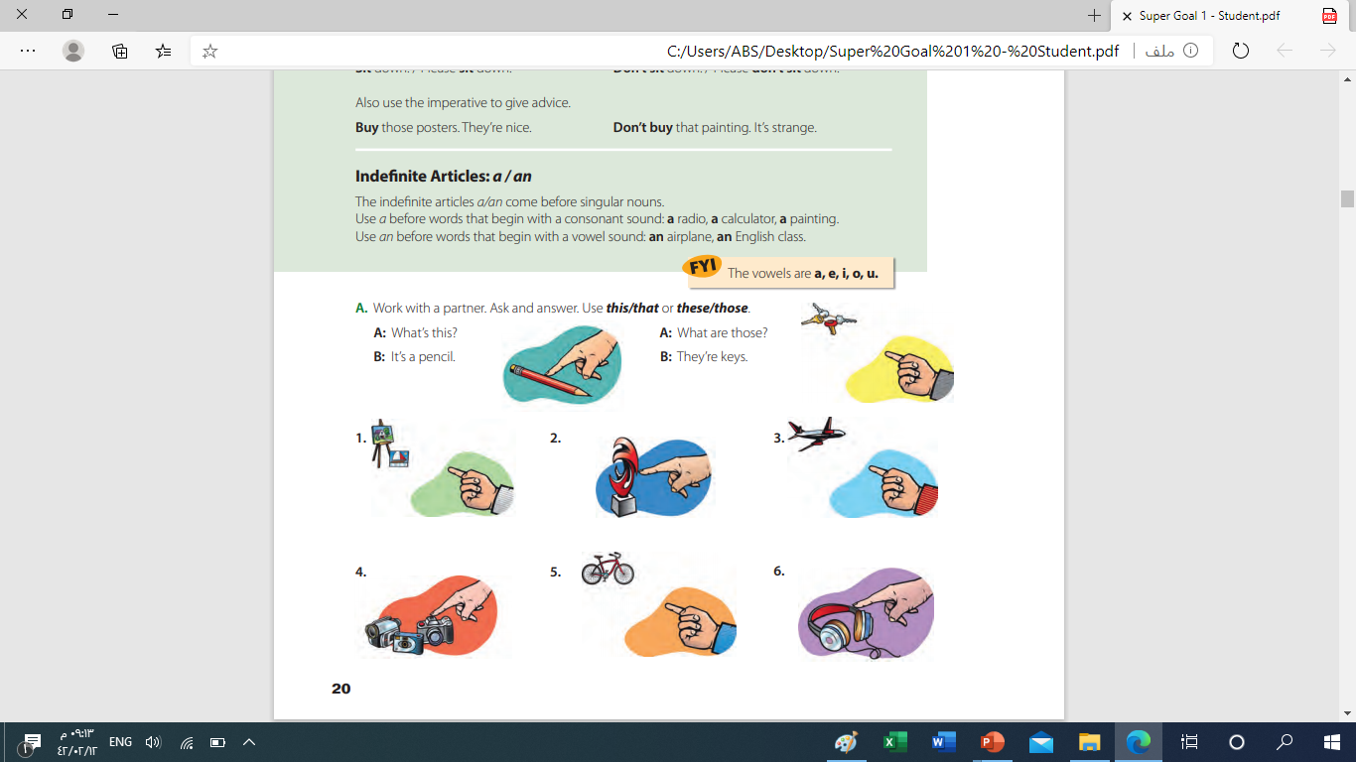
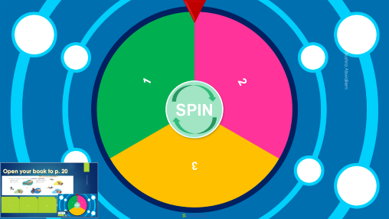
Open your book to p. 20
1
2
3
1-What’s that ?
-It’s a painting
2-What’s this?
-It’s a pencil
3-Whats that?
_it’s a sculpture
3-Whats that?
_it’s an airplane
-What are those?
-They are key chains

Slide 10


Slide 11




Imperatives :
Use the imperative for:
1- Commands
2- Instructions
3- Polite requests
Don’t take pictures

Slide 12
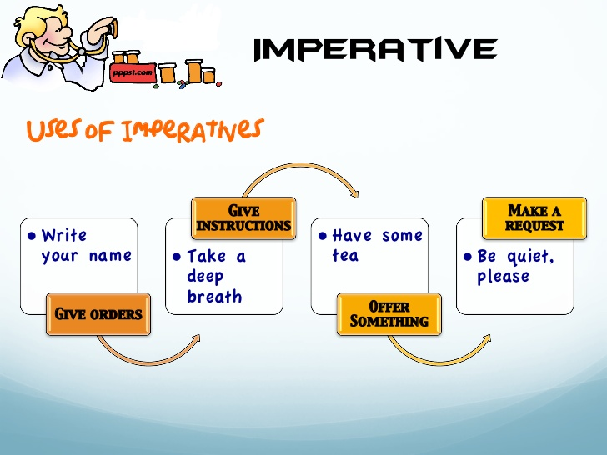
هذه الصورة بواسطة كاتب غير معروف مرخصة بالاسم CC BY-SA-NC

Slide 13
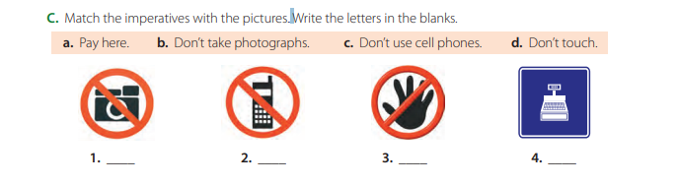
Open your books to P.21
b
c
d
a

Slide 14

Indefinite articles
Indefinite articles go only with singular nouns
a &an=1
an
Vowels
a
Consonants
The rest of the alphabet
a,u,i,o,e
An apple
An airplane
An umbrella
Indefinite
articles
A bicycle
A camera
A sculpture

Slide 15


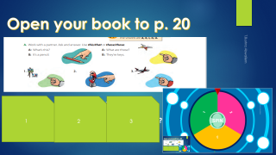

1
2
SPIN
3
tekhnologic
Notes:
3 Segments

