Slide 1






12 form, meaning & function
Today:
Date:
- -1445
Page 17
By: Dalal Al-Juaid

Slide 2


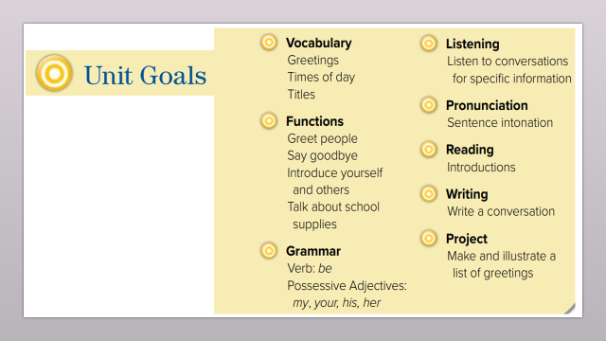
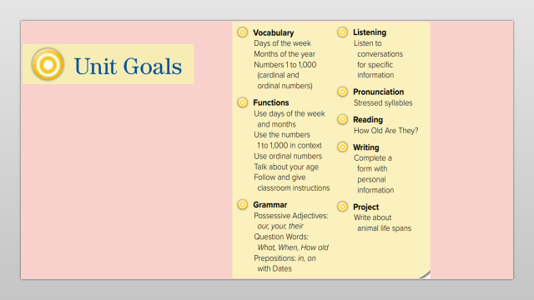
Apply classroom instruction.
write instructions in the correct order.
Warm up
questions
summative

Slide 3
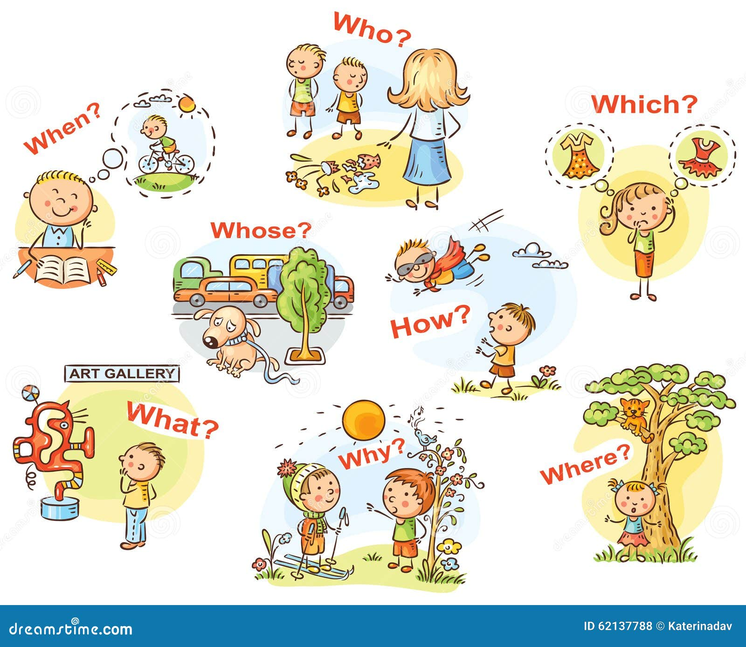

Revision

Slide 4
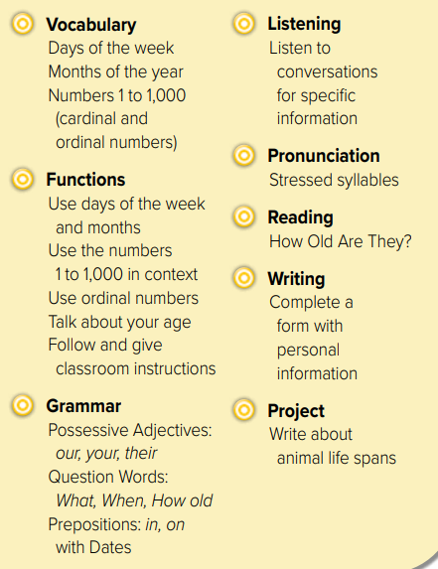
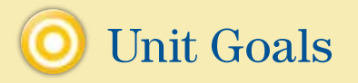

Slide 5


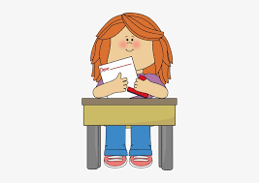
Total physical response
Stand up
Game of two
Open the book
Sit down
Warm up
Close the book
questions
summative

Slide 6


Slide 7
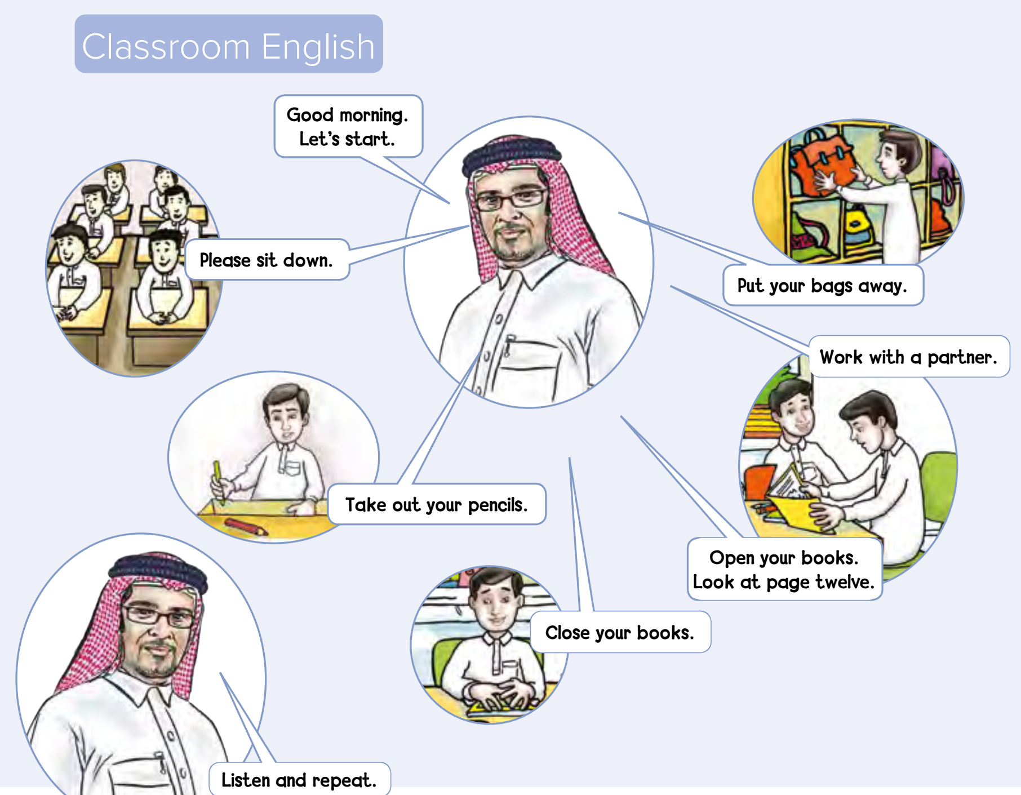




Page 17
4
Think pair share
Warm up
read
questions
summative

Slide 8
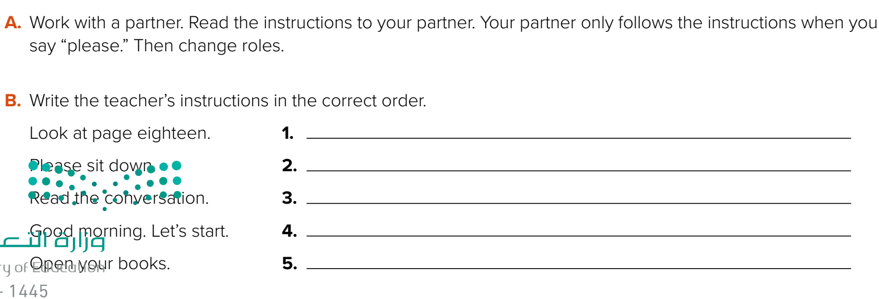

Say : please
Page 17
Warm up
pair work
questions
summative

Slide 9
Think pair share
Good morning, let’s start.
Please sit down.
Open your books.
Warm up
Look at page eighteen
Read the conversation.
questions
summative

Slide 10





Warm up
What did our country do for e-learning?
How should we be polite online?
questions
summative

Slide 11



Write a sentence in your notebook
Warm up
questions
summative

