Slide 1


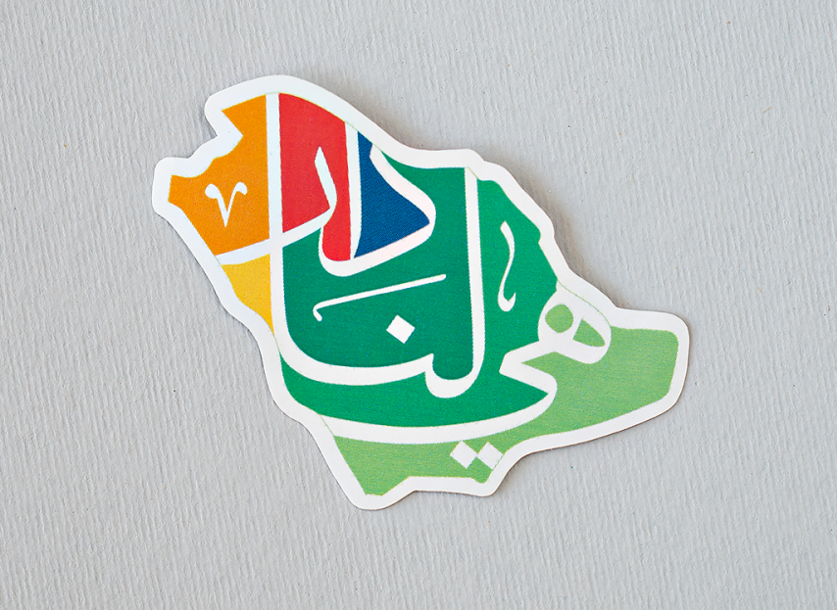



Slide 2
Mega Goal 1.1
Unit 2 - Careers
8 Conversation
By: Essa Al Hussaini

Slide 3



Slide 4




Revision
Job profile
What is it?
What is it for?
Qualifications
Special Skills
What does it highlight?
Personality
Notes:
Meaning of job profile in English
a description of the skills, experience, and personality a person would need in order to do the job:
The job profile outlines the details of an employee's job
CV = Resume

Slide 5
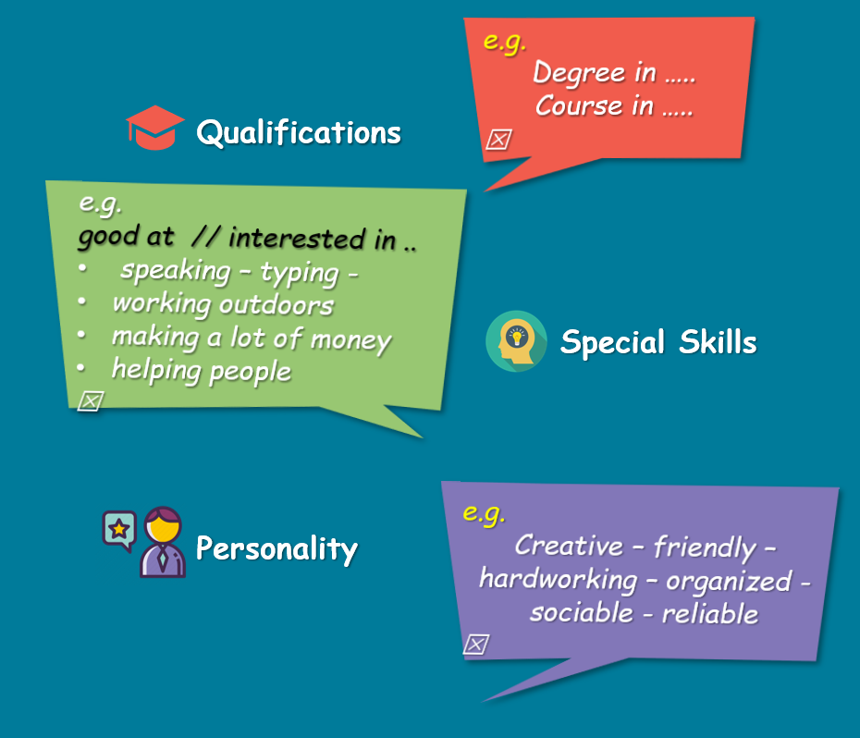
Revision
Job profile
e.g.
Degree in …..
Course in …..
Majored in …
e.g.
good at // interested in ..
speaking – typing -
working outdoors
making a lot of money
helping people
Qualifications
e.g.
Creative – friendly – hardworking – organized - sociable - reliable
Special Skills
Personality

Slide 6
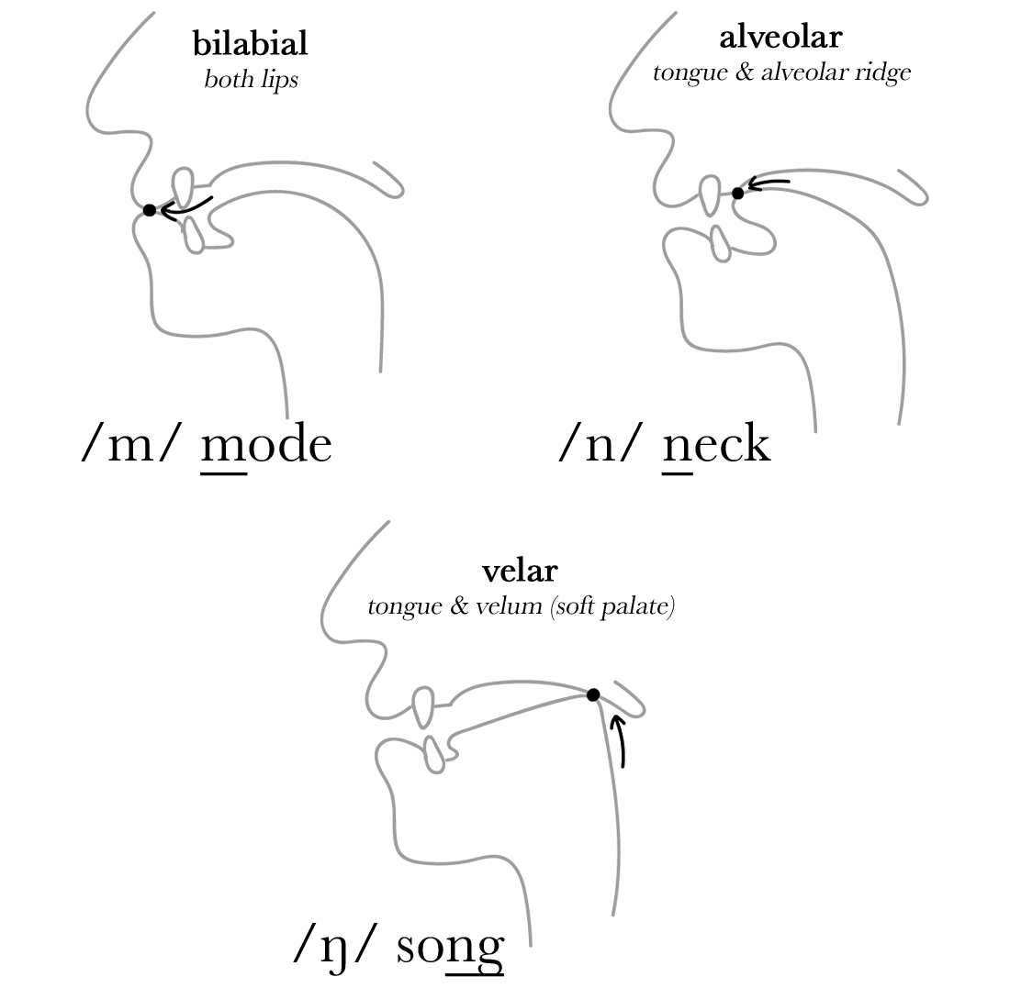
Revision
The sounds
/m/ - /n/ - /ŋ/

Slide 7


Objectives
Answer
question based on a conversation
Use
the "Real Talk" phrases in conversations.

Slide 8

Warm up
Your strengths?
Your dram job?

Slide 9
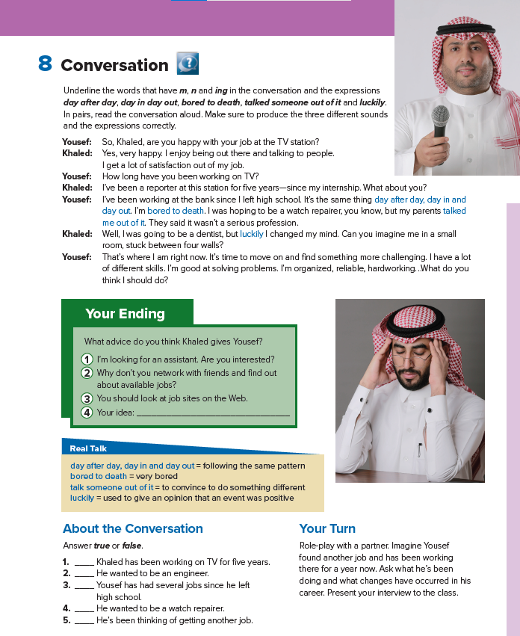
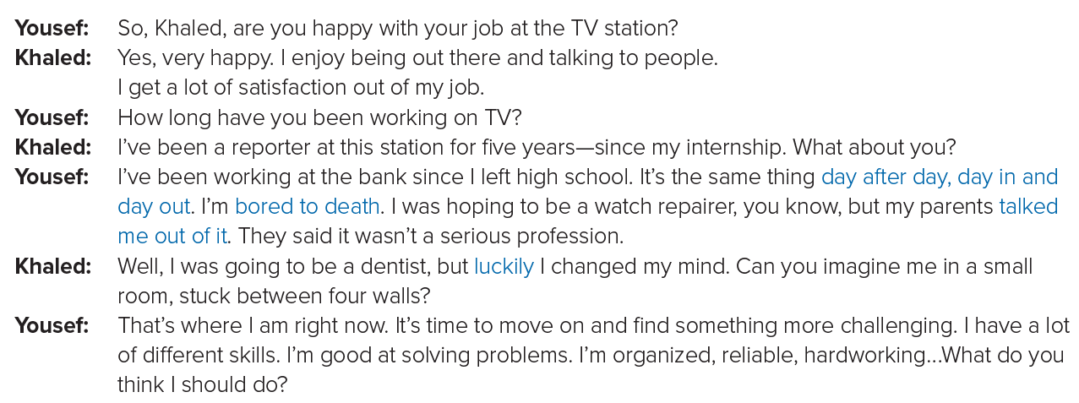
Student’s book
25

Slide 10
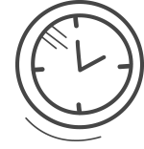


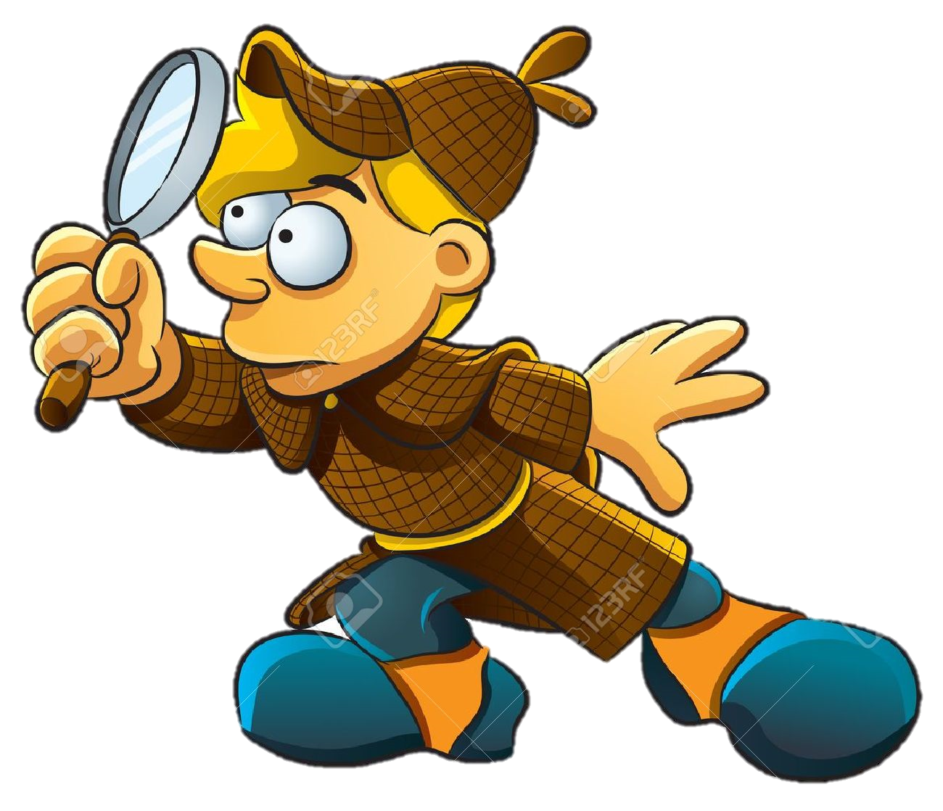


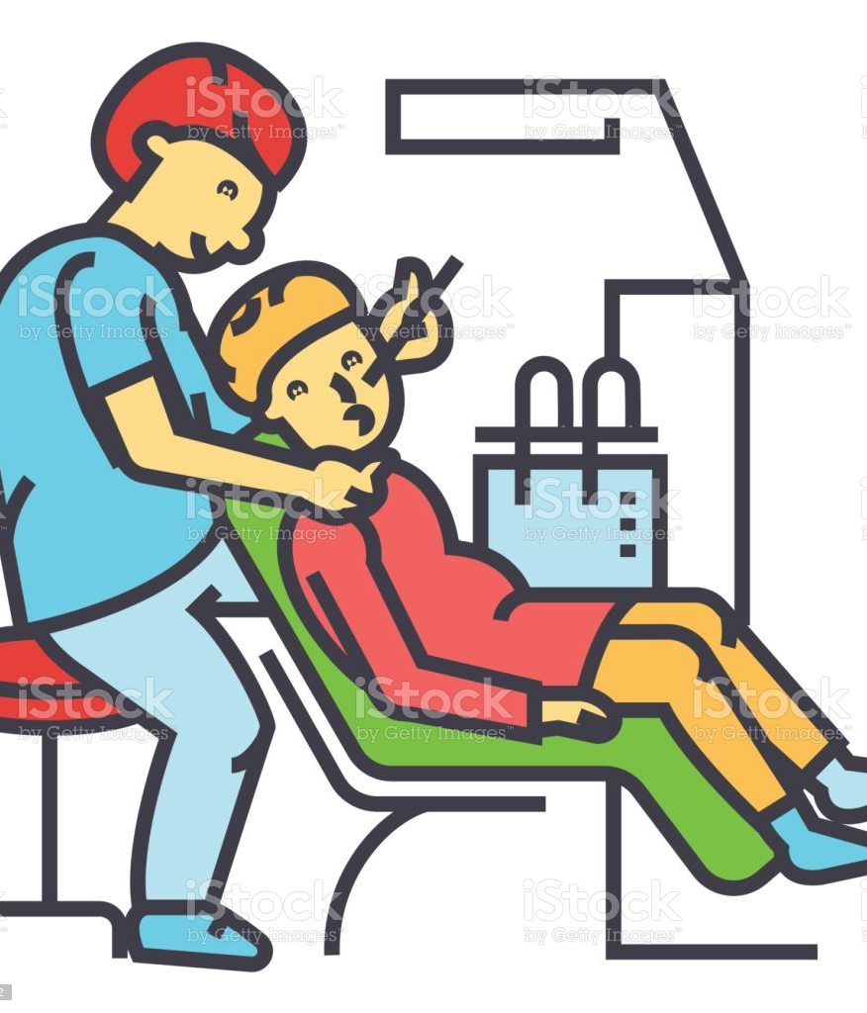
Scanning
Who’s happy
with his job?
Who are the two speakers?
Yousef’s feeling
in his job?
Job titles?
Yousef
Khaled
reporter
bored to death
watch repairer
dentist

Slide 11
Books Closed
Listen & Answer
Enjoys being out talking to people
Why does Khaled like it?
Why doesn’t Yousef like his?
Boring
a TV reporter
Solving problem
Organized
Reliable
hardworking
Khaled’s job?
Yousef’s characteristics?

Slide 12
Khaled has been a reporter since ..?
Listen & read
internship

Slide 13
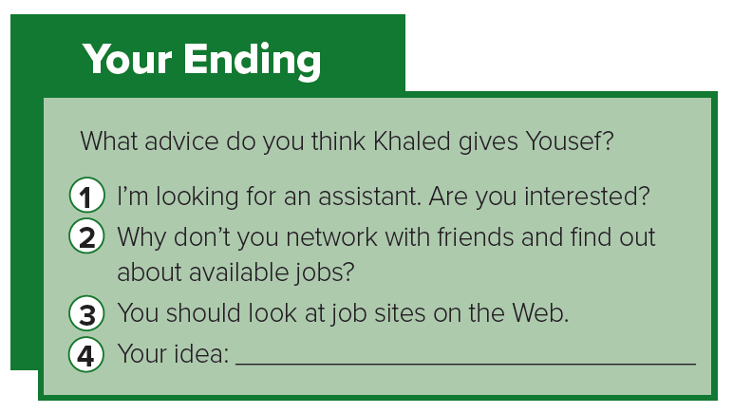
Listen & read
What do you
think I should do?
He
requests for…?
an advice

Slide 14
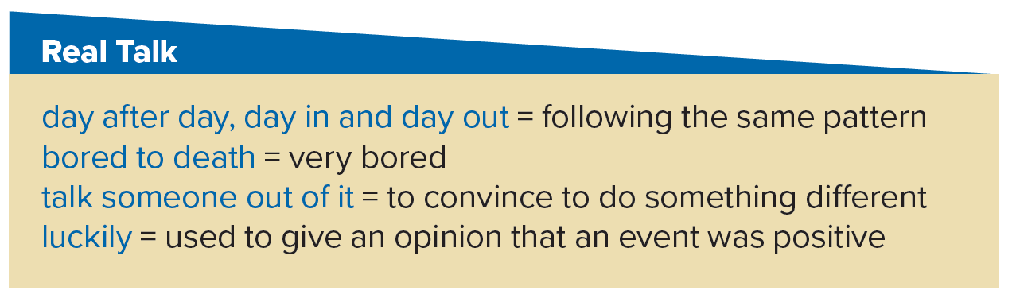





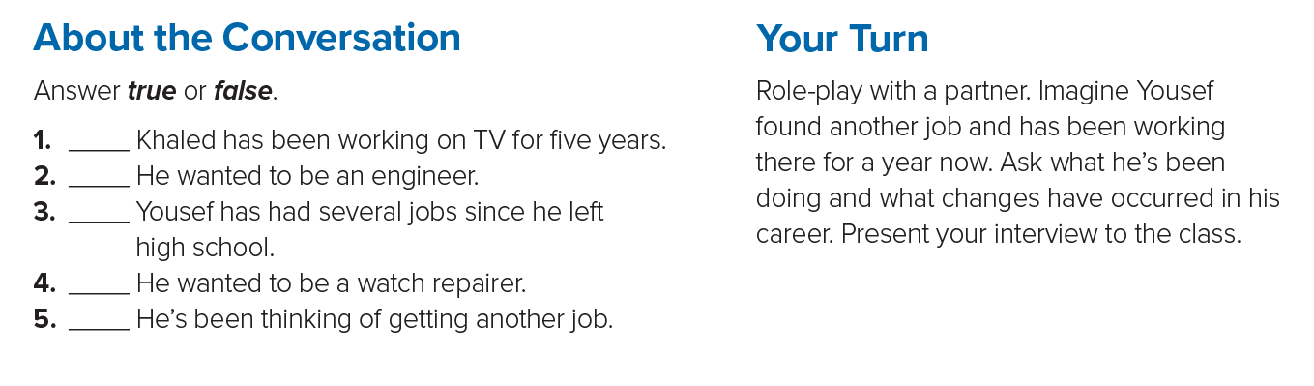
Listen & read
day after day, day in and
day out
bored to death
talked
me out of it
luckily

Slide 15







day after day, day in and
day out
bored to death
talked
me out of it
luckily
T
F
F
T
T

Slide 16
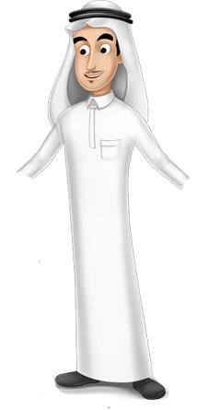
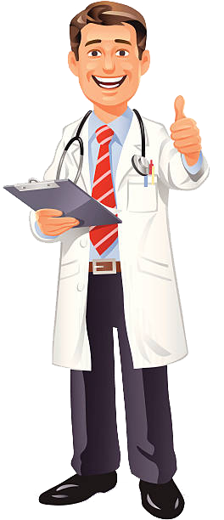
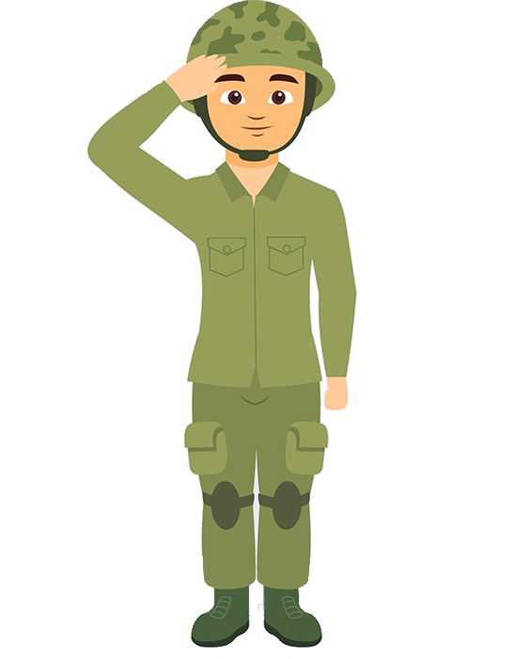
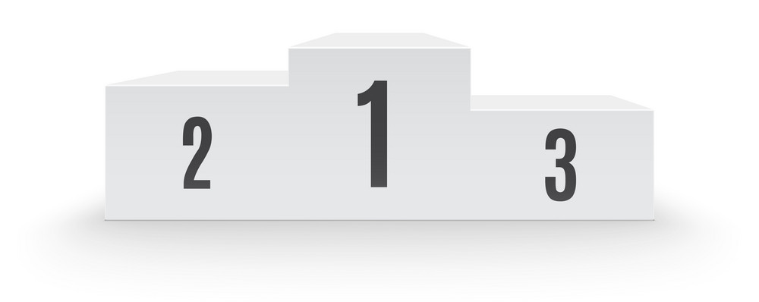
Thank you
crisis heroes
Covid 19- era

Slide 17
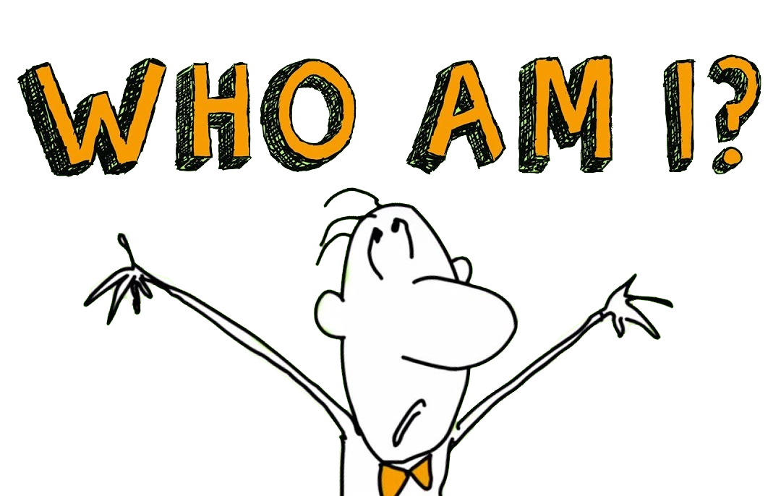

Slide 18






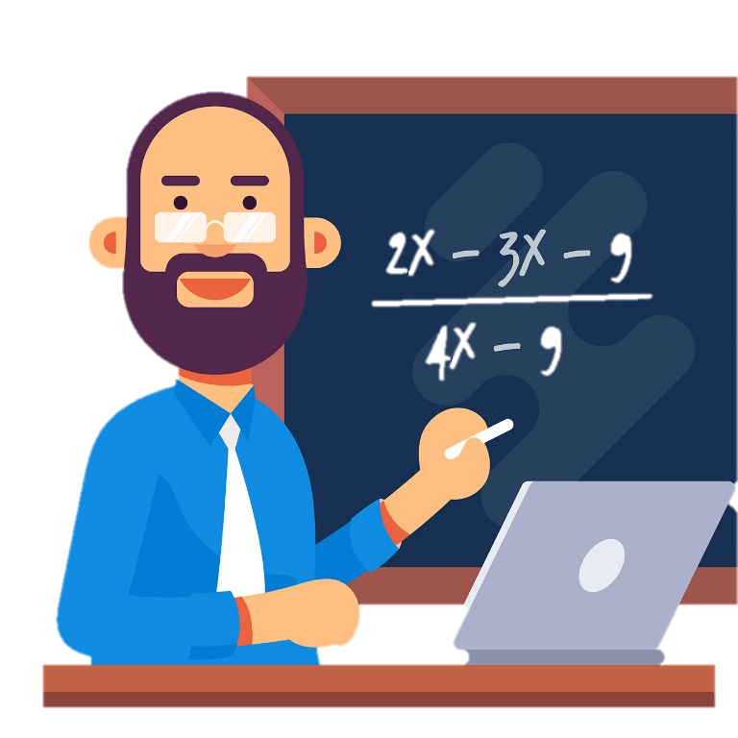
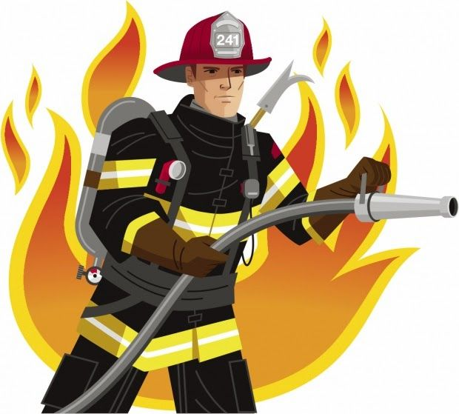
a nurse

Slide 19

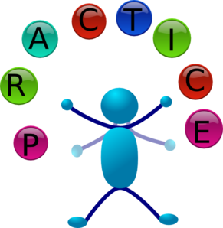



Additional Activities
https://www.liveworksheets.com/ek138280tx
https://wordwall.net/play/784/413/775

Slide 20


