Slide 1
Super
Goal
1

Slide 2
Super Goal 1
Intermediate stage
Here is where fun & learning begins

Slide 3
Time to . . . .
Revise

Slide 4
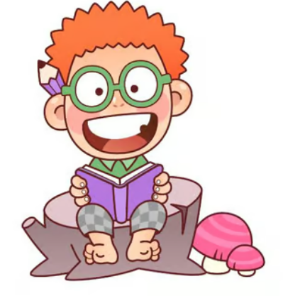
I have a wonderful thing for you______
Your Welcome
Guess What?

Slide 5
Thank you for your help________
Your Welcome
Guess What?

Slide 6
You should do in class
Classroom Rules

Slide 7
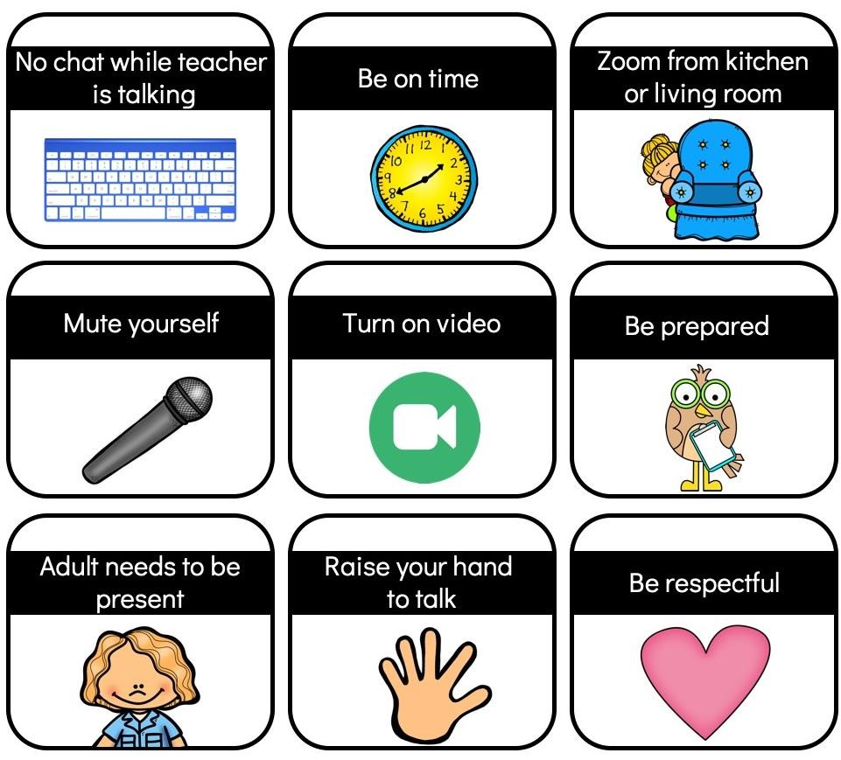



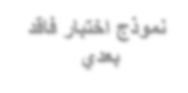



Be quiet
listen to
the teacher
Be on time
Be prepared
Raise your hand
to talk.
Work without
Disturbing others
Be respectful

Slide 8
o
y
T
a
d

Slide 9

Today:
Sunday 5 September
Unit:
What Day is Today
Lesson:
Reading
Pages:
15

Slide 10
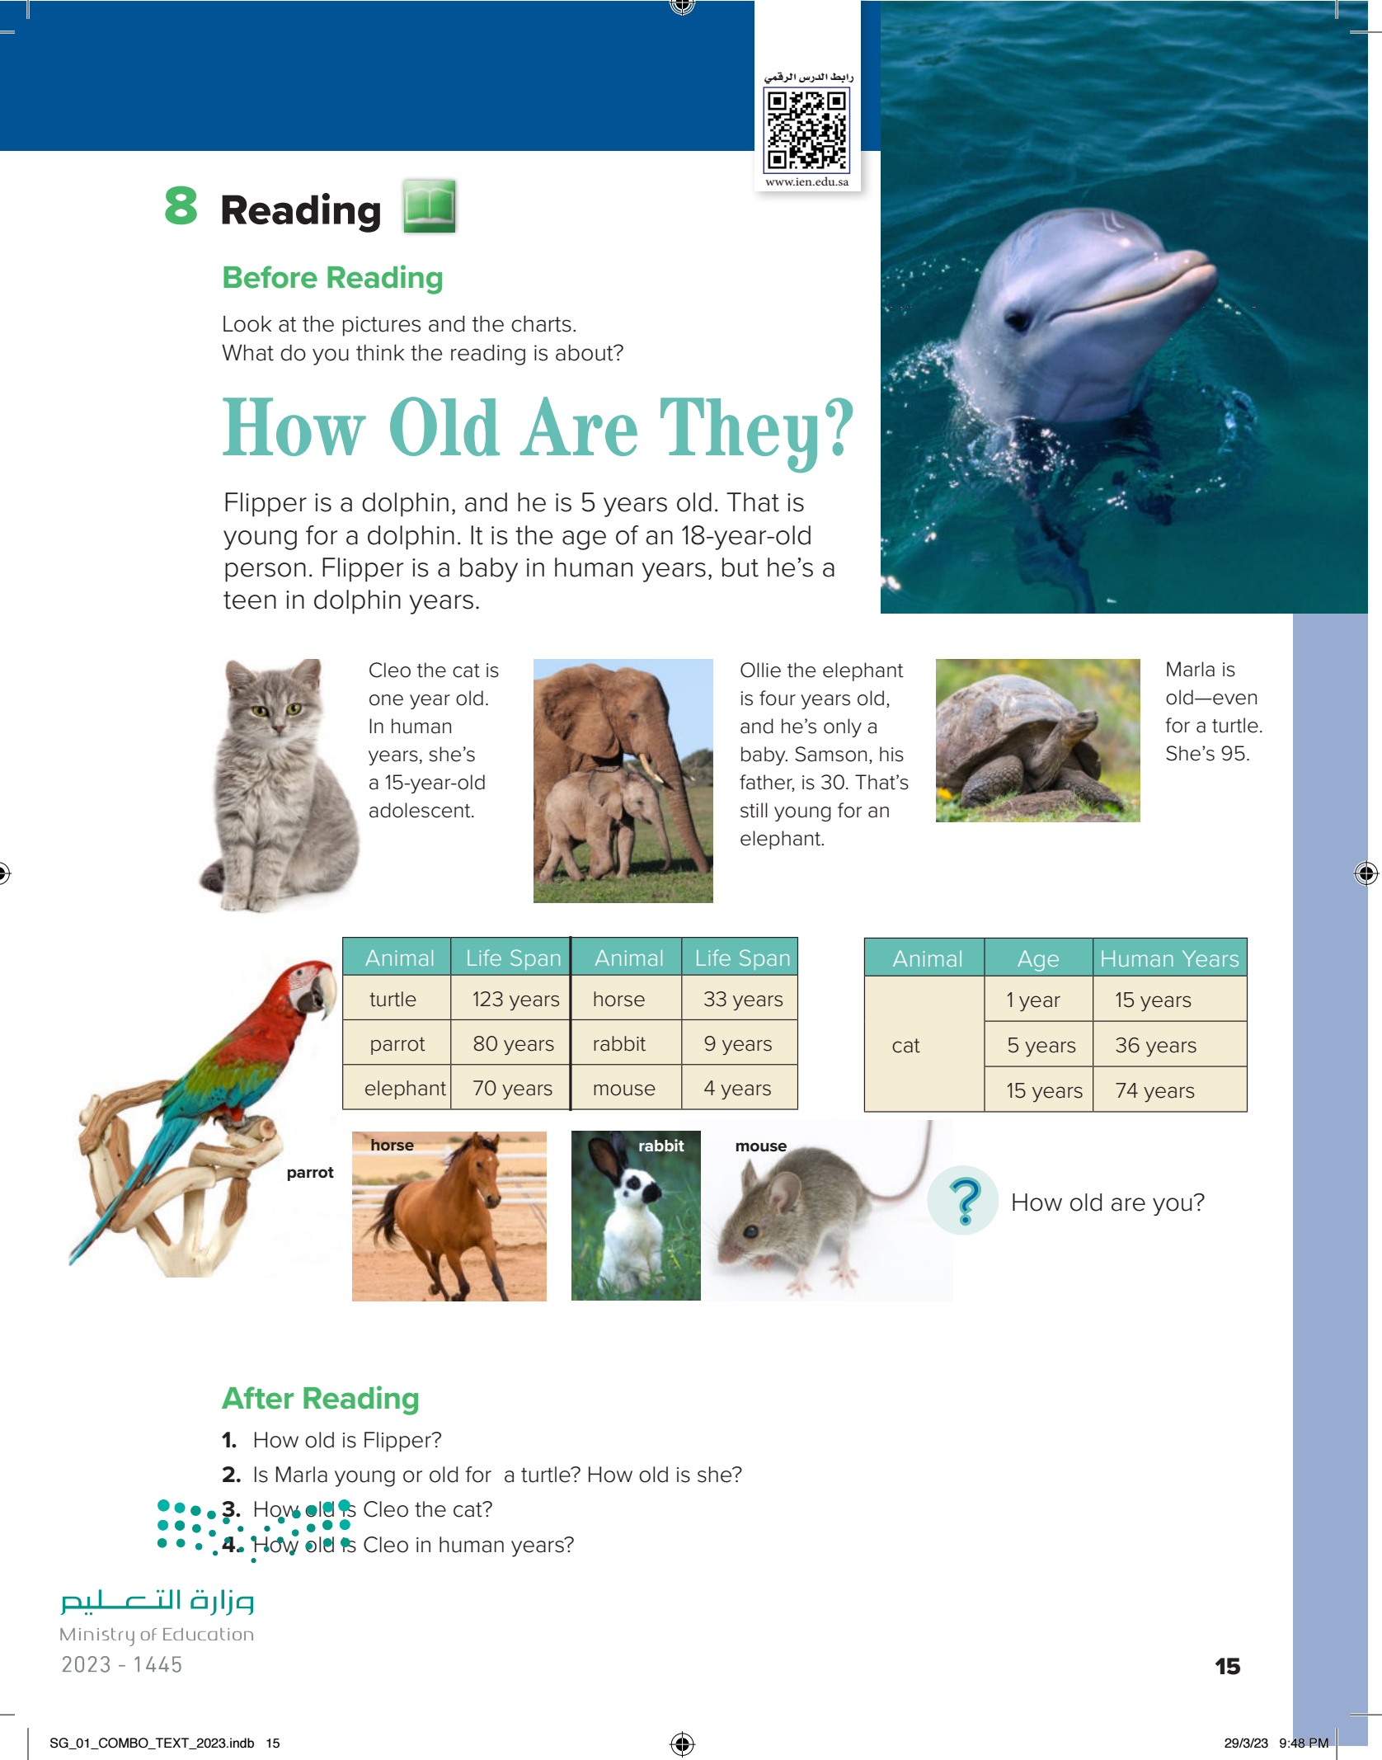

Slide 11
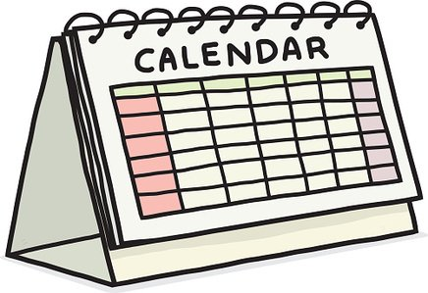
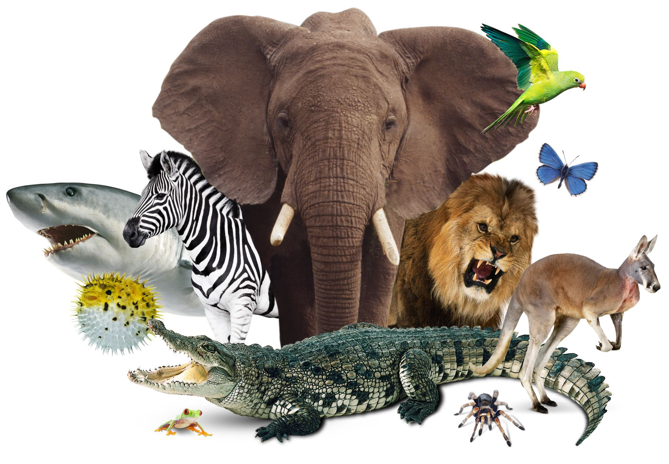
Objectives:-
1. Use prepositions with dates.
2. Identify the main idea of reading

Slide 12
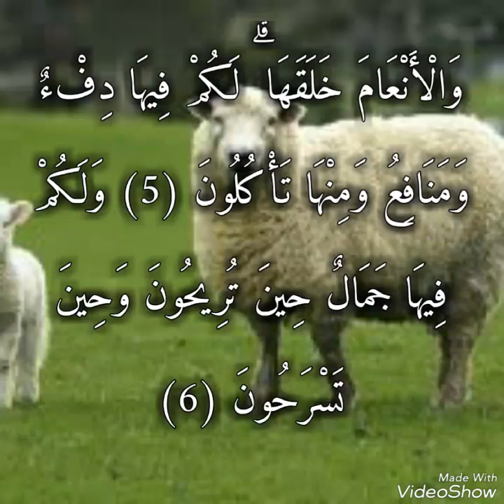


Slide 13
Reading
Page: 15

Slide 14
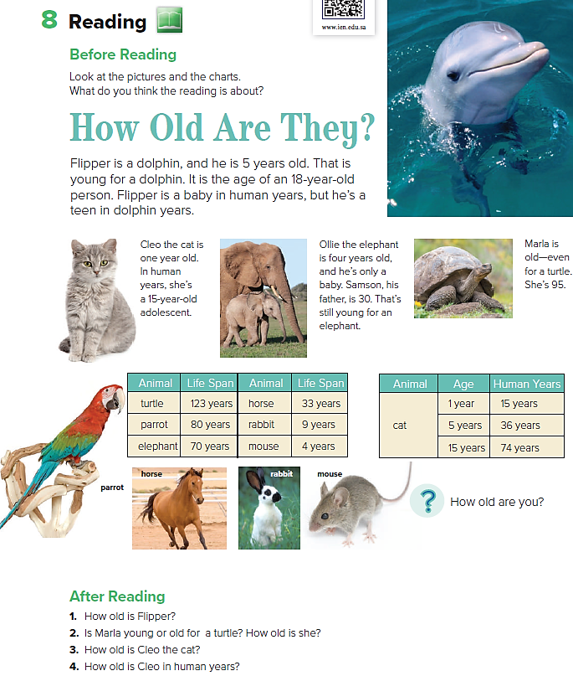

Slide 15


Slide 21
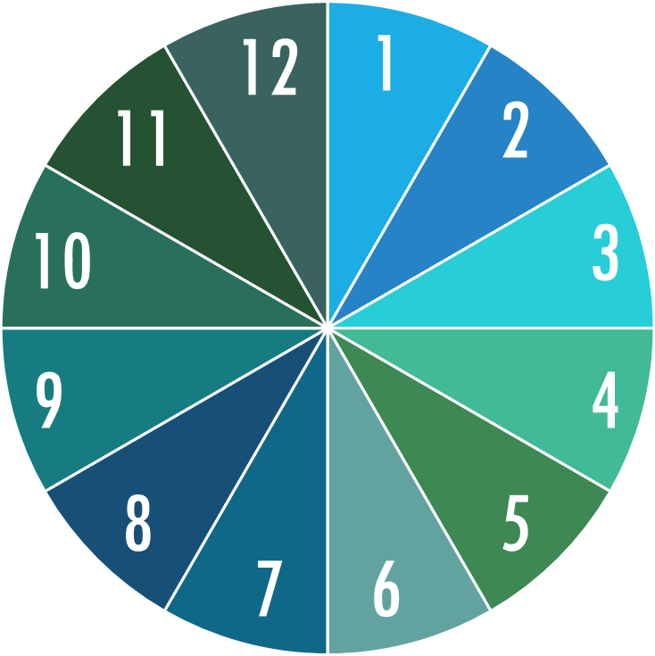
Numbered Head
Student's names
1-
2-
3-
4-
5-
6-
7-
8-
9-
10-
11-
12-


Slide 22

Time For . . .
Page: 15

Slide 23
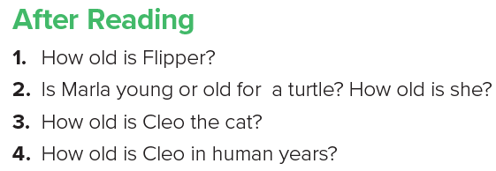

Slide 24
How old is Flipper?
It is 5 years old.

Slide 25
Is Marla young or old for
a turtle? How old is she?
Marla is old for a turtle. She’s 95 (ninety-five).

Slide 26
How old is Cleo the cat?
It is one year old .

Slide 27
How old is Cleo the human?
She is 15 years old .

Slide 28
What does a adolescent means?
It means a teenager.

Slide 29
Apply , Choose & Do

Slide 30
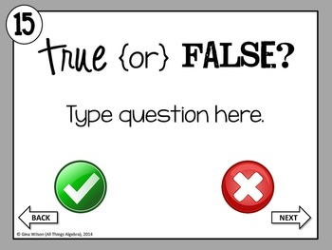
True & False Quiz
Ollie is 15 years old.
Samson is 30 years old.
Cleo is one years old.

Slide 31
Awesome
Job

Slide 32



Slide 33


