Slide 1


Slide 2


Slide 3
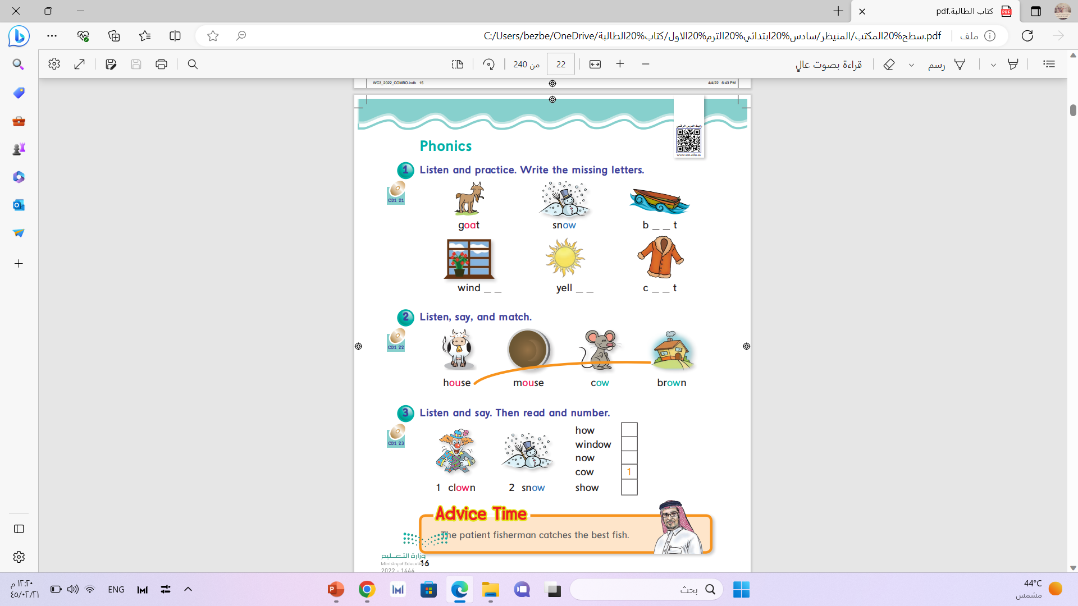
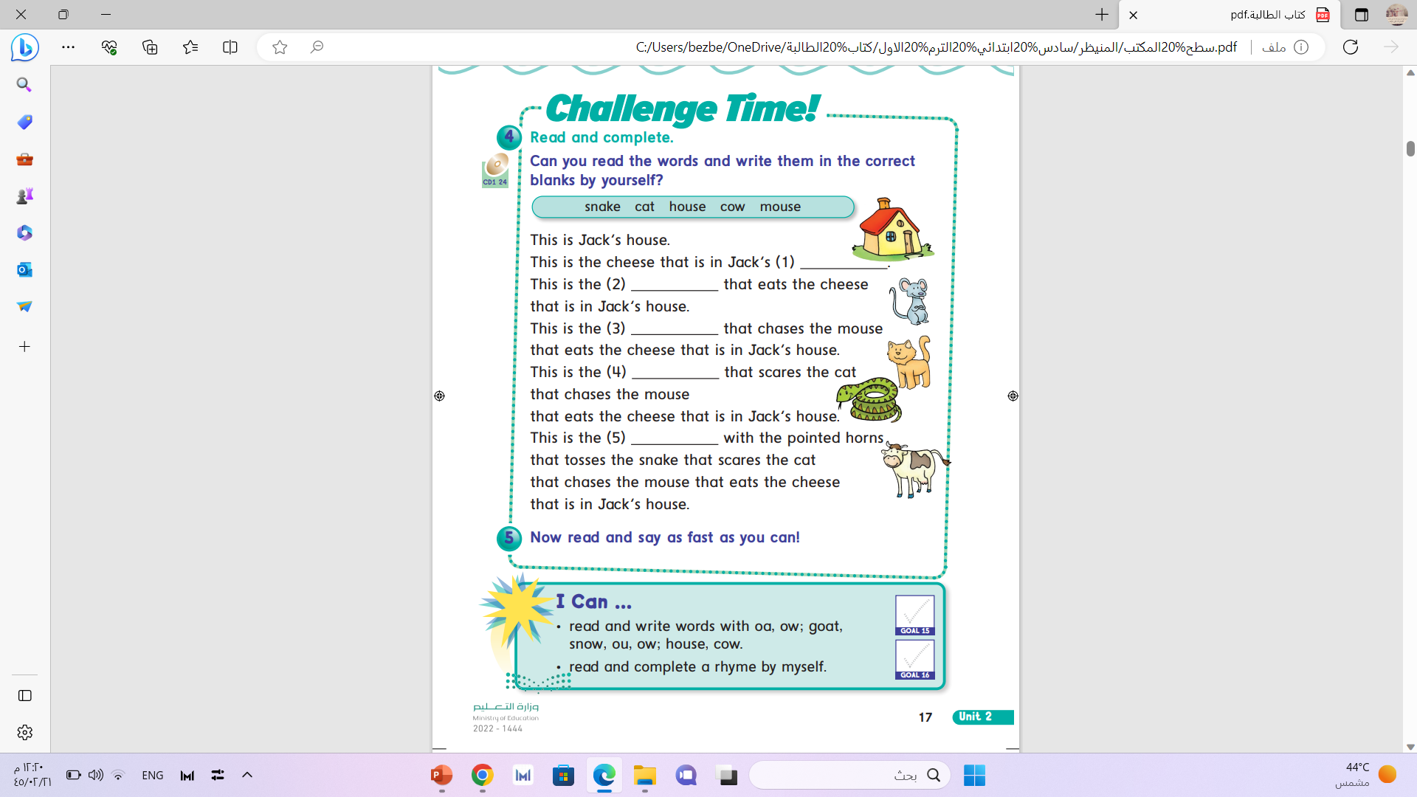

Slide 4


oa
ow

Slide 5


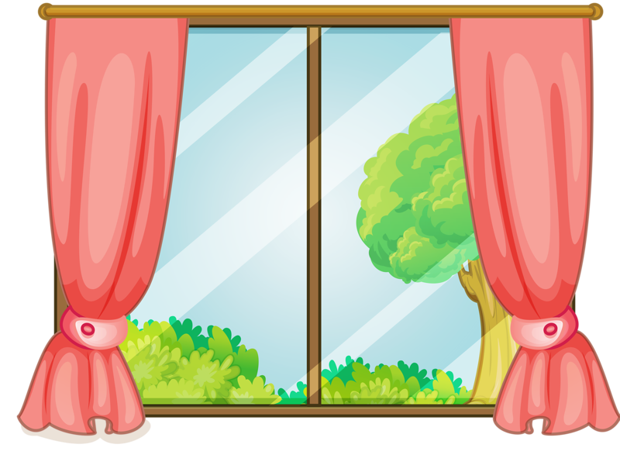
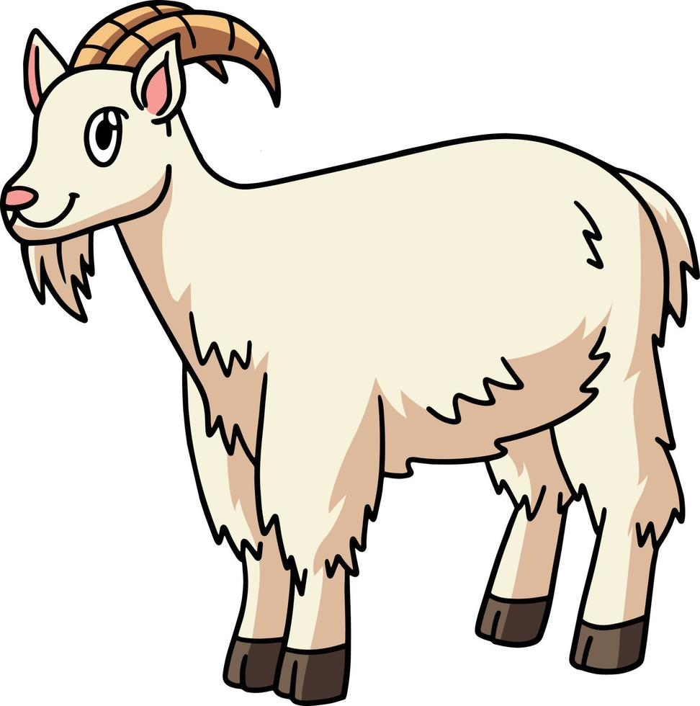
ow
oa
goat
boat
snow
window

Slide 6
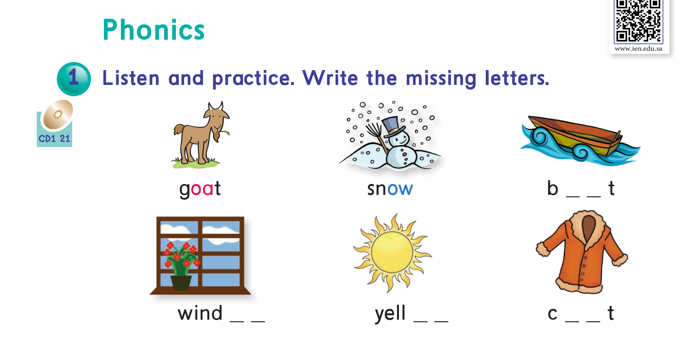

oa
ow
ow
oa
Page : 16

Slide 7
ow
ou

Slide 8
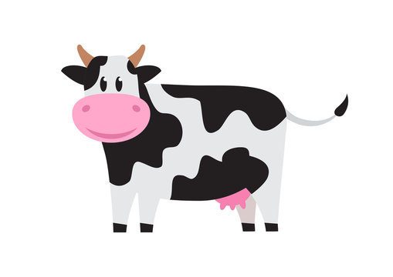


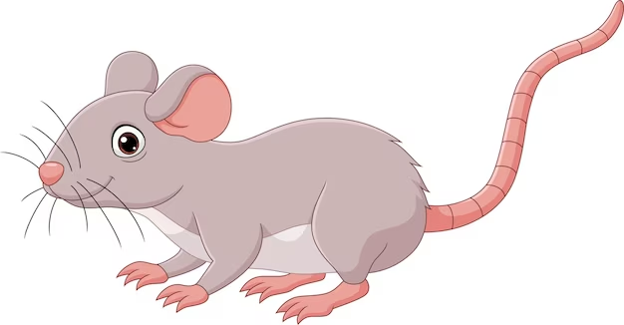
ou
ow
cow
brown
mouse
house

Slide 9
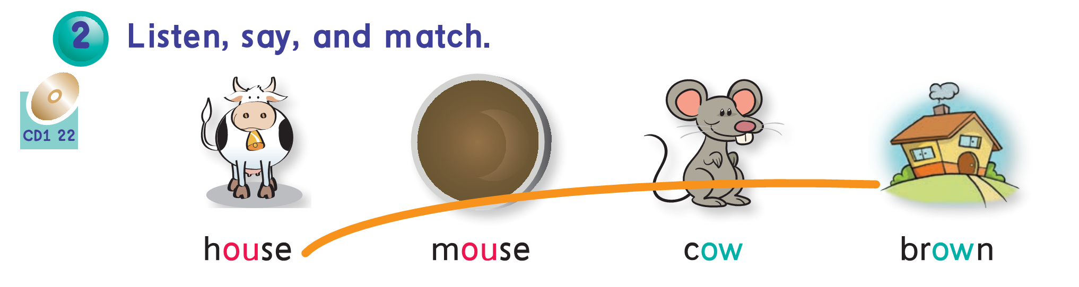
Page : 16

Slide 10
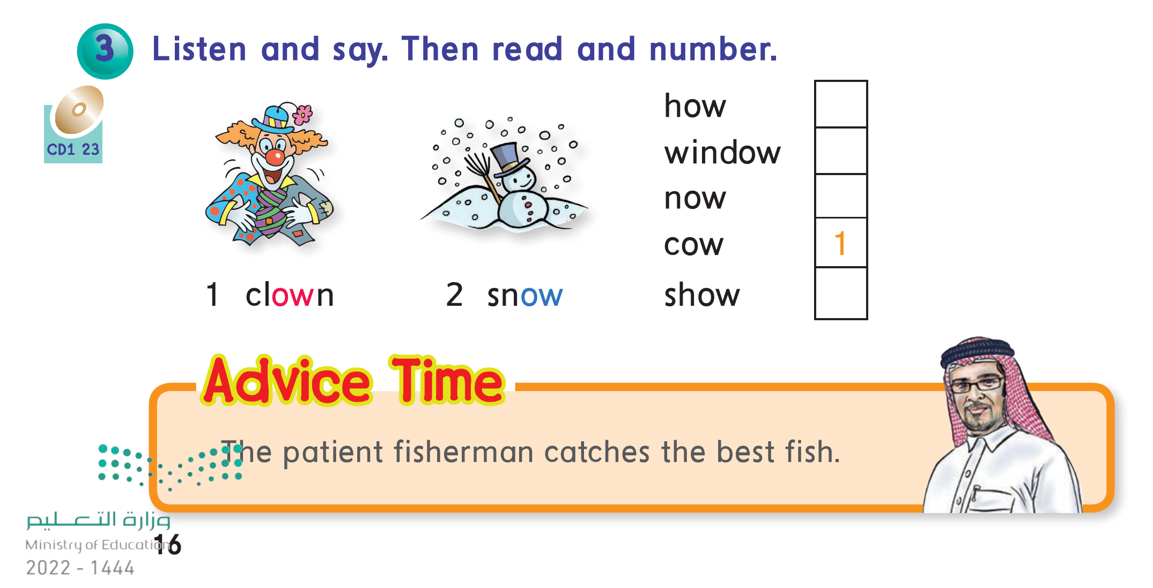
1
2
1
2

Slide 11
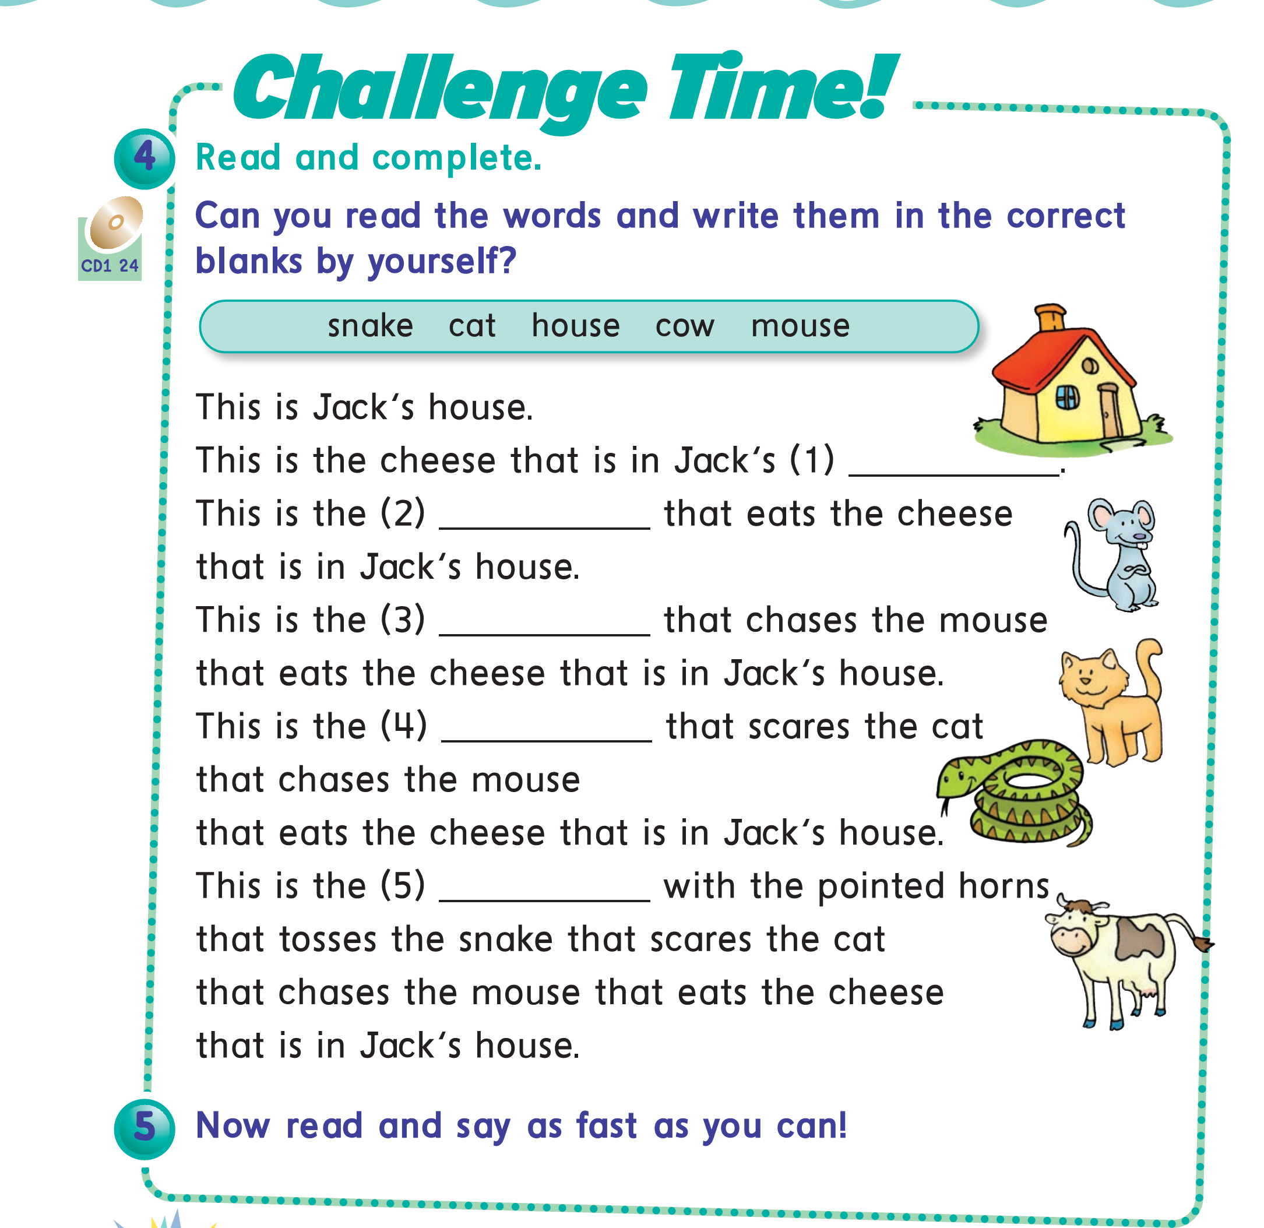
house
mouse
cat
snake
cow
Page : 17

Slide 12
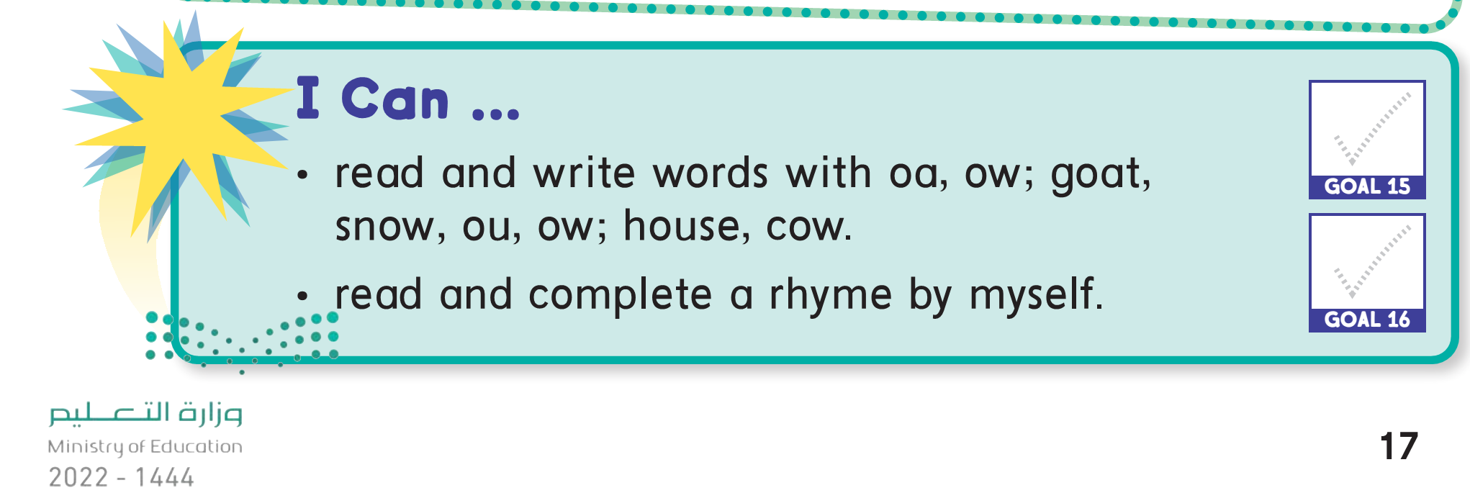

Slide 13

Pages:
153+154

Slide 14
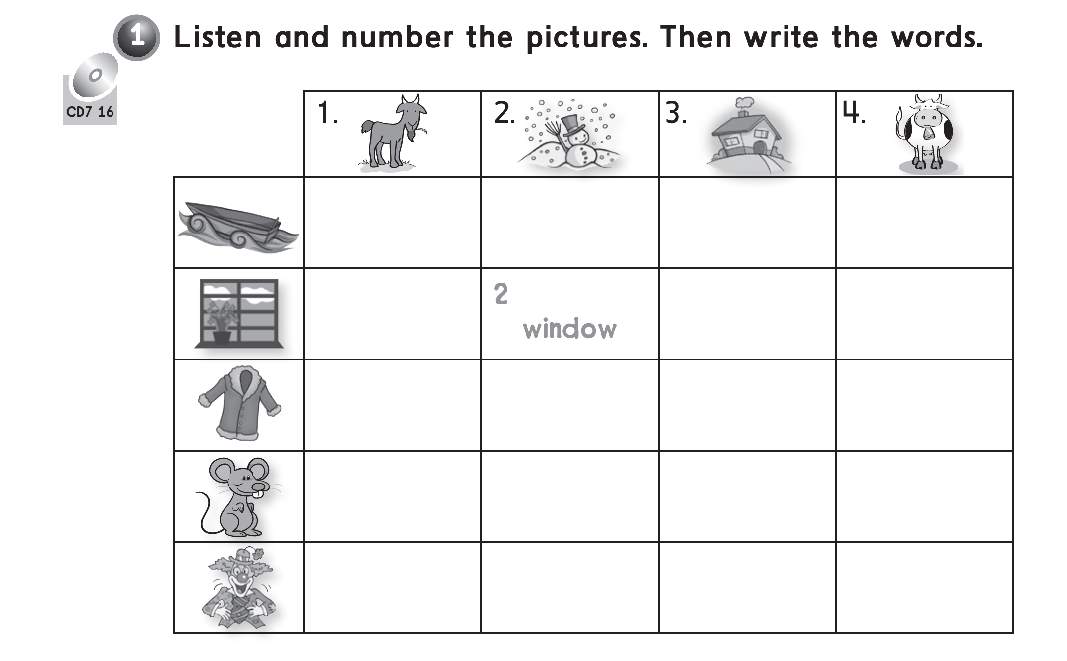
1
boat
1
coat
3
mouse
4
clown

Slide 15
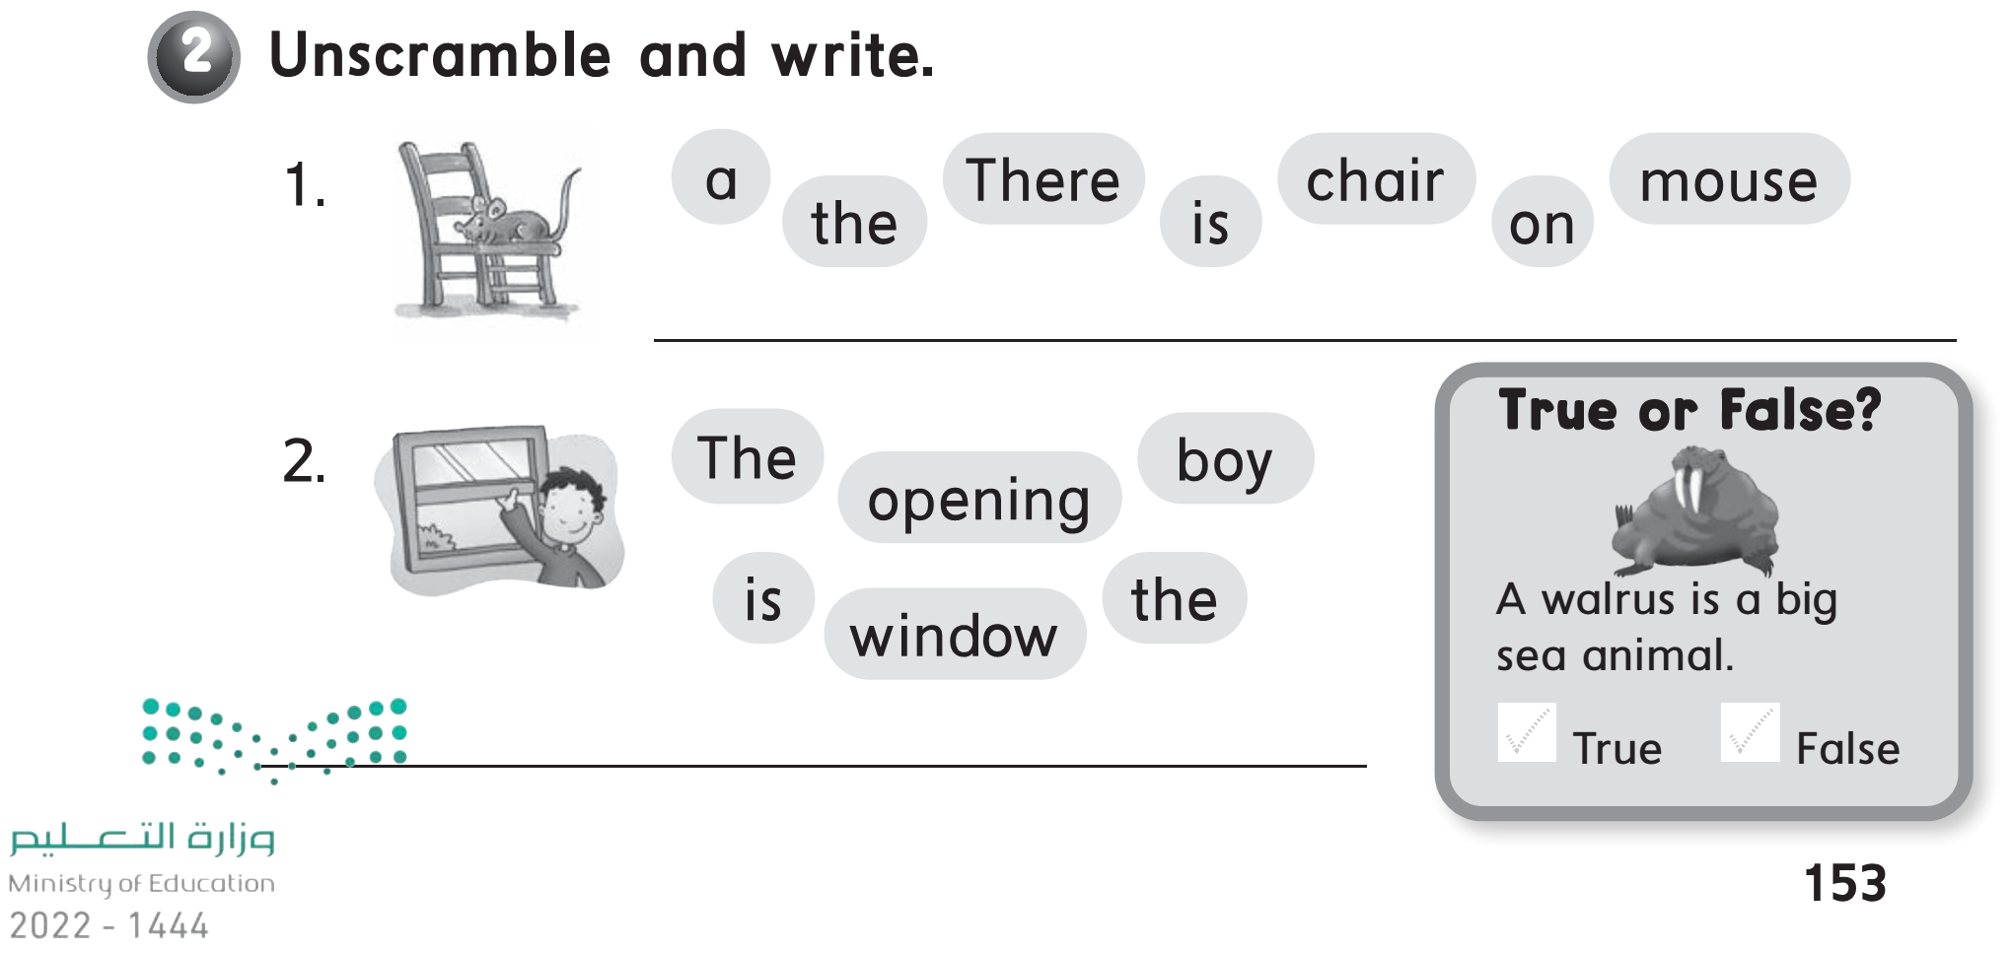
There is a mouse on the chair .
The boy is opining the window .

