Slide 1


Slide 2


Slide 3
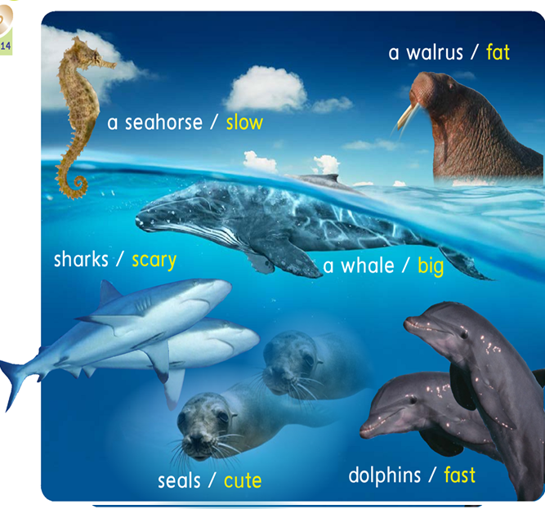

Lets make
a revision

Slide 4
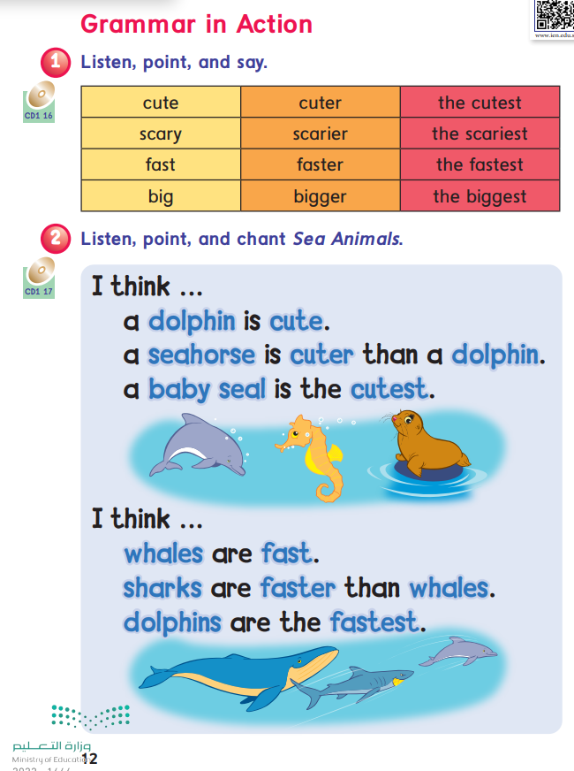
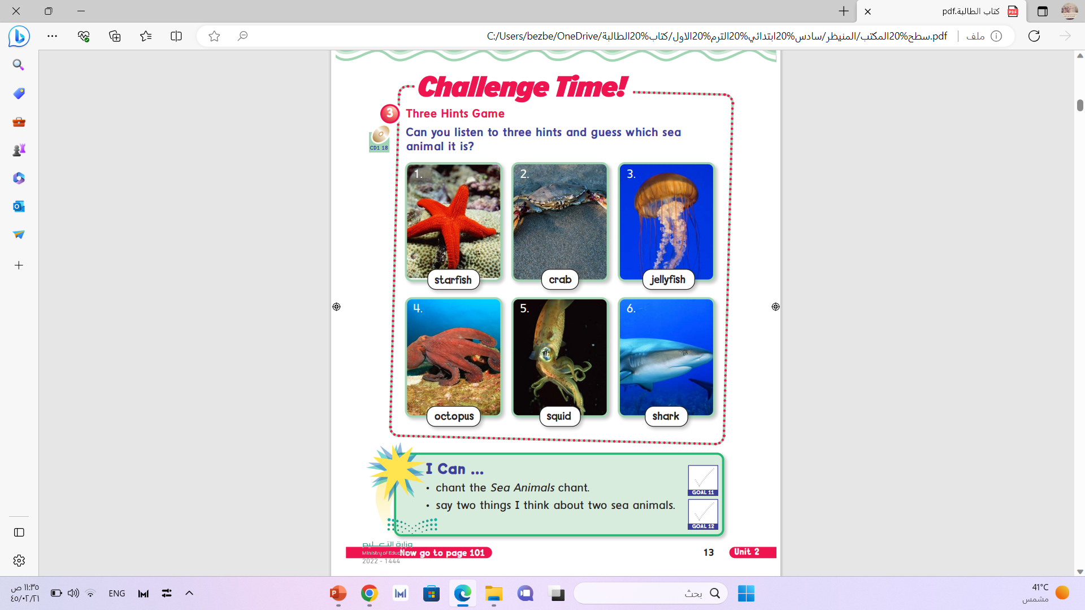

Slide 5
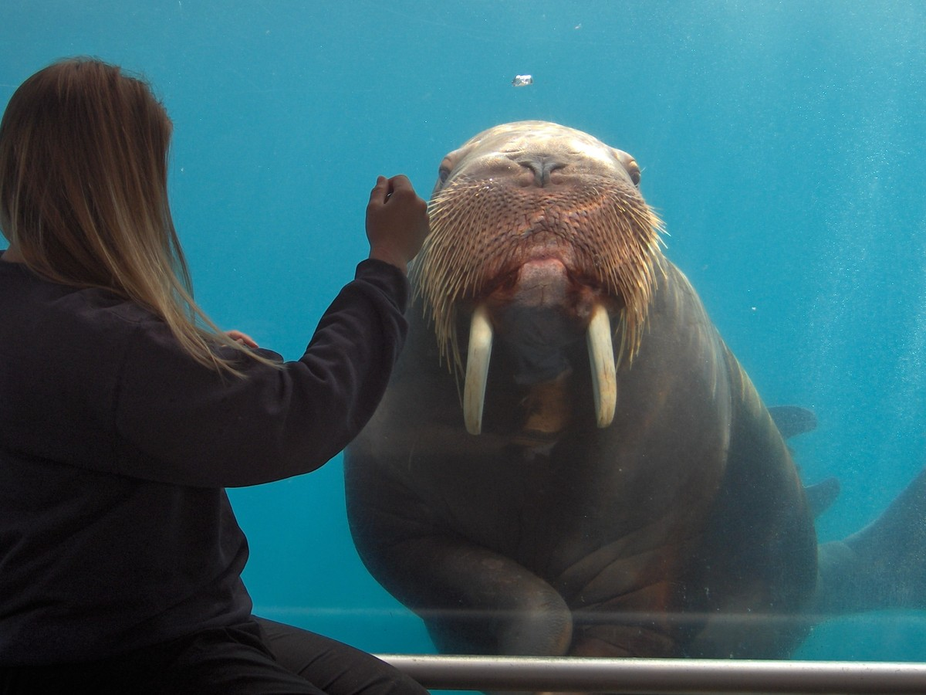
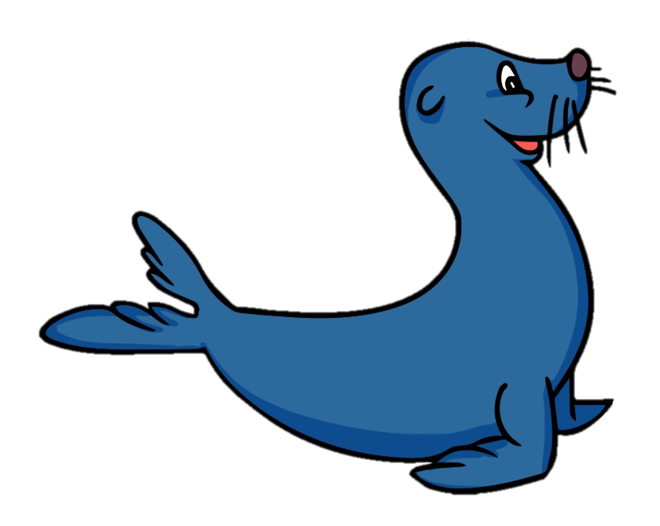
Seals are cuter than walrus.
Cute

Slide 6

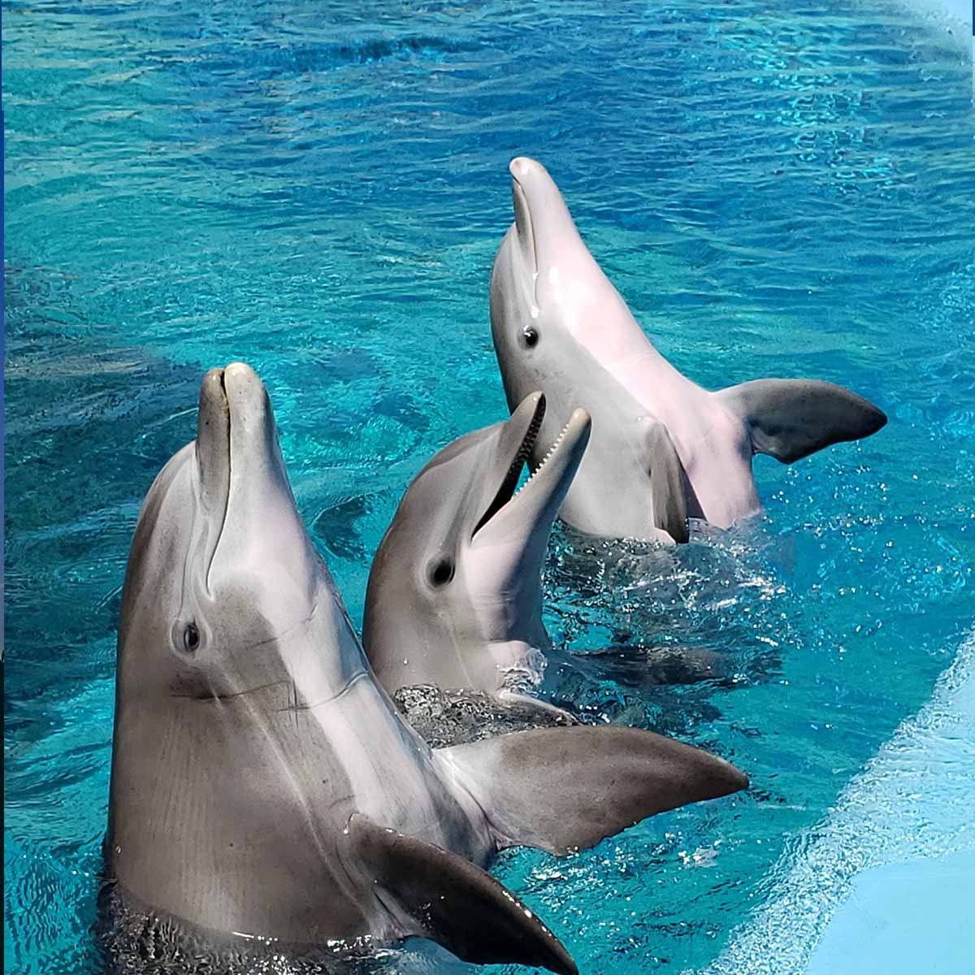
Whales are bigger than dolphin.
Big

Slide 7
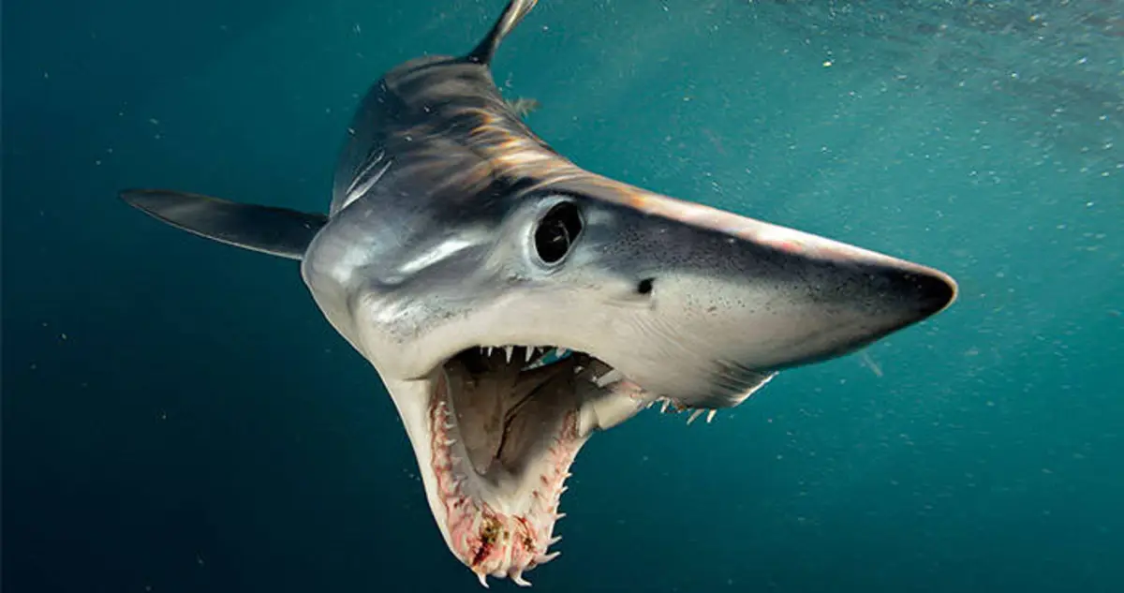
Sharks are scarier than dolphins .
Scary

Slide 8
Dolphins are faster than walrus.
Fast

Slide 9
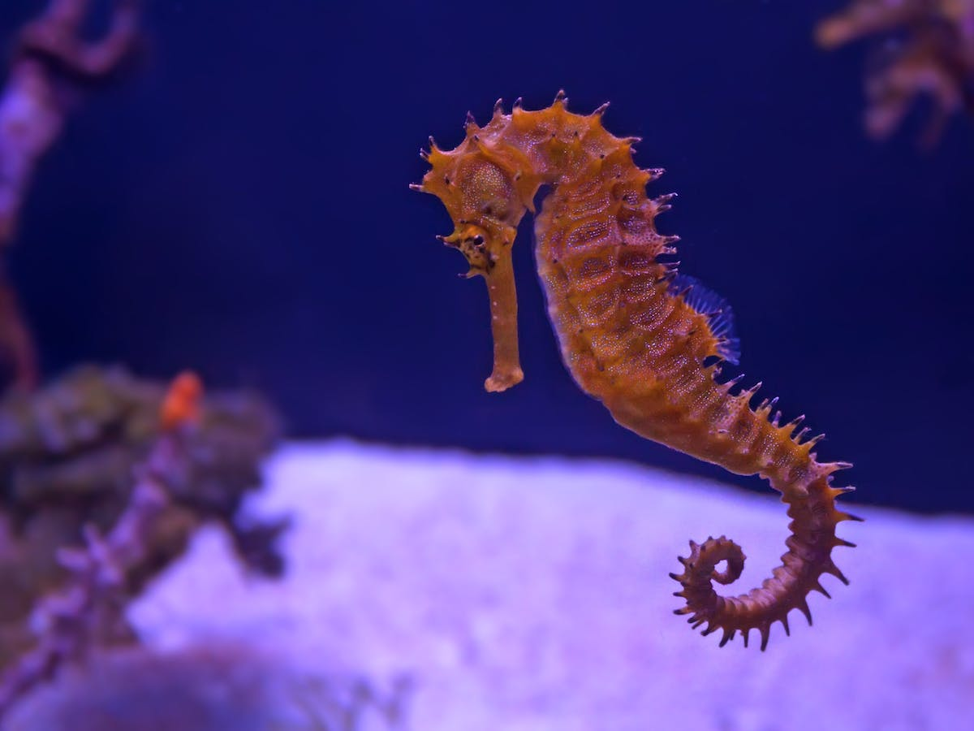
Seahorse is the cutest.
Cute

Slide 10
Whales are the biggest .
Big

Slide 11
Sharks are the scariest .
Scary

Slide 12
Dolphins are the fastest .
Fast

Slide 13
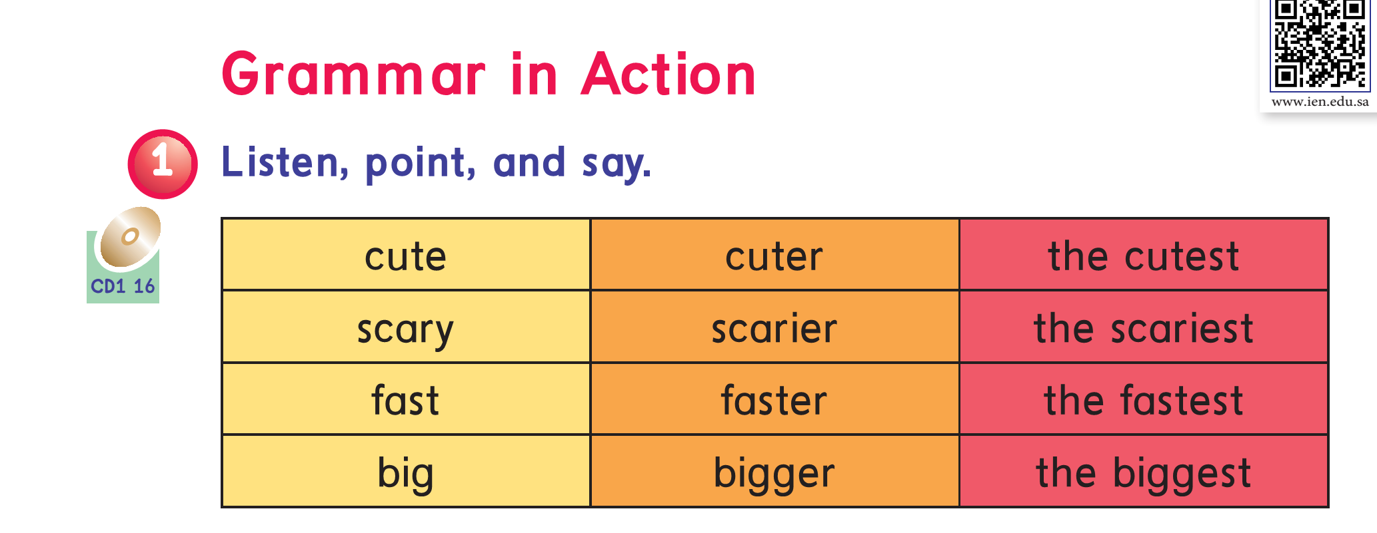

2
More +2
Page : 12

Slide 14
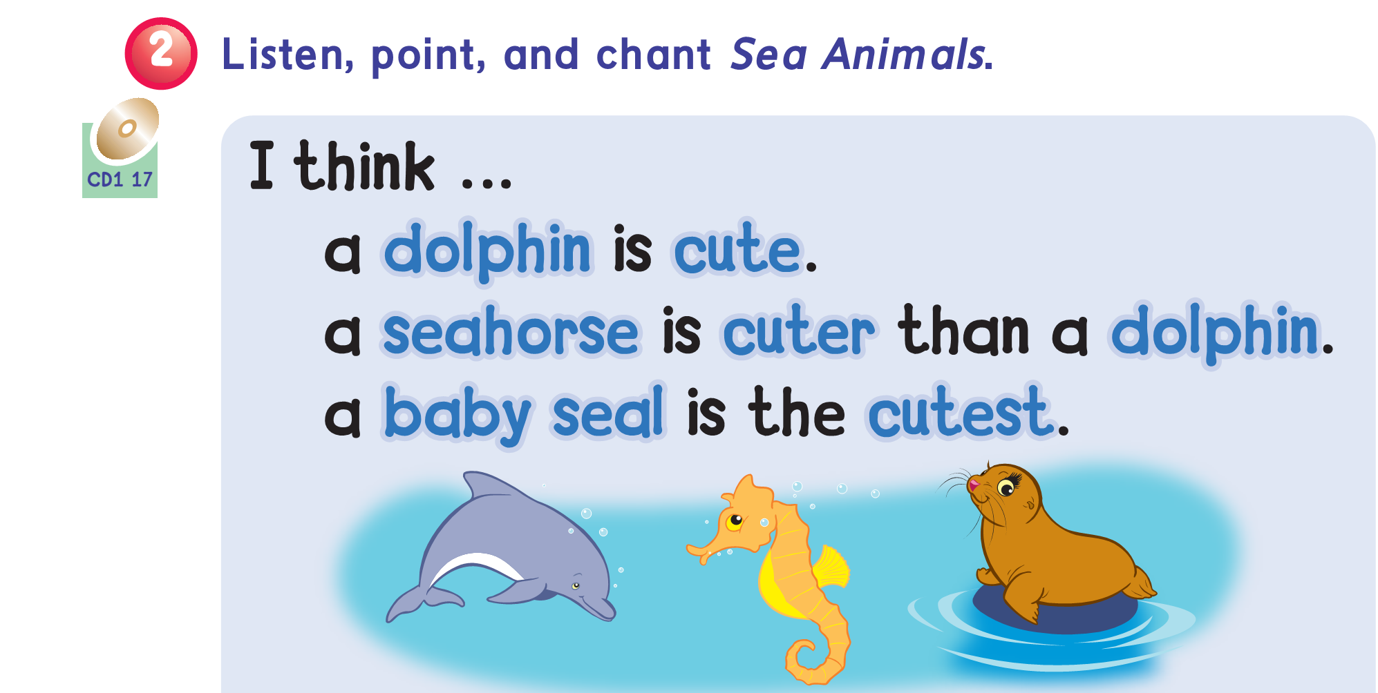
Page : 12

Slide 15
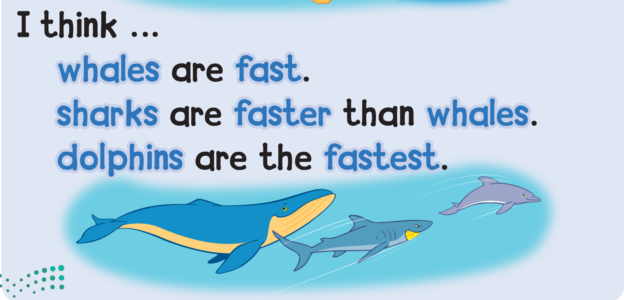
Page : 12

Slide 16
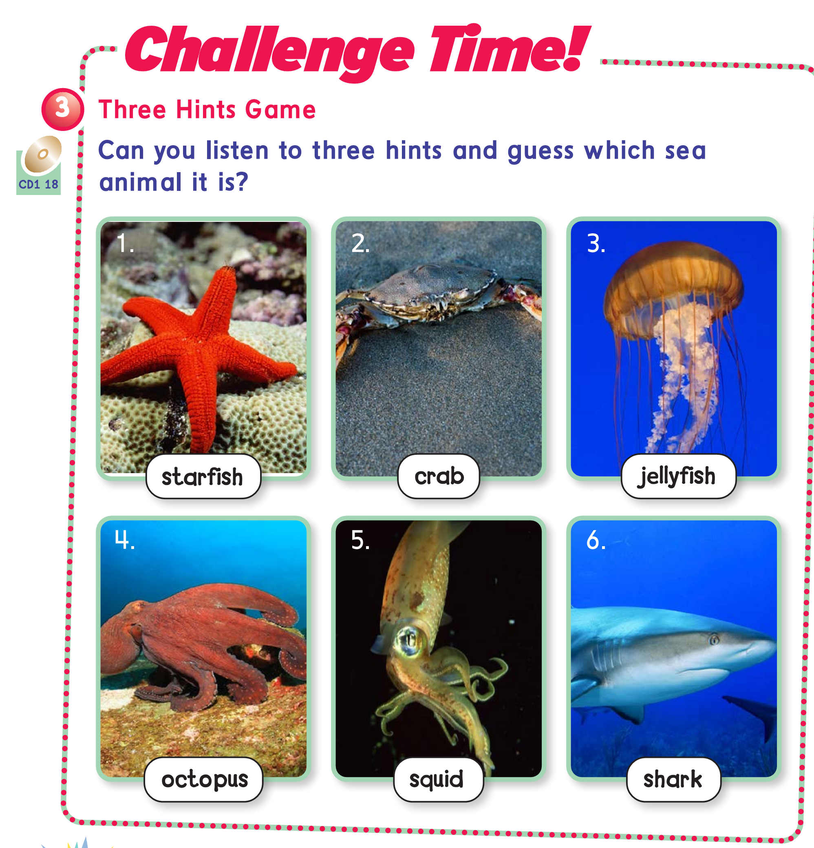
Page : 13

Slide 17
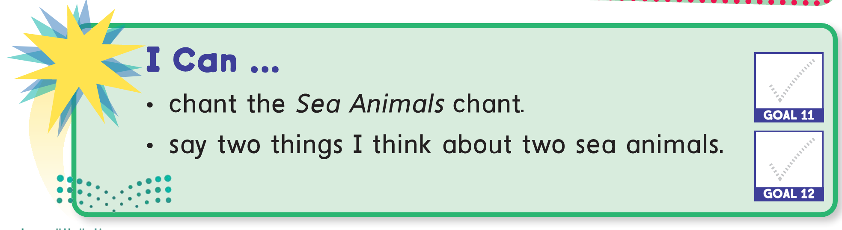

Slide 18

Pages:
149+150

Slide 19
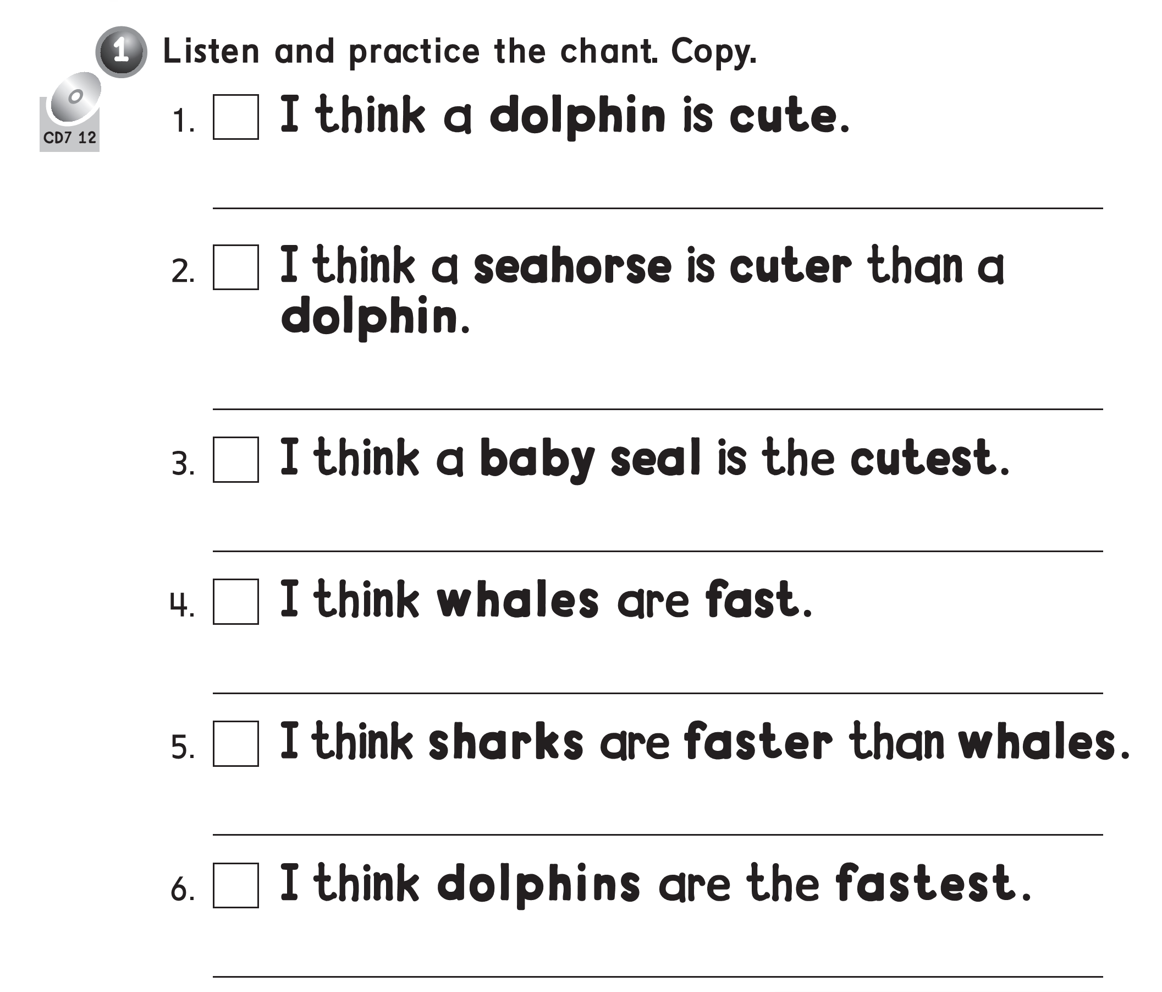

Slide 20
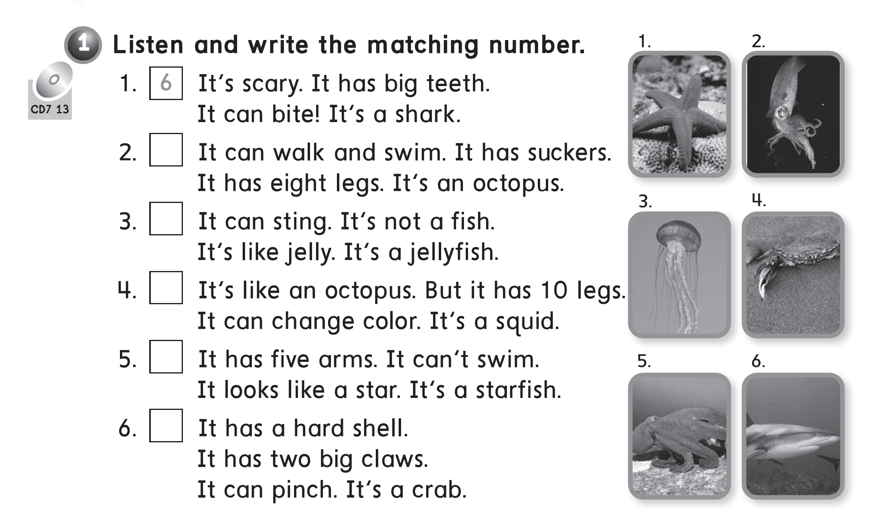
5
3
5
1
6

Slide 21
