Slide 1


U 2 Reading
What are they making?
P 15
Tr. Nora Khalid

Slide 2





What’s the difference?

Slide 3
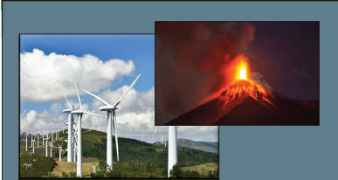
What do you see in the first picture?
2
1
Wind energy
Notes:
Create an outline to get ready:
Introduce the era (Use a mix of media and text)
Organize your artifacts to outline what life was like during the era you are presenting
Think about using a storyboard to outline your images and ideas
Make sure you prepare a clear and well rounded presentation of all aspects of the era (People, jobs, food, transportation, etc. What else should you include so the audience feels like they have visited your era?)

Slide 4
What do you see in the first picture?
2
1
Wind energy
A volcano
Notes:
Create an outline to get ready:
Introduce the era (Use a mix of media and text)
Organize your artifacts to outline what life was like during the era you are presenting
Think about using a storyboard to outline your images and ideas
Make sure you prepare a clear and well rounded presentation of all aspects of the era (People, jobs, food, transportation, etc. What else should you include so the audience feels like they have visited your era?)

Slide 5
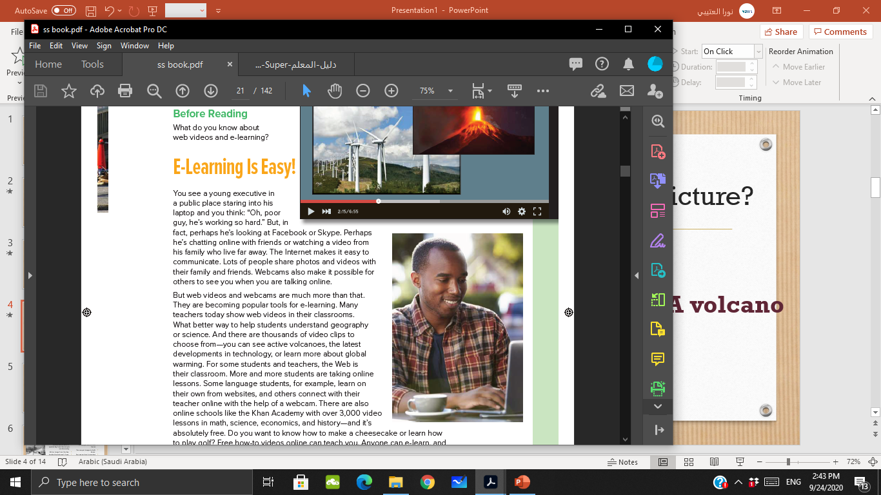
What is the man doing in the third picture?
3
He is using a laptop outdoors.
Notes:
Create an outline to get ready:
Introduce the era (Use a mix of media and text)
Organize your artifacts to outline what life was like during the era you are presenting
Think about using a storyboard to outline your images and ideas
Make sure you prepare a clear and well rounded presentation of all aspects of the era (People, jobs, food, transportation, etc. What else should you include so the audience feels like they have visited your era?)

Slide 6
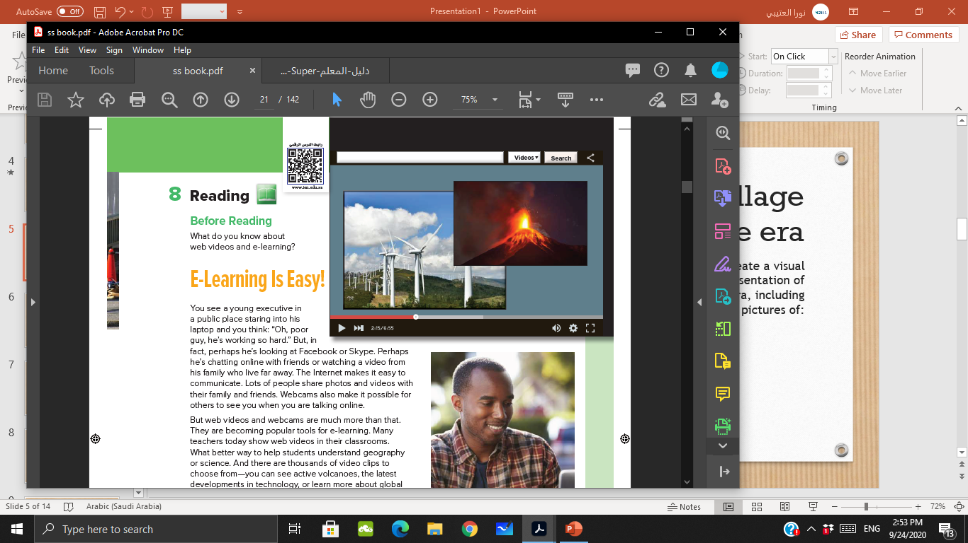
Who can read the title?

Slide 7

What do you know about
E-learning?

Slide 8
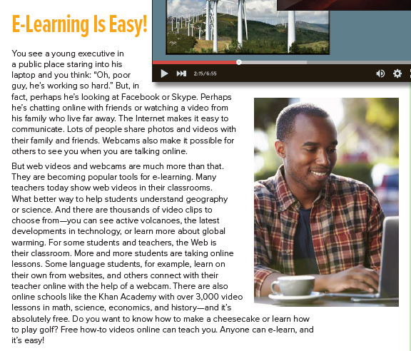

Read and listen

Slide 9

quotation
marks “ “

Slide 10
Can you find a quotation in the text you’ve read?!!!
“Oh, poor guy, he’s working so hard.”
3rd line

Slide 11
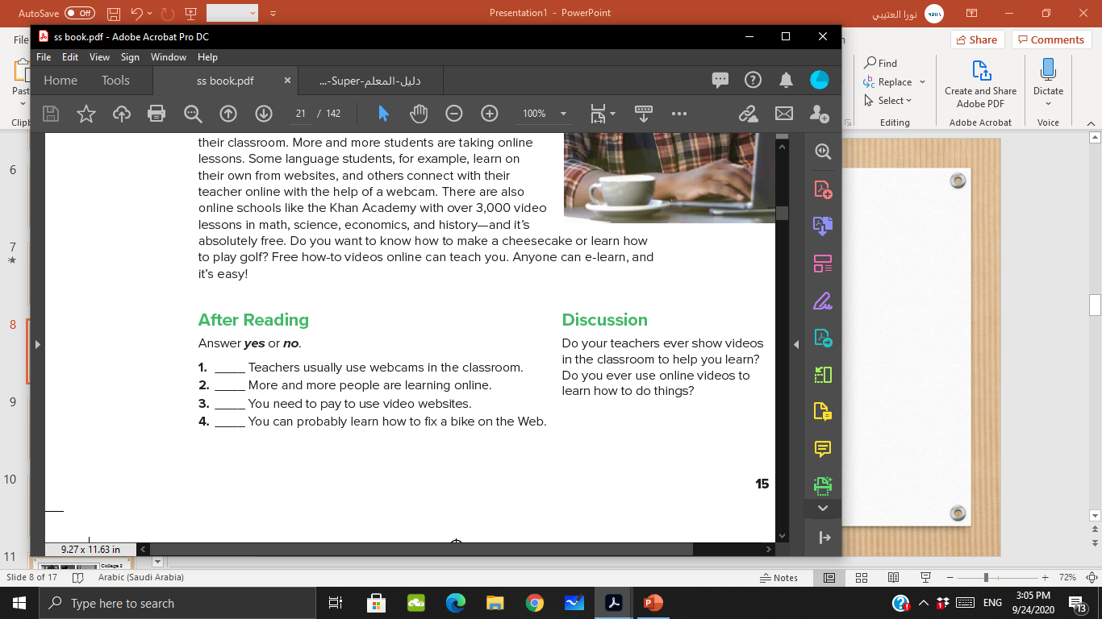
Read then answer

Slide 12
Read and listen

Slide 13
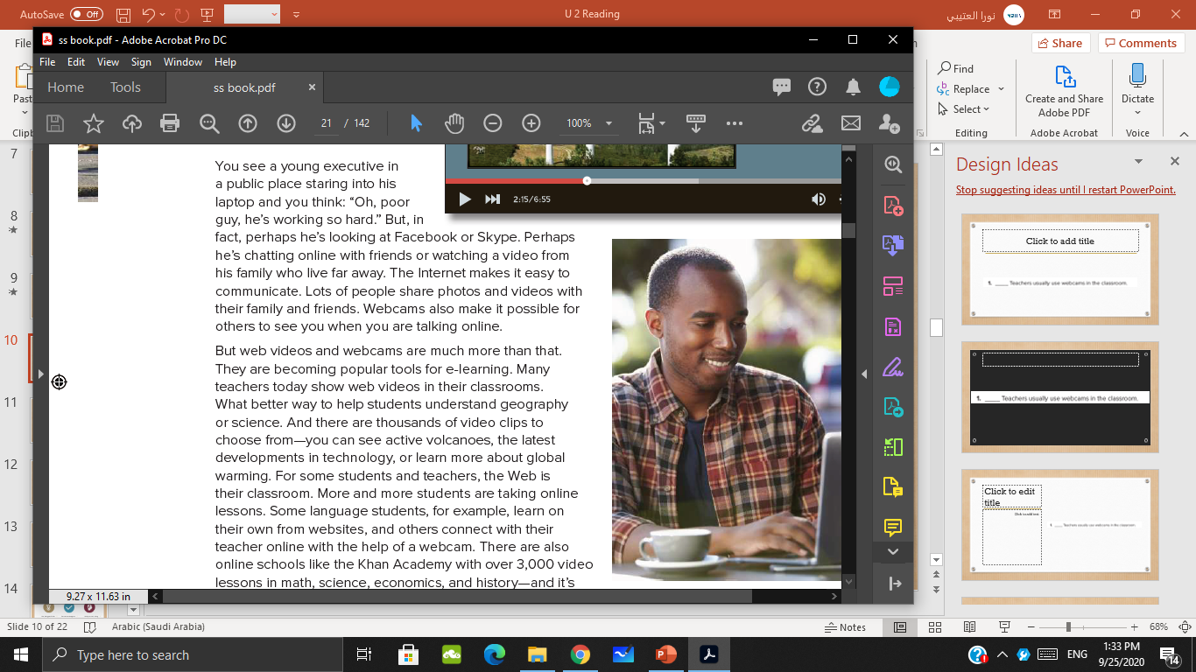
No

Slide 14
Yes

Slide 15
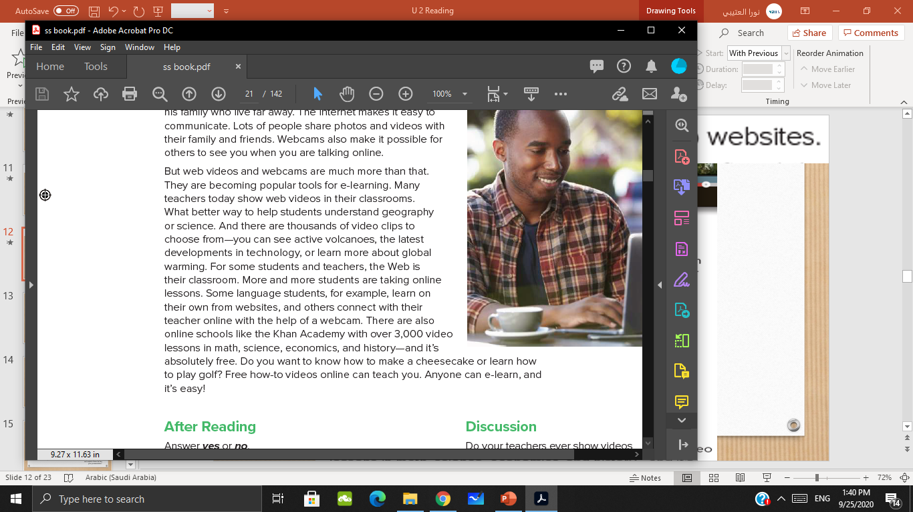
No

Slide 16
Yes

Slide 17
Read and answer
No
Yes
No
Yes

Slide 18


https://forms.office.com/Pages/ResponsePage.aspx?id=HeVmpx24pESCxfp2QsYl-8Gr_P7qVupCmeQLQ6ojf5hUMFk2N0kzNEFBOUtMNFg2WDFVQUNYVTNGQy4u

Slide 19

Search on the internet for some quotations about education from your idols, and share it on padlet

Slide 20


