Slide 1

Super goal 5
Unit 2
Lesson 5 reading
اعداد المعلم / يحيى المنقري متوسطة المأمون بالهفوف

Slide 2

Learning Objectives
*By the end of this lesson, Ss will be able to:
1-Find the meaning of the new words in the text.
2-Match the main ideas with each paragraph.
3-Name the positions King Salman acquire before becoming a king.
4- List some of degrees and academic awards King Salman got.

Slide 3


Slide 4

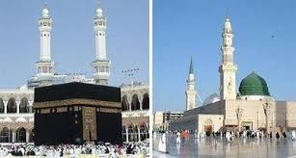



Holy mosques
Degree
Awards

Slide 5
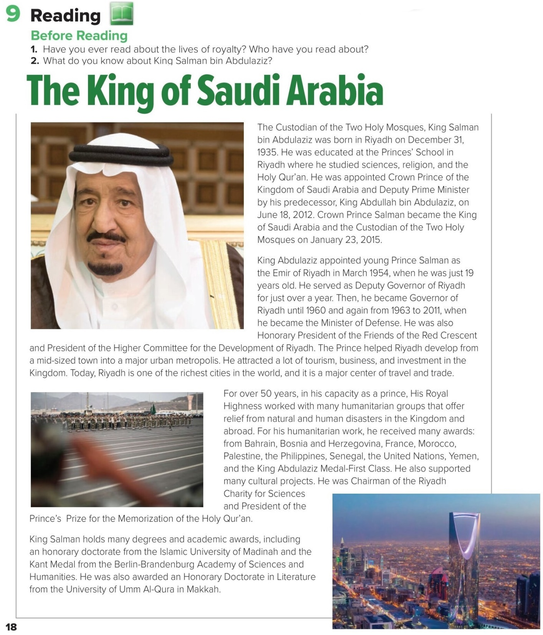

Slide 6
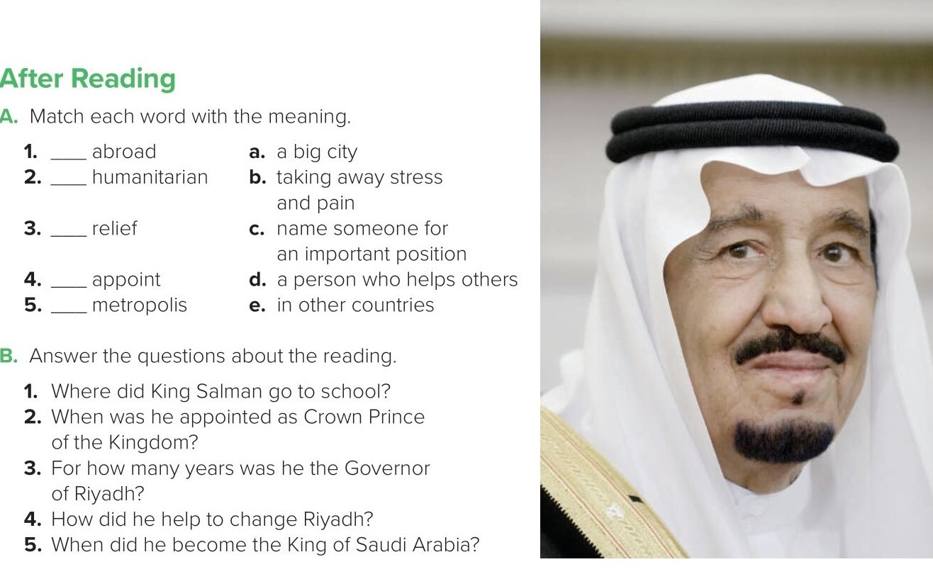
e
d
b
c
a
B.
1. King Salman went to the Princes’ School in Riyadh.
2. He was appointed Crown Prince on June 18, 2012.
3. He was the Governor of Riyadh for about 53 years.
4. He attracted a lot of tourism, business, and investment.
5. He became the King of Saudi Arabia on January 23, 2015.

Slide 7
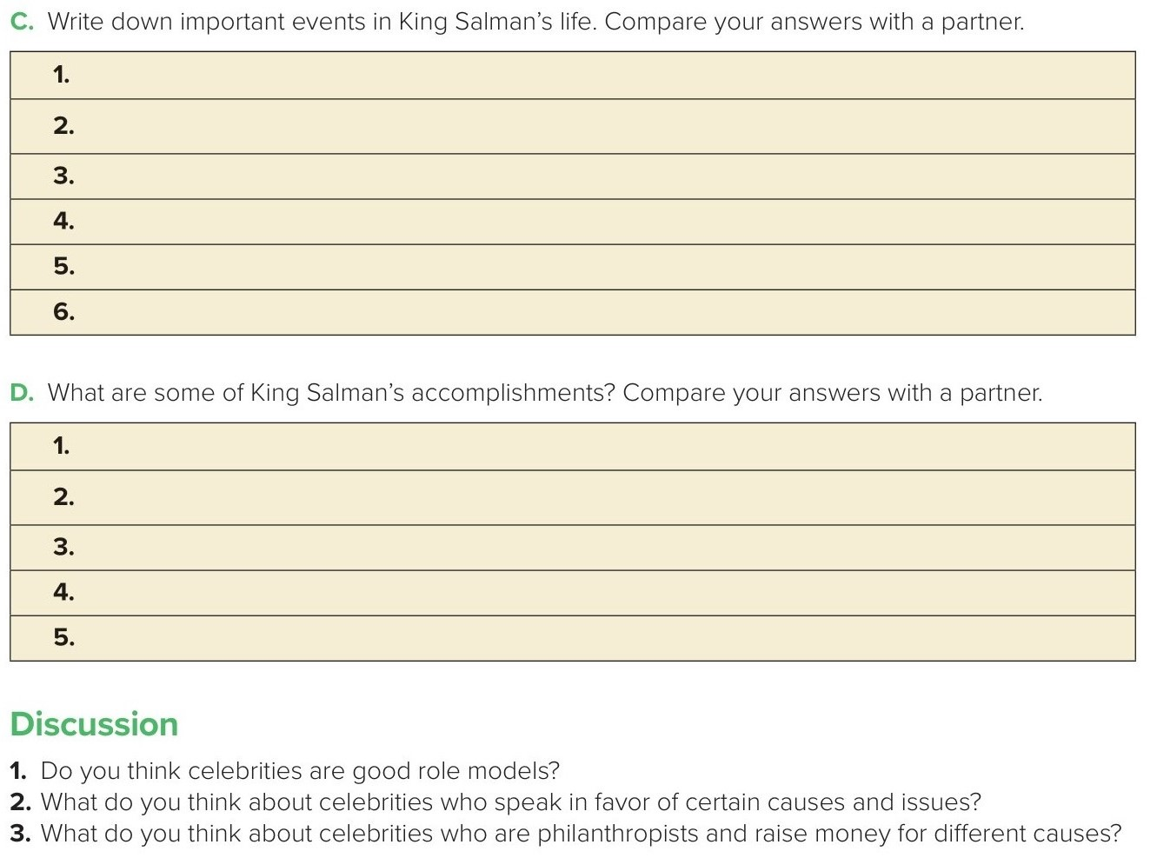
He was educated at the Princes’ School in Riyadh.
He was appointed Emir of Riyadh in 1954.
He was the Governor of Riyadh from 1963 to 2011.
He became the Minister of Defense in 2011.
He was appointed Crown Prince of the Kingdom on June 18,2012
He became the King of Saudi Arabia on January 23, 2015
At the age of 19 he became the Emir of Riyadh.
He helped Riyadh develop into a major urban metropolis by attracting tourism , and investment
For over 50 years, he worked with many humanitarian groups and received many awards.
He holds many degrees and academic awards
He supported many cultural projects such as the Riyadh Charity for Sciences and the
Prince’s Prize for the Memorization of the Holy Qur’an.

Slide 8
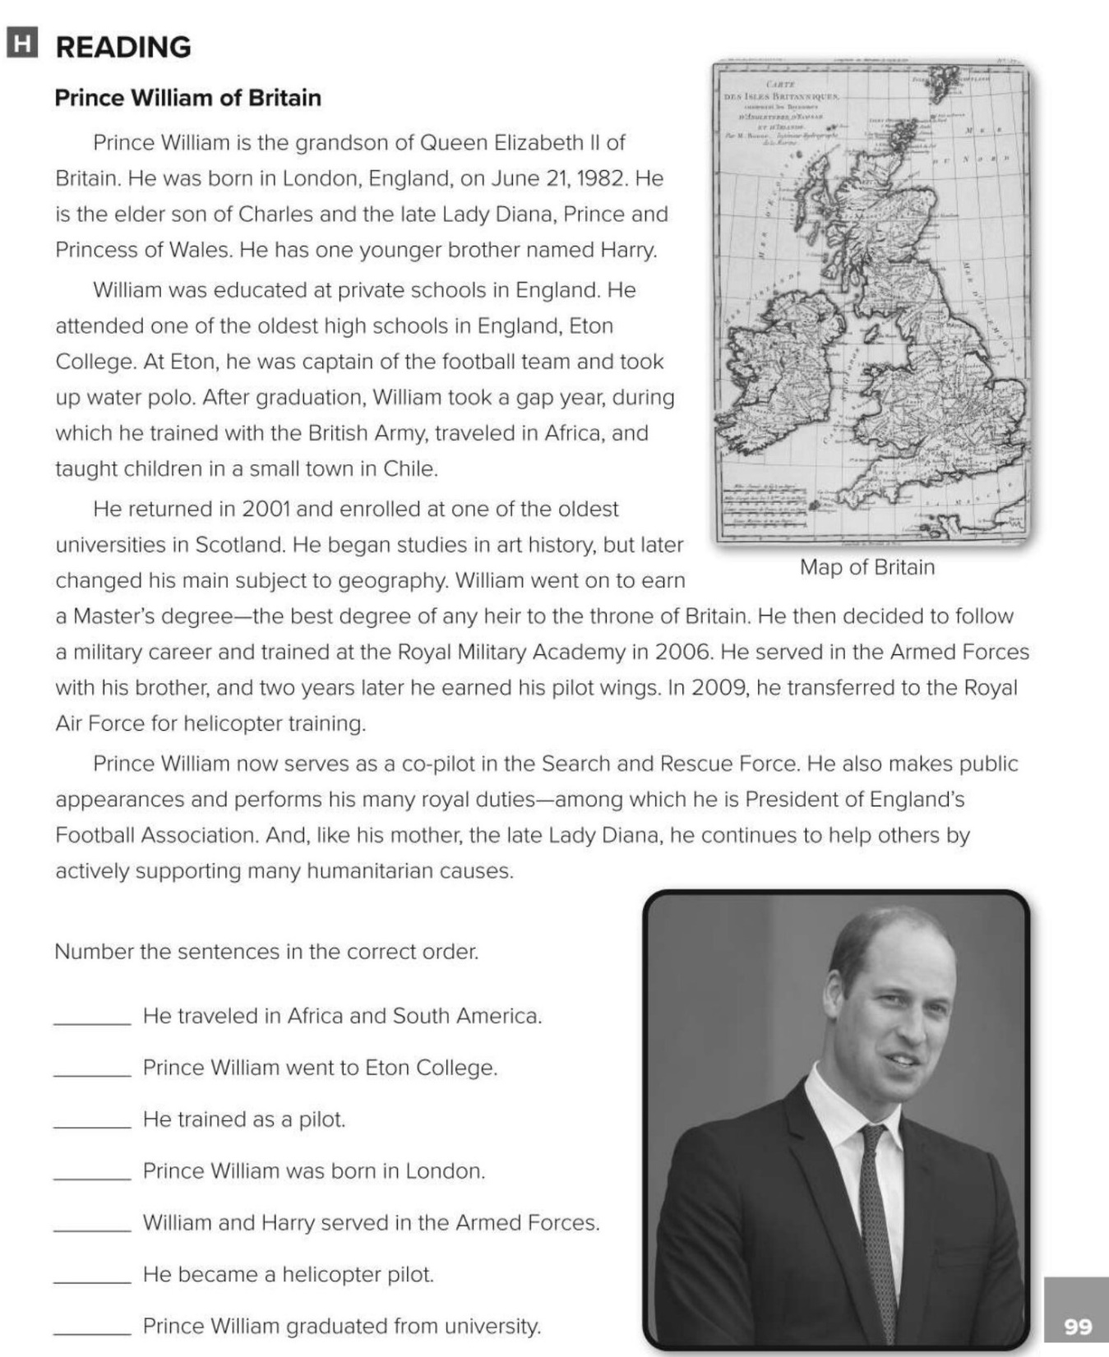
3
2
6
1
5
7
4

Slide 9
Choose the correct answer :
1-
in other countries =
relief
abroad
2-
a big city =
appoint
metropolis
3-
4-
Award
Degree
Goalkeeper
gym

Slide 10


Slide 11


Back

Slide 12


Back

