Slide 1






3 grammar
Today:
Date:
- -1445
Page 12
By: Dalal Al-Juaid

Slide 2


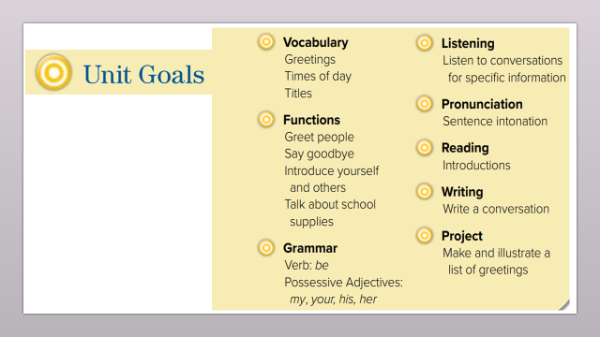
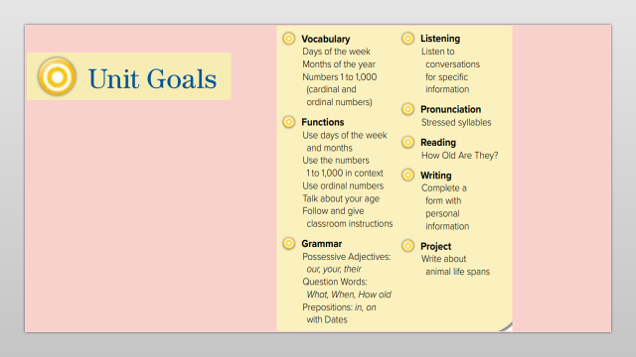
Use plural possessive adjectives (their – our).
Make questions using WHAT – WHEN – HOW OLD.
Warm up
questions
Use ( in – on ) with dates.
Numbers
prepositions
Complete a conversation correctly.
summative

Slide 3
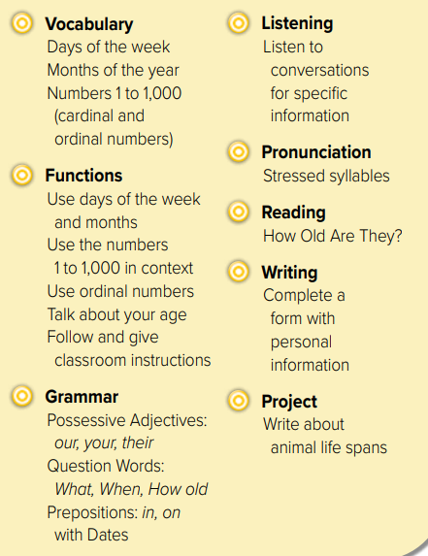
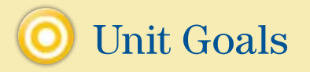

Slide 4





Warm up
questions
Numbers
prepositions
summative

Slide 5

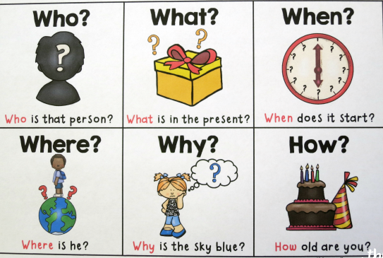
Warm up
questions
Numbers
prepositions
summative

Slide 6

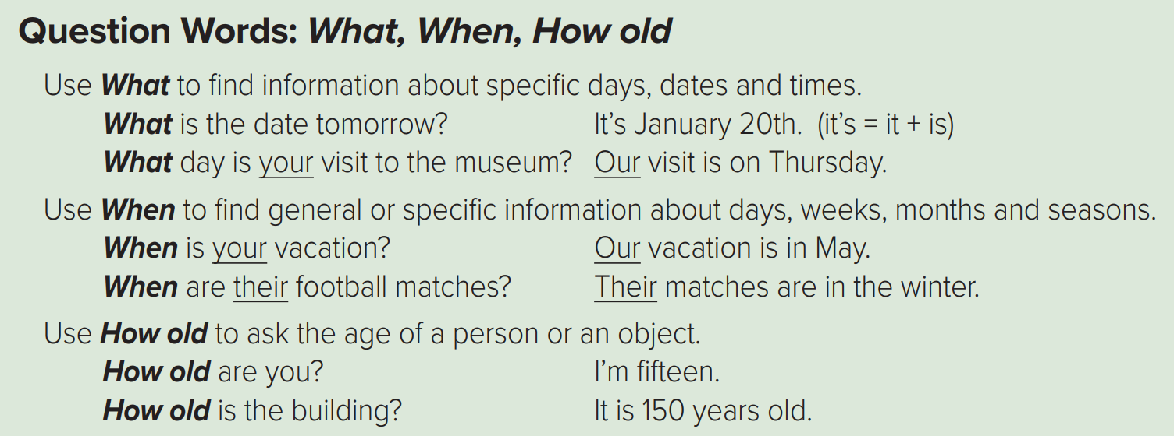














To ask about TIME
Page 12
Warm up
questions
Numbers
prepositions
summative

Slide 7


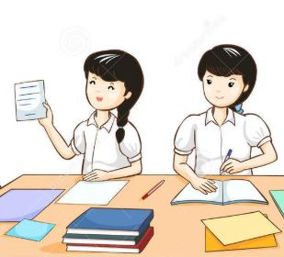

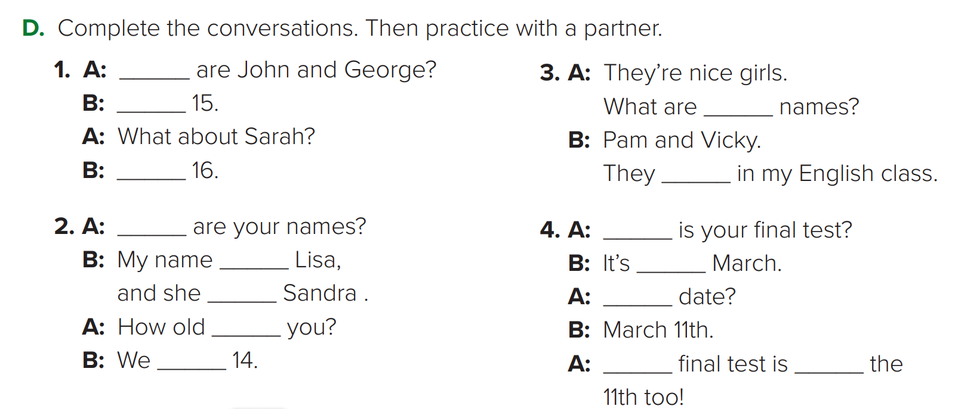
Page 13
Question words
Verb BE
Pronouns
Possessive
Think pair share
How old
They’re
their
She’s
are
Warm up
What
When
questions
is
in
is
What
Numbers
are
are
My
on
prepositions
summative

Slide 8
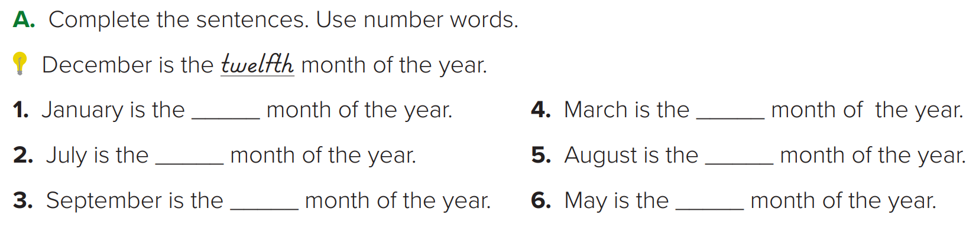
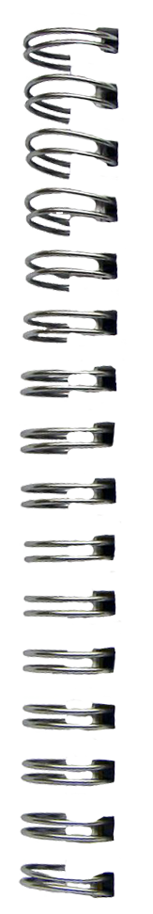
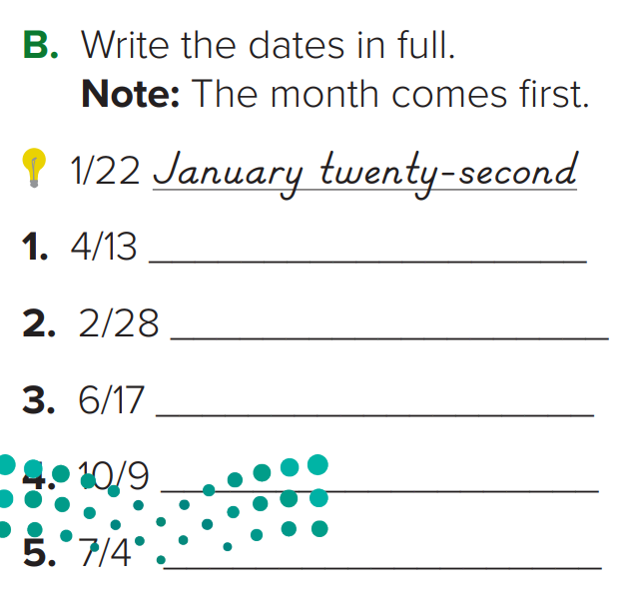
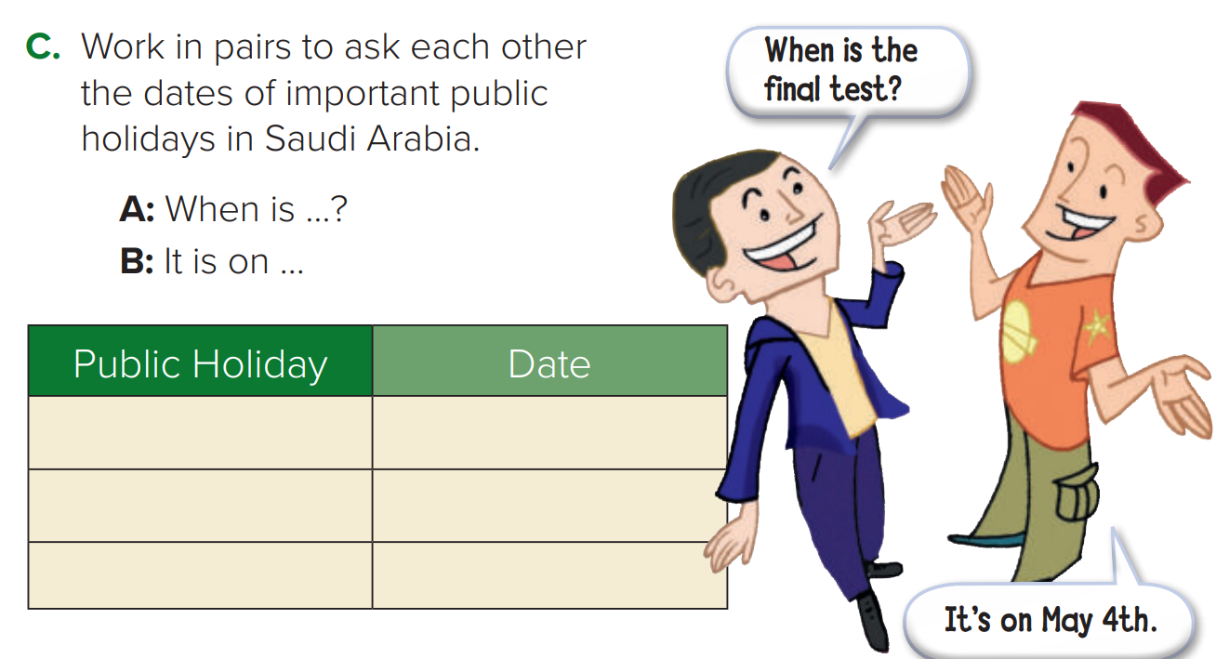

Numbers & date
Page 12
first
third
seventh
eighth
ninth
fifth
pair work
April thirteenth
February twenty-eighth
June seventeenth
National Day
Sep. 23
October ninth
July fourth

Slide 9
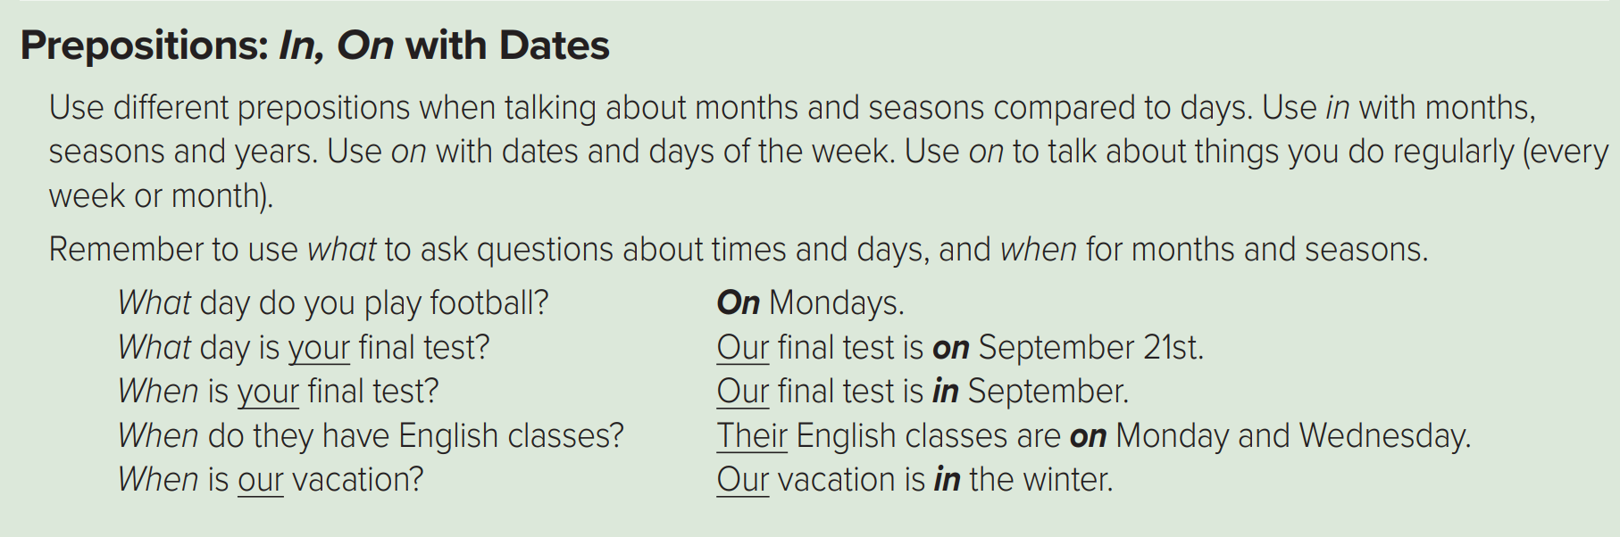







in
+ months / years / seasons
on
+ date / day
Warm up
questions
Numbers
prepositions
summative

Slide 10




Lets play
Warm up
questions
Numbers
prepositions
summative

Slide 11





page 193 Ex(G-H-I)
for practice grammar
Warm up
questions
Numbers
prepositions
summative

Slide 12
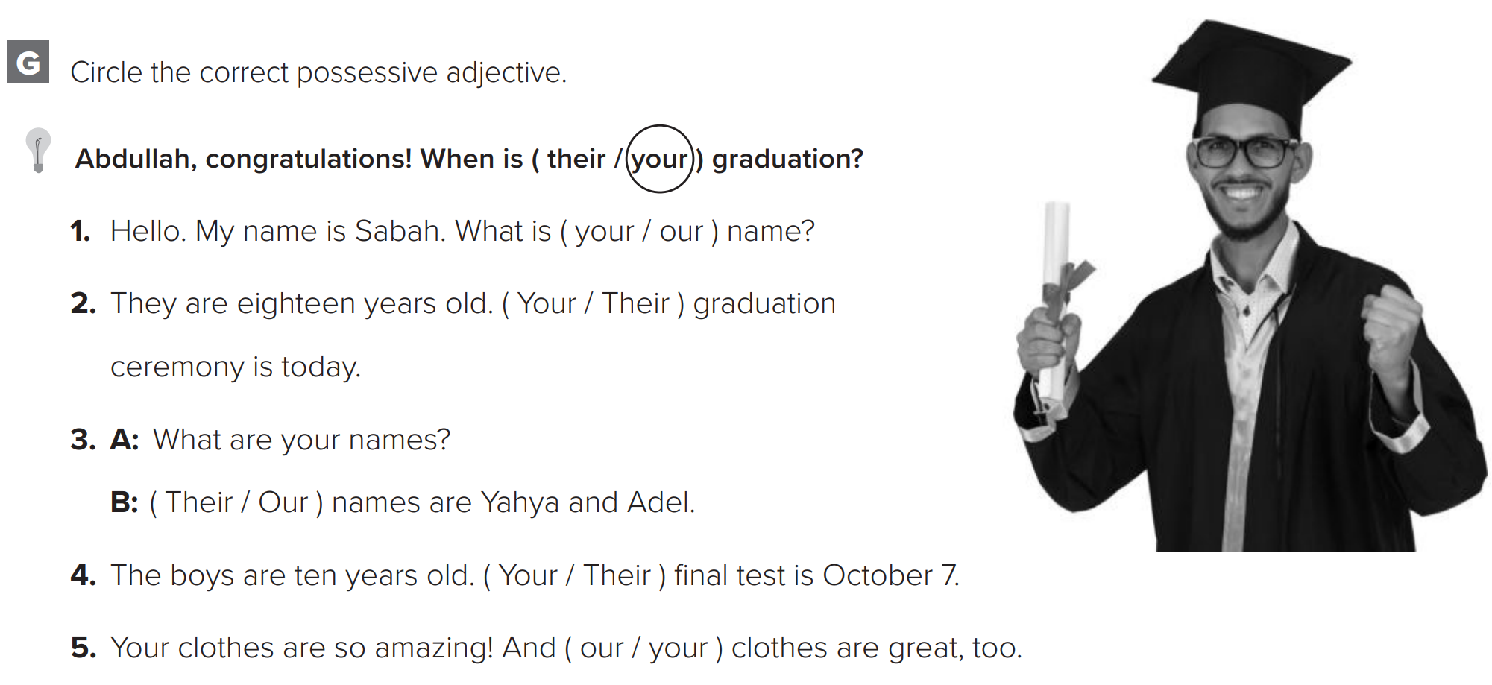
p.193

Slide 13
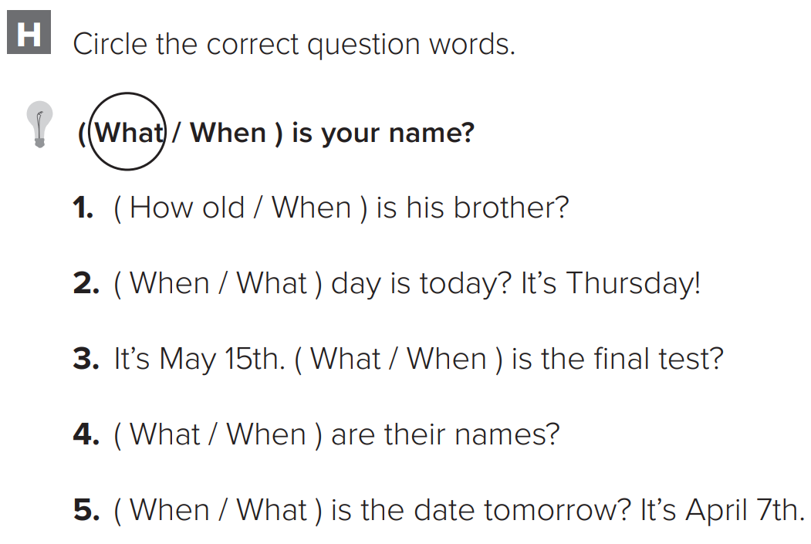
p.193

Slide 14
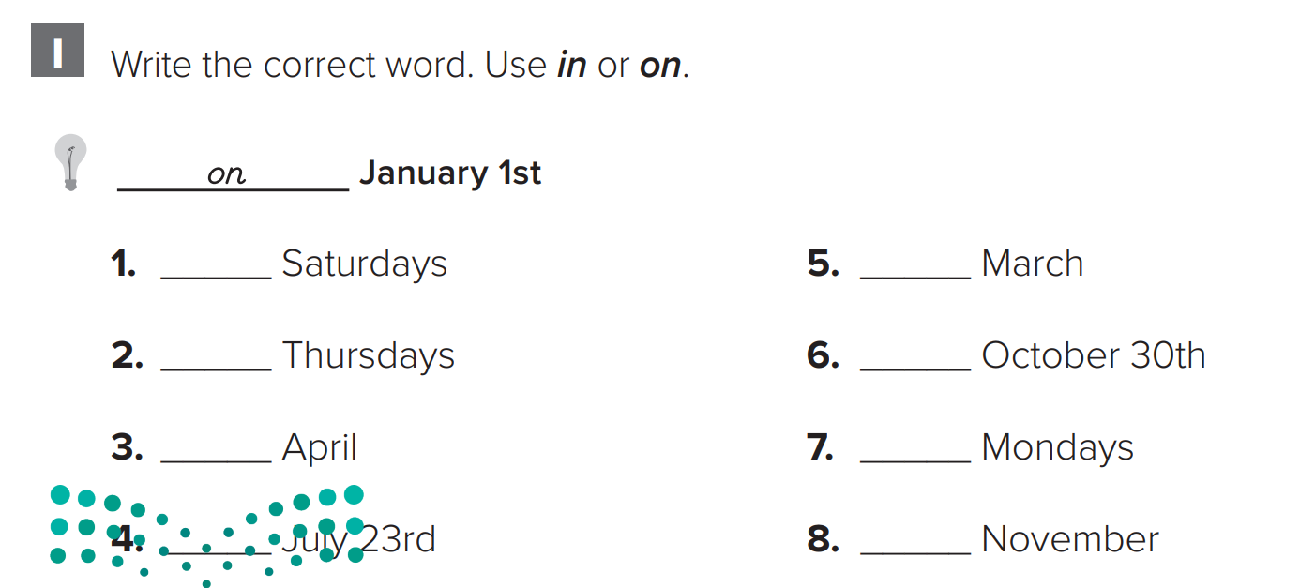
p.193
on
in
on
on
in
on
on
in

