Slide 1
Revision unit 1
Are you here on vacation?
Page 2-9
WB 185 -188

Slide 2
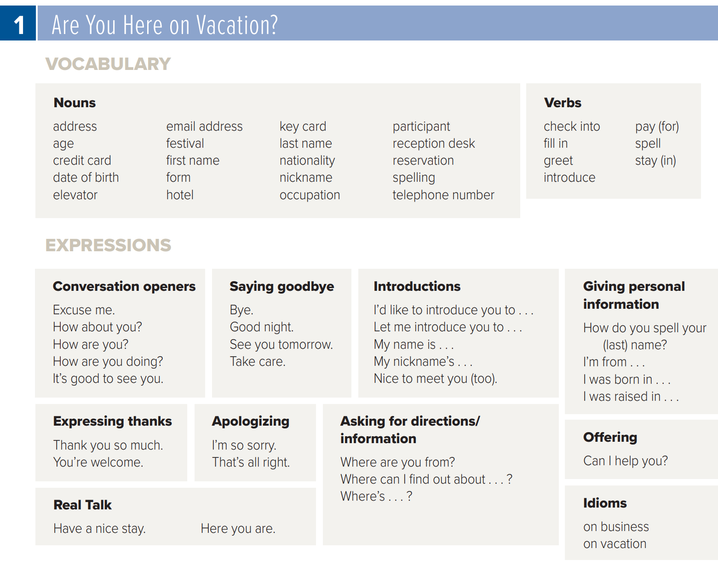

New words
Page 154

Slide 3




Look & Answer

Slide 4
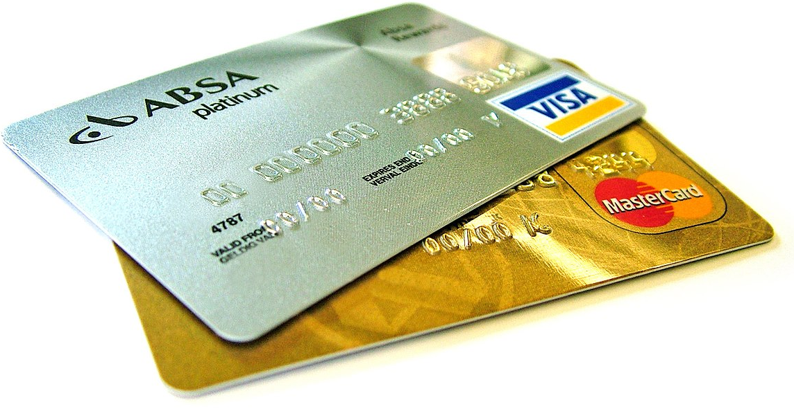
These are …………..
Credit cards

Slide 5

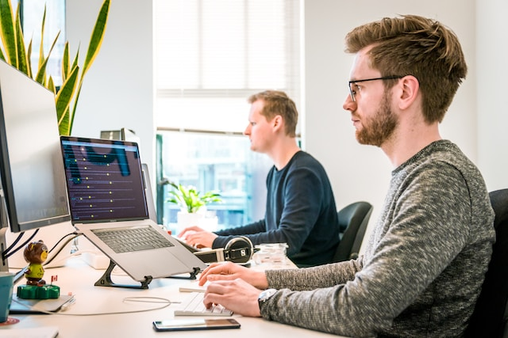
They are on ………………..
business
vacation

Slide 6

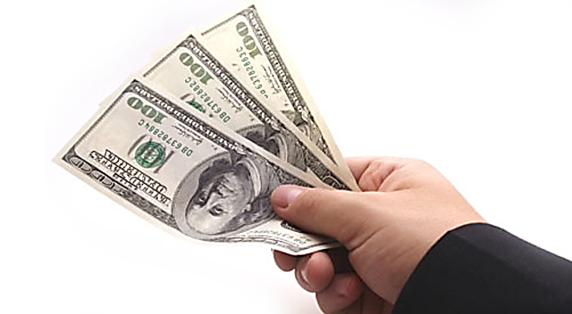
She paid …………
By cash
By credit card

Slide 7

A: ……………….. I’m Fahd.
B: Hi . I’m Khaled.
Goodbye
Good morning
My name is

Slide 8
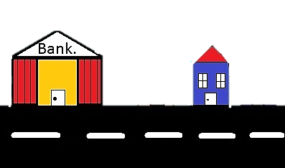
The house is …….. The bank.
Near
Next to

Slide 9



Turn …………..
Left
right

Slide 10
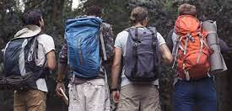
They are ………………………..
businessmen
backpackers
teachers

Slide 11
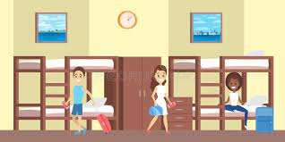
This is a …………….
Hotel
Hostel

Slide 12

Rearrange:
your Who teacher is English
Who is your English teacher?

Slide 13
choose

Slide 14
01
A: See you later Hoor.
B: ………………………… Wateen.
A
B
C
Hello
How are you
Take care

Slide 15
02
A:Thank you.
B: ………………………………………………….
A
B
C
Hi
You’re welcome
sorry

Slide 16
03
It’s polite to say:
( I …………… some water )
A
B
C
need
want
Would like

Slide 17
04
A: …………………………………………?
B: Lateen, but my friends call me LULU
A
B
C
What’s your name
How are you
I’m sorry

Slide 18
05
……………….. are you from?
A
B
C
Where
What
How

Slide 19
06
A: Are you here on vacation?
B: No, ………………………………………………….
A
B
C
I not
I am
I’m not

Slide 20
07
A: What color …… it ?
B: It is black.
A
B
C
am
is
are

Slide 21
08
Opposite of business # ………..
A
B
C
work
job
vacation

Slide 22
09
……………………. Is booking a room in hotel.
A
B
C
money
reservation
vacation

Slide 23
10
Expression used to give something:
A
B
C
How long
Have a nice stay
Here you are

Slide 24
11
A: Where are you from?
B: ……………………………………………….
A
B
C
I’m from Abha
Yes. I’m new here.
My name’s Deema

Slide 25
12
A: Are you new?
B: Yes, ……………..
A
B
C
You are
I am
Am I

Slide 26
13
Key card is used to ………………...
A
B
C
Open door
Pay money
Introduce

Slide 27
14
I have a low budget =
A
B
C
expensive
A lot of money
Little money

Slide 28
15
Opposite of youth # ……
A
B
C
children
Old aged
baby

Slide 29
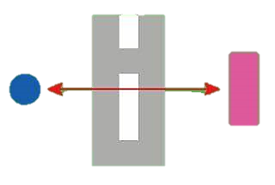
16
shop
theater
The shop is …………… the theatre.
A
B
C
across from
between
on

Slide 30
Correct mistake

Slide 31
They ( is ) backpackers.
They are backpackers

Slide 32
Listen & Say

Slide 33



Listen and
Answer about you:

Slide 34
Prepared By
Dalal Al-Juaid
t.me/dalalforenglish

