Slide 1



Slide 2
Unit-3-
What Will Be ,Will Be
L9 Reading

Slide 3


Objectives
Explain the meaning of a time capsule
Discover the meaning of the time capsule via picture search.
Find the main ideas of the text
Find the meaning of words from the text
Write the reason behind burying the car
Match questions with answers from the text
Write the reason for people gathering in Tulsa
Find out what was people's opinions
Explain the way the time capsule was buried
Describe the condition of the car by 2007

Slide 4





Warm Up
Tell One lie and Tow truth about you

Slide 5

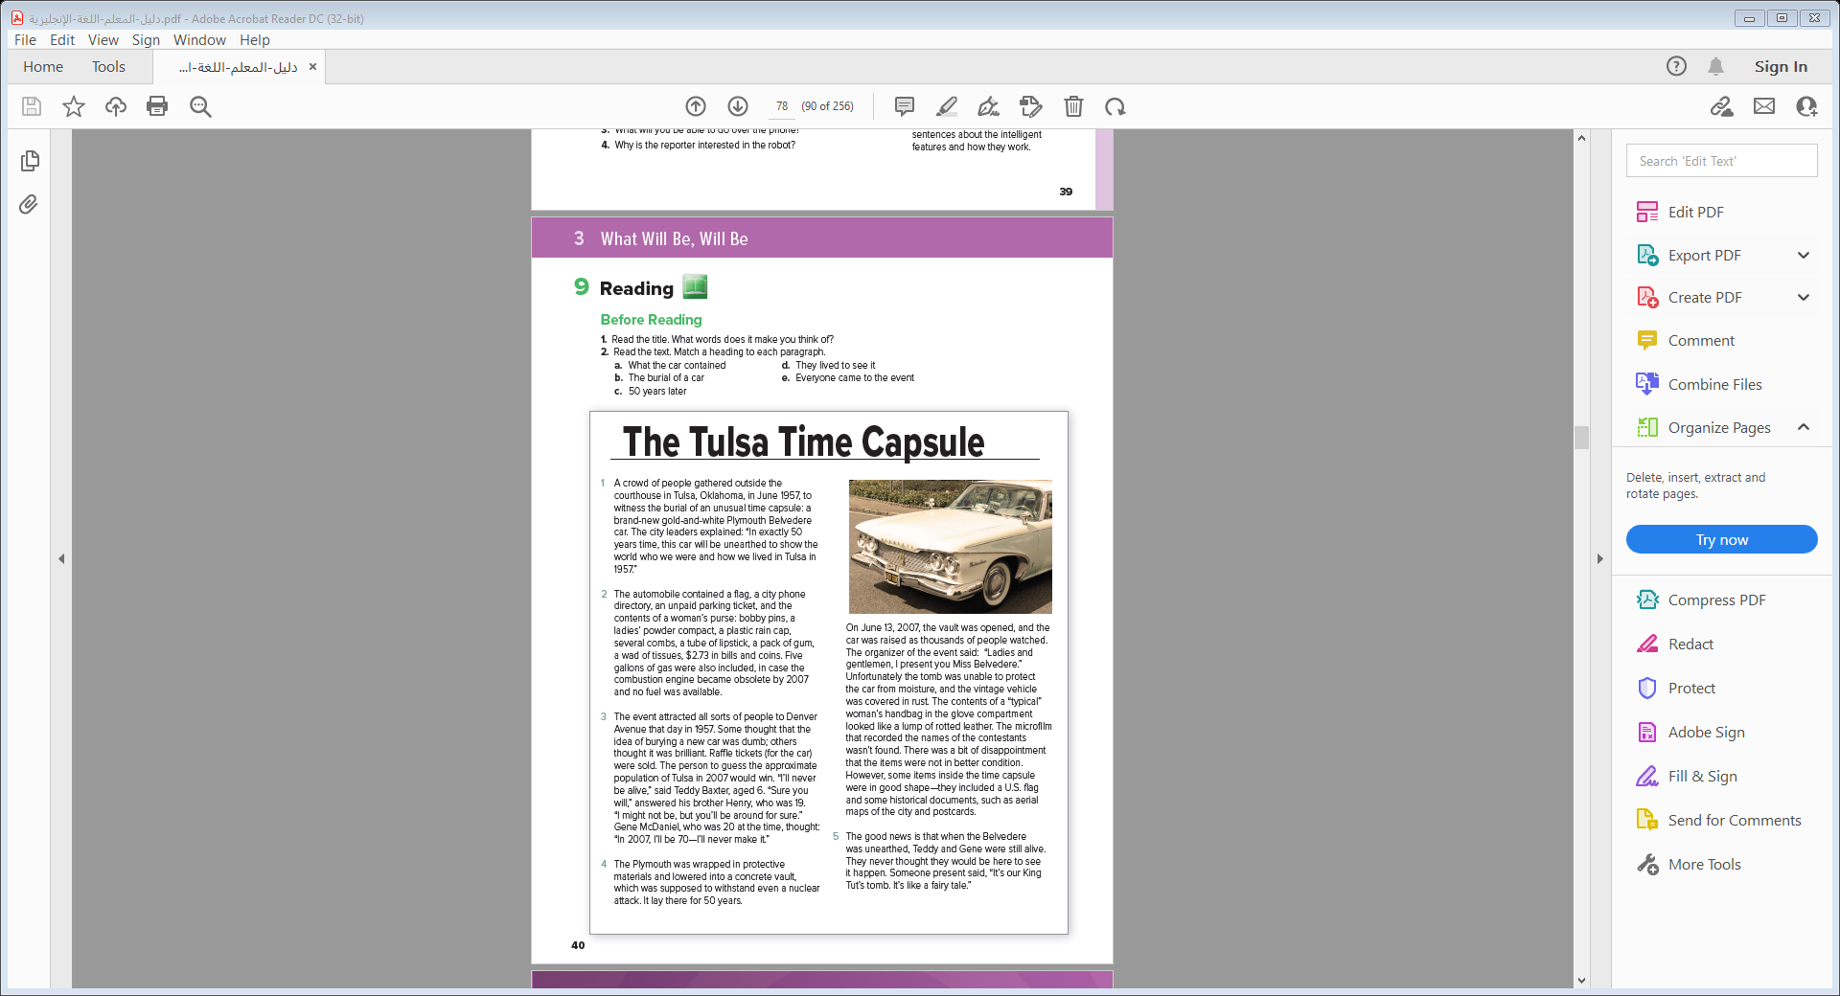
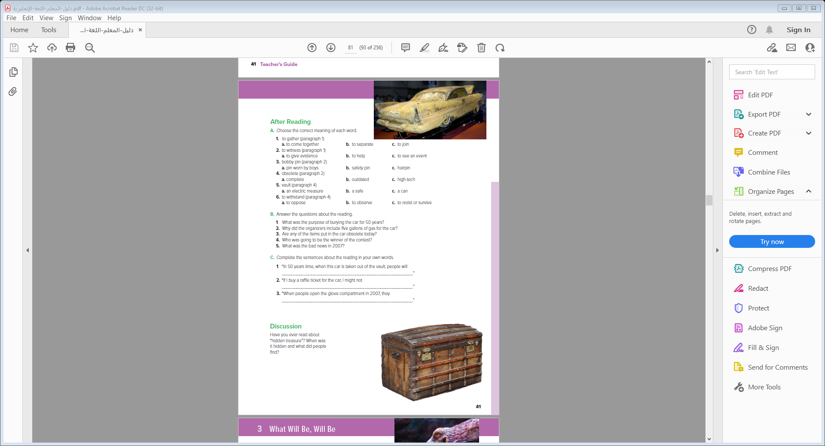
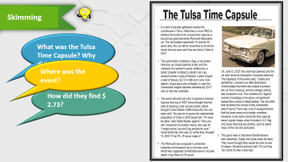

Student Book
P.40-41

Slide 6

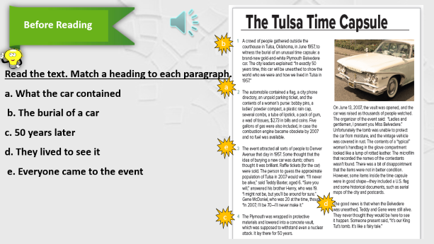
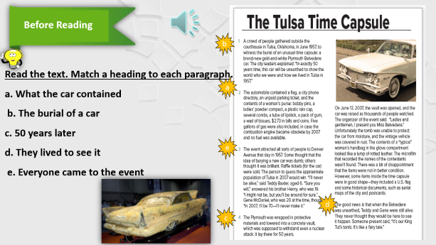
Skimming
What was the Tulsa Time Capsule? Why did they do it
Where was the event?
How did they find $ 2.73?
Notes:
Language Builder
Explain that the meaning of the expression, I’ll (never) make it depends on the context. In this article, to make it means to live that long. Other examples with to make it include:
to make it to the train station on time = to arrive there on time
to make it in a career = to be successful
to make it to the game = to be able to go to the game

Slide 7

Before Reading
b
Read the text. Match a heading to each paragraph.
a. What the car contained
b. The burial of a car
c. 50 years later
d. They lived to see it
e. Everyone came to the event
a
e
d
c

Slide 8
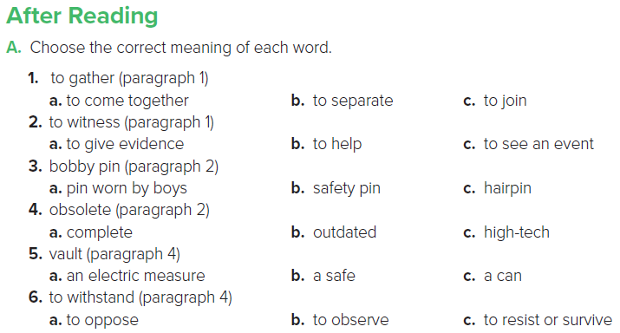


Slide 9
B. Answer the questions about the reading.
1. What was the purpose of burying the car for 50 years?
2. Why did the organizers include five gallons of gas for the car?
3. Are any of the items put in the car obsolete today?
4. Who was going to be the winner of the contest?
5. What was the bad news in 2007?
1. To show how people lived in Tulsa in 1957.
2. In case the combustion engine became obsolete.
3. The microfilm is obsolete.
4. The one who guessed the population of Tulsa in 2007.
5. Water got into the vault, and the car was covered in rust. The microfilm for the contest wasn’t found.

Slide 10
C. Complete the sentences about the reading in your own words.
1. “In 50 years time, when this car is taken out of the vault, people will _____________________________________________________.”
2. “If I buy a raffle ticket for the car, I might not _____________________________________________________.”
3. “When people open the glove compartment in 2007, they _____________________________________________________.”

Slide 11
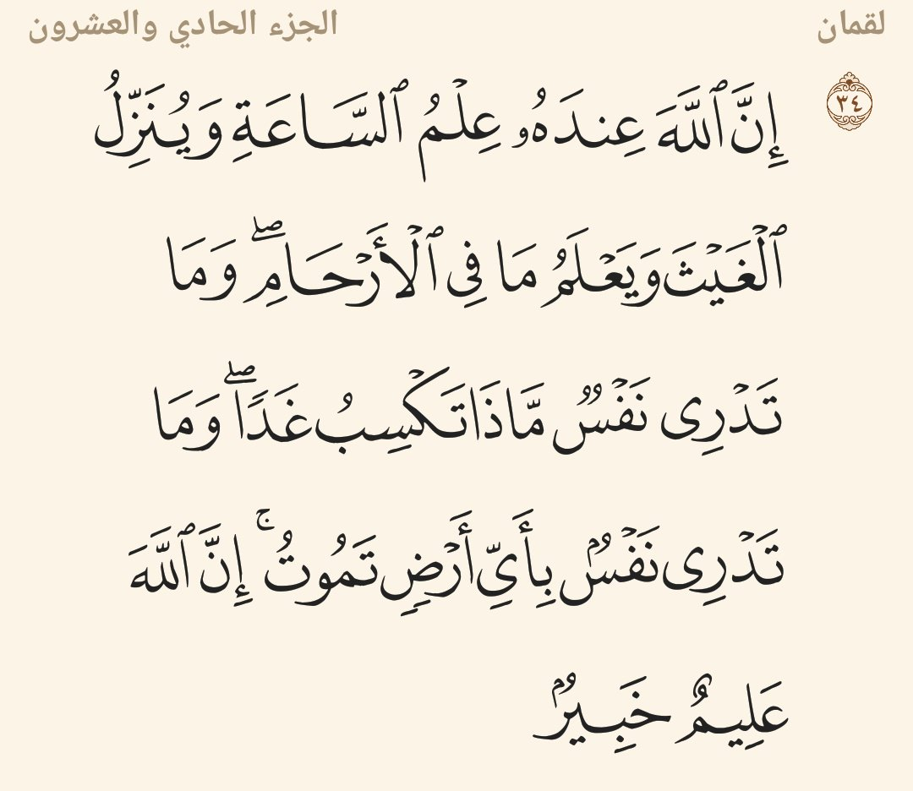

Slide 12


