Slide 1


Slide 2


Slide 3
Unit 2 - Careers
10 Writing

Slide 4


Revision
Integrity at work is a/an ......
Personal experience
Personal accommodation
Personal Quality
hardworking,
patient,
working with others
are ……
Personal education
Personal award
Personal characteristic

Slide 5


Decide the suitable job for people
Write a cover letter for a job application.
Write what each job needs
Analyze a cover letter

Slide 6
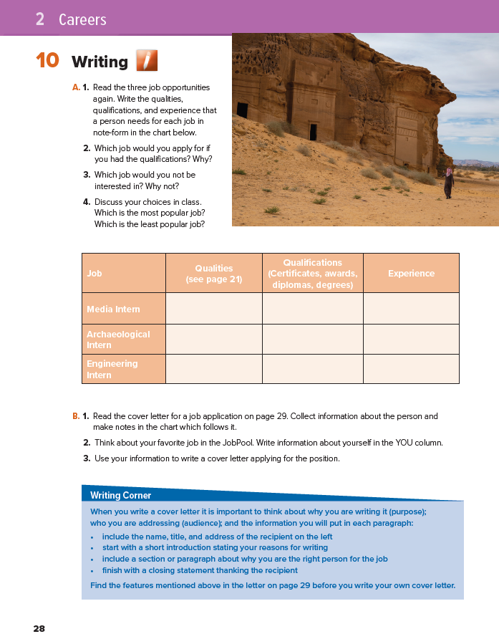
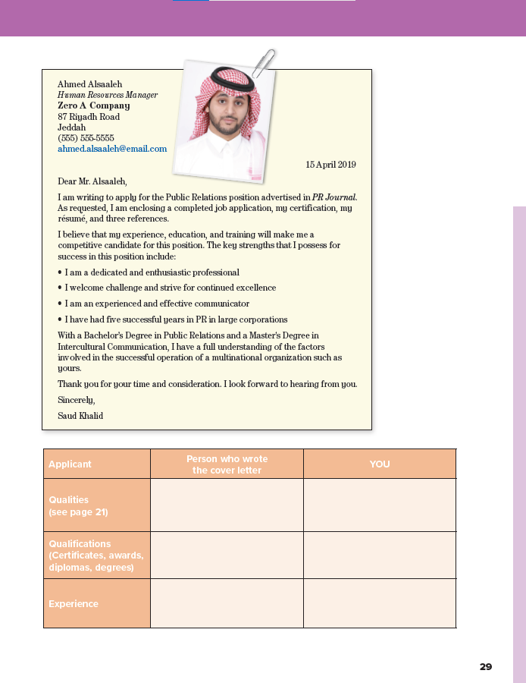

28-29

Slide 7
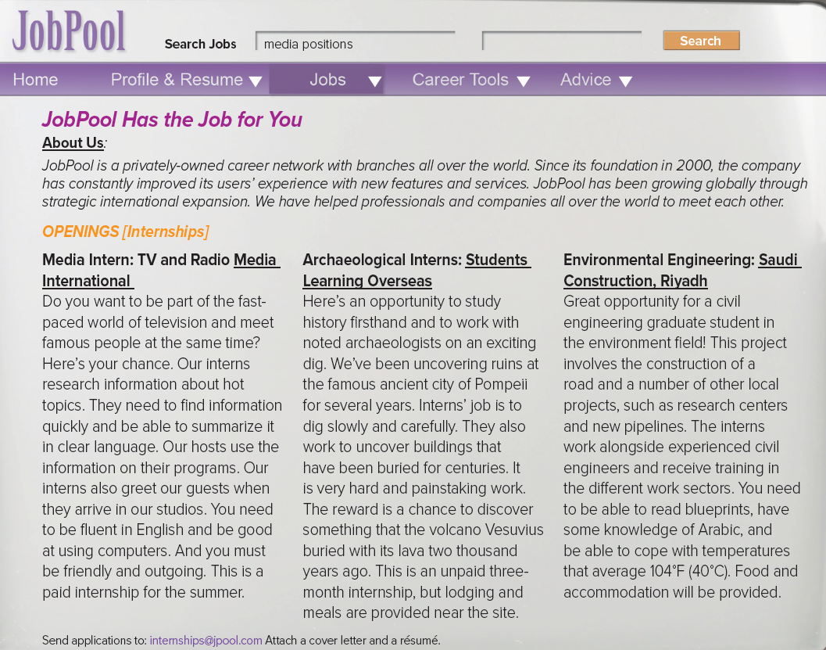




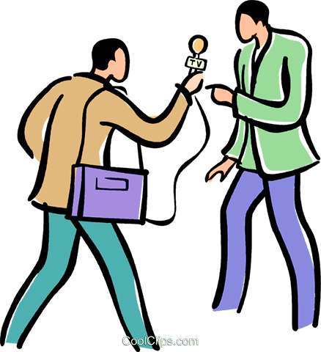
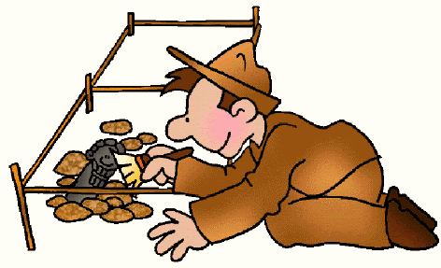
A. 1. Read the three job opportunities again. Write the qualities, qualifications, and experience that a person needs for each job in note-form in the chart below

Slide 8
Experience | Qualifications (Certificates, awards, diplomas, degrees) | Qualities (see page 21) | Job
 |  |  | Media Intern
 |  |  | Archaeological Intern
 |  |  | Engineering Intern
Find information quickly/ summarize/ clear language • fluent English
computer skills • friendly and outgoing
Research and public relations
Not applicable
(no mention)
Not applicable/no mention probably experience is not a necessary requirement
careful and methodical • interested in history • interested in archeology/ working with noted archeologists
Not applicable
(no mention)
ability to read blueprints • knowledge or Arabic • tolerance to high temperatures
Degree in civil engineering/ graduate student
Not required

Slide 9
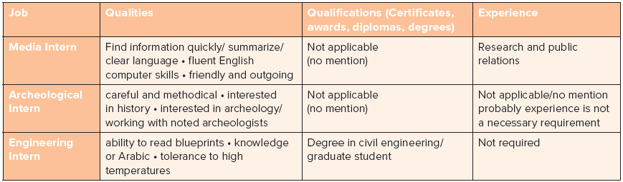

Discuss your choices in class. Which is the most popular job? Which is the least popular job
Which job would you apply for if you had the qualifications? Why?
Which job would you not be interested in? Why not?
the most / least popular job is ..

Slide 10
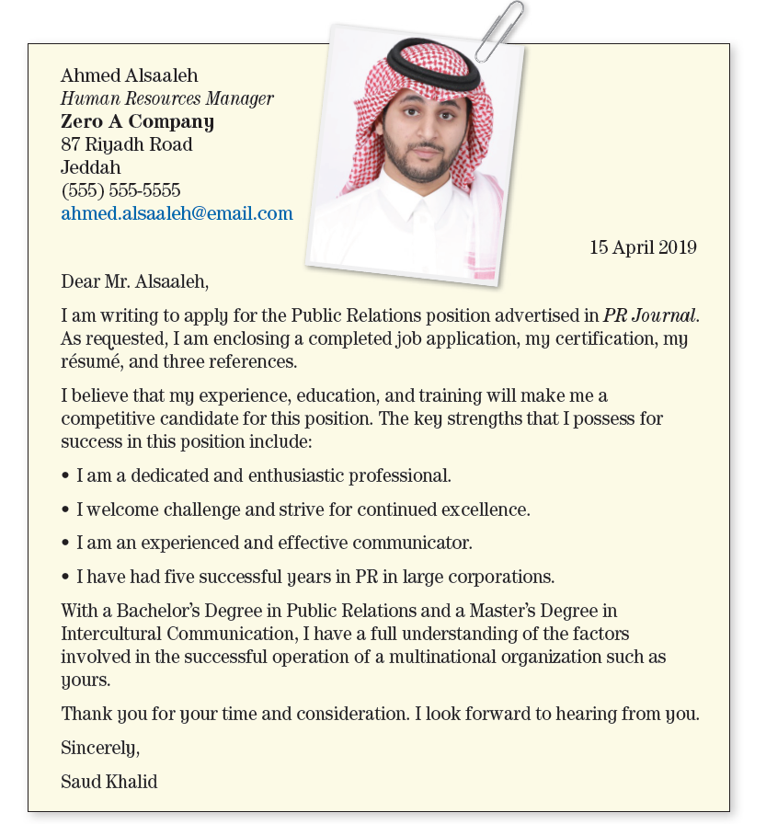
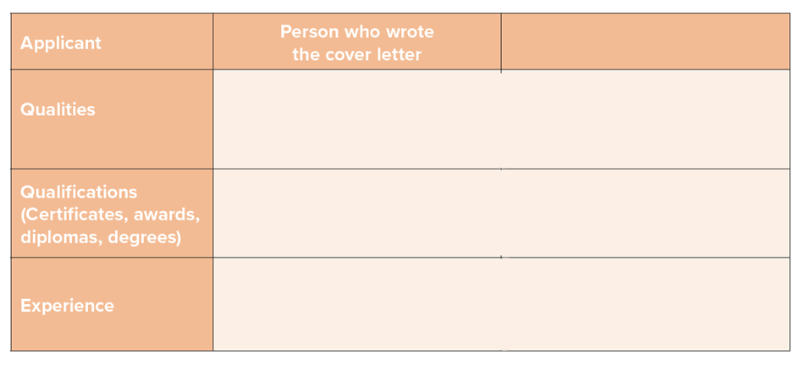
Read Cover
letter
Make notes
Collect
information
- dedicated / enthusiastic
- competitive & strifeful to be excellent
- Communication skills
- Bachelor’s Degree in Public Relations
- Master’s Degree in intercultural communication
5 years in PR in large corporation

Slide 11

e.g.
Write information about yourself
your favorite job in the JobPool.
- dedicated / enthusiastic
- competitive & strifeful to be excellent
- Communication skills
Communication skills
Interpersonal skills
Teamwork
- Bachelor’s Degree in Public Relations
- Master’s Degree in intercultural communication
Degree in Media
5 years in PR in large corporation
Host a TV program in 2018

Slide 12

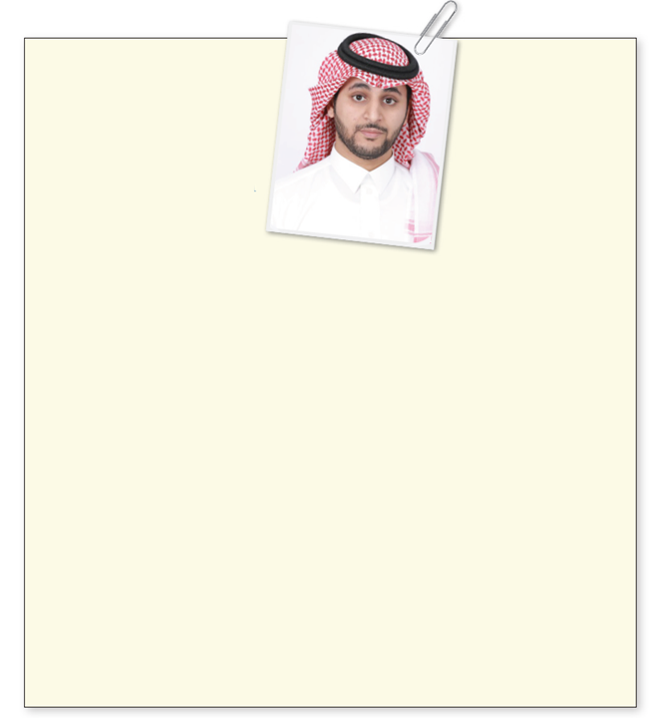
Recipient address
introduction
Writing Corner
When you write a cover letter it is important
to think about why you are writing it (purpose);
who you are addressing (audience); and the information you will put in each paragraph:
include the name, title, and address of the recipient on the left
start with a short introduction stating your reasons for writing
include a section or paragraph about why you are the right person for the job
finish with a closing statement thanking the recipient
reasons for writing
closing

Slide 13
Recipient address
Use your information to write a cover letter applying for the position
A TV Host
introduction
- good at communicating
- interested in working with people
- Friendly / creative / flexible
reasons for writing
Degree in in Interior Design
Architecture course
Manager for 3 years in Furniture Design Company, Al-Ahssa
closing

Slide 14
Have A Nice Day

