Slide 1




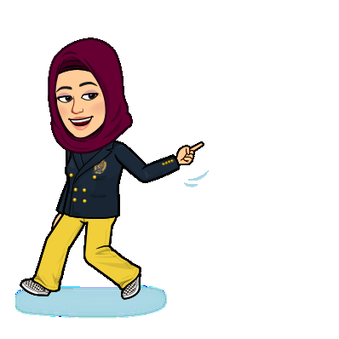
Good Morning

Slide 2


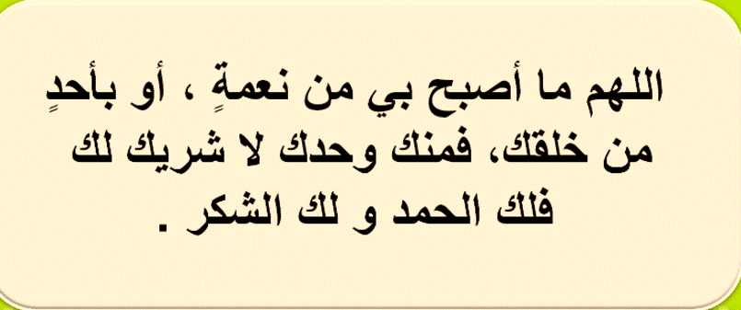

Slide 3

Unit -2-
Career
4 Language in Context
5 Listening
6 Pronunciation

Slide 4
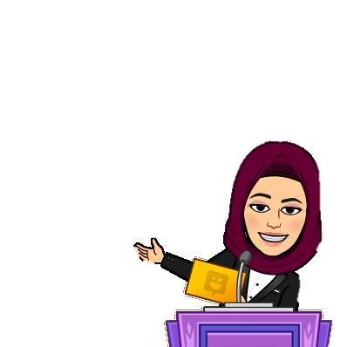
OBJECTIVES
Prepare a personal job profile
Select a job for classmates
Interview a classmate
Recognize the sound in m, n, and ing
Share positively in pair work

Slide 5

4 Language in Context

Slide 6
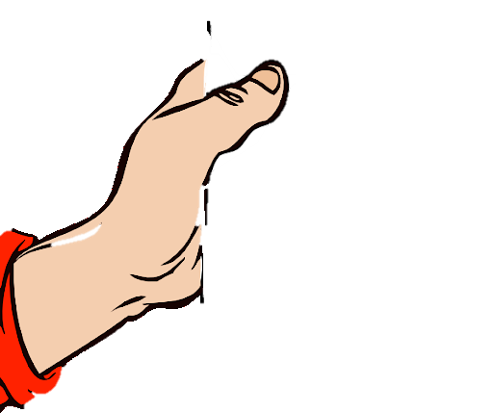
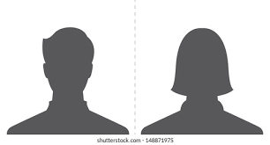


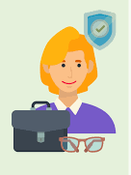
4 Language in Context
Job Profile
What is it?
Qualifications
What is it for?
Special Skills
Personality

Slide 7
e.g.
Degree in …..
Course in …..
Majored in…….
Qualifications
Job Profile
e.g.
good at // interested in ..
speaking – typing -
working outdoors
making a lot of money
helping people
Special Skills
Qualifications
Special Skills
e.g.
Creative – friendly – hardworking – organized - sociable - reliable
Personality
Personality

Slide 8
* TV reporter
A TV reporter needs to be confident and has to be comfortable in front of the cameras, and should be interested in following news
events.
TV reporter
Possible Job
Qualifications
degree in
journalism
Skills Special
good at speaking
in public
Personality
confident

Slide 9

5 Listening

Slide 10



Books Closed
You are going to
listen to a job interview
Listen and answer

Slide 11
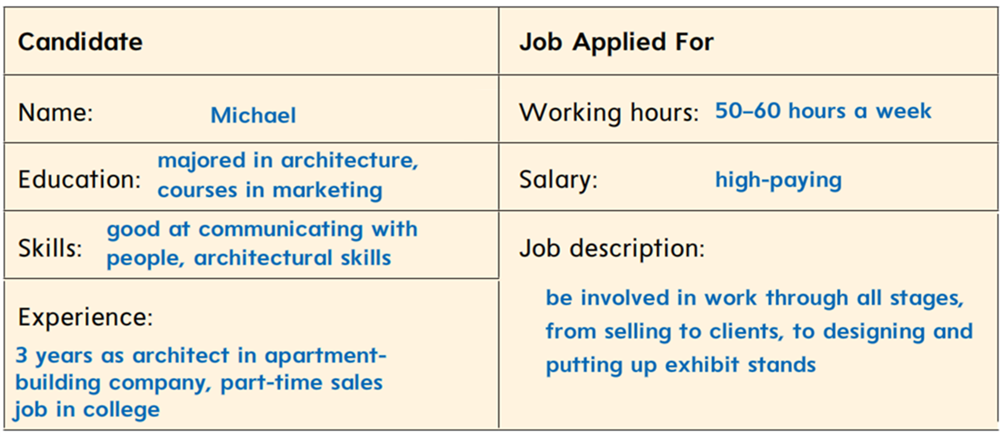
Books Opened p-42
Listen & Complete

Slide 12
6 Pronunciation

Slide 13
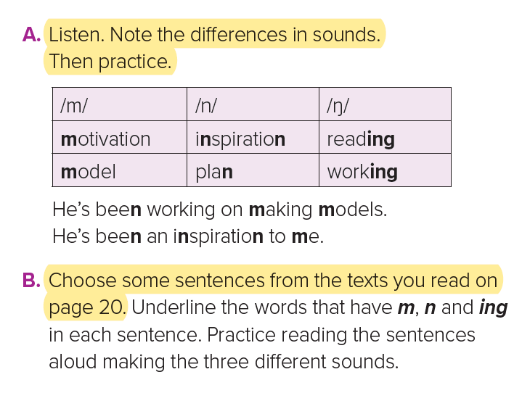
A. Listen. Note the differences in sounds. Then practice.
The sounds
/m/ - /n/ - /ŋ/

Slide 14
7 About you

Slide 15

In pairs, ask the questions and have your friend answer. Then switch roles.
1. What do you plan to do when you finish school?
2. Do you have a job? How long have you been working at your present job?
3. What career interests you? Why?
4. Have you ever had a job interview?
Talk about it.
5. Have you ever had an internship? Talk about it.
6. Tell your partner about the jobs you’ve had and the courses you’ve taken. Say how long you’ve been doing the jobs or taking the courses.

Slide 16

Hissah Alotaibi

