Slide 1


Good Morning

Slide 2


Slide 3
Unit 2 - Careers
8 Conversation

Slide 4
Objective's
Use the "Real Talk" phrases in conversation
Reorganize a job interview
Share positively in pair work

Slide 5

Warm Up
What is your dreamy job?
What are your Skills?

Slide 6

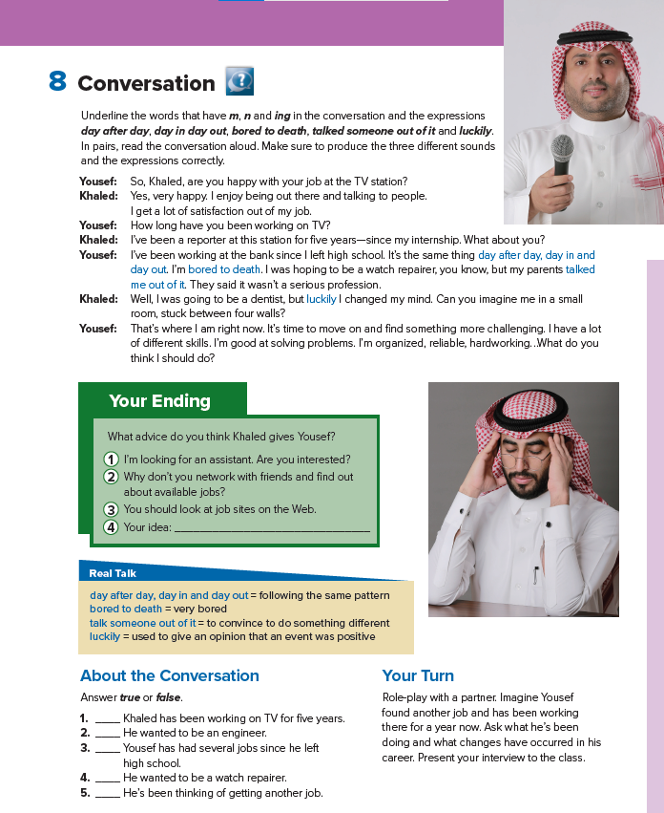
Yousef request for an…?
What are their jobs title?
Student’s book
p-24
Who is happy with his job?
Who are they?

Slide 7

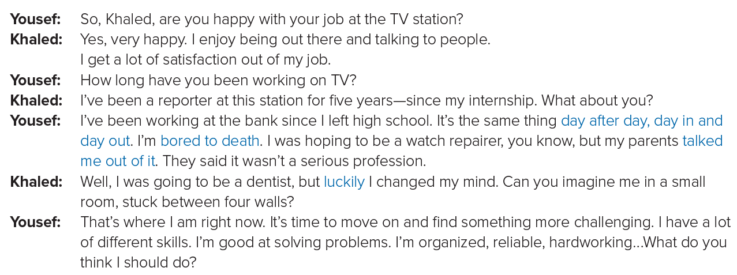
Yousef request for an…?
Skimming
What are their jobs title?
Who is happy with his job?
Who are they?

Slide 8


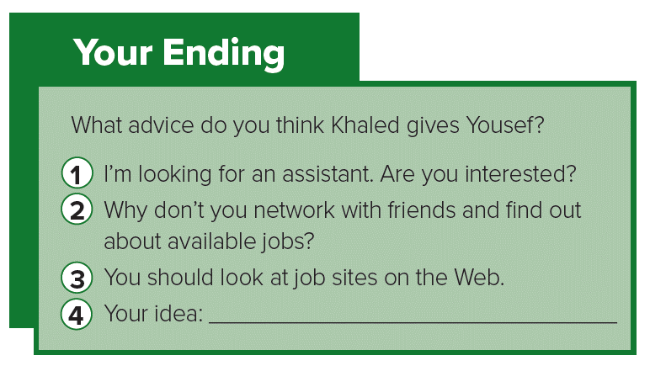
Listen & Answer

Slide 9

Listen & Answer

Slide 10
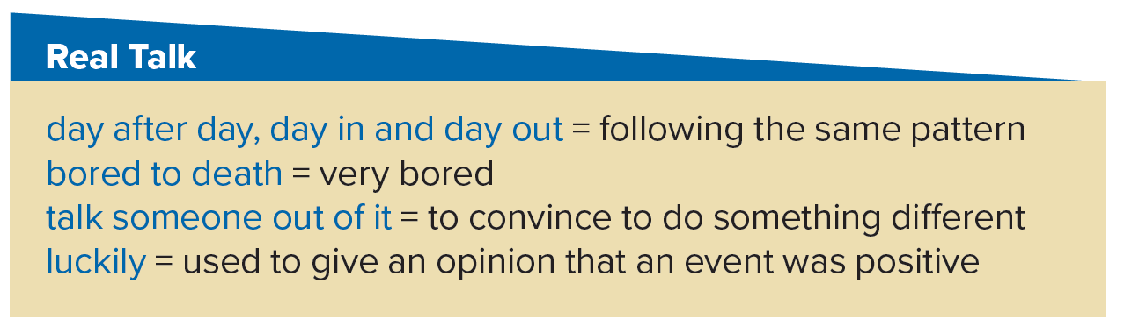



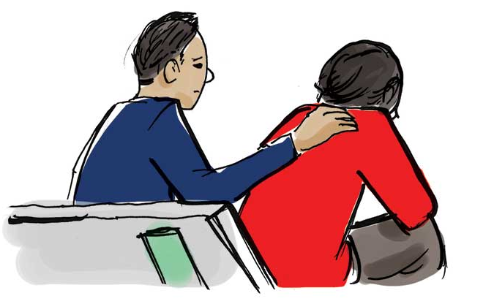

Slide 11

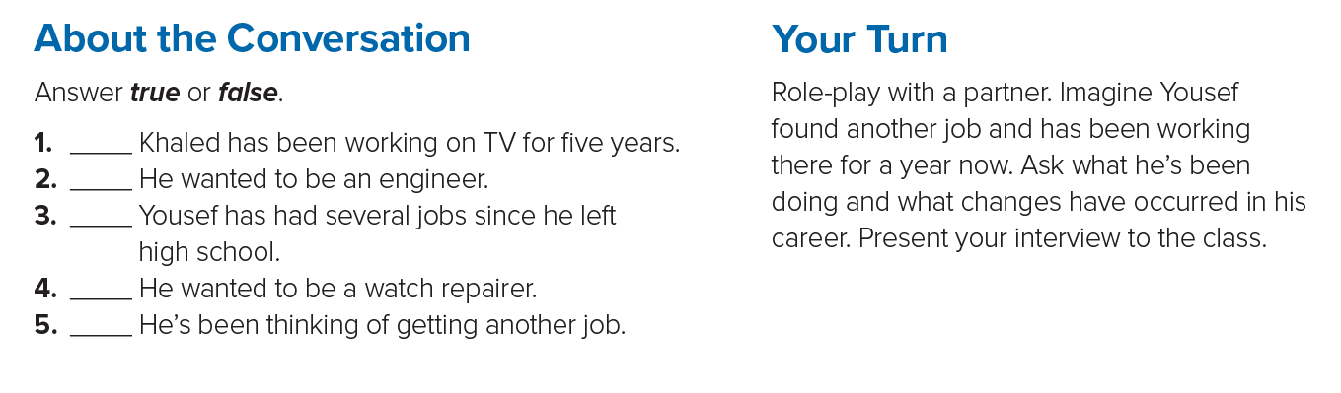
T
F
F
T
T

Slide 12

Now
It’s
Your Turn

Slide 13


