Slide 1


GOOD MORNING

Slide 2
Unit -1-
Big Changes
10-
WRITING

Slide 3


Slide 4

OBJECTIVES:
Identify mistakes in a written sentence
Write an essay about an important change in your country
Appreciate the importance of this impact
1
2
3
4
5
6
Say
verse of aya about change
Rewrite the sentences correctly with capital letters
Make notes about an event and its impact in my country.

Slide 5

Lets Know what you know ,
Which of the following words should be written in capital letters :
1-makkah
2- jordan
3- september
4-sunday
5-king fahad hospital
6-some people got corona vaccine.

Slide 6


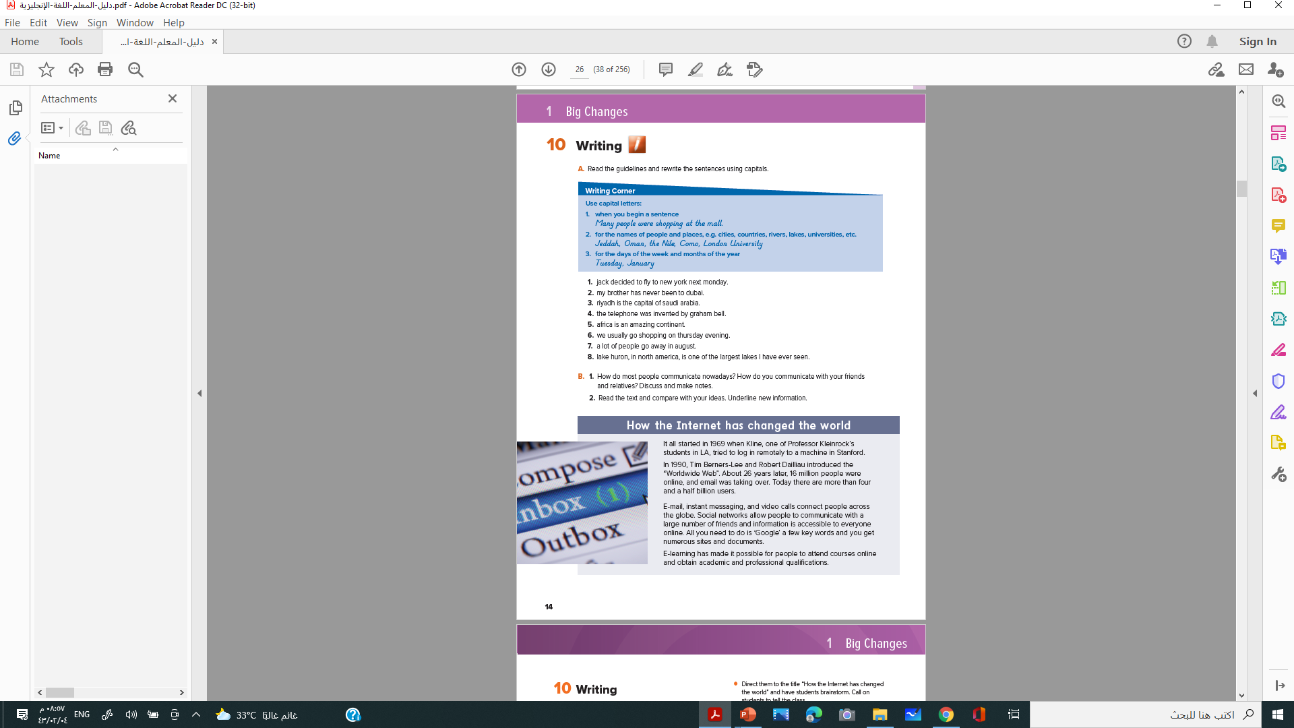
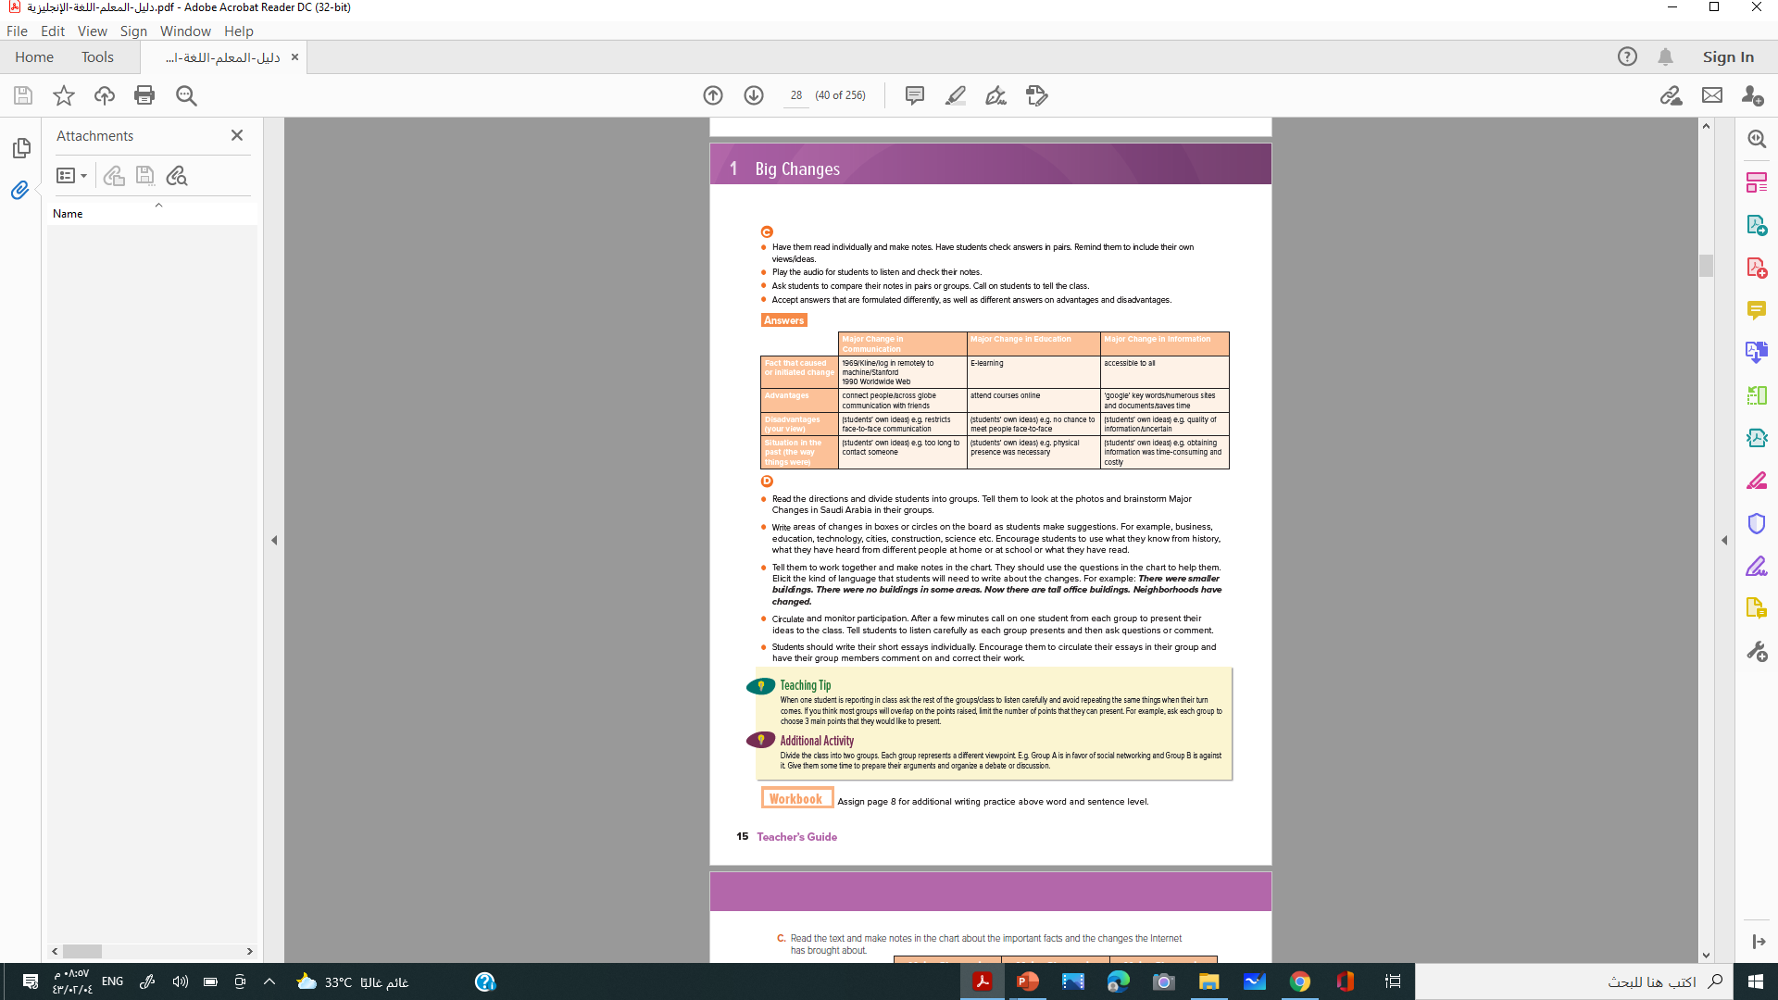

Students Book p.14

Slide 7


Read the guidelines and rewrite the sentences using capitals
A
Writing Corner
Use capital letters:
1. when you begin a sentence
Many people were shopping at the mall.
2. for the names of people and places, e.g. cities, countries, rivers, lakes, universities, etc.
Jeddah, Oman, the Nile, Como, London University
3. for the days of the week and months of the year
Tuesday, January

Slide 8

1. jack decided to fly to new york next monday.
1. Jack decided to fly to New York next Monday.
2. my brother has never been to dubai.
2. My brother has never been to Dubai
3. riyadh is the capital of saudi arabia.
3. Riyadh is the capital of Saudi Arabia
4. the telephone was invented by graham bell.
4. The telephone was invented by Graham Bell.
5. africa is an amazing continent.
5. Africa is an amazing continent
6. we usually go shopping on thursday evening
. We usually go shopping on Thursday evening.
7. a lot of people go away in august.
7. A lot of people go away in August
8. lake huron, in north america, is one of the largest lakes I have ever seen.
8. Lake Huron, in North America, is one of the largest lakes I have ever seen.

Slide 9


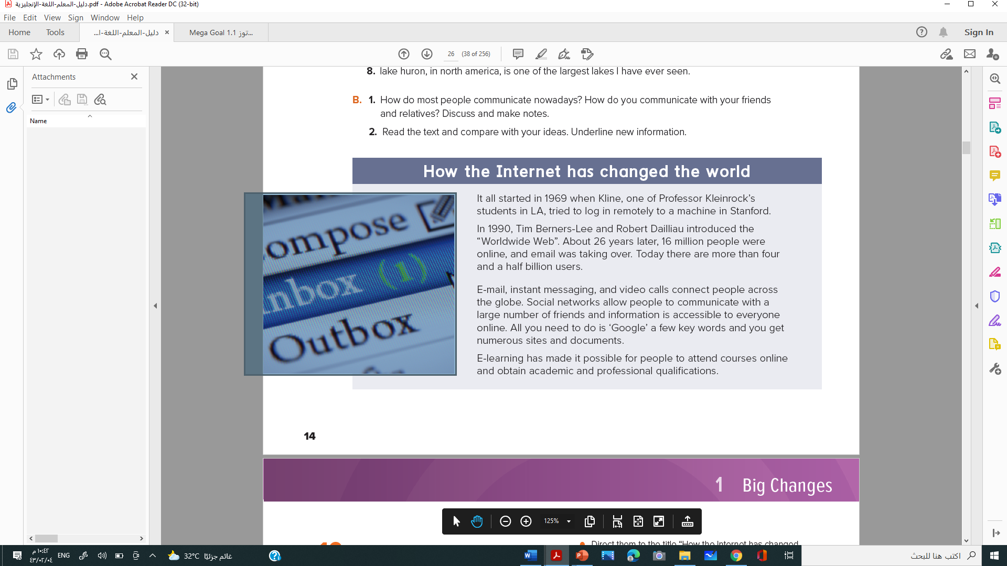
B
1. How do most people communicate nowadays?
How do you communicate with your friends and relatives? Discuss and make notes.
2. Read the text and compare with your ideas. Underline new information
How the Internet has changed the world

Slide 10
C
Read the text and make notes in the chart about the important facts and the changes the Internet has brought about.
Major Change in Information | Major Change in Education | Major Change in Communication
accessible to all | E-learning | 1969/Kline/log in remotely to machine/Stanford 1990 Worldwide Web | Fact that caused or initiated change
google’ key words/numerous sites and documents/saves time | attend courses online | connect people/across globe communication with friends | Advantages
(students’ own ideas) e.g. quality of information/uncertain | students’ own ideas) e.g. no chance to meet people face-to-face | (students’ own ideas) e.g. restricts face-to-face communication | Disadvantages (your view)
students’ own ideas) e.g. obtaining information was time-consuming and costly | students’ own ideas) e.g. physical presence was necessary | (students’ own ideas) e.g. too long to contact someone | Situation in the past (the way things were)

Slide 11

D
Think about an event that has brought about major changes. Make notes in the chart about the event and the impact it has had on your country

Slide 12
Impact 3 | Impact 2 | Impact 1
 |  |  | What was the event?
 |  |  | When and/ or where did it happen?
 |  |  | Did the event have a positive or negative impact on your country?
Use the information you put in the chart to write a short discursive essay about the event and the impact on your country
Exchange and comment on each other’s work. Correct and re-write.

Slide 13




Slide 14


Hissah Alotaibi

