Slide 1
Mega Goal 1.1
Unit 1 - BIG CHANGES
11 Form, Meaning and Function
By: Essa Al Hussaini

Slide 2

Let’s continue
to protect ourselves!

Slide 3

Objectives
USE
simple past tense correctly
USE
past progressive tense correctly

Slide 4
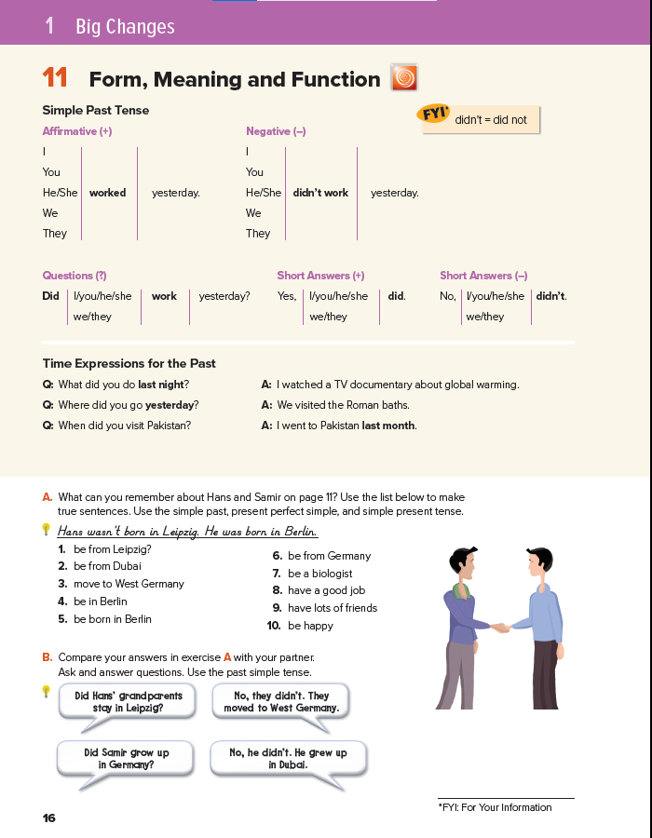
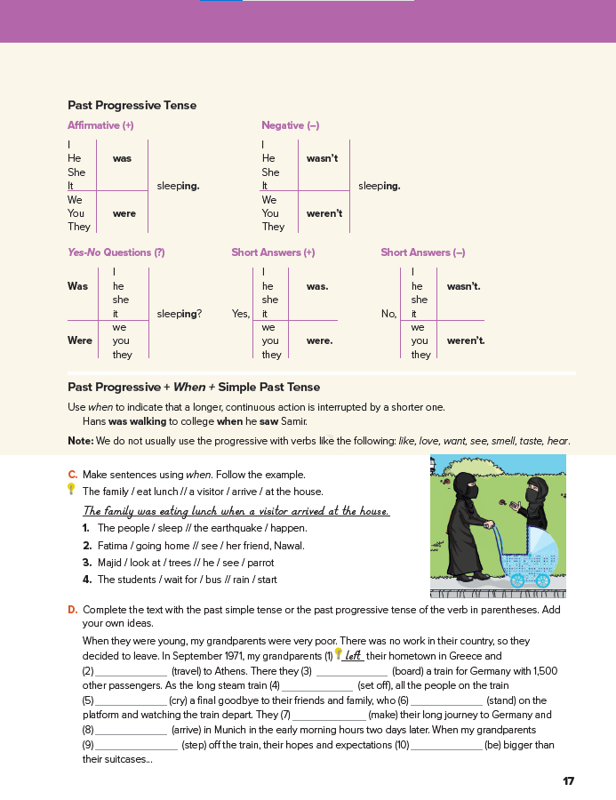
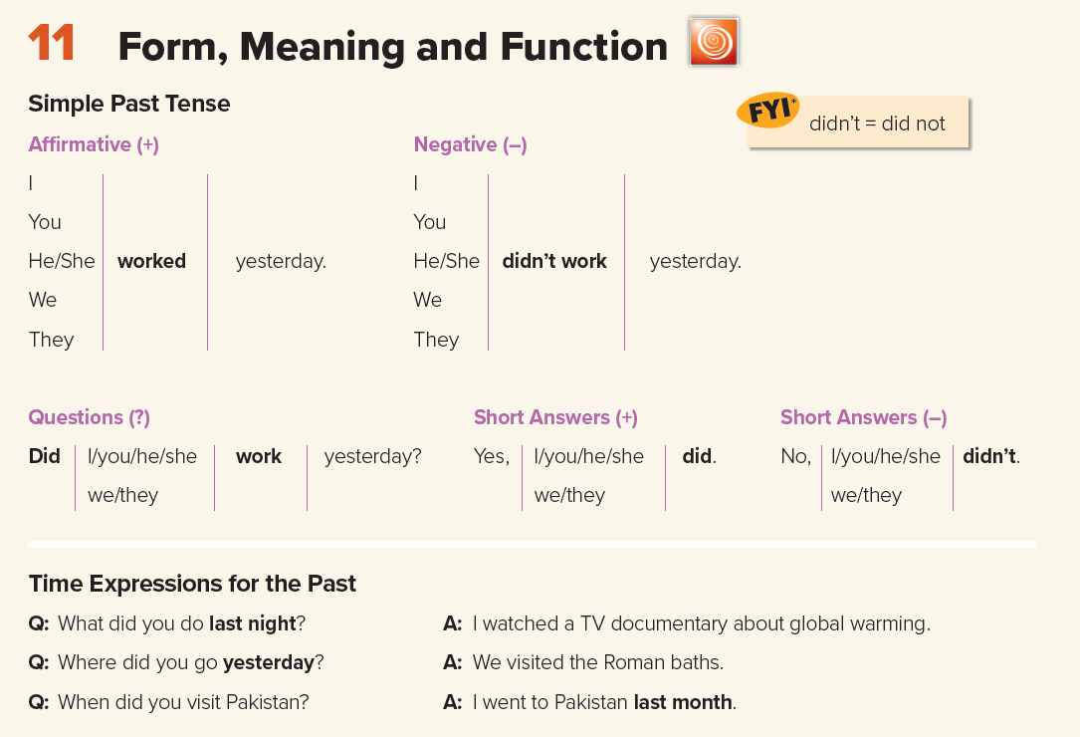

16-17

Slide 6
irregular verbs (p: 72)
ate
didn’t eat

Slide 7
irregular verbs (p: 72)
ate
didn’t eat
eat

Slide 8
irregular verbs (p: 72)
ate
didn’t eat
eat

Slide 9

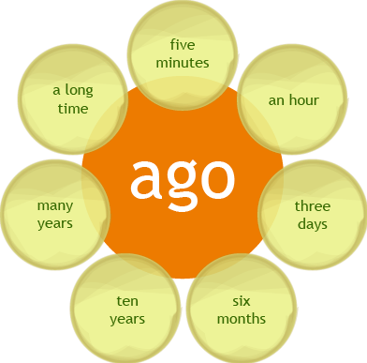
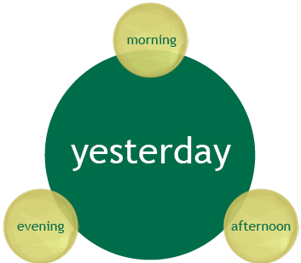
irregular verbs (p: 73)
ate
didn’t eat
eat
day

Slide 10

irregular verbs (p: 72)
ate
didn’t eat
eat

Slide 11
WORKBOOK
87

Slide 12
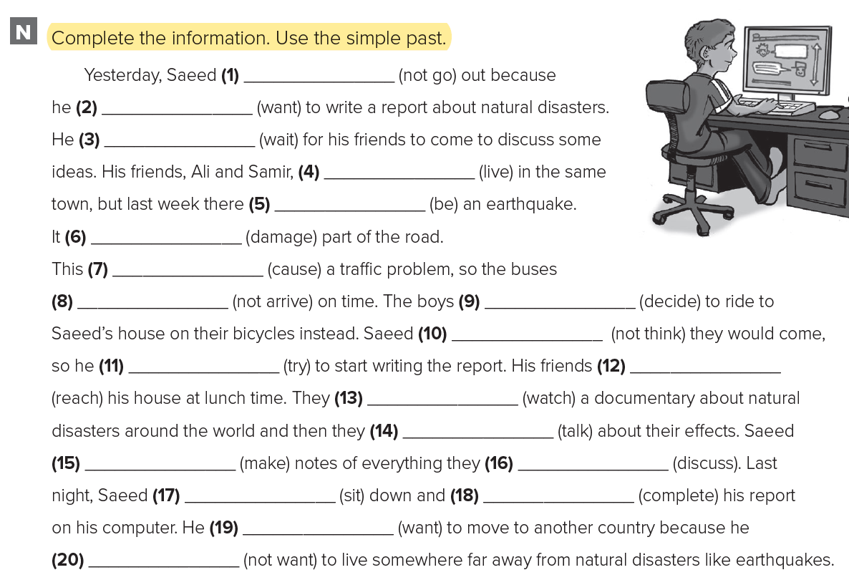
WORKBOOK
87
didn’t go
wanted
waited
lived
was
damaged
caused
didn’t arrive
decided
didn’t think
tried
reached
watched
talked
made
discussed
sat
completed
wanted
didn’t want

Slide 13
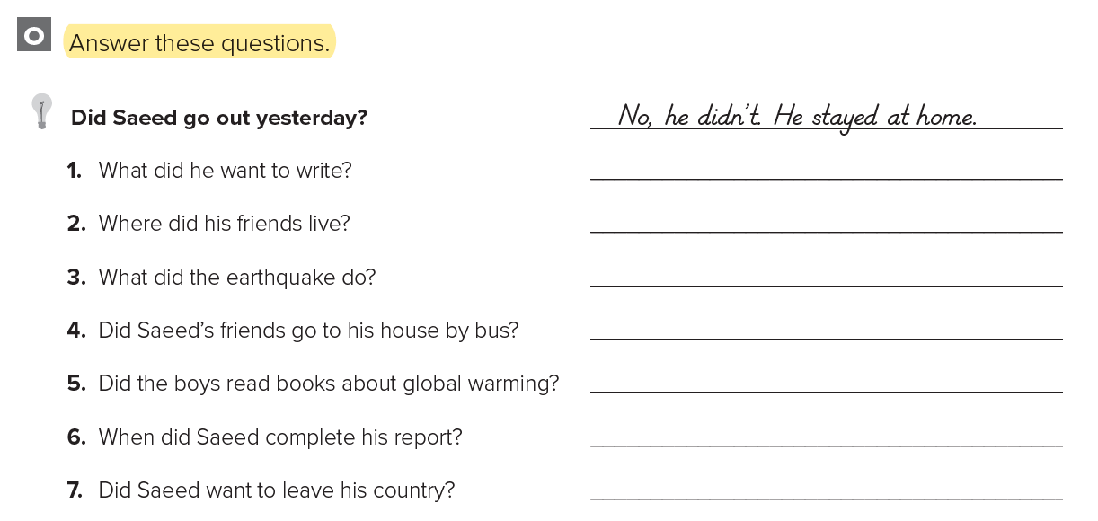

WORKBOOK
87
a report
1. He wanted to write a report.
2. They lived in the same town.
3. It damaged the road
4. No, they didn’t.
5. No. they didn’t.
6. He completed it last night.
7. Yes, he did.
in the same town
the road
no
no
last night
yes

Slide 14
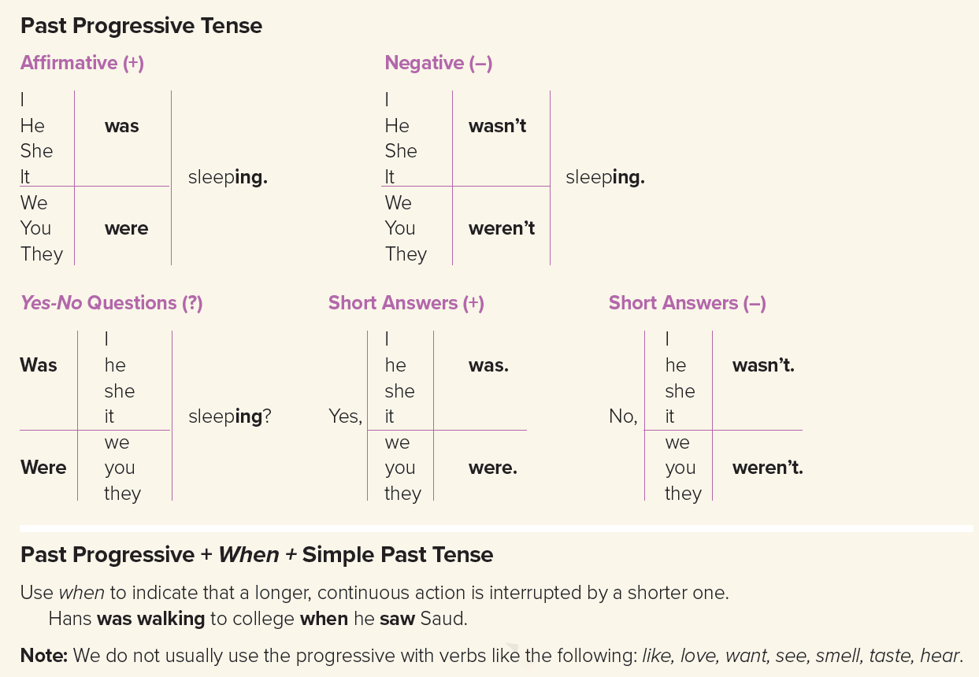
17

Slide 18


When
Note
Hans was walking to college
when
He saw Saud
FYI
Hans was walking to college when he saw Saud.
When Hans saw Saud, he was walking to college.
Stative Verbs
Notes:
Stative verb: https://www.my
happyenglish.com/free-english-lesson/2020/11/19/english-lesson-stative-verbs/
I am smelling this rose. It smells so nice. =
In the progressive form, smelling refers to using your effort (and your nose) to check the aroma or odor of something.
As a stative verb, smell refers to aroma or odor coming into our nose. We don’t use our effort to smell.
I smell pizza.

Slide 19
FYI
We do not usually use the progressive with verbs like the following
Notes:
Stative verb: https://www.my
happyenglish.com/free-english-lesson/2020/11/19/english-lesson-stative-verbs/
I am smelling this rose. It smells so nice. =
In the progressive form, smelling refers to using your effort (and your nose) to check the aroma or odor of something.
As a stative verb, smell refers to aroma or odor coming into our nose. We don’t use our effort to smell.
I smell pizza.

Slide 20
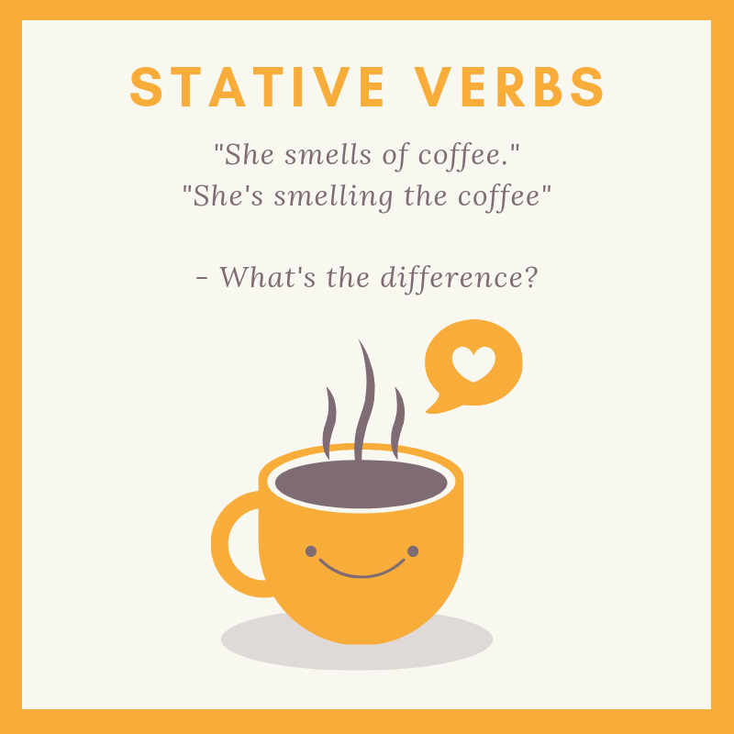
Notes:
Stative verb: https://www.my
happyenglish.com/free-english-lesson/2020/11/19/english-lesson-stative-verbs/
I am smelling this rose. It smells so nice. =
In the progressive form, smelling refers to using your effort (and your nose) to check the aroma or odor of something.
As a stative verb, smell refers to aroma or odor coming into our nose. We don’t use our effort to smell.
I smell pizza.

Slide 21
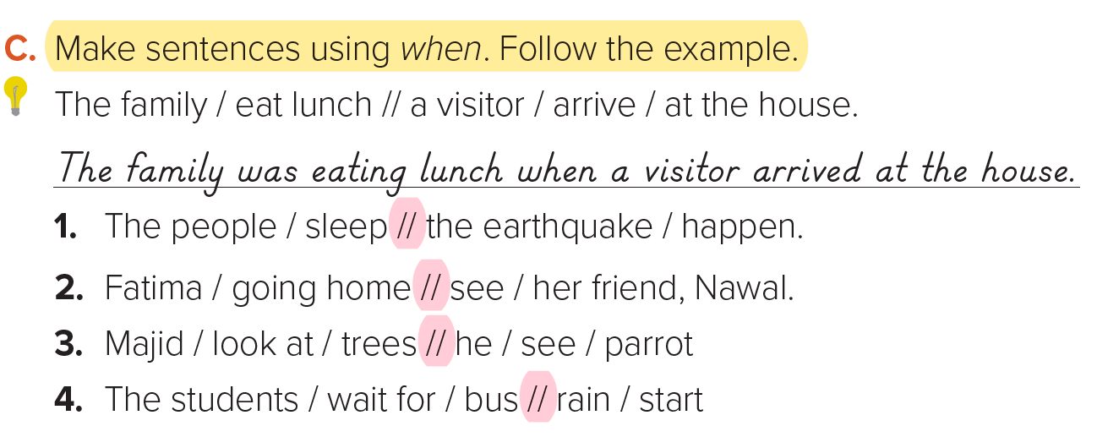
17
1. The people were sleeping when the earthquake happened.
2. Fatima was going home when she saw her friend, Nawal.
3. Majid was looking at the trees when he saw a parrot.
4. The students were waiting for a bus when it started to rain.

Slide 22
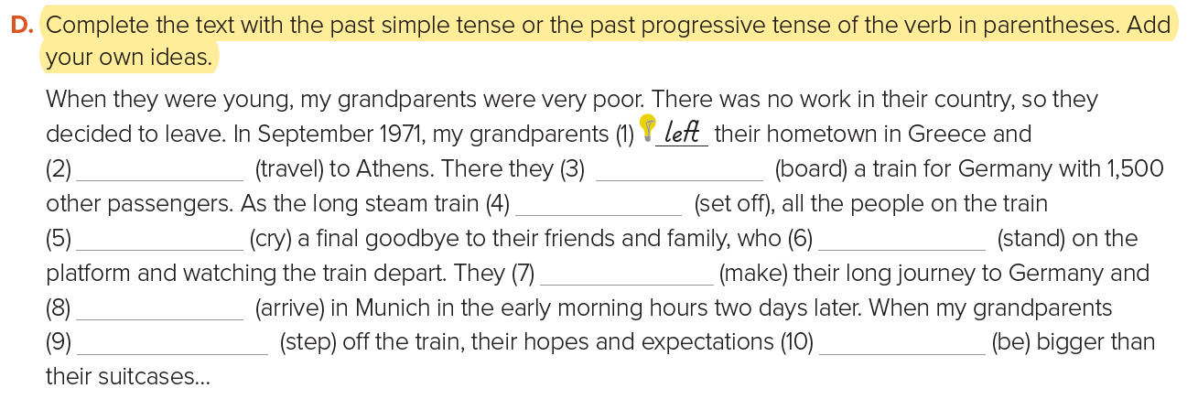
17
traveled
boarded
was setting off
cried
were standing
made
arrived
stepped
were

Slide 23
WORKBOOK
88

Slide 24
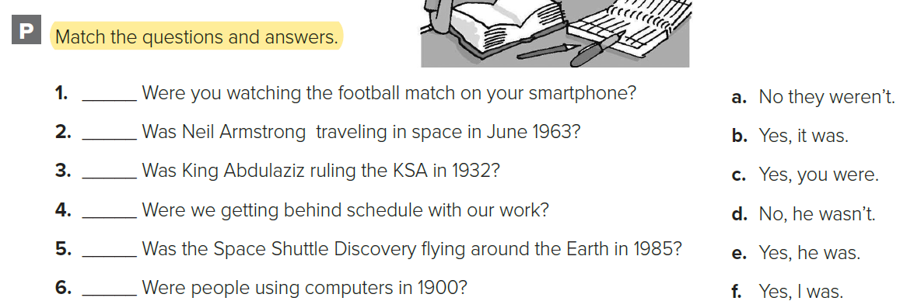
WORKBOOK
88
f
d
e
c
b
a

Slide 25
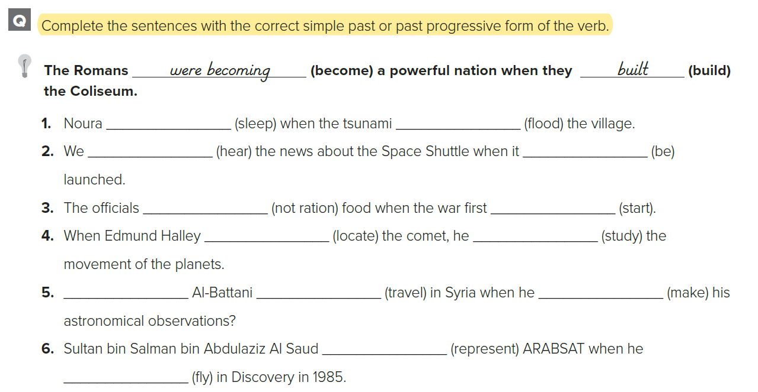
WORKBOOK
88
was sleeping
flooded
heard
was
weren’t rationing
started
located
was studying
Was
traveling
made
was representing
flew

Slide 26
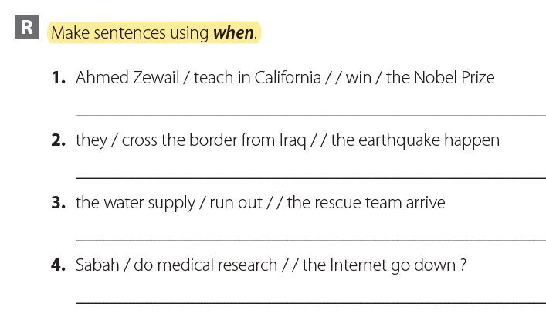
HOMEWORK
WORKBOOK @
88

Slide 27


