Slide 1
Super Goal 1

Slide 2
Unit 1

Slide 3
The objectives of the lesson :
At the end of this session, the students will be able to :
List some school supplies
Match school supplies to their functional verb

Slide 4
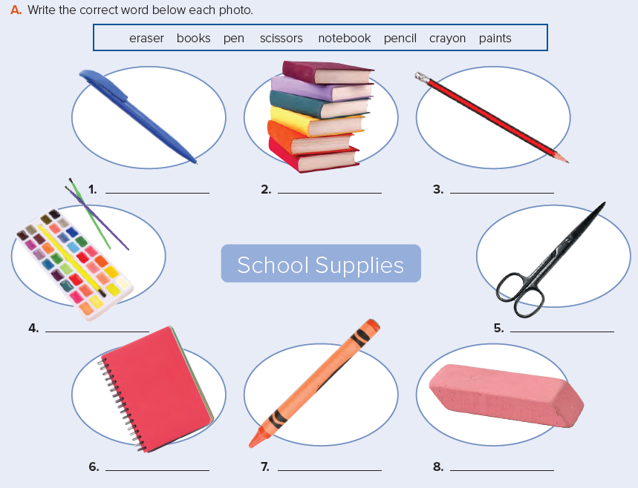
pen
books
pencil
paints
scissors
notebook
crayon
eraser

Slide 5

read
cut
write
write
color

