Slide 1
Super Goal 1

Slide 2
Unit 1

Slide 3
The objectives of the lesson :
At the end of this session, the students will be able to :
Give full meaning answer to WH questions
Practice low intonation in a question
Extract information through listening
Start a conversation with a classmate

Slide 4

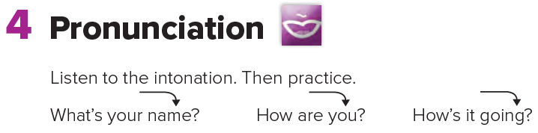

Slide 5
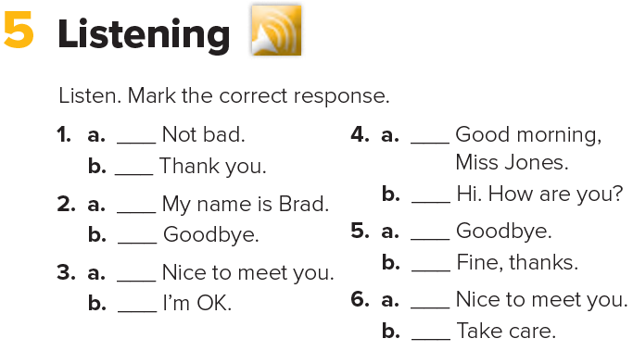


Slide 6
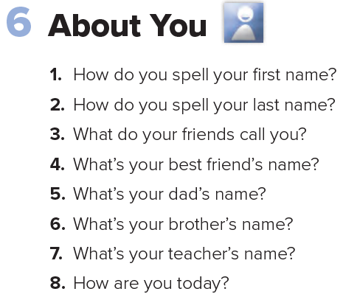


Slide 7
Where are the people in the picture ?

Slide 8
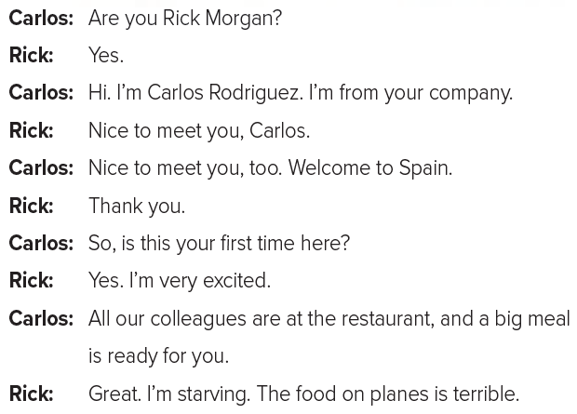

Slide 9
