Slide 1
Super Goal 1

Slide 2
Unit 1

Slide 3

The objectives of the lesson :
At the end of this session, the students will be able to :
Use singular possessive adjectives " my – your – his – her " correctly
Use the verb to be with different subjects

Slide 4
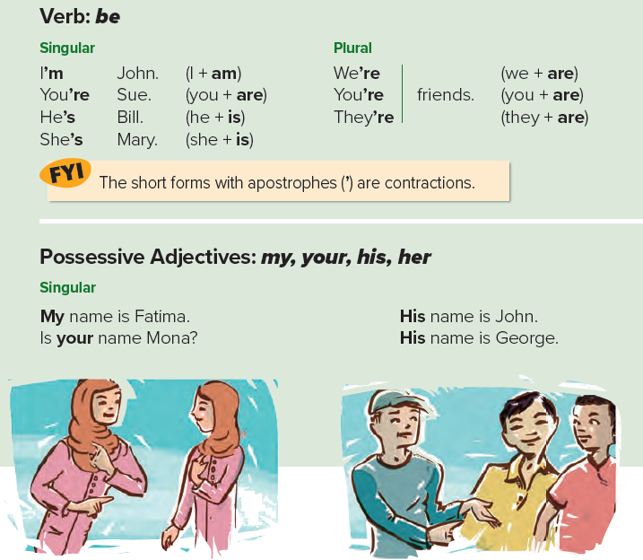

Slide 5
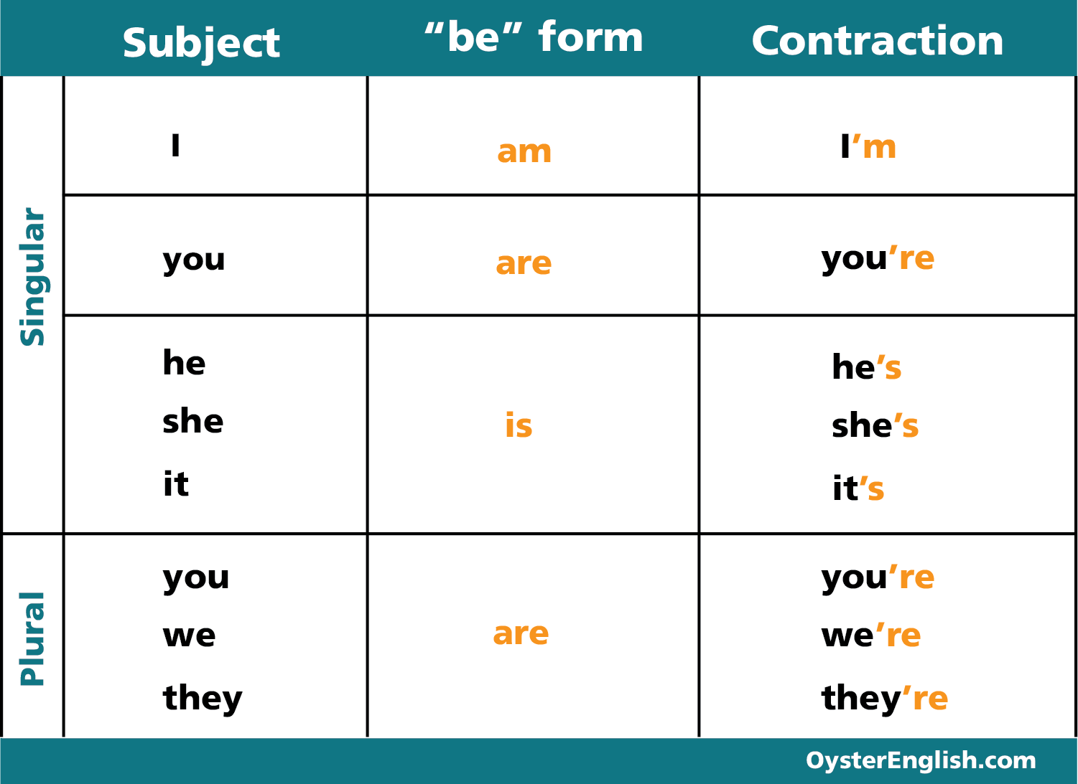

Slide 6
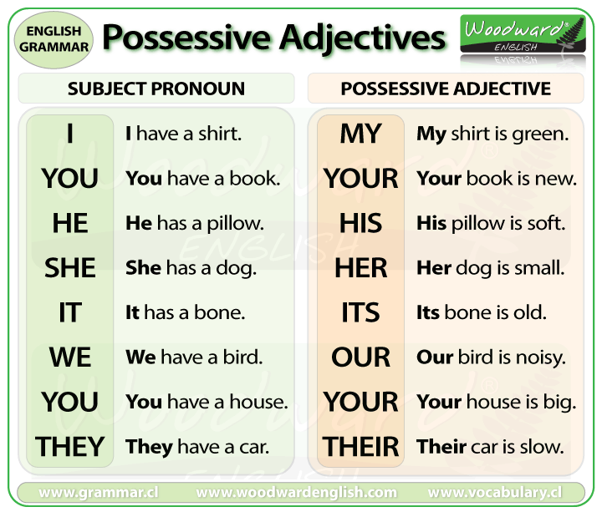

Slide 7


Slide 8
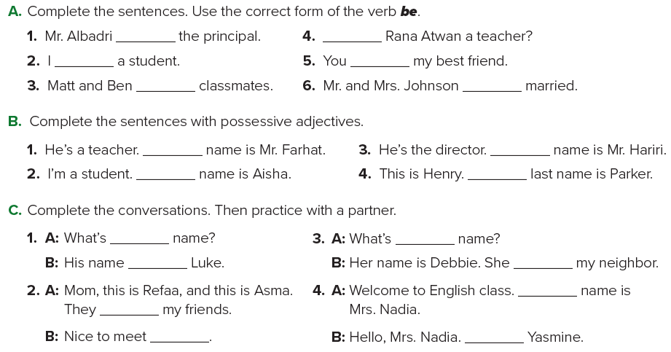
is
Is
am
are
are
are
His
His
My
His
his
her
is
is
My
are
you
I am

Slide 9
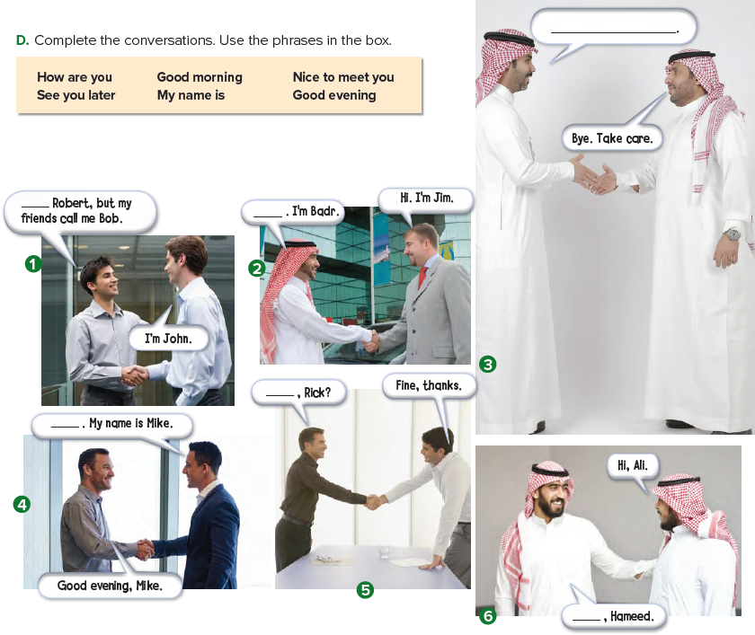
1- My name is
2- Nice to meet you
3- See you later
4- Good evening
5- How are you
6- Good morning

Slide 10

Page 90-91

